Slide 1
Beyond Imaging: Near-Horizon Physics from Movies and Polarization Maps Based on GRMHD Simulations
Richard Anantua (CfA/BHI)
1-8-2020
Collaborators: SEan Ressler and Eliot Quataert (Berkeley); Roger Blandford (Stanford); Alexander Tchekhovskoy (Northwestern); Avi Loeb (CFA/BHI), RaZieH Emami (CfA)
Presentation at AAS 235 Honolulu

Slide 2
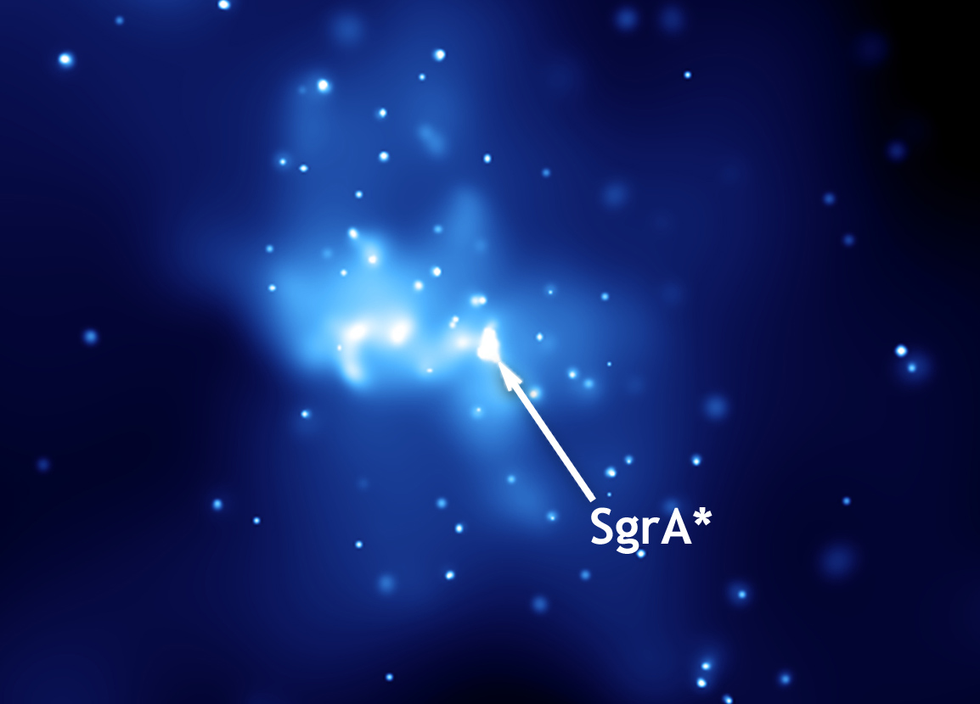
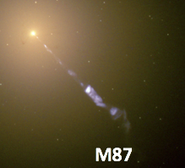
“Observing” JAB Systems
Start with general relativistic magnetohydrodynamic (GRMHD) simulation or semi-analytic model of jet (or outflow)/accretion flow/black hole (JAB) system
Convert GRMHD variables to radiation prescriptions for emission, absorption, polarization, particle acceleration and/or dissipation to emulate sources
Add “observer” viewing sources, e.g., Event Horizon Telescope (EHT) targets:
Sgr A*
M87

Slide 3
Simulations and Emission Models
Assumptions (Ressler et al., 2015, 2017)
Between standard and normal evolution & magnetically-arrested disk (semi-MAD) flux
Accretion dynamical time shorter than timescale of Coulomb collisions between leptonic (e+e-) and hadronic plasmas (p,ions) => Two-temperature model
GRMHD mass conservation and energy-momentum equations with viscosity and heating
Critical Beta Electron Temperature Model
Constant T_{e}/T_{p} at $β<<β_{c}$
T_{e} suppressed at $β>>β_{c}$
Constant $β_{e}$ Model
Magnetic Bias Model
$$∂_{μ}\left({ρu}^{μ}\right)=0$$
$$∂_{μ}T^{μν}=∇_{μ}\left(T_{g}^{μν}+T_{EM}^{μν}\right)=−τ^{μν}$$
$$\frac{T_{e}}{T_{e}+T_{p}}=f Exp[−β/β_{c}]$$
$$0<f<1$$
$${β_{e}=\frac{P_{e}}{P_{b}}=\frac{{(γ_{e}−1)u}_{e}}{b^{2}/2}⟹u}_{e}=\frac{1}{(γ_{e}−1)}β_{e}\frac{b^{2}}{2}$$
Equipartition for P_{e}~P_{b}
$$P_{e}=K_{N}{\left(\frac{b}{\sqrt{2}}\right)}^{N}{, K}_{N}=K_{2}\frac{〈\frac{b^{2}}{2}〉}{〈{\left(\frac{b}{\sqrt{2}}\right)}^{N}〉},K_{2}=1$$
P_{e}~ ${\text{P}}_{\text{b}}^{ n}$, n=N/2

Slide 4
Near-Horizon Images in Parameter Space
Sgr A* EHT Intrinsic Size Constraints:
Circular Gaussian (Doeleman et al. 2008) emitting region width D for I > 0.2 x I_{Max} : 8.2M < D <16.2M
Anisotropic emitting region (Johnson et al. 2018) major axis $9.87M<θ_{maj}<12.69M$
$$\left(f,β_{c}\right)=\left(0.1,0.01\right)$$
$$\left(f,β_{c}\right)=(0.1,0.1)$$
$$\left(f,β_{c}\right)=(0.1,1)$$
D=15.99M
Decreasing $β_{e0}$
n=0
D=27.14M
D=26.93M
D=28.42M
Increasing f, $β_{c}$
$$\left(f,β_{c}\right)=(0.5,0.01)$$
$$\left(f,β_{c}\right)=(0.5,0.1)$$
$$\left(f,β_{c}\right)=(0.5,1)$$
D=10.1M
D=25.41M
D=58.4M
$β_{e0}$=0.01
$β_{e0}$=0.1
$β_{e0}$=1
D=19.85M
D=18.35M
D=15.5M
Anantua, Ressler and Quataert (2019) (submitted to MNRAS)
D=54.22M
n=2
Notes:
Here are synthetic 230 GHz intensity maps over a scan of model parameter space from our fiducial semi-mad simulation (with values f=0.1,0.5 and $β_{c}$=0.01,0.1,1; $β_{e}$=0.01,0.1,1; n=0,2)
The Critical Beta Electron Temperature model images appear to be a uniform projection of the coronal disk-jet region
The synthetic emitting regions are asymmetric and more compact for higher values of f and $β_{c}$
The Constant $β_{e}$ and Bias models have drastic variation of image morphology for the parameters considered:
Decreasing N leads to emission at larger radii in the outflow and more asymmmetry
Decreasing the constant $β_{e}$ makes the emission region more compact and asymmetric—
Note this is similar to the behavior of the electron temperature model in the high (f, $β_{c}$) limit
The emitting regions in synthetic observations are defined so the intensity is at least 20% of the max intensity of the synthetic intensity map, and characteristic size D is the diameter of a circle equal in area to the emitting region
(Note for an EHT dynamic range of 2 decades of magnitude, 10% would be the geometric mean of min and max intensity)
Observations favor compact, asymmetric emitting regions
The Sgr A* EHT size constraint (expressed in gravitational radii M) is satisfied for the lowest-$β_{e}$Constant $β_{e}$ Model and the highest (f, $β_{c}$) Electron Temperature Model and the n=0 Bias Model
----------------------------------
Even before the M87 April image came out, the preferred model had similar morphology to the observation
As M_dot increases: more optically thick (while normalizing to same flux) -> (L_nu -> r^2 F_nu B_nu), B_nu~nu^2 ~T (as M_dot goes up, T goes down, r increases (peak is to right of 230 GHz) )
-Do linear Mass accretion rate sequence
-Do emitting region size sequence
As M_dot goes down at a fixed tune of 230GHz: High temp-> high synch peak, Gamma^2&Theta^2 large inverse Compton scattering
As M_dot changes, the the peak of sync emission relative to 230 GHz changes
Higher f (higher electron temp)=> synchrotron peak is wider (more temperatures), optical
Does self-absorption or broad range of T in different models produce differences in synchrotron spectra? Peak frequency vs. synchrotron frequency.
P_e>P_g in some bias model regions where we don’t trust gas. Distribution of T at high temp end in regions with emitting plasma
Image and spectra of (f,beta_c)=(10,1) with M_dot as low as beta=1 model
ARQ18 MNRAS Fig 12: Long tails ~nu^1/3
At what frequency does the synchroton emission become optically thick?
Model: Sphere of radius R, density, temp and B-field; thermal self-absorption synchrotron, nu_peak ~theta^2 nu_B
Let n change in the sphere, fix the flux at some frequency, vary beta, see what the sequence of spectra look like

Slide 5
Intra-Hour Movie Variability
M=20s
Type III- Thick Photon Ring
Type IV - Extended Outflow
Type I - Thin, Compact, Asymmetric Photon Ring/Crescent
Type II - Inflow-Outflow Boundary + Thin Photon Ring

Slide 6
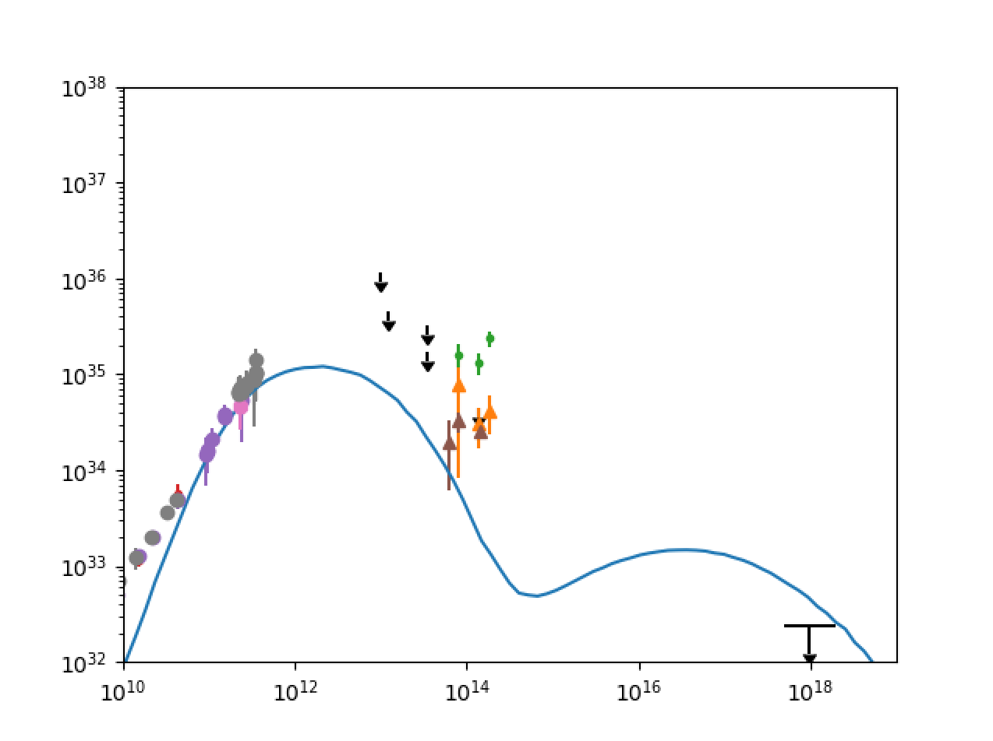
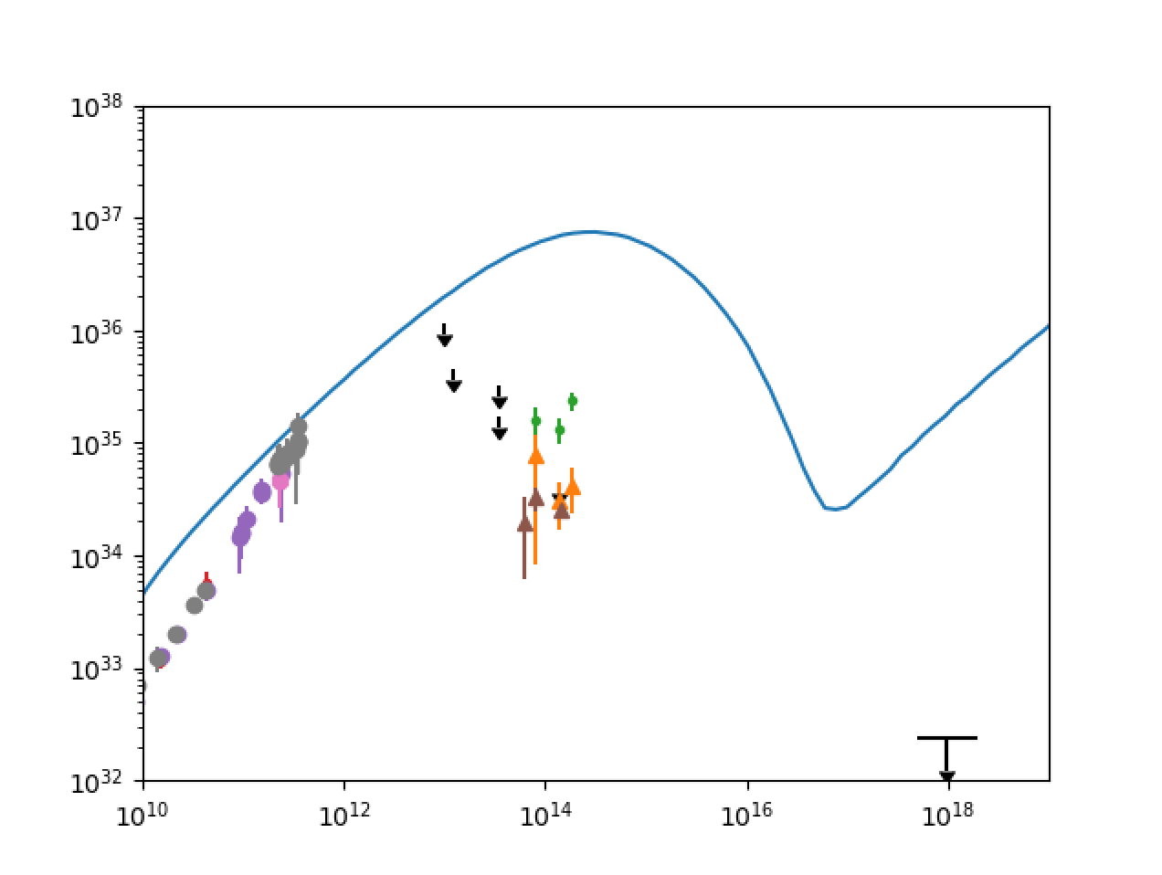
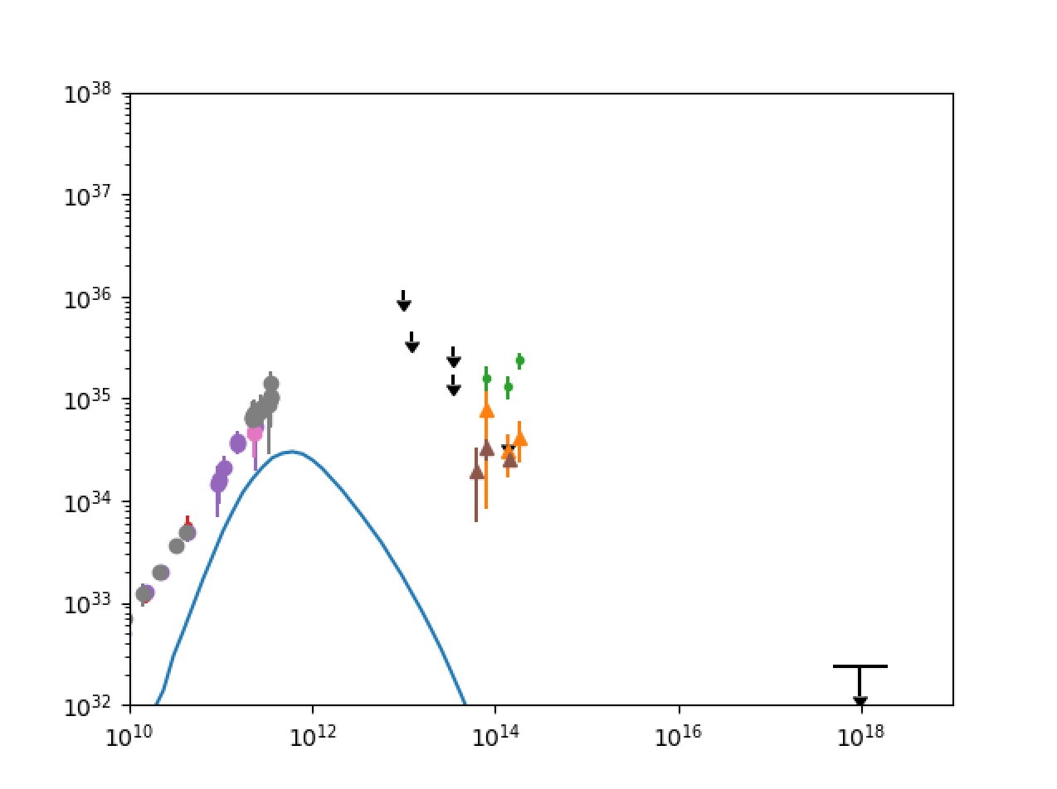
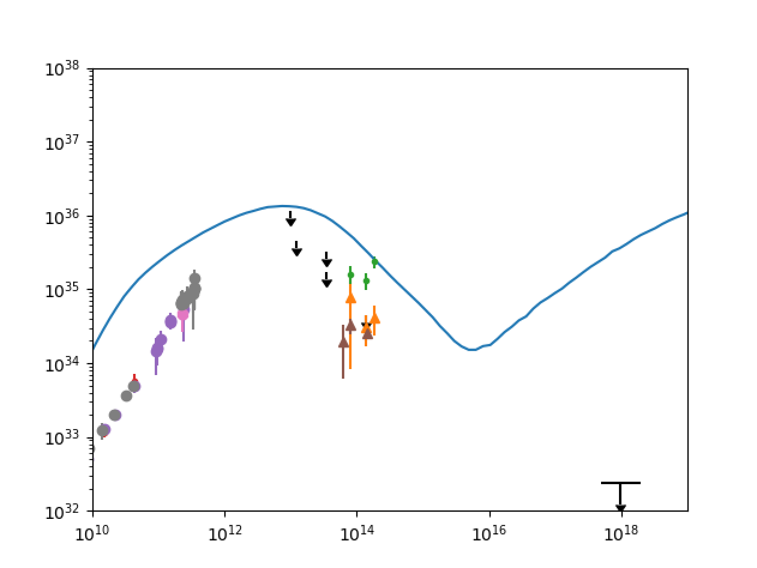
Sgr A* Classification: Spectra and Time-Averaged Images
${νL}_{ν}$ [erg/s]
${νL}_{ν}$ [erg/s]
$ν$ [Hz]
$ν$ [Hz]
Type III- Thick Photon Ring;
spectral excesses at
low and high frequency
Type IV - Extended Outflow; spectral excesses at
low and high frequency and flat low frequency knee
Type I - Thin, Compact, Asymmetric Photon Ring/Crescent; best fit spectrum
Type II - Inflow-Outflow Boundary + Thin Photon Ring; steep spectrum
${νL}_{ν}$ [erg/s]
${νL}_{ν}$ [erg/s]
$ν$ [Hz]
$ν$ [Hz]

Slide 7
Sgr A* Classification: mm-Variability
Type III- Thick Photon Ring;
spectral excesses at
low and high frequency; low amplitude, slow (nearly monotonic) radio variability
Type Ia or b - Thin, Compact, Asymmetric Photon Ring/Crescent; best fit spectrum; moderate or high amplitude, fast oscillating radio variability
Type II - Inflow-Outflow Boundary + Thin Photon Ring; steep spectrum; moderate amplitude, fast oscillating radio variability
Type IV - Extended Outflow; spectral excesses at
low and high frequency and flat low frequency knee; low amplitude, slow oscillating radio variability

Slide 8
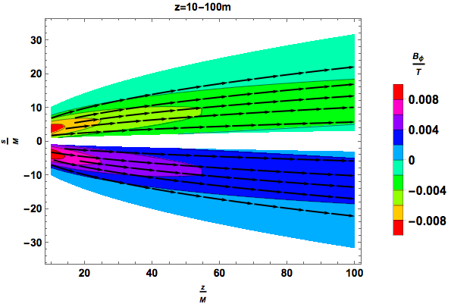
Stationary, Axisymmetric Self-Similar Semi-Analytic Model
Relate fieldline angular speed and flux connected to horizon to force free GRMHD
Compare with HARM simulation jet region to derive fitting forms in self-similar parameter .
Use self-similarity to obtain GRMHD flow on different scales
$Φ_{B}(ξ)$
$Ω_{B}(ξ )$
$$\left[\begin{aligned}\begin{matrix}B_{s} \\ B_{φ}\end{matrix} \\ B_{z}\end{aligned}\right]=\left[\begin{aligned}\begin{matrix}−\frac{1}{2πs}\frac{∂Φ}{∂z} \\ \frac{I}{2πs}\end{matrix} \\ \frac{1}{2πs}\frac{∂Φ}{∂s}\end{aligned}\right]$$
$$\left[\begin{aligned}\begin{matrix}v_{s} \\ v_{φ}\end{matrix} \\ v_{z}\end{aligned}\right]=\left[\begin{aligned}\begin{matrix}\frac{s}{2z}v_{z} \\ sΩ_{B}(1−v_{z})\end{matrix} \\ v_{z0}e^{−0.001s^{8}/z^{4}}\end{aligned}\right]$$
$$ρ\vec{E}+\vec{j}×\vec{B}=\vec{0}⇒I=−2Ω_{B}ξΦ′$$
$$ξ=s^{2}/z$$
$$Ω_{B}(ξ)=0.15\exp{[−0.3ξ^{2}]}$$
$$Φ(ξ)=\tanh{[−0.3ξ]}$$
B_{Poloidal} (arrows) & B_{Toroidal} (colors)
at various jet segments
10M<z<10²M
10²M<z<10³M

Slide 9
M87 Stokes Maps – Ion-Reduced Constant $β_{e}$Model
$$N_{e}\left(γ\right)={K_{e}γ}^{−p}, N_{i}\left(γ\right)={K_{i}γ}^{−p}, γ_{min}≤γ≤γ_{max}$$
$$\tilde{P_{e}}=\frac{4π}{3}{{K′}_{e}{m_{e}c}^{2}γ′}^{2−p}=\frac{n−n_{i}}{n}β_{e0}P_{B}, {n−n}_{i}=n_{e−}+n_{e+}$$
$$β_{e0}={10}^{−2}$$
$$β_{e0}={10}^{−4}$$
Anantua, Emami & Loeb
(2019) ArXiv:1909:09230
$ν$ 230 GHz 43GHz
0.0 0.25 0.5 n_{e+}/n

Slide 10
Conclusions
Sgr A*
230 GHz synthetic intensity maps on the scale of tens of gravitational radii appear:
Mostly uniform coronal projections + photon rings for electron temperature models; vary greatly in equipartition-inspired (beta and bias) models
Emitting region most compact for low $β$ and high ($f_{e}$ , $β_{c}$); more asymmetric for decreasing $β$and decreasing $N$
Synthetic spectra are:
Flatter spectra in beta and bias models than electron temperature models (best fit ($f_{e}$ , $β_{c}$)=(0.5,1); flatter for decreasing $β$and decreasing $N$
M87
Self-consistent GRMHD simulations can be used to replicate observational signatures of AGN jets including helical substructure and collimation
Semi-analytic modeling
General e-e+p plasma and ion-reduced beta model may enable discrimination of plasma content for strongly polarized sources such as M87 and 3C 279

