Slide 1
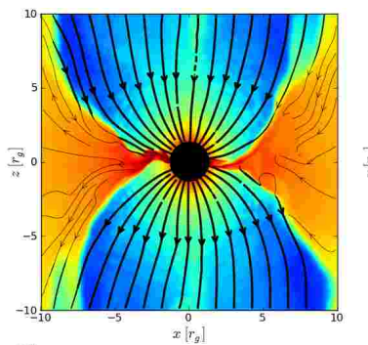
Broad Concepts Behind GRMHD Simulations
Concepts behind the GRMHD simulations of plasmas around a BH, include:
The generalization of PDEs to account for curved spacetime.
Pairing Maxwell’s equations with Einstein’s field equations and the ideal MHD equations and assumptions.
For these situations, we start with a HARM GRMHD simulation assuming:
Geometrically thin, magnetically arrested disk
Jet power derived from flux threading black hole of mass M and spin a/M = 0.92
Power law coefficients for radiative transfer
Mass Conservation
Energy-Momentum Conservation
Stress Tensor
Example of a model snapshot showing log of rest-mass density in color in the z − x plane at y = 0, where
From McKinney, Tchekovskoy, & Blandford, MNRAS 423 3083 (2012)

