Slide 1
Order of magnitude physics
Celestial Mechanics
Richard Anantua
Jing Luan
Jeffrey Fung

Slide 2
Celestial Mechanics
This week is all about astronomy (Finally!)

Slide 3
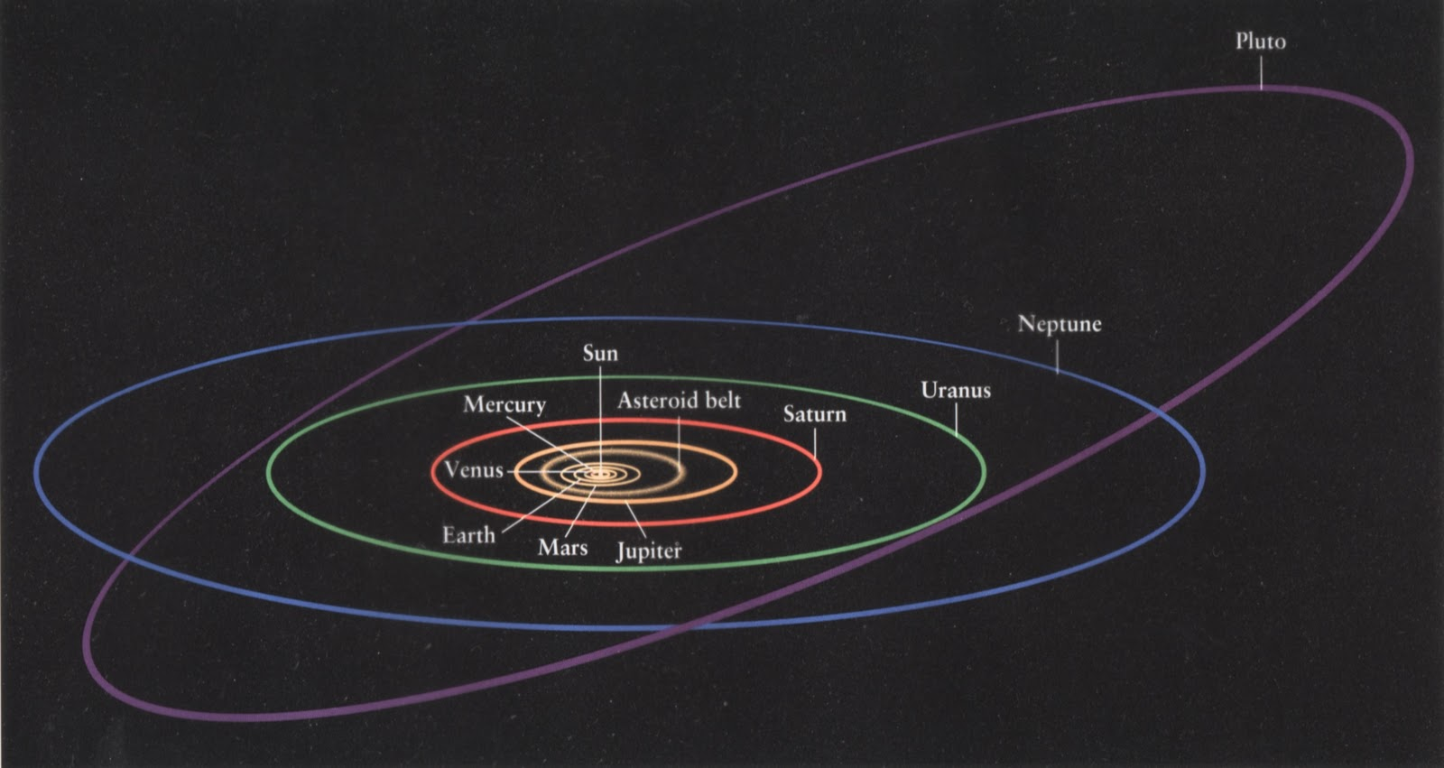
Celestial Mechanics
This week is all about astronomy (Finally!)
Gravity, to be specific.

Slide 4
Classical Mechanics
Classical mechanics – fields and point particles in absolute space and time with “action at a distance”
Newton’s law of universal gravitation where G=6.67x10⁻¹¹Nm²kg⁻²
Dynamics: Newton’s laws of motion (inertia, $\sum_{i}{{\vec{F}}_{i}}=m\vec{a}$, action-reaction)
M₁
M₂
$\vec{Fg}1 on{2}=G\frac{M1M2}{r2}$ $\frac{\vec{r}1−\vec{r}2}{|\vec{r}1−\vec{r}2|}$
r₁-r₂
Notes:
Einstein-1894
http://nerdywithchildren.com/what-was-albert-einstein-like-as-a-kid/

Slide 5
Classical Mechanics – Newtonian Gravity
Newton’s Law of Universal Gravitation
Gravitational Potential Energy
Kinetic Energy
Taking M₂ = m to be a unit mass, the gravitational potential (P.E. per unit mass) and field (force per unit mass) due to M₁ = M are:
$\vec{F}1 on{2}=\frac{GM1M2}{r2}$ $\frac{\vec{r}1−\vec{r}2}{|\vec{r}1−\vec{r}2|}$
M₁
r₁-r₂
M₂
$$Ug=−\frac{GM1M2}{|\vec{r}1−\vec{r}2|}$$
$KE=\frac{mv^{2}}{2}=\frac{p^{2}}{2m}$, $p$=$mv$
Gravitational Potential
$$Φ_{g}=−\frac{GM}{r}$$
Gravitational Field
$$\vec{g}=−\frac{GM}{r2}\hat{r}$$

Slide 6
Celestial Mechanics
This week is all about astronomy (Finally!)
Orbits

Slide 7
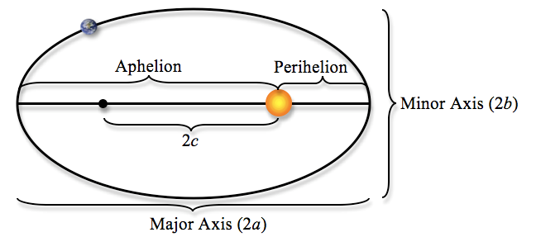
Orbits: Kepler’s Laws
1. Planets move in elliptical orbits, with the sun at one focus.

Slide 8
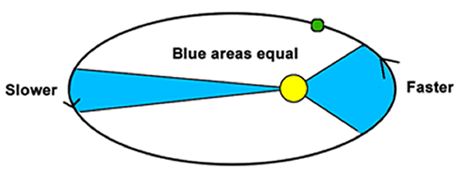
Orbits: Kepler’s Laws
2. A line that connects a planet to the sun sweeps out equal areas in equal times.

Slide 9
Orbits: Kepler’s Laws
Exercise: If mass m is released at rest a distance r from a mass M with gravitational
potential V(r)=-GM/r, what happens?
$r →$0
Exercise: If the mass m instead has initial velocity perpendicular to r and kinetic energy
exceeding |V(r)|, what happens?
$r→∞$
Exercise: If r is constant, equate the centripetal force to mv²/r to express orbital
period as a function of the radius for a circular orbit.
$$\frac{mv^{2}}{r}=\frac{GmM}{r^{2}}, v=\frac{2πr}{P}$$
$$⇒P^{2}=\frac{4π^{2}}{GM}r^{3}$$
$$P^{2}∝a^{3}$$
3.
Kepler’s 3rd Law:

Slide 10
Orbits: Kepler’s Laws
$$P^{2}∝a^{3}$$
3.
$$P^{2}=\frac{4π^{2}}{GM}a^{3}$$
Neptune’s orbit is 30 AU in radius.
What is its orbital period?
$$P=\sqrt{\frac{4π^{2}}{6.67×10^{−11}\frac{N m^{2}}{{kg}^{2}}1.99×10^{30}kg}{\left(30∙365.25∙24∙60∙60 s∙3∙{10}^{8}\frac{m}{s}\right)}^{3}}=4.8∙{10}^{9}s$$
$$=155yr$$

Slide 11
Orbits: Kepler’s Laws
$$P^{2}∝a^{3}$$
3.
$$P^{2}=\frac{4π^{2}}{GM}a^{3}$$
Neptune’s orbit is 30 AU in radius.
What is its orbital period? 155yr
Neptune was discovered in 1846.
We have only just seen it go around once!

Slide 12
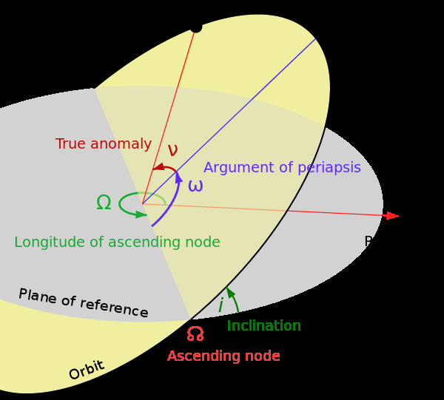
Six Orbital Elements
Semi-major axis a
size of the orbit
Eccentricity e
shape of the orbit
Argument of periapsis ω
orientation of the orbit
Inclination i
tilt of the orbital plane
Longitude of ascending node ☊
orientation of the orbital plane
True anomaly ν
Current position along the orbit

Slide 13
Six Orbital Elements
Usually we can place the reference plane at the orbtial plane, so i = 0.
And usually we do not worry about the orientation of the orbit (ω, ☊).

Slide 14
Basic Concepts
Force of gravity:
$${\vec{F}}_{g} = −\frac{GMm}{r^{2}}\hat{r}$$
Specific Angular momentum:
$$l = \left|\vec{r}×\vec{v}\right| = rv_{φ}$$
EXERCISE: Can angular momentum change if the only
force is the gravity from a point mass?

Slide 15
Basic Concepts
Force of gravity:
$${\vec{F}}_{g} = −\frac{GMm}{r^{2}}\hat{r}$$
Specific Angular momentum:
$$l = \left|\vec{r}×\vec{v}\right| = rv_{φ}$$
EXERCISE: Can angular momentum change if the only
force is the gravity from a point mass?
$$\overset{˙}{l} = \left|\vec{v}×\vec{v}+\vec{r}×\vec{a}\right| = 0 \left(\overset{˙}{l}≡\frac{dl}{dt}\right)$$
No: Angular momentum l = r $v_{φ}$ does not change when orbiting a point mass.
Notes:
Note the force of gravity accelerates objects along a line connecting two masses (thus parallel to rHat)

Slide 16
Lagrangian Formalism
Apply Newton’s 2nd law to the simple case of a body falling to the ground
Newton’s 2nd Law: $m\vec{a}=\sum_{i}{{\vec{F}}_{i}}$
Can we use an alternate formalism to obtain the equations of motion?
Define Lagrange function
EXERCISE: Use the Euler-Lagrange equations to find the equations of motion
$$m\ddot{z}=F_{g}=−mg⇒\ddot{z}=−g$$
$$ℒ(q_{1},…,q_{n};t)=T−U$$
$$\frac{d}{dt}\frac{∂ℒ}{∂{\dot{q}}_{i}}=\frac{∂ℒ}{∂q_{i}}, i=1,…,n$$
Euler-Lagrange Equations
$$ℒ\left(x,y,z;t\right)=T−U=\frac{1}{2}m({\dot{x}}^{2}+{\dot{y}}^{2}+{\dot{z}}^{2})−mgz$$
$$m\ddot{x}=\frac{d}{dt}\frac{∂ℒ}{∂\dot{x}}=\frac{∂ℒ}{∂x}=0=\frac{∂ℒ}{∂y}=\frac{d}{dt}\frac{∂ℒ}{∂\dot{y}}=m\ddot{y}$$
$$\frac{d}{dt}\frac{∂ℒ}{∂\dot{z}}=\frac{∂ℒ}{∂z}⟹m\ddot{z}=−mg ∴\ddot{z}=−g$$

Slide 17
Orbital Motion Lagrangian
We can use the Lagrangian formalism for orbital motion
EXERCISE: Use the Euler-Lagrange equations to find the equations of motion
$$v_{⊥}=r\dot{θ}$$
$$\vec{L}=\vec{r}×\vec{p}=m\vec{r}×\vec{v}$$
$$\vec{r}$$
M
_{m}
$$v_{∥}=\dot{r}$$
$$ℓ=\frac{L}{m}=r^{2}\dot{θ}$$
$$ℒ=T−U=\frac{1}{2}m{\dot{r}}^{2}+\frac{1}{2}mr^{2}{\dot{θ}}^{2}+\frac{GMm}{r}$$
$$\frac{d}{dt}\frac{∂ℒ}{∂\dot{θ}}=\frac{∂ℒ}{∂θ}⟹0=\frac{d}{dt}mr^{2}\dot{θ}⟹2r\dot{r}\dot{θ}=r^{2}\ddot{θ}⟹\ddot{θ}=−2\frac{\dot{r}\dot{θ}}{r}=−2\frac{\dot{r}ℓ}{r^{3}}$$
$$\frac{d}{dt}\frac{∂ℒ}{∂\dot{r}}=\frac{∂ℒ}{∂r}⟹m\ddot{r}=mr{\dot{θ}}^{2}−\frac{GMm}{r^{2}}⟹\ddot{r}=r{\dot{θ}}^{2}−\frac{GM}{r^{2}}=\frac{ℓ^{2}}{r^{3}}−\frac{GM}{r^{2}}$$

Slide 18
Orbital Equation of Motion
$$\overset{¨}{r}=−\frac{GM}{r^{2}} + \frac{l^{2}}{r^{3}}= −\frac{GM}{r^{2}} + \frac{v_{φ}^{2}}{r}$$
Gravity
Centrifugal force
(Not a real force. Only exists because we are in polar coordinates.)
Notes:
Explain why centrifugal force moves things outwards

Slide 19
Order of magnitude physics
Celestial Mechanics
Richard Anantua
Jing Luan
Jeffrey Fung
Notes:
Final Exam W Aug 7 1:30p in class
We will try to make it 1.5 h worth of material and give 2.5h
Topics will be broadly sampled from Week 1 - Week 5, but not Week 6 Cosmology (Cf. Syllabus)
Questions will be ~3 long answer and several multiple choice
We will hold a review session, possibly Tues if we can find a common time, or during F or M class time

Slide 20
Review
TRUE OR FALSE:
The natural tendency of an object in motion is to return to rest if no forces act on it.
Planetary orbits are circular.
Angular momentum is conserved if the only force is gravity due to a point mass.
EXERCISE: What is the period of the following orbit:
FALSE
FALSE
TRUE
$$P^{2}=\frac{4π^{2}}{GM}a^{3}$$
2AU
$$⇒\frac{P}{P_{⨁}}={\left(\frac{4AU}{AU}\right)}^{3/2}$$
$$⇒\text{P}=\text{8}\text{yr}$$
$${ M}_{⨀}$$
4AU

Slide 21
Applying Gravitational Equations of Motion
Radial equation in the special case of a circular orbit:
EXERCISE: For a circular orbit, determine $r$, $l$, and $v_{φ}$ in terms of the semi-major axis a
$$0=\overset{¨}{r}=−\frac{GM}{r^{2}} + \frac{l^{2}}{r^{3}}= −\frac{GM}{r^{2}} +\frac{v_{φ}^{2}}{r}$$
$$r=a, l=\sqrt{GMa}, v_{φ}=\sqrt{\frac{GM}{a}}$$
EXERCISE: Can we derive Kepler’s third law from this?
$$P = \frac{2πr}{v_{φ}} = 2π\sqrt{\frac{a^{3}}{GM}}$$
Kepler’s 3rd Law

Slide 22
Celestial Mechanics
This week is all about astronomy (Finally!)
Gravity, to be specific.
Close Encounters

Slide 23
Applying Gravitational Equations of Motion
These stars are orbiting something at the center of the Galaxy.
Notes:
SO2 orbits in 15 yrs

Slide 24
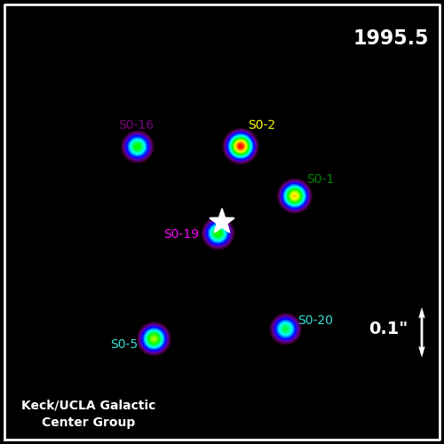
Applying Gravitational Equations of Motion
These stars are orbiting something at the center of the Galaxy.
EXERCISE: What is the mass of the object in units of solar mass?
$$M=\frac{4π^{2}}{GP^{2}}r^{3}$$
$$P≈15yr$$
$$r≈d sin θ≈dθ≈\left(8000∙3∙3∙{10}^{8}∙365∙24∙60∙60 ∙3∙{10}^{8}m\right)0.13\frac{1}{360∙60∙60}2π=1.4∙{10}^{14}m$$
$$⇒M=7.8∙{10}^{36}kg=3.8∙{10}^{6}M_{⨀}$$
Notes:
SO2 orbits in 15 yrs
SO2 is situated 0.15” from Galactic Center

Slide 25
Applying Gravitational Equations of Motion
The special case of a circular orbit
$$\overset{¨}{r} = 0 = −\frac{GM}{r^{2}} + \frac{l^{2}}{r^{3}}$$
$$E = E_{g}+E_{kin} = −\frac{GMm}{a} + \frac{1}{2}{mv}_{φ}^{2}$$
EXERCISE: How much energy is there in an orbiting satellite in terms of orbital radius $a$?
$$\frac{4π^{2}a^{2}}{v^{2}}=P^{2}={4π}^{2}\frac{1}{GM}a^{3}⟹v^{2}=\frac{GM}{a}$$
$$⟹E= −\frac{GmM}{2a}$$
Semi-major axis is a measurement of energy. This holds true even for elliptical orbits!
Notes:
Re-express v^2 using the definition of period and Kepler’s 3rd law
We can do this an easier way using the virial theorem

Slide 26
Applying Gravitational Equations of Motion
Open Orbits
$$E = E_{g}+E_{kin} = −\frac{GMm}{a} + \frac{1}{2}{mv}_{φ}^{2}=−\frac{GmM}{2a}$$
If E = 0, the orbit becomes a parabola extending to infinity.
So the escape velocity is:
$$E_{kin} = −E_{g} → v_{φ} =\sqrt{\frac{2GM}{ a}}$$
For E > 0, the orbit becomes hyperbolic

Slide 27
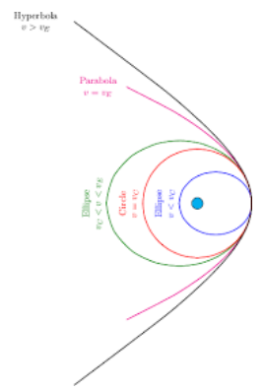
Orbit Shapes
Hyperbola ($ε>1$)
Ellipse ($0<ε<1$)
Parabola ($ε\text{=}$1)
Circle ($ε$=0)
Rank the orbits from lowest to highest energy.
Circle, ellipse, parabola, hyperbola
Notes:
https://www.shmoop.com/forces-motion/space-orbits.html

Slide 28
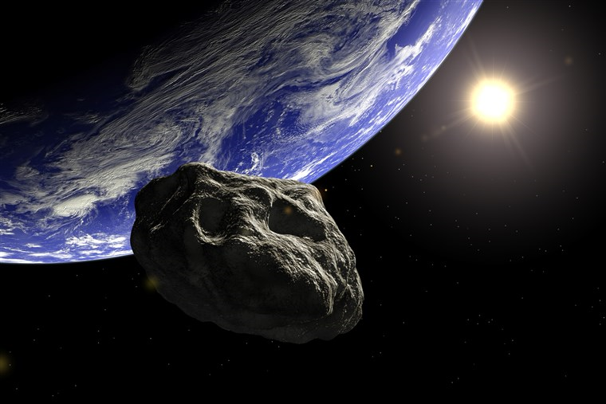
The Earth is constantly bombarded by asteroids.
Why hasn’t it captured any of them as satellites?
(Hint: The typical orbital speed of an asteroid is 25km/s)
$$v_{esc} =\sqrt{\frac{2GM_{E}}{R_{E}}}$$
$$=\sqrt{\frac{2×6.67×10^{−11}\frac{N m^{2}}{{kg}^{2}}5.98×10^{24}kg}{6.38×10^{6}m}}$$
$$=11km/s$$
The typical orbital speed of an
asteroid is greater than the escape speed from Earth, and asteroids accelerate as they approach Earth
Notes:
Hint: what is the typical speed of asteroids when they are near the Earth’s orbit?

Slide 29
Impulse Approximation
How to compute the change in velocity?
trajectory
force
$${\vec{v}}_{final}−{\vec{v}}_{∞}=\int_{t=0}^{t=t_{final}}{\frac{GM}{ {\left|\vec{r}\right|}^{3}}}\vec{r}dt$$

Slide 30
Impulse Approximation
How to compute the change in velocity?
trajectory
force
$$v_{f,⊥}=acceleration×\frac{ b}{ speed}$$

Slide 31
Impulse Approximation
How to compute the change in velocity?
$$lengthscale:b$$
trajectory
force
$$v_{f,⊥}=acceleration×\frac{ b}{speed}$$

Slide 32
Impulse Approximation
How to compute the change in velocity?
$$lengthscale:b$$
trajectory
force
$$v_{f,⊥}=\frac{GM}{ b^{2}}×\frac{ b}{speed}$$

Slide 33
Impulse Approximation
How to compute the change in velocity?
$$lengthscale:b$$
trajectory
force
$$v_{f,⊥}=\frac{GM}{ b^{2}}×\frac{ b}{v_{∞}}$$

Slide 34
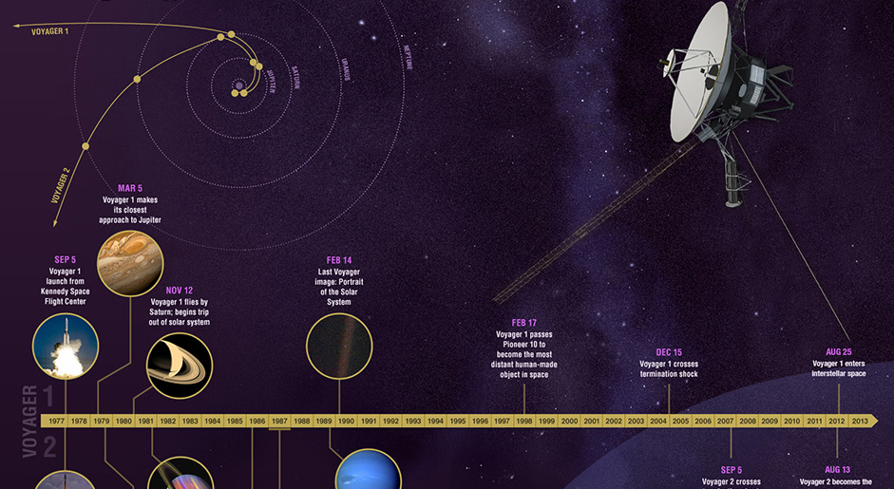
Gravity Assist
By visiting the planets, the voyagers somehow managed to gain enough speed to escape the solar system.

Slide 35
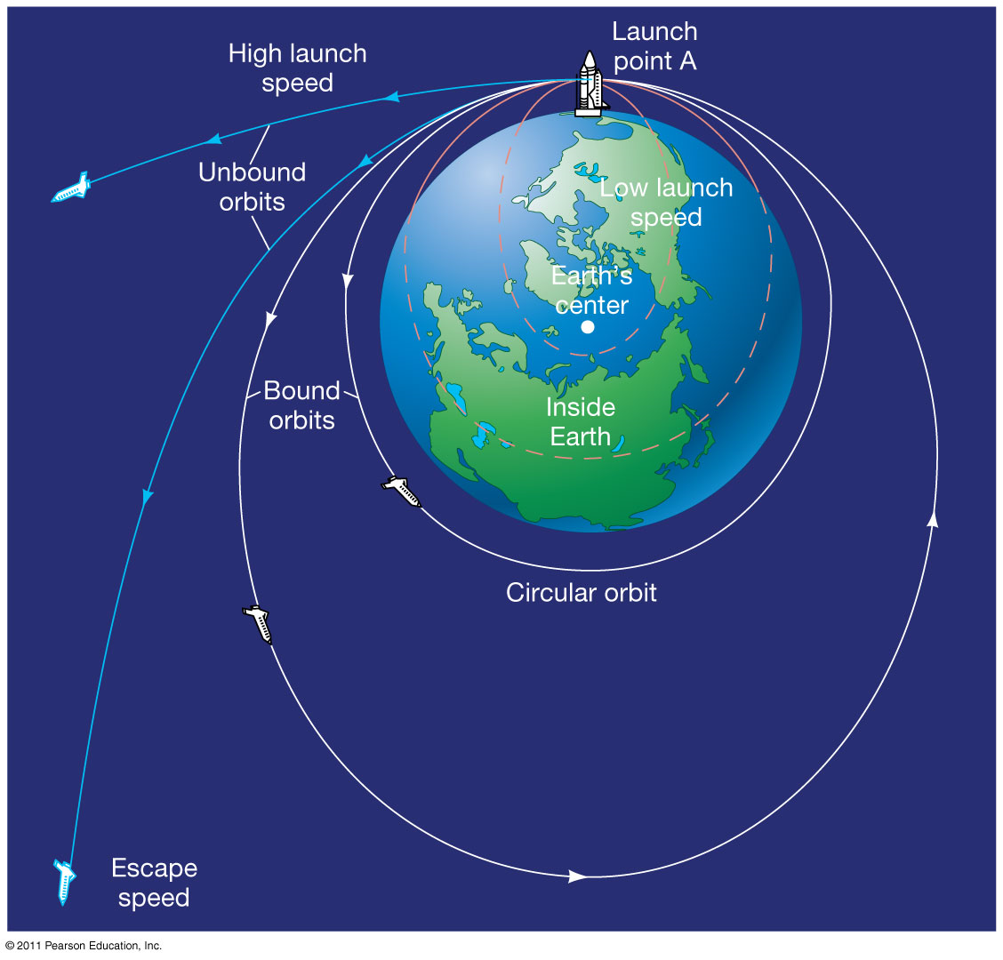
What is the speed a spacecraft needs to escape the solar system from 1 au?
What about from 30 au (Neptune’s orbit)?
$$v_{esc,1AU} =\sqrt{\frac{2GM_{⨀}}{1AU}}$$
$$=\sqrt{\frac{2∙6.67×10^{−11}\frac{N m^{2}}{{kg}^{2}}1.99×10^{30}kg}{8∙60∙3∙{10}^{8}m}}$$
$$=\frac{40km}{s}$$
$$v_{esc,30AU} =\sqrt{\frac{1}{30}}v_{esc,1AU}=8\frac{km}{s}$$
Notes:
Using the center of the Sun as a vantage point, the orbital speed of the Earth can add to that of a rocket so a rocket aimed along the orbit of earth needs <40km/s to escape the Solar System
Neptune’s orbital speed is 5km/s, which is of course < 8km/s for otherwise Neptune would escape
Orbital size over orbital period scales like r/T ~ r/r^3/2 ~ 1/r^1/2

Slide 36
Gravity Assist
$$v_{∞} = 0$$
Do you really gain any speed from passing near a planet?
$$v_{f}= ?$$

Slide 37
Gravity Assist
$$v_{∞} = 0$$
Do you really gain any speed from passing near a planet?
Not really, because energy is conserved!
$$v_{f} = 0$$

Slide 38
Gravity Assist
What about now?
$$v_{∞}≠ 0$$
$$v_{f}= ?$$

Slide 39
Gravity Assist
What about now?
$$v_{∞}≠ 0$$
You get back the same speed, except the direction has changed.
$$\left|v_{f}\right| = \left|v_{∞}\right|$$

Slide 40
Gravity Assist
What about now?
$$v_{∞}≠ 0$$
You get back the same speed, except the direction has changed.
Now, what if it is the planet that is moving?
$$\left|v_{f}\right| = \left|v_{∞}\right|$$

Slide 41
Gravity Assist
$$v_{∞}≈ 0$$
The planet is moving to the left at speed u.
We have learned about motion around stationary gravitating bodies. How can we apply that to this case?
$$v_{planet}= −u$$
?

Slide 42
Gravity Assist
Go to the planet’s frame of motion, then everything we learned still applies!
When the approach is close enough, the spacecraft can do a 180 degree turn.
This is the maximally assisted case.
$$v_{∞}= u$$
$$v_{planet}= 0$$
$$v_{f}= −u$$

Slide 43
Gravity Assist
$$v_{∞}= u−u=0$$
Now we go back to the inertial frame.
$$v_{planet}= 0−u=−u$$
The final speed is not zero anymore! Our spacecraft has gained a speed $≈$ 2 times the planet’s speed, in the direction of the planet’s motion. (Energy is still conserved as a tiny amount of speed is deducted from the planet.)
$$v_{f}= −u−u=−2u$$

Slide 44
Gravity Assist
$$v_{∞}= u−u=0$$
$$b$$
Use impulse approximation to estimate the approach distance b in this maximally assisted case.
$$v_{planet}= 0−u=−u$$
$$v_{f}= −u−u=−2u$$

Slide 45
Gravity Assist
$$Δv= 2u = at$$
$$v_{∞}= u−u=0$$
$$a ≈ \frac{{GM}_{p}}{ 2b^{2}}$$
$$b$$
$$t ≈ \frac{ πr}{v_{esc}\left(b\right)} = π\sqrt{\frac{ b^{3}}{2{GM}_{p}}}$$
$$v_{planet}= 0−u=−u$$
$$2u ≈ \sqrt{\frac{{GM}_{p}}{ b}} → b = \frac{{GM}_{p}}{ 4u^{2}}$$
$$v_{f}= −u−u=−2u$$

Slide 46
Deep Impact
Movie: Deep Impact (1998)
https://www.imdb.com/title/tt0120647/
Unless a comet can be destroyed before colliding with Earth, only those allowed into shelters will survive. Which people will survive?

Slide 47
Order of magnitude physics
Celestial Mechanics
Richard Anantua
Jing Luan
Jeffrey Fung

Slide 48
Final Exam
Closed book, no notes, Campbell 121 W Aug 8 1:30p-4p
Review session Mon Aug 6 in class
30% of final grade
Topics: Weeks 1-5
Basics: Units, Dimensional Analysis, Buckingham Pi Theorem
Fundamental Interactions, Nuclear and Atomic Physics
Material Physics
Wave Physics
Celestial Mechanics

Slide 49
Review: Gravity Assist
A satellite is boosted the opposite direction in this maximally assisted case.
$$\vec{b}$$
Estimate the average acceleration using the values at r=$∞$ and r $≈$b away from the planet?
$$v_{∞}=0$$
$$a ≈ \frac{{GM}_{p}}{ 2b^{2}}$$
Estimate the minimum time for planet to go from $\vec{b}→−\vec{b}$ if it reaches the escape speed $v_{esc}(b)$ at $−\vec{b}$?
$$v_{planet}= −u$$
$$v_{esc}\left(b\right)=\sqrt{\frac{{2GM}_{p}}{ b}}⟹t ≥ \frac{ πb}{v_{esc}\left(b\right)} = π\sqrt{\frac{ b^{3}}{2{GM}_{p}}}⟶t=2^{3/2}\sqrt{\frac{ b^{3}}{2{GM}_{p}}}$$
Estimate the impact parameter b.
$$v_{f}=−2u$$
$$Δv=2u= at≈ \sqrt{\frac{{GM}_{p}}{ b}} → b = \frac{{GM}_{p}}{ 4u^{2}}$$
$$Δv= 2u = at$$
Notes:
Assume v(b) =~ v(-b) = v_{esc} .
2^3/2piSqrt

Slide 50
Elliptical Orbits (and Others)
$$\overset{¨}{r} = −\frac{GM}{r^{2}} + \frac{l^{2}}{r^{3}} ≠ 0$$
Complicated problem to solve.
So we are not going to solve it.
Instead, we will do something much simpler.

Slide 51
Elliptical Orbits (and Others)
$$\overset{¨}{r} = −\frac{GM}{r^{2}} + \frac{l^{2}}{r^{3}} ≠ 0$$
Let r = a + x, where x<<a,
i.e., the orbit is close to circular, but not exactly.
And we know
$$l =\sqrt{GMa}$$
$$\overset{¨}{x}?$$
What is

Slide 52
Elliptical Orbits (and Others)
$$\overset{¨}{r} = −\frac{GM}{r^{2}} + \frac{l^{2}}{r^{3}} ≠ 0$$
EXERCISE: Write each term in terms of x = r-a. HINT: (1+ $δ$)^{n} $≈1+$n $δ$
$$\overset{¨}{x} = \overset{¨}{r}$$
$$−\frac{GM}{r^{2}} = −\frac{GM}{{\left(a+x\right)}^{2}} ≈ −\frac{GM}{a^{2}}\left(1−2\frac{x}{a}\right)$$
$$\frac{l^{2}}{r^{3}} = \frac{GMa}{{\left(a+x\right)}^{3}} ≈ \frac{GM}{a^{2}}\left(1−3\frac{x}{a}\right)$$

Slide 53
Elliptical Orbits (and Others)
$$\overset{¨}{x} = −\frac{GM}{a^{3}}x , κ =\sqrt{\frac{GM}{a^{3}}}$$
is the “epicyclic frequency”
It happens to be the same
as the “orbital frequency”
$$Ω = \frac{2π}{P} =\sqrt{\frac{GM}{a^{3}}}$$
$$\frac{κ}{Ω}=1$$
which is why orbits are elliptical rather than any other shapes.

Slide 54
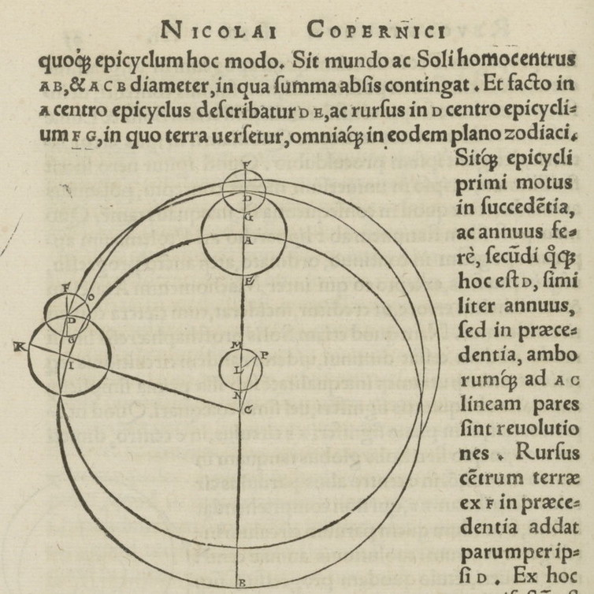
Elliptical Orbits (and Others)
$$\overset{¨}{x} = −κ^{2}x → x=A\cos\left(κt\right), A = ae$$
This describes epicycles, a circular motion on top of the circular orbit.
Used by Copernicus to model planetary motions, because he believed circles are “perfect” shapes.
On the Revolutions of the Heavenly Spheres
By Nicolaus Copernicus

Slide 55
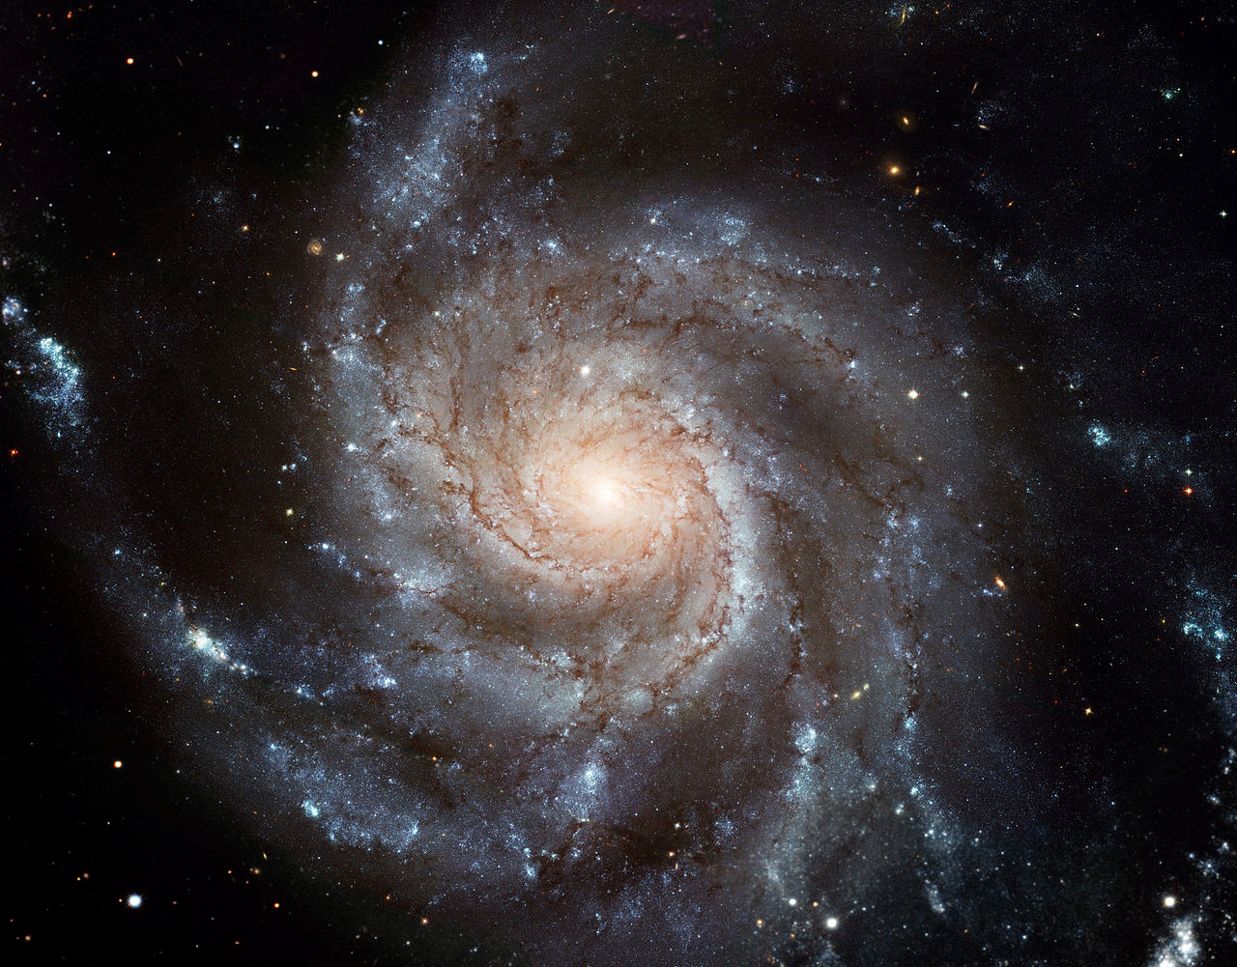
Elliptical Orbits (and Others)
But not all orbits are elliptical.
Because not all systems orbit point masses.

Slide 56
Elliptical Orbits (and Others)
Inside a disk, gravity weakens more gradually
with increasing distance. Say we have:
where r_{c} is a constant of order the size of the disk.
$$F_{g} = −\frac{GMm}{rr_{c}}$$
Then what are the orbital frequency Ω
and epicyclic frequency κ?

Slide 57
Elliptical Orbits (and Others)
$$0 = −\frac{GM}{rr_{c}}+\frac{l^{2}}{r^{3}} → r=a , l = \sqrt{\frac{{GMa}^{2}}{r_{c}}} , Ω = \sqrt{\frac{GM}{a^{2}r_{c}}}$$
$$\overset{¨}{r} = −\frac{GM}{rr_{c}} + \frac{l^{2}}{r^{3}} → \overset{¨}{x} = −\frac{GM}{ar_{c}}\left(1−\frac{x}{a}\right)+\frac{GM}{ar_{c}}\left(1−3\frac{x}{a}\right)$$
$$\overset{¨}{x} = −\frac{2GM}{a^{2}r_{c}}x=κ^{2}x , κ ≡\sqrt{\frac{2GM}{a^{2}r_{c}}}$$

Slide 58
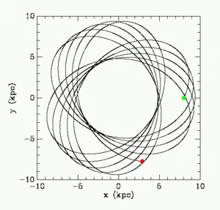
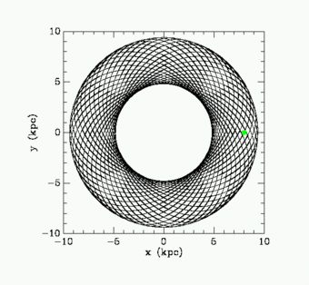
Elliptical Orbits (and Others)
$$Ω = \sqrt{\frac{GM}{a^{2}r_{c}}} , κ=\sqrt{\frac{2GM}{a^{2}r_{c}}}$$
$$\frac{κ}{Ω}=\sqrt{2}$$
Orbits form a rosetta pattern.

Slide 59
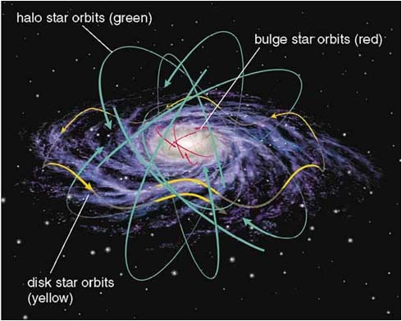
Recall an epicycle is described as:
$$\overset{¨}{x} = −κ^{2}x → x=ae\cos\left(κt\right),κ =\sqrt{\frac{2GM}{a^{2}r_{c}}}$$
In the solar neighborhood (stars within ~300 light years from us),
stars have typical speeds of about 20 km/s relative to us. Assume
10⁸ solar masses are in the region.
EXERCISE: What is the typical eccentricity of a star in the solar neighborhood?
$$\dot{x}= −aeκ sin\left(κt\right)=−e\sqrt{\frac{2GM}{r_{c}}}sin\left(κt\right)$$
$$\left\langle \sin^{2}\left(κt\right)\right\rangle =\frac{1}{2}⟹\left\langle e^{2}\right\rangle =\frac{r_{c}\left\langle {\dot{x}}^{2}\right\rangle }{GM}$$
$$⟹\left\langle e\right\rangle =\sqrt{\frac{(300∙9.5∙{10}^{15}m)\left\langle {(2∙{10}^{4}m/s)}^{2}\right\rangle }{6.67∙10^{−11}\frac{N m^{2}}{{kg}^{2}}{10}^{8}∙1.99∙10^{30}kg}}=0.29$$

Slide 60
Extra Slides

Slide 61
Dynamical Friction
What will happen?

Slide 62
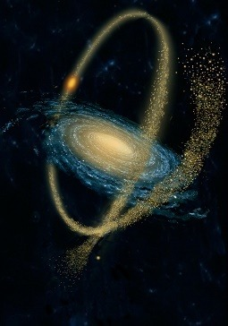
Dynamical Friction
Large galaxies regularly cannibalize small ones.
Every encounter slows down the small galaxies’ motion, until it complete merges with the host.
The process is known as dynamical friction.

Slide 63
Dynamical Friction
$$F_{dyn}≈4π\ln\left(\frac{r_{max}}{r_{min}}\right)\frac{ρG^{2}M^{2}}{ v_{M}^{2}}$$
Can we derive this using impulse approximation?

Slide 64
Dynamical Friction
$$v_{∥} = v_{M}$$
$$m$$
$$v_{⊥}$$
$$b$$
$$M$$
$$x$$
$$F_{dyn} = M\frac{Δv}{Δt}$$

Slide 65
Dynamical Friction
$$v_{∥} = v_{M}$$
$$m$$
$$v_{⊥}$$
$$b$$
$$M$$
$$x$$
$$F_{dyn} = M\frac{Δv}{Δt}$$
$$Δv = \frac{Gm}{ x^{2}}\frac{ b}{v_{⊥}}$$

Slide 66
Dynamical Friction
$$v_{∥} = v_{M}$$
$$m$$
$$v_{⊥}$$
$$b$$
$$M$$
$$x = v_{∥}\frac{ b}{v_{⊥}}$$
$$F_{dyn} = M\frac{Δv}{Δt}$$
$$Δv = \frac{Gm}{ x^{2}}\frac{ b}{v_{⊥}}$$

Slide 67
Dynamical Friction
$$v_{∥} = v_{M}$$
$$m$$
$$v_{⊥} = \frac{GM}{ b^{2}}\frac{ b}{v_{∥}}$$
$$b$$
$$M$$
$$x = v_{∥}\frac{ b}{v_{⊥}}$$
$$F_{dyn} = M\frac{Δv}{Δt}$$
$$Δv = \frac{Gm}{ x^{2}}\frac{ b}{v_{⊥}}$$

Slide 68
Dynamical Friction
$$v_{∥} = v_{M}$$
$$m$$
$$v_{⊥} = \frac{GM}{ b^{2}}\frac{ b}{v_{∥}}$$
$$b$$
$$M$$
$$x = v_{∥}\frac{ b}{v_{⊥}}$$
$$F_{dyn} = M\frac{Δv}{Δt}$$
$$Δv = \frac{G^{2}Mm}{ b^{2}v_{∥}^{3}}$$

Slide 69
Dynamical Friction
$$v_{∥} = v_{M}$$
$$m = ρ\left(v_{∥}Δt\right)\left(2πb^{2}Δb\right)$$
$$v_{⊥} = \frac{GM}{ b^{2}}\frac{ b}{v_{∥}}$$
$$b$$
$$M$$
$$x = v_{∥}\frac{ b}{v_{⊥}}$$
$$F_{dyn} = M\frac{Δv}{Δt}$$
$$Δv = \frac{G^{2}Mm}{ b^{2}v_{∥}^{3}}$$

Slide 70
Dynamical Friction
$$v_{∥} = v_{M}$$
$$m = ρ\left(v_{∥}Δt\right)\left(2πb^{2}Δb\right)$$
$$v_{⊥} = \frac{GM}{ b^{2}}\frac{ b}{v_{∥}}$$
$$b$$
$$M$$
$$x = v_{∥}\frac{ b}{v_{⊥}}$$
$$F_{dyn} = 2π\frac{ρG^{2}M^{2}}{ v_{∥}^{2}}\frac{Δb}{ b}$$

Slide 71
Dynamical Friction
$$v_{∥} = v_{M}$$
$$m = ρ\left(v_{∥}Δt\right)\left(2πb^{2}Δb\right)$$
$$v_{⊥} = \frac{GM}{ b^{2}}\frac{ b}{v_{∥}}$$
$$b$$
$$M$$
$$x = v_{∥}\frac{ b}{v_{⊥}}$$
$$F_{dyn} = 2π\frac{ρG^{2}M^{2}}{ v_{∥}^{2}}\int_{r_{min}}^{r_{max}}{\frac{db}{ b}}$$

Slide 72
Dynamical Friction
$$v_{∥} = v_{M}$$
$$m = ρ\left(v_{∥}Δt\right)\left(2πb^{2}Δb\right)$$
$$v_{⊥} = \frac{GM}{ b^{2}}\frac{ b}{v_{∥}}$$
$$b$$
$$M$$
$$x = v_{∥}\frac{ b}{v_{⊥}}$$
$$F_{dyn} = 2πln\left(\frac{r_{max}}{r_{min}}\right)\frac{ρG^{2}M^{2}}{ v_{∥}^{2}}$$
We are off by just a factor of 2!

Slide 73
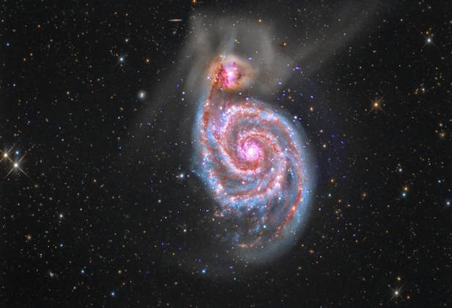
A small galaxy with 10⁷ stars plunges into the Milky Way at a speed of 100 km/s.
Approximately long will it take to become fully absorbed?

