Slide 1
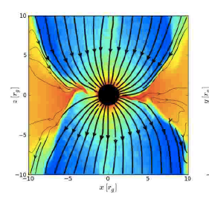
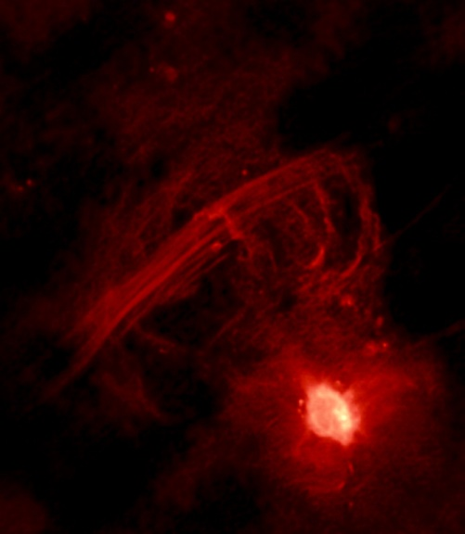
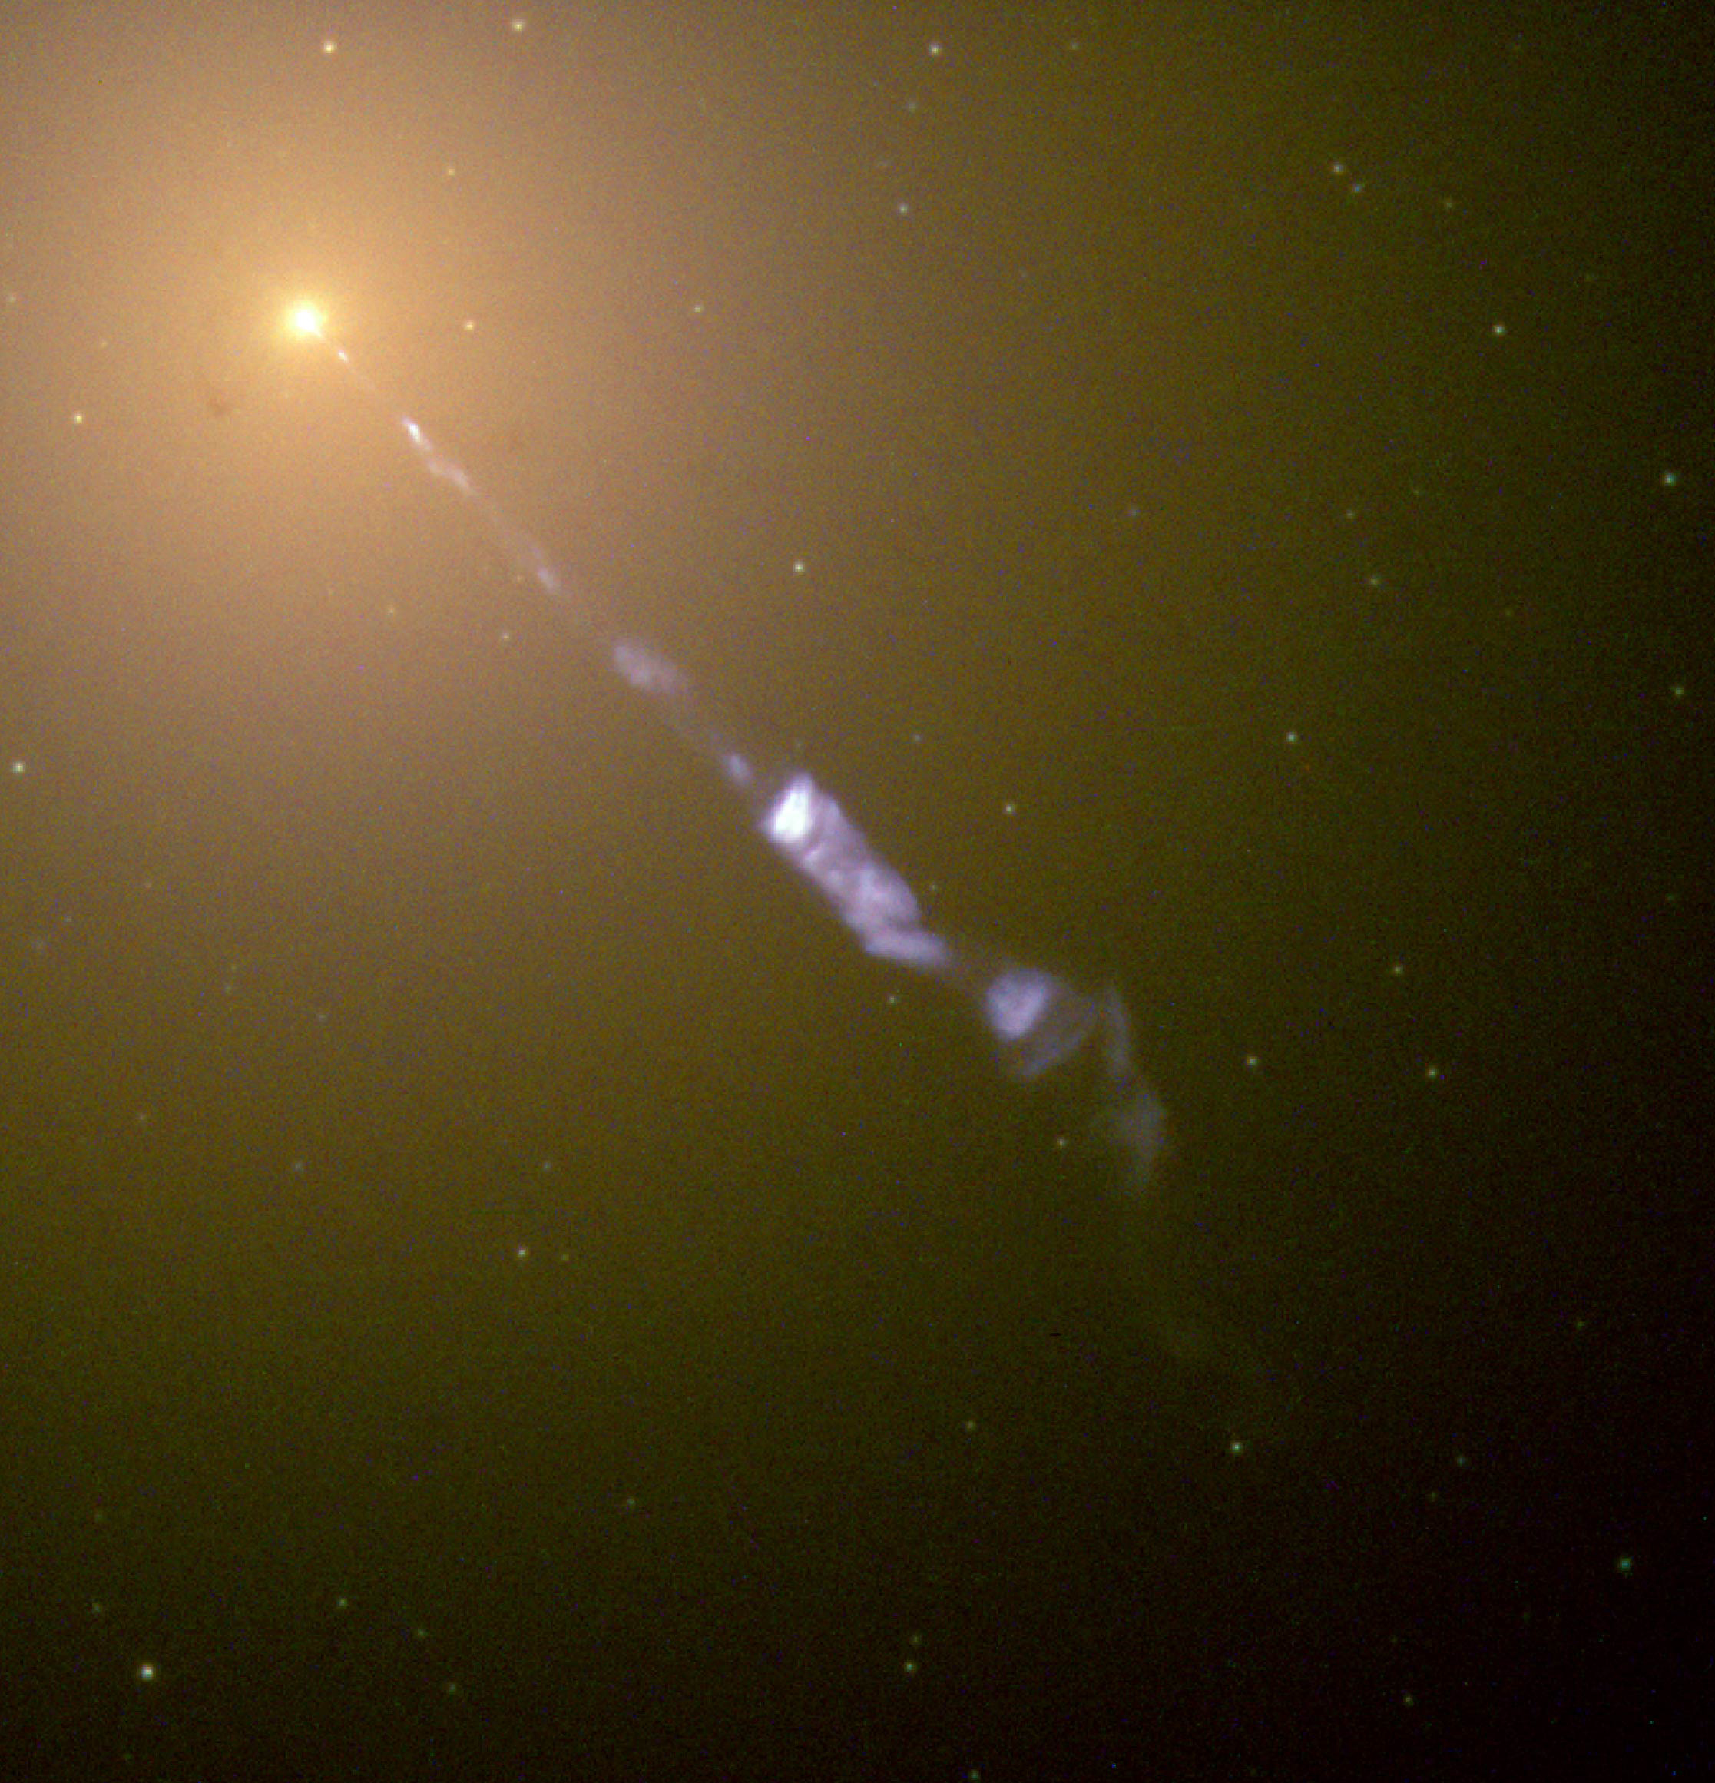
“Observing” JAB Simulations – Probing Near-Horizon Scales in AGN
Courtesy:
Jonathan McKinney Farhad Zadeh/VLA/NRAO Richard Anantua NASA/ESA/HHT
Richard Anantua (Postdoc at UC Berkeley/Harvard-Smithsonian CfA)
Collaborators: Roger Blandford (Stanford), Alexander Tchekhovskoy (Northwestern), Eliot Quataert (Berkeley) and Sean Ressler (Berkeley)
American Astronomical Society
Jan. 8, 2019

Slide 2
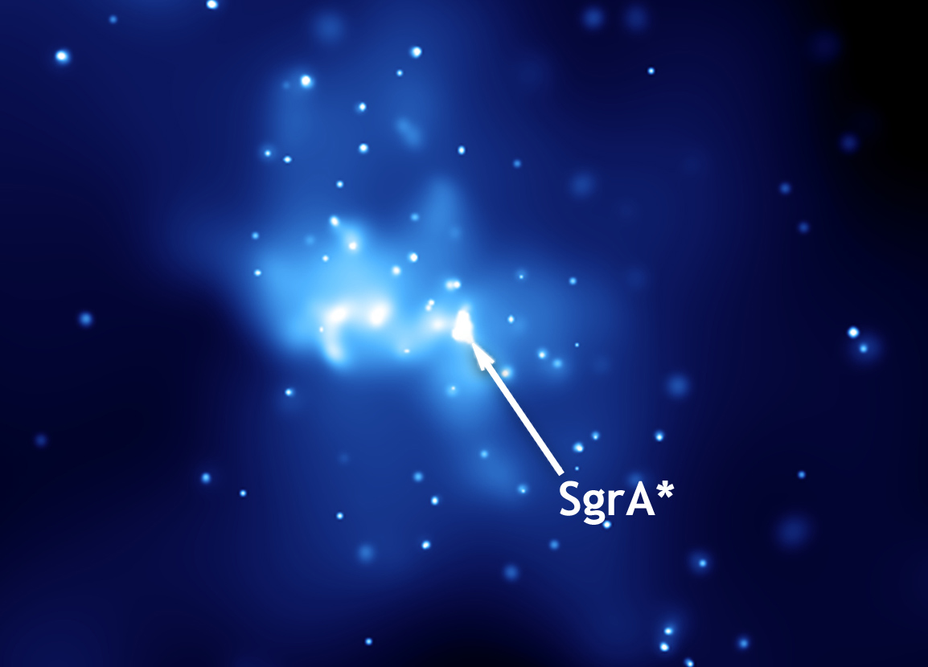
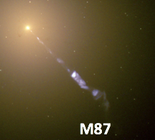
Overview: “observing” JAb simulations
Start with general relativistic magnetohydrodynamic (GRMHD) simulation of jet (or outflow)/accretion flow/black hole (JAB) system
Convert GRMHD variables ($ρ$, $u_{g}$, $b^{μ}$,$uμ$) to radiation prescriptions for emission (via electron temperature $T_{e}$, pressure $P_{e}$, energy density $u_{e}$) to emulate sources
Add “observer” viewing sources, e.g., Event Horizon Telescope (EHT) targets:
Sgr A*
M87

Slide 3
Emission models and radiative transfer
Emission models
Electron temperature model
Constant T_{e}/T_{p} at $β<<β_{c}$
T_{e} suppressed at $β>>β_{c}$
Constant $β_{e}$ model
Bias model
Bias model
Dissipation models
Formulate emissivity prescriptions based on expected mechanisms of particle acceleration and dissipation, e. g., current density j^{α} or shear stress τ or shear strain S
$$\frac{T_{e}}{T_{p}}=f Exp[−β/β_{c}]$$
$$0<f<1$$
$${β_{e}=\frac{P_{e}}{P_{b}}=\frac{{(γ_{e}−1)u}_{e}}{b^{2}/2}⟹u}_{e}=\frac{1}{(γ_{e}−1)}β_{e}\frac{b^{2}}{2}$$
Equipartition for P_{e}~P_{b}
$$P_{e}=K_{N}{\left(\frac{b}{\sqrt{2}}\right)}^{N}{, K}_{N}=K_{2}\frac{〈\frac{b^{2}}{2}〉}{〈{\left(\frac{b}{\sqrt{2}}\right)}^{N}〉},K_{2}=1$$
$$j_{ν,Ω,1,2}=\frac{3^{1/2}𝒟^{4}r_{e}ν}{2c}{\tilde{P}}_{e}{\left(\frac{3eB_{e}}{2πνm_{e}}\right)}^{3/2}\left\{f_{1},f_{2}\right\},{ B}_{e}=𝒟^{−1}|\vec{B}′×\hat{n}′|$$
$$Alpha Model {\tilde{P}}_{e}∝α$$
$$Shear Model{ \tilde{P}}_{e}∝|dv_{z}/ds|$$
$$Current Density Model {\tilde{P}}_{e}∝j^{2}$$

Slide 4
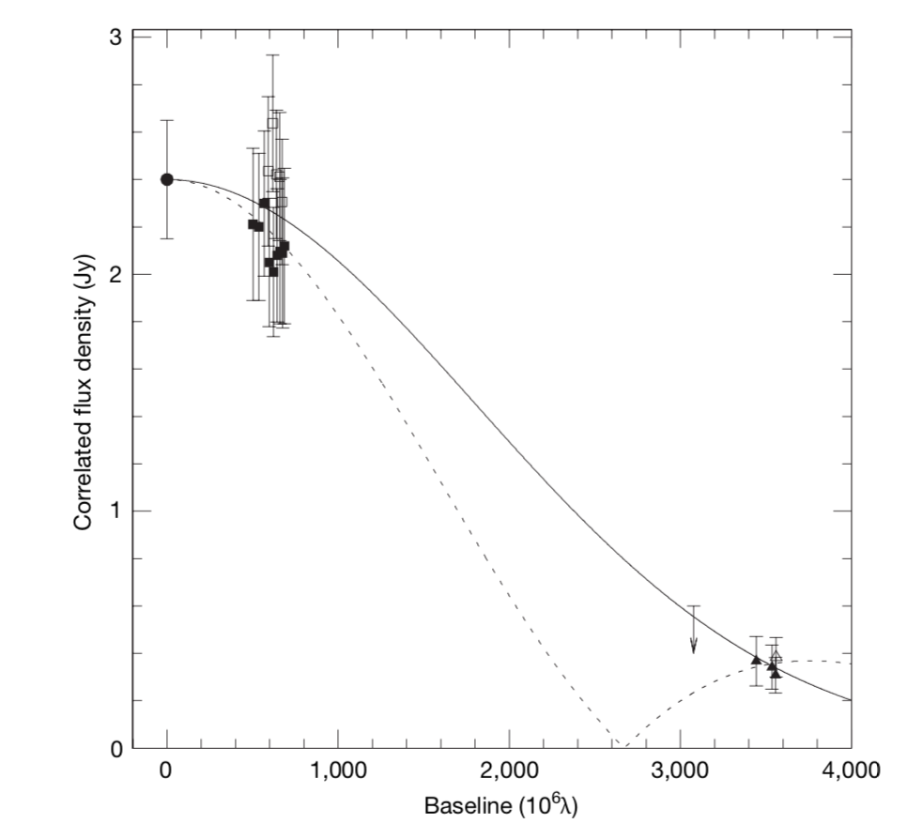
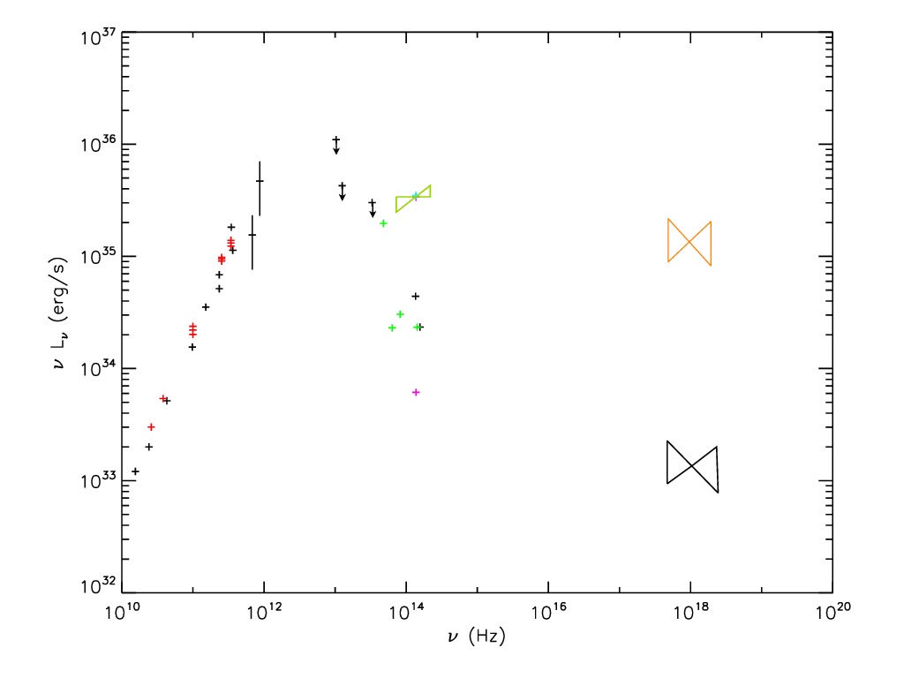
sgr A* image and spectral observations
Sgr a* image and spectral observations
Event Horizon Telesope (EHT) 230 GHz emitting region size constraints
Intrinsic size: $37_{−10}^{+16}μas$
Scattering size: $43_{−8}^{+14}μas$
Sgr A* spectrum from 10¹⁰Hz microwaves to 10²⁰Hz X-rays
1.3 Jy at 32 GHz in ApJ (Bower et al. 2015)
2.4 Jy at 230 GHz by EHT in Nature (Doeleman et al. 2008)
Sub-mm ($≿$ 3x10¹¹Hz) bump in IR
b
Doeleman et al., 2008
Amplitude
(Falcke and Markoff 2013)

Slide 5
Image sequence by emitting region size
Image sequence by emitting regions size
EHT Size Constraint: 12.8M<D<20.8M
$β_{e}$=0.01, (M_{unit},F_{230 GHz})
=(1.90238e19g,2.40437Jy)
-2.92429e-9 $M_{⊙}$/yr
$\left(f,β_{c}\right)=(0.5,1)$, (M_{unit},F_{230 GHz})
=(3.94188e19,g,2.3596Jy)
-6.05935e-9 $M_{⊙}$/yr
Electron Evol, (M_{unit},F_{230 GHz})
=(1.03897e20g,2.40415Jy)
-1.69688e-8 $M_{⊙}$/yr
$\left(f,β_{c}\right)=(0.5,0.1)$, (M_{unit},F_{230 GHz})
=(7.3322e19g,2.36663Jy)
-1.12709e-8 $M_{⊙}$/yr
$\left(f,β_{c}\right)=(0.5,0.01)$, (M_{unit},F_{230 GHz})
=(2.35543e20g,2.39263Jy)
-3.6207e-8 $M_{⊙}$/yr
$\left(f,β_{c}\right)=(0.1,1)$, (M_{unit},F_{230 GHz})
=(5.94859e20g,2.40018Jy)
-9.14401e-8 $M_{⊙}$/yr
D=15.5M
D=20.2M
D=21.2M
D=24.0M
D=27.5M
D=35.5M
$\left(f,β_{c}\right)=(0.1,0.1)$, (M_{unit},F_{230 GHz})
=(7.58373e20g,2.39541Jy)
-1.16575e-7 $M_{⊙}$/yr
$\left(f,β_{c}\right)=\left(0.1,0.01\right)$, (M_{unit},F_{230 GHz})
=(1.11648e21g,2.40128Jy)
-1.71622e-7 $M_{⊙}$/yr
$β_{e}$=0.1, (M_{unit},F_{230 GHz})
=(4.08628e18g,2.37581Jy)
-6.28132e-10 $M_{⊙}$/yr
N=0, (M_{unit},F_{230 GHz})
=(9.18101e18g,2.43161Jy)
-1.41128e-9 $M_{⊙}$/yr
N=4, (M_{unit},F_{230 GHz})
=(2.95599e18g,2.38875Jy)
-4.54387e-10 $M_{⊙}$/yr
$β_{e}$=1, (M_{unit},F_{230 GHz})
=(2.51415e18g,2.4266Jy)
-3.86468e-10 $M_{⊙}$/yr
D=36.9M
D=37.5M
D=46.9M
D=63.0M
D=91.3M
D=97.7M

Slide 6
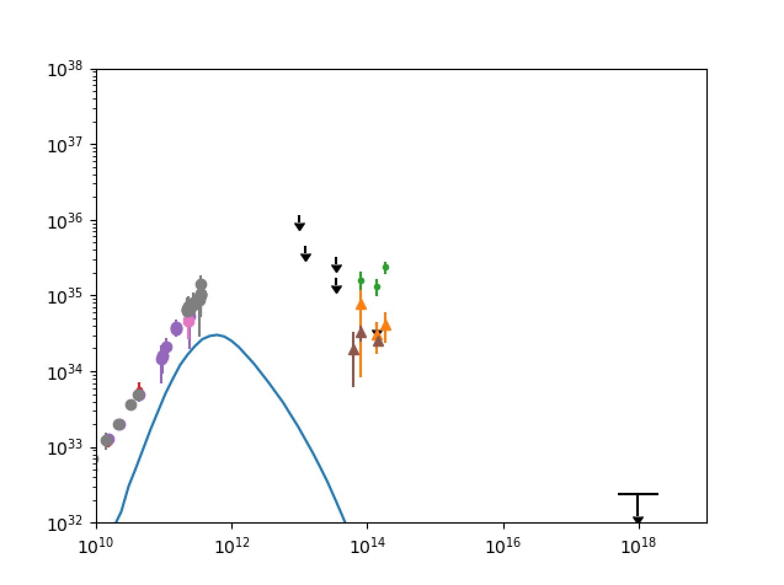
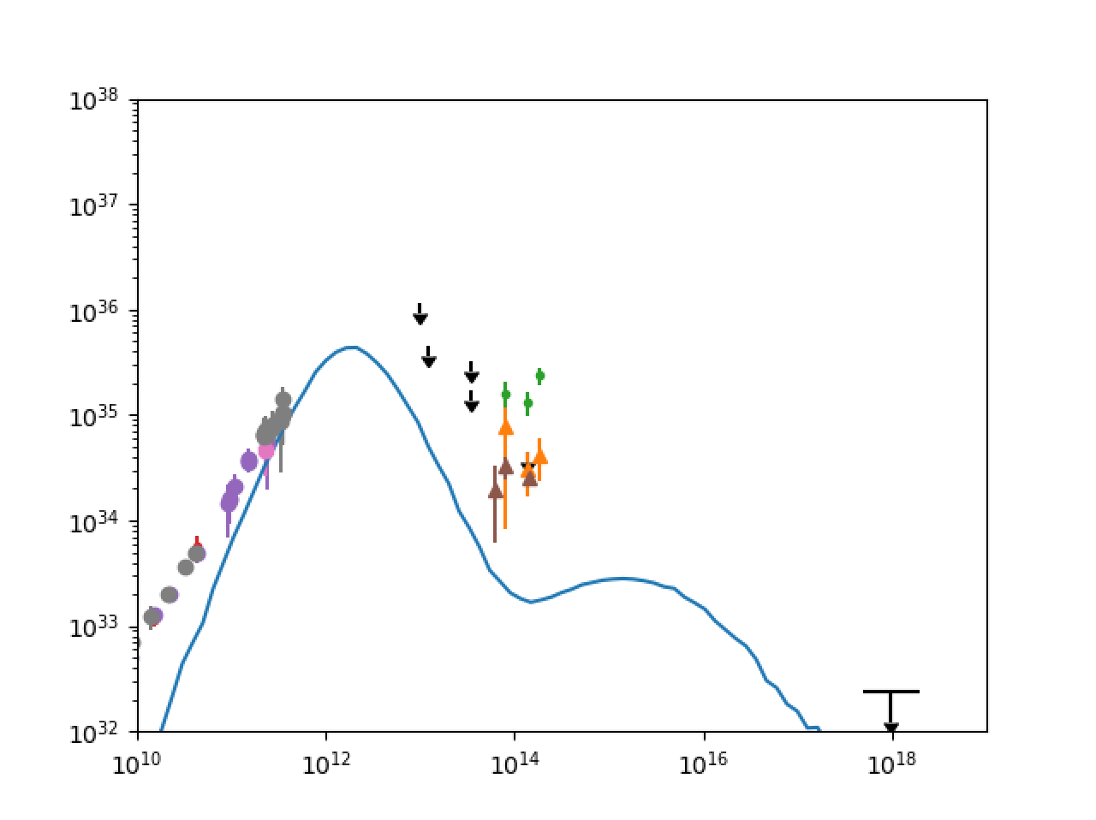
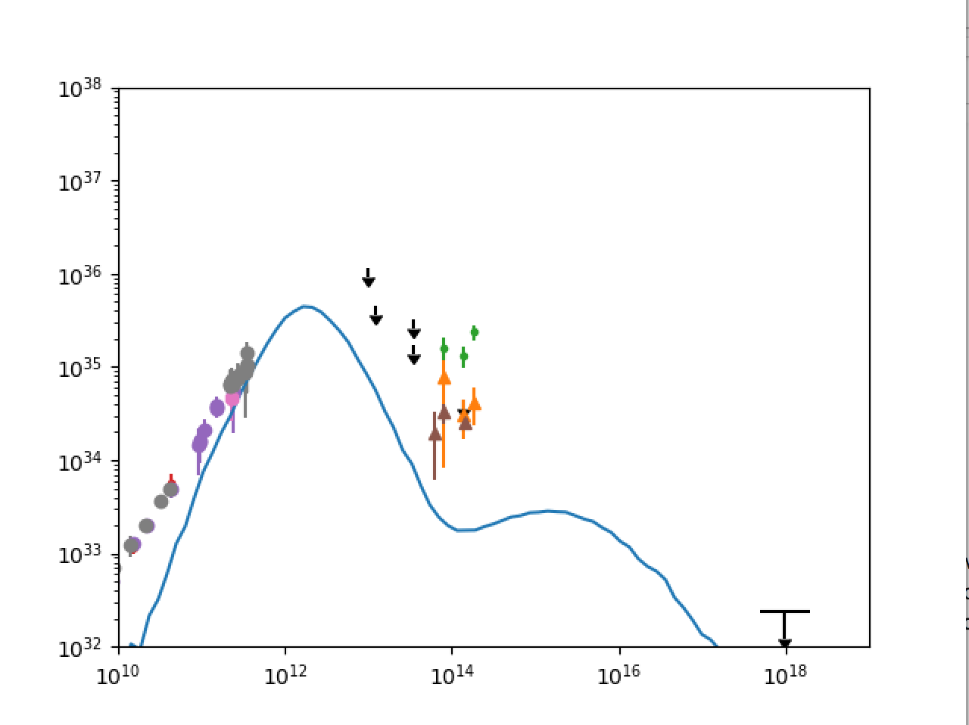
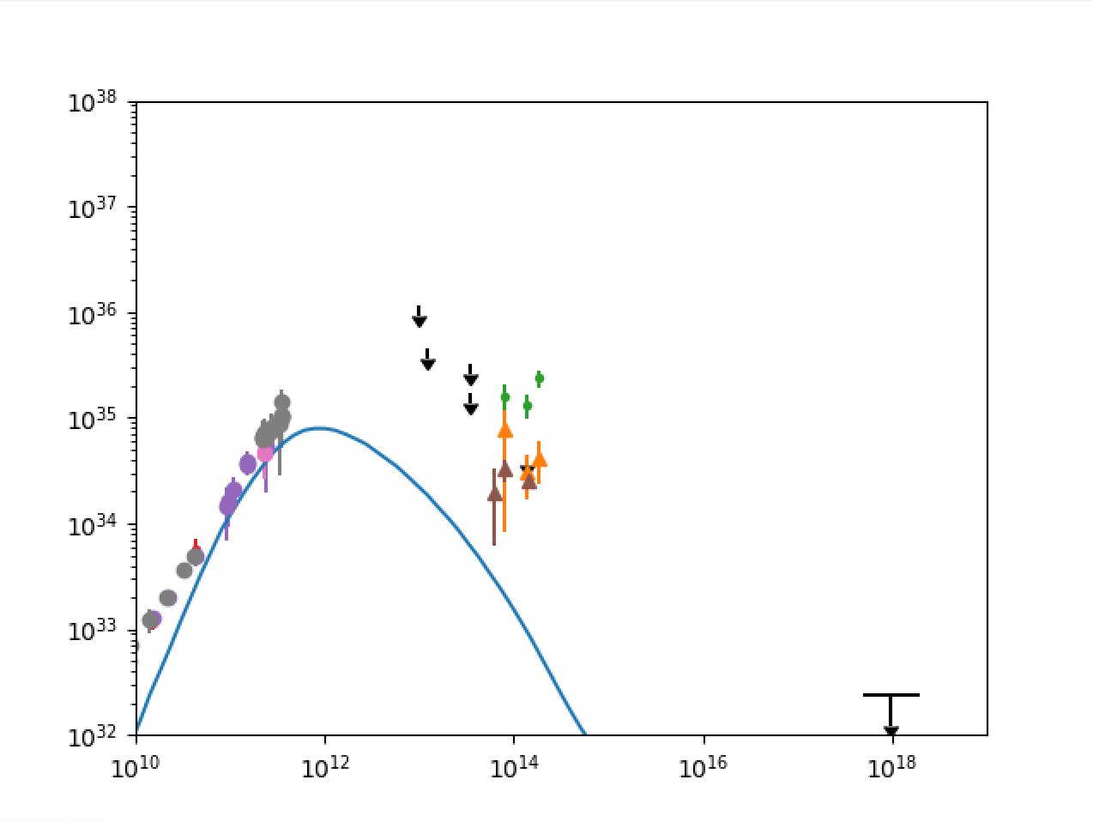
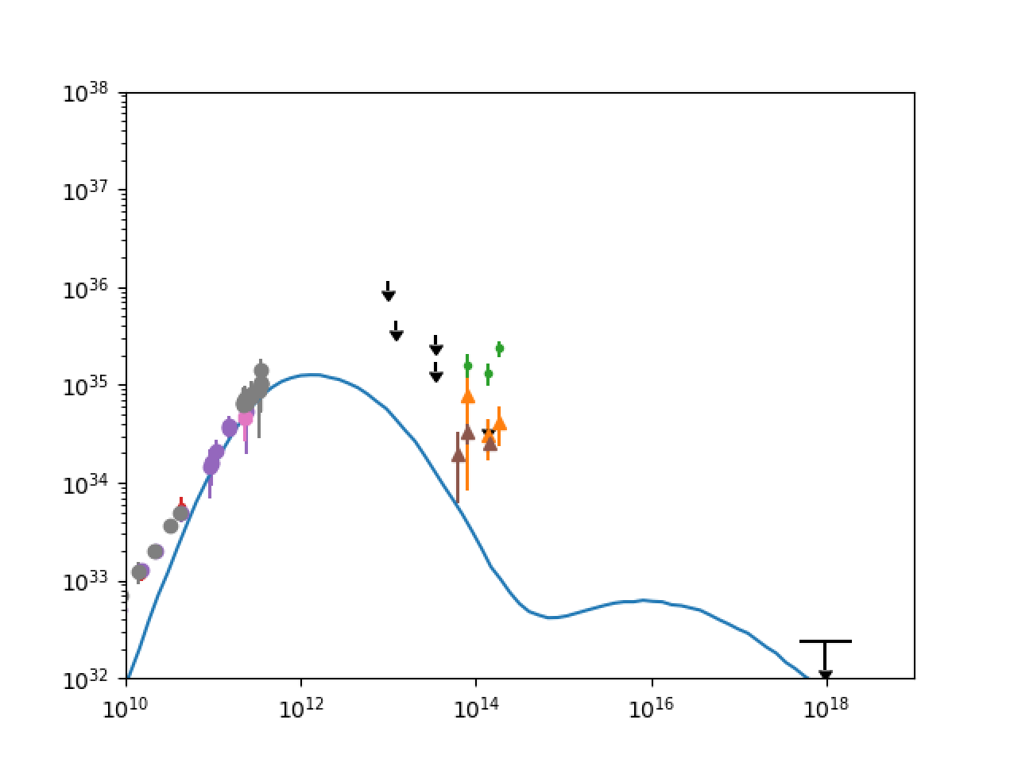
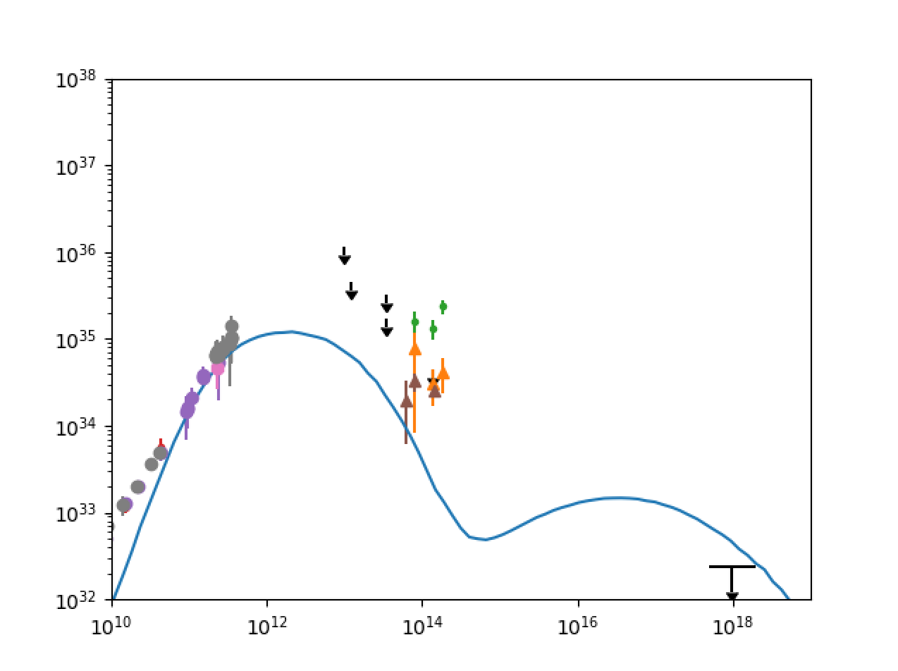
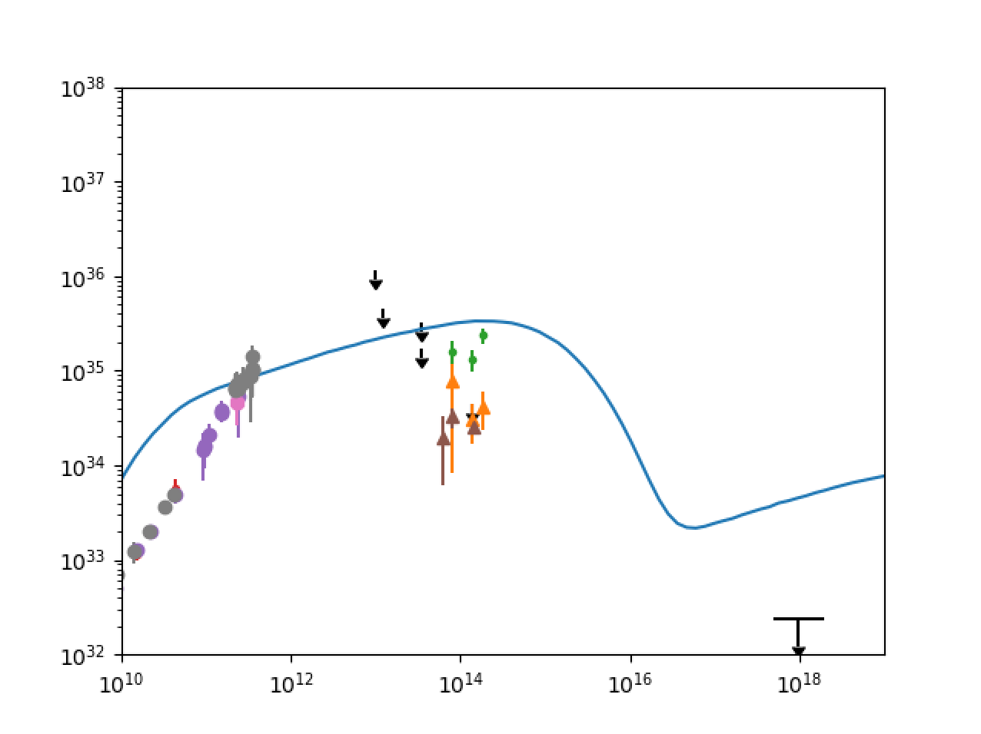
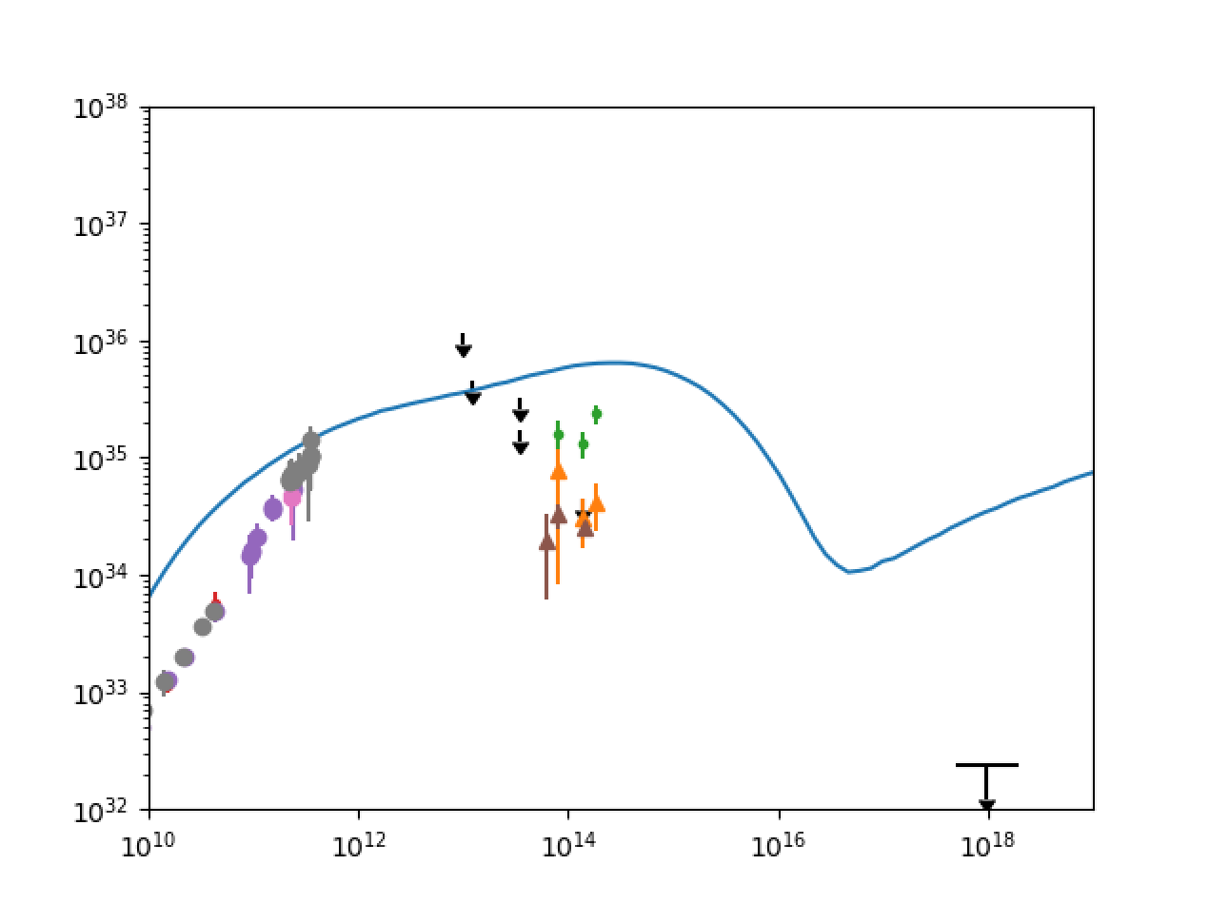
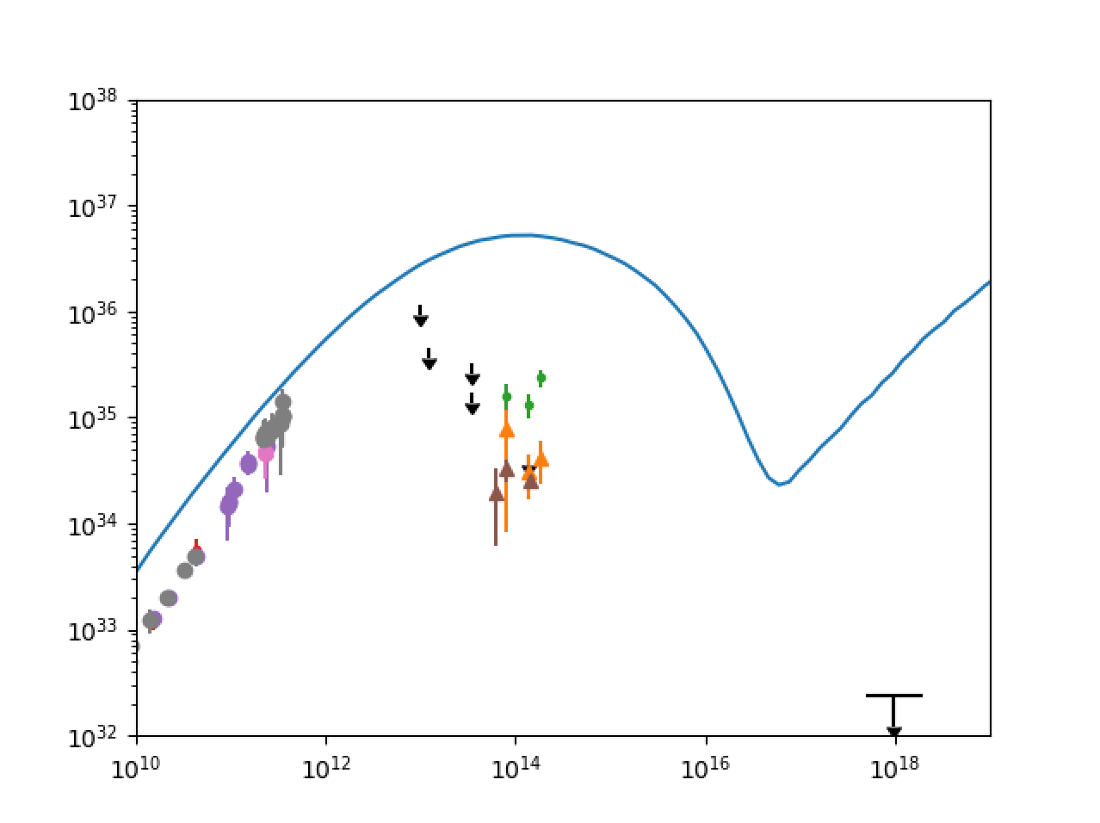
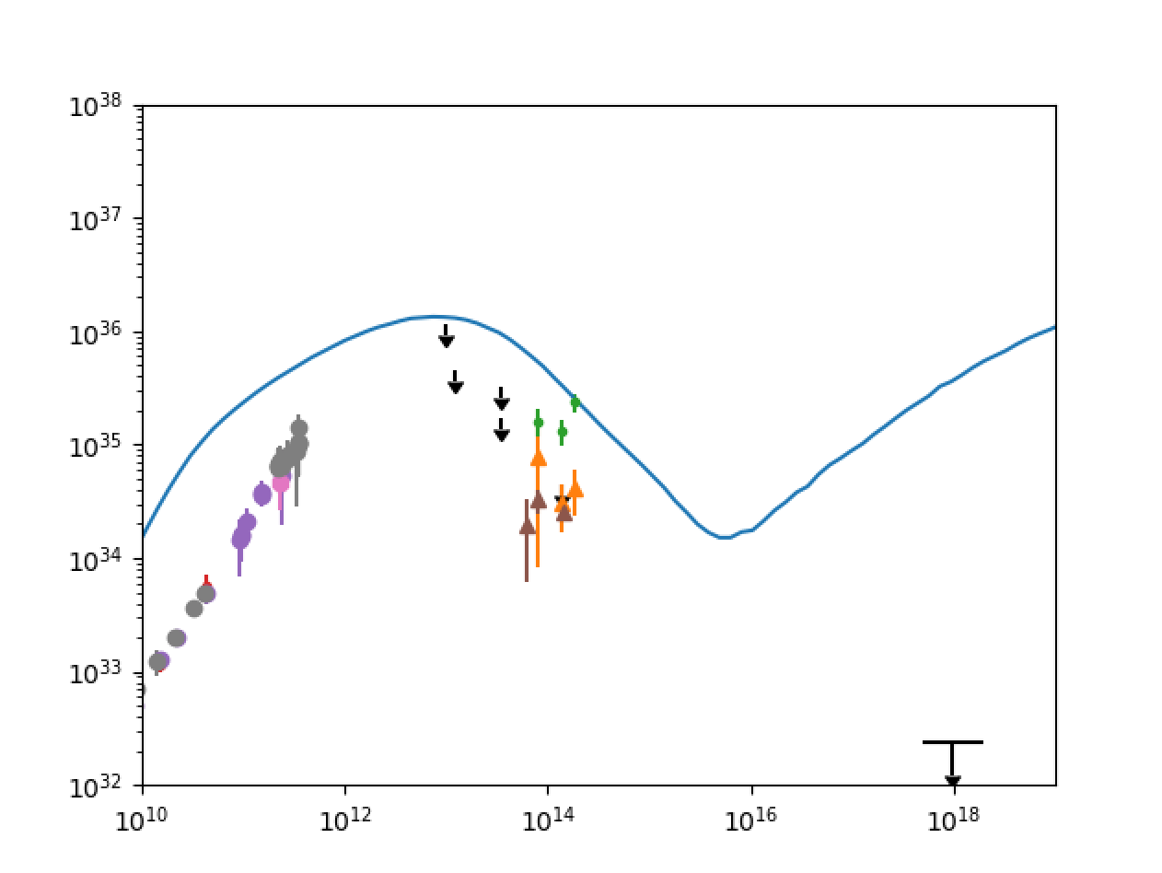
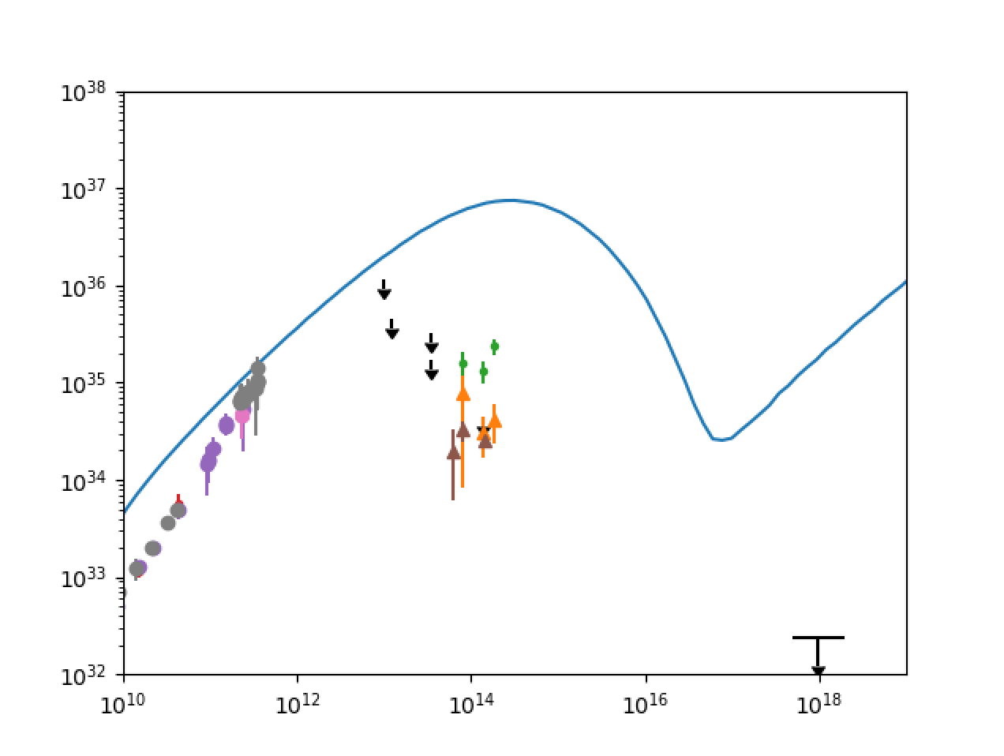
Spectra in electron temperature model
Spectra in electron temperature and beta and bias models
Electron temperature ($f$ , $β_{c}$) models have steeper-than-observed spectrum likely corona-dominated
Beta models have flatter-than-observed spectra near sub mm-bump, but similar low frequency slope to observed spectrum
Bias model spectra are slightly flatter than observed and overproduce high frequency end
Analytic model of jet outflow with $B$~$B_{φ}$~1/r and equipartition assumption yields flat spectrum, isothermal jet (Blandford and Königl, 1979); GRMHD simulations (Moscibrodska and Falcke, 2013) confirm flat spectra due to optically thick regions
($f$, $β_{c}$)=(0.1,0.01)
($f$, $β_{c}$)=(0.1,0.1)
($f$, $β_{c}$)=(0.1,1)
($f$, $β_{c}$)=(0.5,0.01)
($f$, $β_{c}$)=(0.5,0.1)
($f$, $β_{c}$)=(0.5,1)
${νL}_{ν}$ [erg/s]
${νL}_{ν}$ [erg/s]
${νL}_{ν}$ [erg/s]
${νL}_{ν}$ [erg/s]
${νL}_{ν}$ [erg/s]
${νL}_{ν}$ [erg/s]
$ν$ [Hz]
$ν$ [Hz]
$ν$ [Hz]
$ν$ [Hz]
$ν$ [Hz]
$ν$ [Hz]
$β_{e}$= 0.01
$β_{e}$= 0.1
$β_{e}$= 1
$N$ = 0
$N$ = 4
${νL}_{ν}$ [erg/s]
${νL}_{ν}$ [erg/s]
${νL}_{ν}$ [erg/s]
${νL}_{ν}$ [erg/s]
${νL}_{ν}$ [erg/s]
$ν$ [Hz]
$ν$ [Hz]
$ν$ [Hz]
$ν$ [Hz]
$ν$ [Hz]

Slide 7
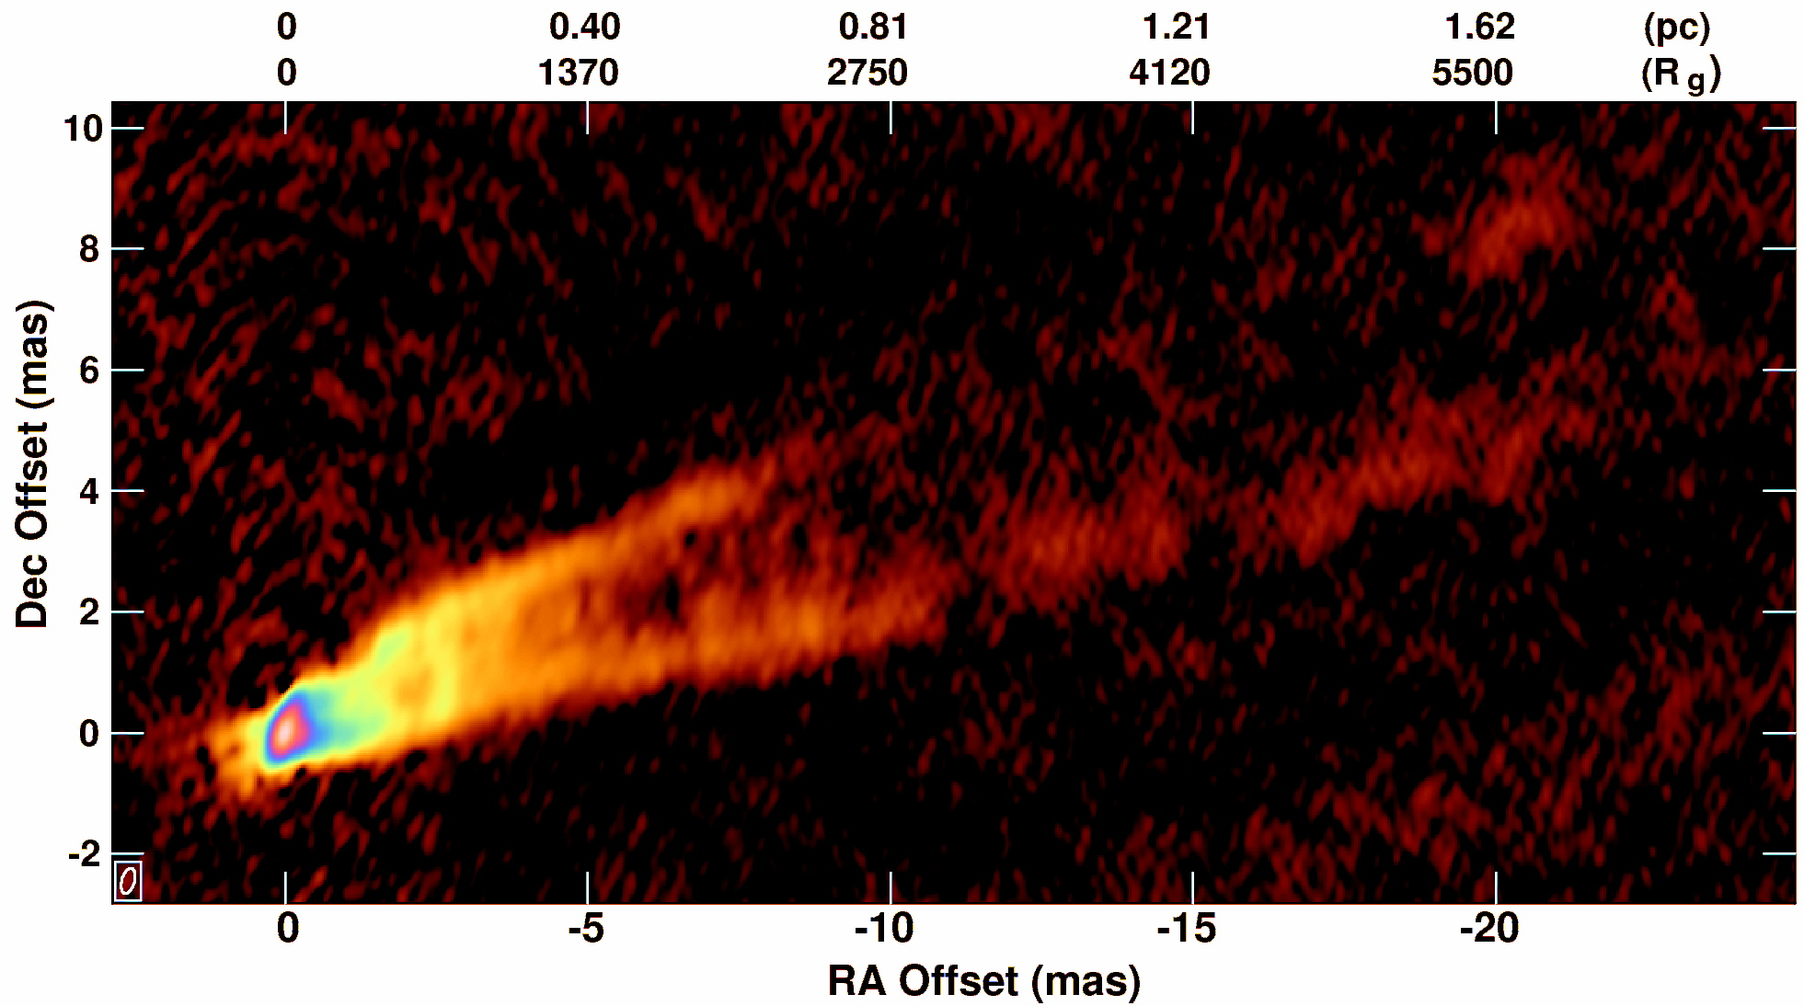
M87 Observations
Giant elliptical galaxy located in the Virgo Cluster 5.4x10⁷ly from us.
M87’s jets source from radio to gamma rays.
M87’s 6.6x10⁹ M$⨀$ (Gebhardt et al., 2011) central black hole has angular width (3.9μas)— comparable to that of Sgr A* (5.3μas).
EHT observations coming soon
43GHz (7mm) VLBA M87 (Courtesy of Craig Walker (NRAO))

Slide 8
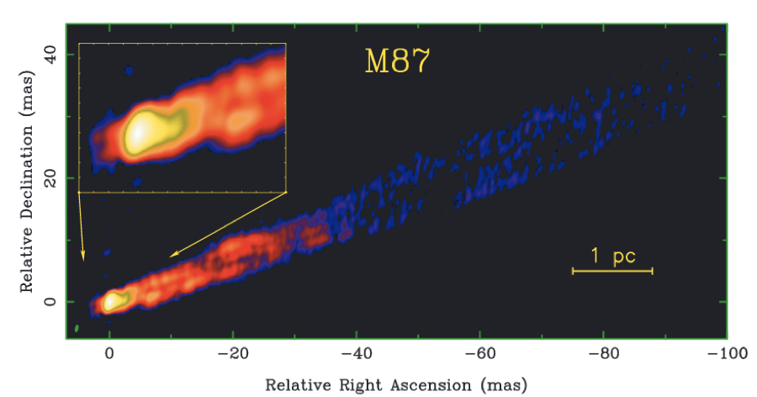
Jet Collimation and Substructure
Simulated collimation increases with N in models where P_{e}~ b^{N}
EHT & VLBA observed collimation profile (Globus and Levinson, 2016)
Investigate perturbations e^{i(mΦ+nz+lR+ωt)} for pinch instability (m=0) or magnetic Kelvin-Helmholtz instabilities (m=1) wobble
Observed Profile
(Contours):
Emissivity: N=0, j’_{ν}~B^{’1.5} (left), N=2, j’_{ν}~ B^{’3.5} (right)
(θ_{Obs},Φ_{Obs})=(20°,0°) T_{obs}=2000M
Jet Isolation:
x²+y²-(z/2)²<-40², |z|<40M
x²+y²<40², |z|>40M
(θ_{Obs},Φ_{Obs})=(15°,0°),
T_{Obs}=2000M,2056M,…,2560M
Emissivity: j’_{ν}~B^{’1.5}
Jet Isolation: 0.5|z|>x²+y²>20M
M87 Observation at 15GHz
Anantua, Blandford and
Tchekhovskoy (2018) Galaxies, 6, 31
Kovalev, Lister, Homan and
Kellermann (2007) ApJL, 668, 27

Slide 9
Connecting with Observations: M87 43 GHz Radio Map Time Series
vs. Current Density Model
Current density model based on having particles accelerated at current layers
(θ_{Obs},Φ_{Obs})=(20°,0°), T_{Obs}=2000M,2056M,…,2560M
Emissivity: Current Density Model
Disk subtraction: |z|>35M
L_{JSq}=1e4 M
M87 43GHz (7mm) VLA maps
21-Day frame rate, Epochs A,B,D-L
Courtesy of Craig Walker (NRAO), Chun Ly (UCLA), Bill Junor (Los Alamos), and Phil Hardee (U. Alabama)
$$B_{e}=𝒟^{−1}|\vec{B}′×\hat{n}′|$$
Anantua, Blandford and
Tchekhovskoy (2018) Galaxies, 6, 31

Slide 10
Conclusions
Sgr A*
230 GHz synthetic intensity maps on the scale of tens of gravitational radii appear:
Mostly uniform coronal projections + photon rings for electron temperature models; vary from inflow to outflow dominated in equipartition-inspired (beta and bias) models
Emitting region most compact for low $β_{e}$and high ($f$, $β_{c}$); more asymmetric for decreasing $β_{e}$and decreasing $N$
Synthetic spectra are:
Flatter spectra in beta and bias models than electron temperature models (best fit ($f$, $β_{c}$)=(0.5,1); flatter for decreasing $β_{e}$and decreasing $N$
M87
Self-consistent GRMHD simulations can be used to replicate observational signatures of AGN jets including helical substructure and collimation

