Slide 1
“Observing” JAB simulations: approaching horizon scales in agn
Richard Anantua (CfA/BHI)
Collaborators: Sean Ressler and Eliot Quataert (UC Berkeley); Roger Blandford (Stanford); Alexander Tchekhovskoy (Northwestern)
Presentation at 22nd International Conference on General Relativity and Gravitation
Valencia, Spain
7-8-2019

Slide 2
Overview: “observing” JAb simulations
Start with general relativistic magnetohydrodynamic (GRMHD) simulation of jet (or outflow)/accretion flow/black hole (JAB) system
Convert GRMHD variables to radiation prescriptions for emission, absorption, polarization, particle acceleration and/or dissipation to emulate sources
Add “observer” viewing sources, e.g., Sgr A* at the Galactic Center

Slide 3
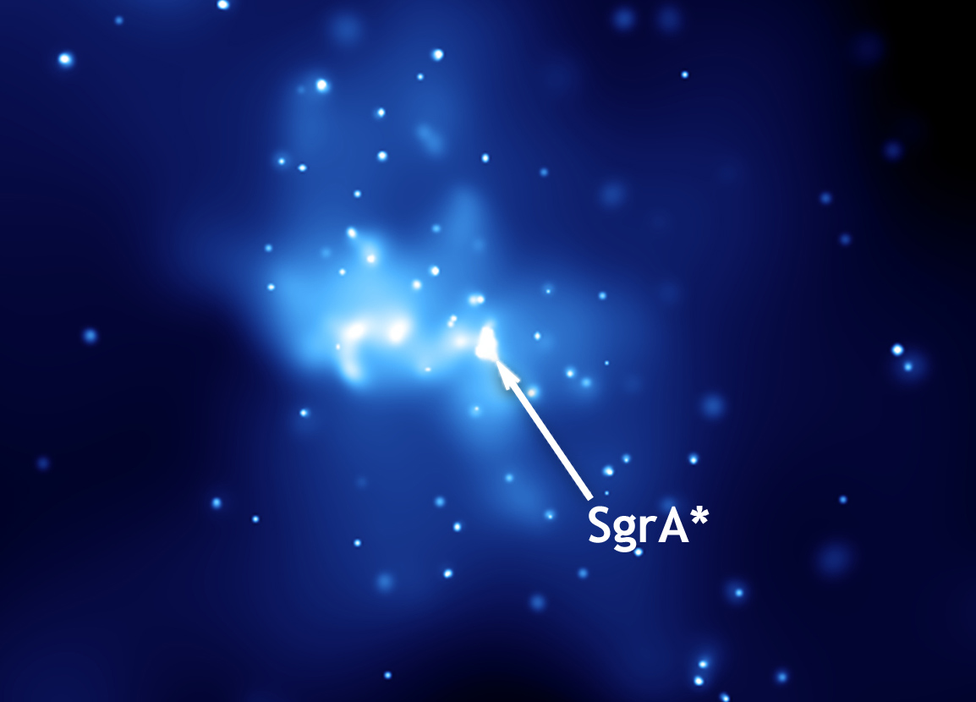
sagitTarius a* Luminosity and accretion
The Galactic Center radio source Sgr A at d=8.18kpc (Abuter et al., 2019) has a relatively bright region, Sgr A*, surrounded by an accretion flow
Sgr A* has central black hole mass: 4.14x10⁶$M_{⨀}$ (Abuter et al., 2019)
Sgr A* has extremely low luminosity: L_{SgrA*} = 10⁻⁹L_{Edd} -10⁻¹⁰L_{Edd} (Sabha et al., 2018); L_{SgrA*} $≾$ 10³⁷ erg/s = 2600 $L_{⨀}$ (Narayan et al., 1998)
Sgr A* also has low $\dot{M}≲2x{10}^{−7}M_{⨀}\text{/}\text{yr}\text{ (}\text{Marrone} \text{et} \text{al}\text{., 2007)}$, sourced mainly by ~30 Wolf-Rayet stars Ressler, Quataert and Stone, 2018)
Sgr A

Slide 4
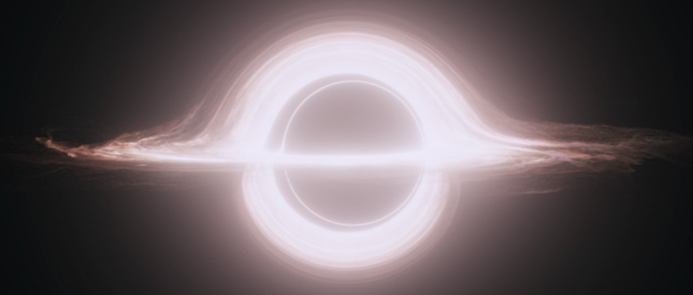
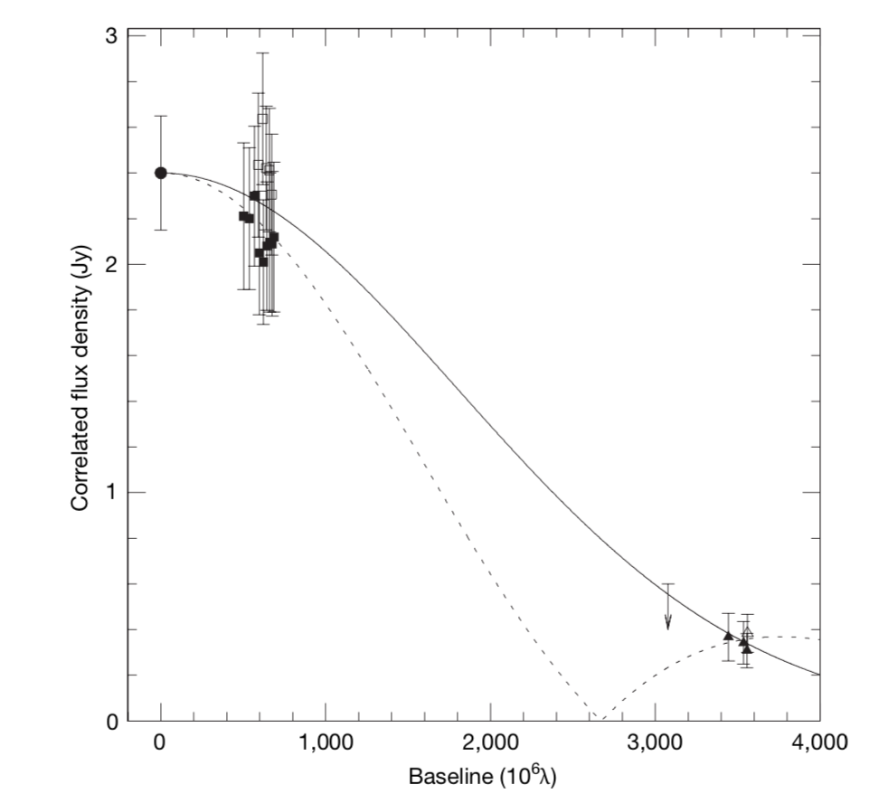
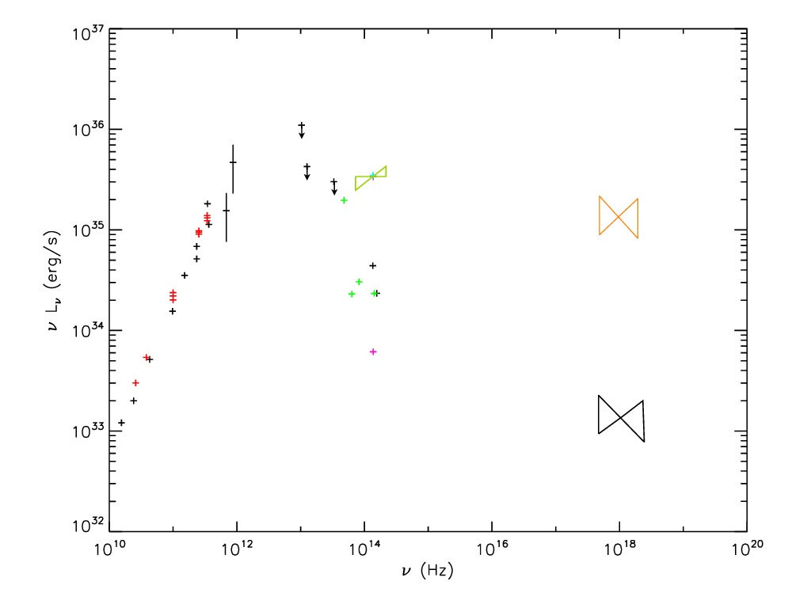
sgr A* image and spectral observations
Sgr a* image and spectral observations
Event Horizon Telesope (EHT) 230 GHz emitting region size constraints
Intrinsic size: $37_{−10}^{+16}μas$
Scattering size: $43_{−8}^{+14}μas$
Sgr A* spectrum from 10¹⁰Hz microwaves to 10²⁰Hz X-rays
1.3 Jy at 32 GHz in ApJ (Bower et al. 2015)
2.4 Jy at 230 GHz by EHT in Nature (Doeleman et al. 2008)
Sub-mm ($≿$ 3x10¹¹Hz) bump in IR
b
Non-point symmetric (Fish et al. 2016)
ring more likely than circular Gaussian
Doeleman et al., 2008
Amplitude
(Falcke and Markoff 2013)

Slide 5
Simulation: Assumptions and fluid equations
Assumptions (Ressler et al., 2015, 2017)
Accretion dynamical time shorter than timescale of Coulomb collisions between leptonic (e+e-) and hadronic plasmas (p,ions) => Two-temperature model
Electrons radiate heat more efficiently than protons: T_{e} << T_{p}
Mass accretion rate – $\dot{M}$ determines normalization of spectral flux summed over intensity maps in various models at a chosen frequency
Fiducial (semi-MAD) model between standard and normal evolution (SANE) $Φ=M\sqrt{\dot{mc}}=0,r_{g}≡M$& magnetically-arrested disk (MAD) flux $Φ=M\sqrt{\dot{mc}}=50$ ; SANE and MAD also considered
GRMHD mass conservation and energy-momentum equations
Stress-energy-momentum tensor with viscous and heating terms
Entropy governed by Vlasov eq. and 1st moment, and entropy eq.
$$∂_{μ}\left({ρu}^{μ}\right)=0$$
$$∂_{μ}T^{μν}=∇_{μ}\left(T_{g}^{μν}+T_{EM}^{μν}\right)=−τ^{μν}$$
$$T_{e}^{μν}=\left(ρ_{e}+u_{e}+P_{e}\right)u_{e}^{μ}u_{e}^{ν}+P_{e}g^{μν}+τ_{e}^{μν}+q_{e}^{μ}u_{e}^{ν}+q_{e}^{ν}u_{e}^{μ}$$
$$T_{p}^{μν}=\left(ρ_{p}+u_{p}+P_{p}\right)u_{p}^{μ}u_{p}^{ν}+P_{p}g^{μν}+τ_{p}^{μν}$$
$$s=\frac{\ln{Pρ^{−γ}}}{γ−1}$$
$$\frac{∂f}{∂t}+\vec{v}∙{\vec{∇}}_{\vec{x}}f+\frac{q}{m}\left(\vec{E}+\frac{1}{c}\vec{v}×\vec{B}\right){\vec{∇}}_{\vec{v}}f=0$$
$${∂_{μ}T}_{e}^{μν}=−enu_{e}^{μ}F_{μ}^{ν}, {∂_{μ}T}_{p}^{μν}=enu_{p}^{μ}F_{μ}^{ν}0$$
$$ρT_{e}u^{μ}∂_{μ}s_{e}=Q_{e}−∂_{μ}q_{e}^{μ}−a_{μ}q_{e}^{μ}$$

Slide 6
Emission models and radiative transfer
Beta Critical Electron Temperature Model
Constant T_{e}/T_{p} at $β$<< $β_{c}$
T_{e} suppressed at $β$>> $β_{c}$
Constant $β_{e}$ Model
Magnetic Bias Model
Postprocessing
Intensity maps computed using IBOTHROS (Noble et al. 2007) for radiative transfer
Spectra computed using GRMONTY (Dolence et al. 2009) Monte Carlo ray tracing
$$\frac{T_{e}}{T_{p}}=f Exp[−β/β_{c}]$$
$$0<f<1$$
$${β_{e}=\frac{P_{e}}{P_{b}}=\frac{{(γ_{e}−1)u}_{e}}{b^{2}/2}⟹u}_{e}=\frac{1}{(γ_{e}−1)}β_{e}\frac{b^{2}}{2}$$
Equipartition for P_{e}~P_{B}
$$P_{e}=K_{n}{\left(\frac{b}{\sqrt{2}}\right)}^{2n}{, K}_{n}=K_{1}\frac{〈\frac{b^{2}}{2}〉}{〈{\left(\frac{b}{\sqrt{2}}\right)}^{2n}〉},K_{1}=1$$

Slide 7
Image sequence by emitting region size
Images in parameter space
$$\left(f,β_{c}\right)=\left(0.1,0.01\right)$$
$$\left(f,β_{c}\right)=(0.1,0.1)$$
$$\left(f,β_{c}\right)=(0.1,1)$$
Decreasing $β_{e0}$
n=0
Increasing f, $β_{c}$
$$\left(f,β_{c}\right)=(0.5,0.01)$$
$$\left(f,β_{c}\right)=(0.5,0.1)$$
$$\left(f,β_{c}\right)=(0.5,1)$$
$β_{e0}$=0.01
$β_{e0}$=0.1
$β_{e0}$=1
n=2
Anantua, Ressler and Quataert (2019) (submitted to MNRAS)

Slide 8
Image sequence by emitting region size
Image sequence by emitting region size
EHT Intrinsic Size Constraint for I > 0.2 x I_{Max} : 8.2M < D <16.2M
$β_{e}$=0.01, (M_{unit},F_{230 GHz})
=(1.90238e19g,2.40437Jy)
-2.92429e-9 $M_{⊙}$/yr
$\left(f,β_{c}\right)=(0.5,1)$, (M_{unit},F_{230 GHz})
=(3.94188e19,g,2.3596Jy)
-6.05935e-9 $M_{⊙}$/yr
Electron Evol, (M_{unit},F_{230 GHz})
=(1.03897e20g,2.40415Jy)
-1.69688e-8 $M_{⊙}$/yr
n=0, (M_{unit},F_{230 GHz})
=(9.18101e18g,2.43161Jy)
-1.41128e-9 $M_{⊙}$/yr
$\left(f,β_{c}\right)=(0.5,0.1)$, (M_{unit},F_{230 GHz})
=(7.3322e19g,2.36663Jy)
-1.12709e-8 $M_{⊙}$/yr
$\left(f,β_{c}\right)=(0.5,0.01)$, (M_{unit},F_{230 GHz})
=(2.35543e20g,2.39263Jy)
-3.6207e-8 $M_{⊙}$/yr
n=0
D=10.1M
D=15.5M
D=15.71M
D=15.99M
D=18.35M
D=19.85M
$β_{e}$=0.1, (M_{unit},F_{230 GHz})
=(4.08628e18g,2.37581Jy)
-6.28132e-10 $M_{⊙}$/yr
$\left(f,β_{c}\right)=(0.1,0.1)$, (M_{unit},F_{230 GHz})
=(7.58373e20g,2.39541Jy)
-1.16575e-7 $M_{⊙}$/yr
$\left(f,β_{c}\right)=\left(0.1,0.01\right)$, (M_{unit},F_{230 GHz})
=(1.11648e21g,2.40128Jy)
-1.71622e-7 $M_{⊙}$/yr
$\left(f,β_{c}\right)=(0.1,1)$, (M_{unit},F_{230 GHz})
=(5.94859e20g,2.40018Jy)
-9.14401e-8 $M_{⊙}$/yr
n=2, (M_{unit},F_{230 GHz})
=(2.95599e18g,2.38875Jy)
-4.54387e-10 $M_{⊙}$/yr
$β_{e}$=1, (M_{unit},F_{230 GHz})
=(2.51415e18g,2.4266Jy)
-3.86468e-10 $M_{⊙}$/yr
n=2
D=25.41M
D=26.93M
D=27.14M
D=28.42M
D=54.22M
D=58.4M

Slide 9
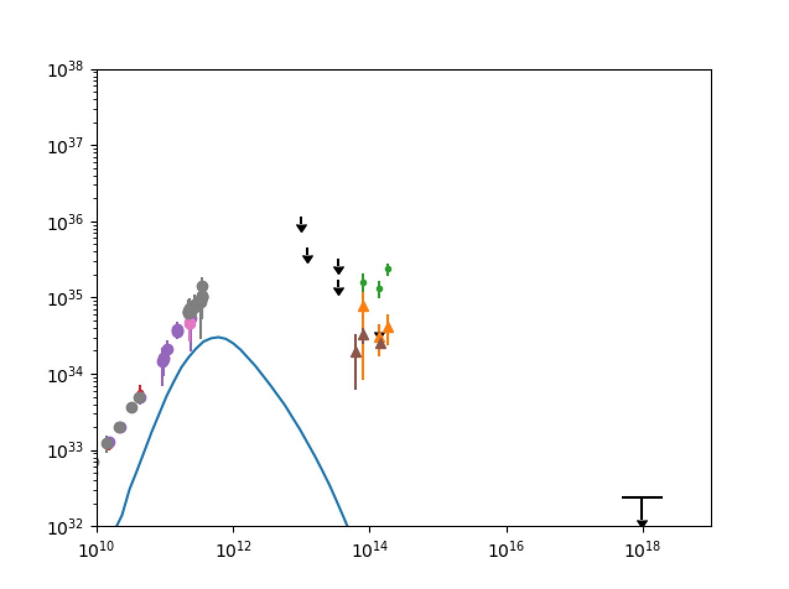
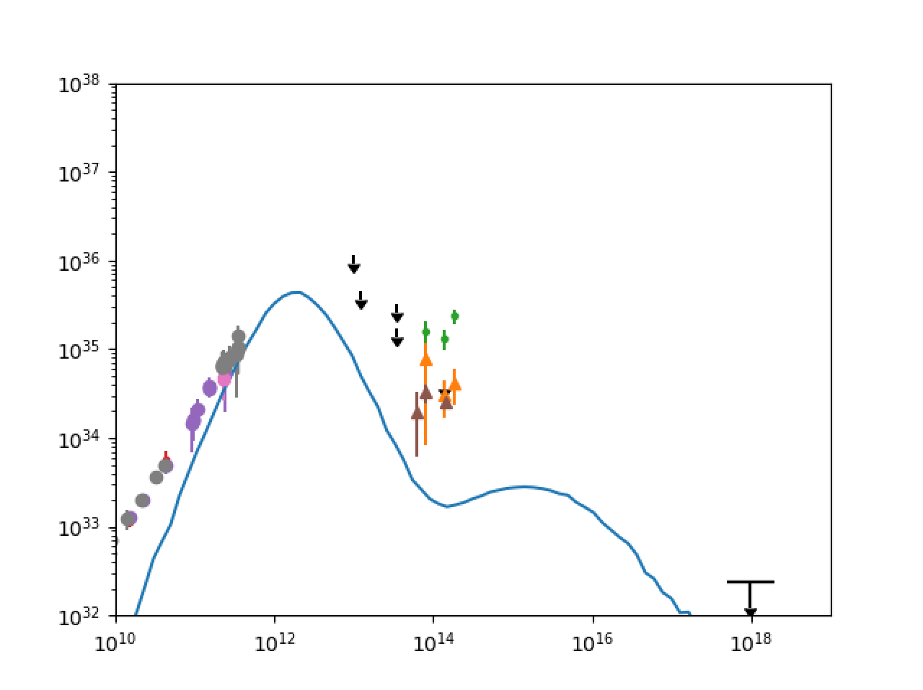
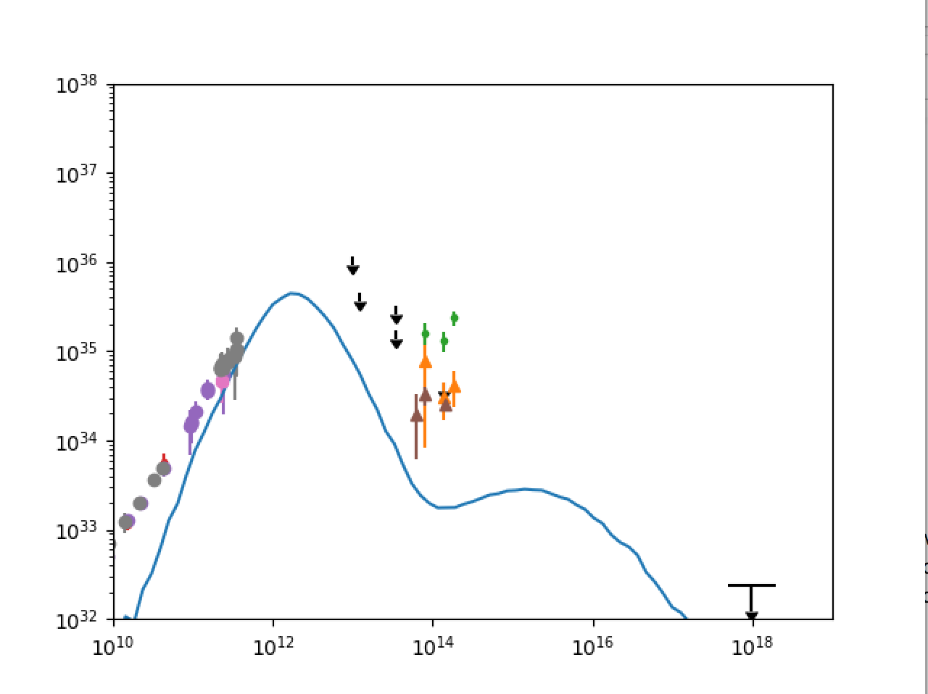
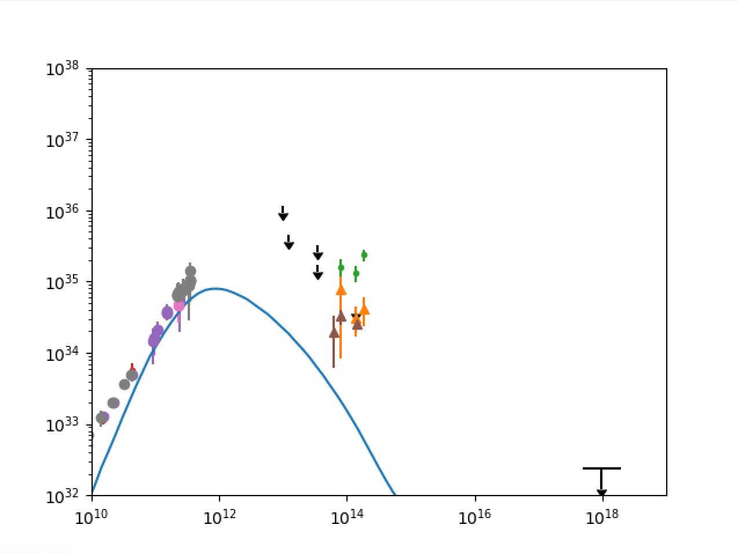
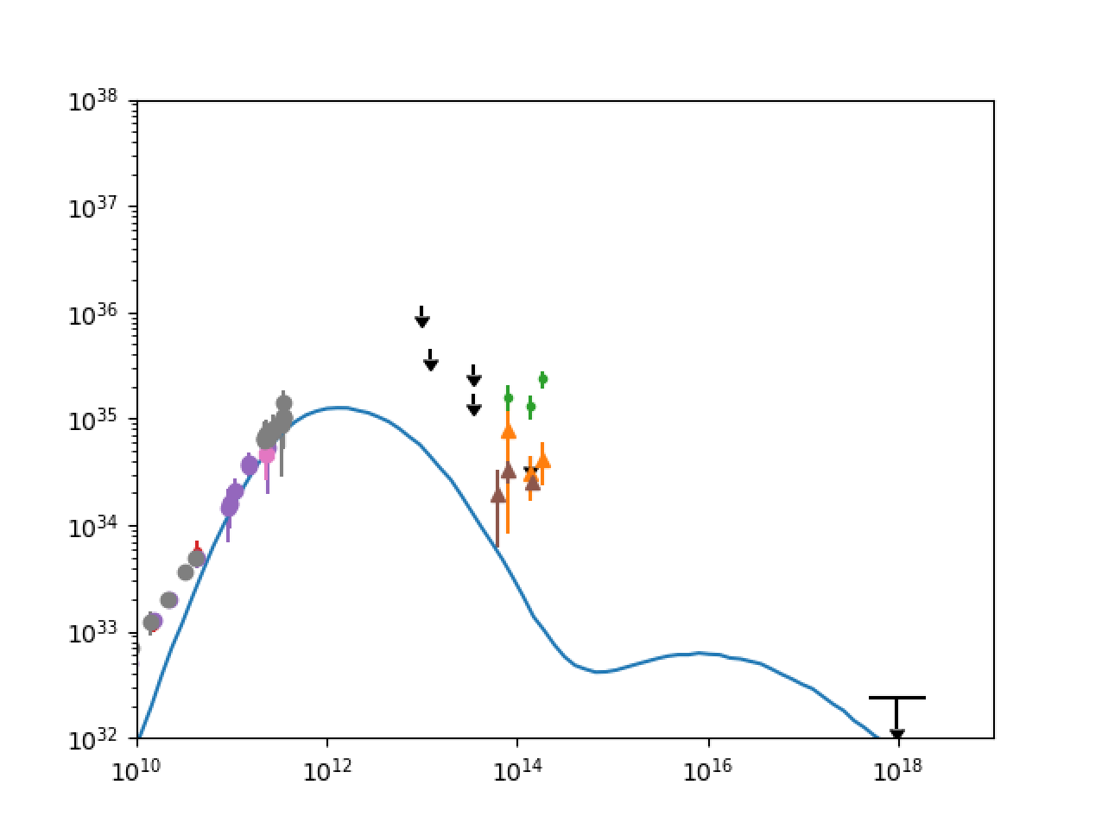
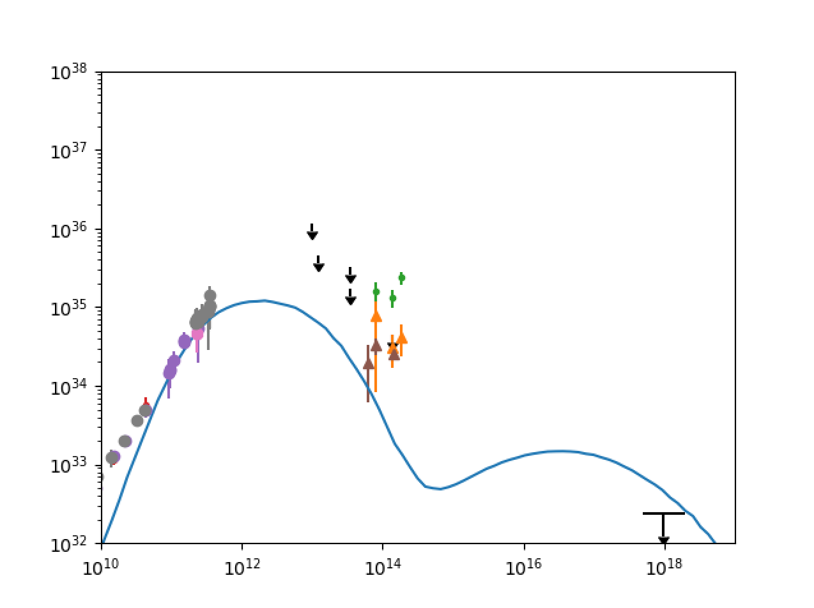
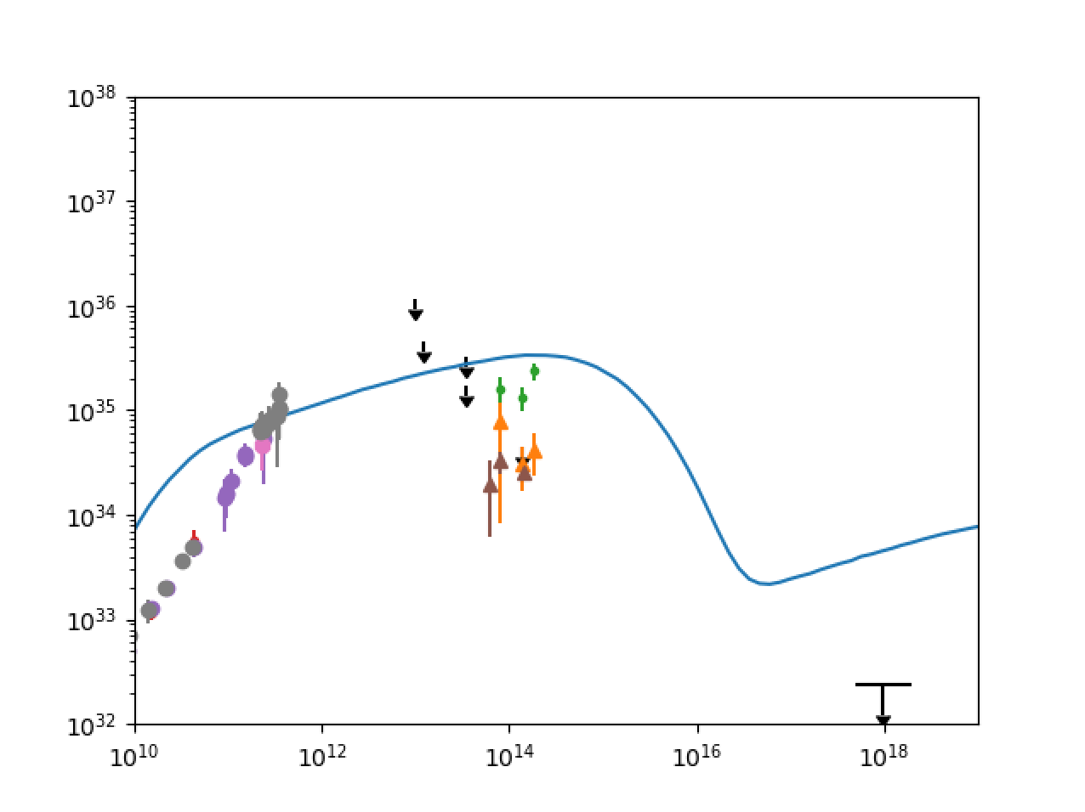
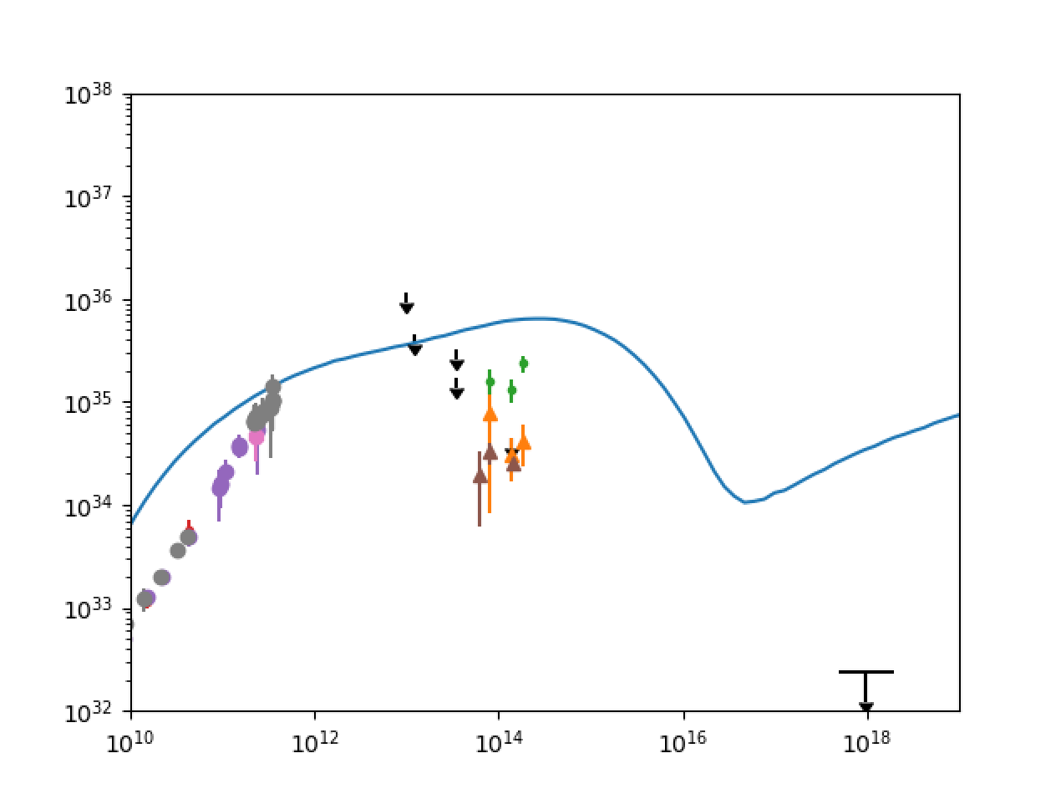
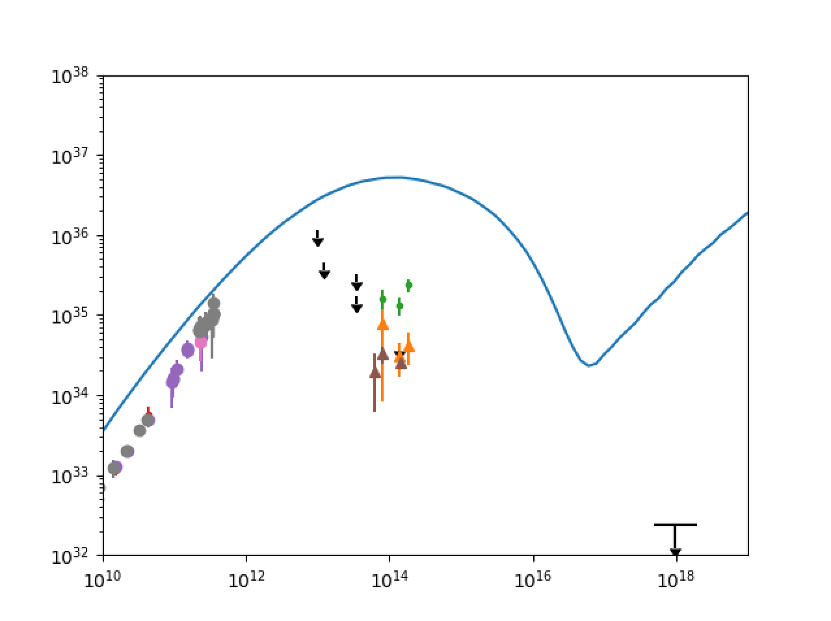
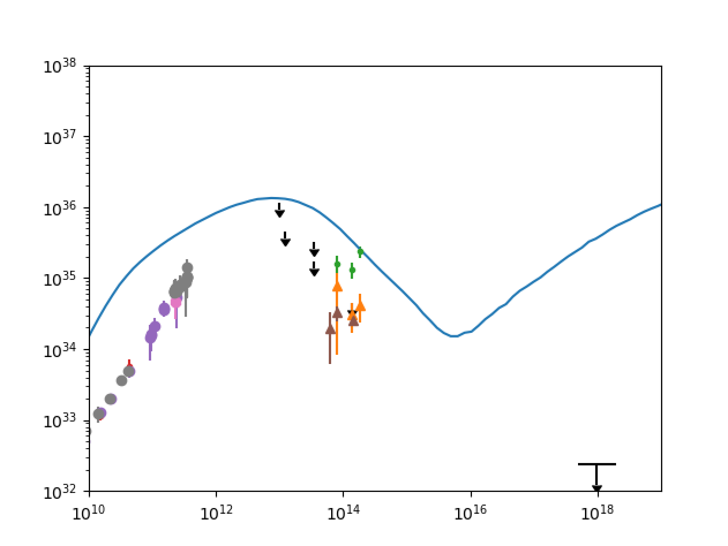
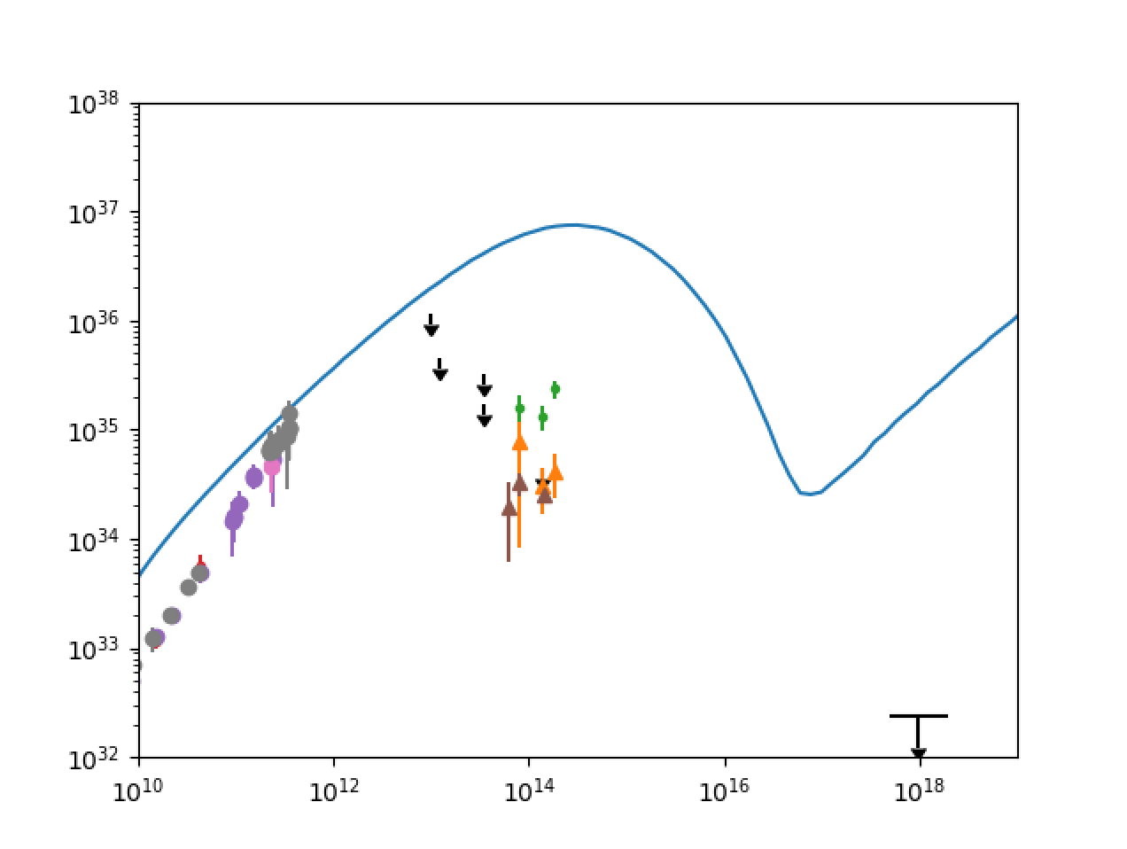
Spectra in electron temperature model
Spectra in electron temperature and constant electron beta and bias models
Electron temperature ($f$ , $β_{c}$) models have steeper-than-observed spectrum likely corona-dominated
Constant Electron Beta models have flatter-than-observed spectra near sub mm-bump, but similar low frequency slope to observed spectrum
Magnetic Bias model spectra are slightly flatter than observed and overproduce high frequency end
Analytic model of jet outflow with $B$~$B_{φ}$~1/r and equipartition assumption yields flat spectrum, isothermal jet (Blandford and Königl, 1979); GRMHD simulations (Moscibrodska and Falcke, 2013) confirm flat spectra due to optically thick regions
($f$, $β_{c}$)=(0.1,0.01)
($f$, $β_{c}$)=(0.1,0.1)
($f$, $β_{c}$)=(0.1,1)
($f$, $β_{c}$)=(0.5,0.01)
($f$, $β_{c}$)=(0.5,0.1)
($f$, $β_{c}$)=(0.5,1)
${νL}_{ν}$ [erg/s]
${νL}_{ν}$ [erg/s]
${νL}_{ν}$ [erg/s]
${νL}_{ν}$ [erg/s]
${νL}_{ν}$ [erg/s]
${νL}_{ν}$ [erg/s]
$ν$ [Hz]
$ν$ [Hz]
$ν$ [Hz]
$ν$ [Hz]
$ν$ [Hz]
$ν$ [Hz]
$β_{e}$= 0.01
$β_{e}$= 0.1
$β_{e}$= 1
$n$ = 0
$n=2$
${νL}_{ν}$ [erg/s]
${νL}_{ν}$ [erg/s]
${νL}_{ν}$ [erg/s]
${νL}_{ν}$ [erg/s]
${νL}_{ν}$ [erg/s]
$ν$ [Hz]
$ν$ [Hz]
$ν$ [Hz]
$ν$ [Hz]
$ν$ [Hz]

Slide 10
Sgr A* Model Classification
IMAGE VARIABILITY AND MODEL CLASSIFICATION
Type III- Thick Photon Ring
Type IV - Extended Outflow
Type I - Thin, Compact, Asymmetric Photon Ring/Crescent
Type II - Inflow-Outflow Boundary + Thin Photon Ring

Slide 11
Time averaged image Classification
Spectra and TIME AVERAGED IMAGES
${νL}_{ν}$ [erg/s]
${νL}_{ν}$ [erg/s]
$ν$ [Hz]
$ν$ [Hz]
Type III- Thick Photon Ring;
spectral excesses at
low and high frequency
Type IV - Extended Outflow; spectral excesses at
low and high frequency and flat low frequency knee
Type I - Thin, Compact, Asymmetric Photon Ring/Crescent; best fit spectrum
Type II - Inflow-Outflow Boundary + Thin Photon Ring; steep spectrum
${νL}_{ν}$ [erg/s]
${νL}_{ν}$ [erg/s]
$ν$ [Hz]
$ν$ [Hz]

Slide 12
.
SANE Image parameter space
$$\left(f,β_{c}\right)=\left(0.1,0.01\right)$$
$$\left(f,β_{c}\right)=(0.1,0.1)$$
$$\left(f,β_{c}\right)=(0.1,1)$$
.
n=0
$β_{e0}$=0.01
$β_{e0}$=0.1
$β_{e0}$=1
$$\left(f,β_{c}\right)=(0.5,0.01)$$
$$\left(f,β_{c}\right)=(0.5,0.1)$$
$$\left(f,β_{c}\right)=(0.5,1)$$
n=2

Slide 13
.
MAD Image parameter space
$$\left(f,β_{c}\right)=\left(0.1,0.01\right)$$
$$\left(f,β_{c}\right)=(0.1,0.1)$$
$$\left(f,β_{c}\right)=(0.1,1)$$
n=0
$β_{e0}$=0.01
$β_{e0}$=0.1
$β_{e0}$=1
$$\left(f,β_{c}\right)=(0.5,0.01)$$
$$\left(f,β_{c}\right)=(0.5,0.1)$$
$$\left(f,β_{c}\right)=(0.5,1)$$
n=2

Slide 14
Conclusions
Novel emission models of Sgr A* based on turbulent heating and equipartition span a large parameter space
230 GHz synthetic intensity maps on the scale of tens of gravitational radii appear with:
Mostly uniform coronal projections + photon rings for Electron Temperature Models; vary greatly in equipartition-inspired (Constant Electron Beta and Bias) Models
Emitting region most compact for low $β$ and high ($f$ , $β_{c}$); more asymmetric for decreasing $β_{e}$and decreasing $n$
Synthetic spectra are:
Flatter spectra in Beta and Bias Models than Electron Temperature Models (best fit ($f$, $β_{c}$)=(0.5,1); flatter for decreasing $β$and decreasing $n$
The models input into SANE, semi-MAD and MAD Sgr A* simulations result in a few classes of quasi-stationary images and spectral patterns

