Slide 1
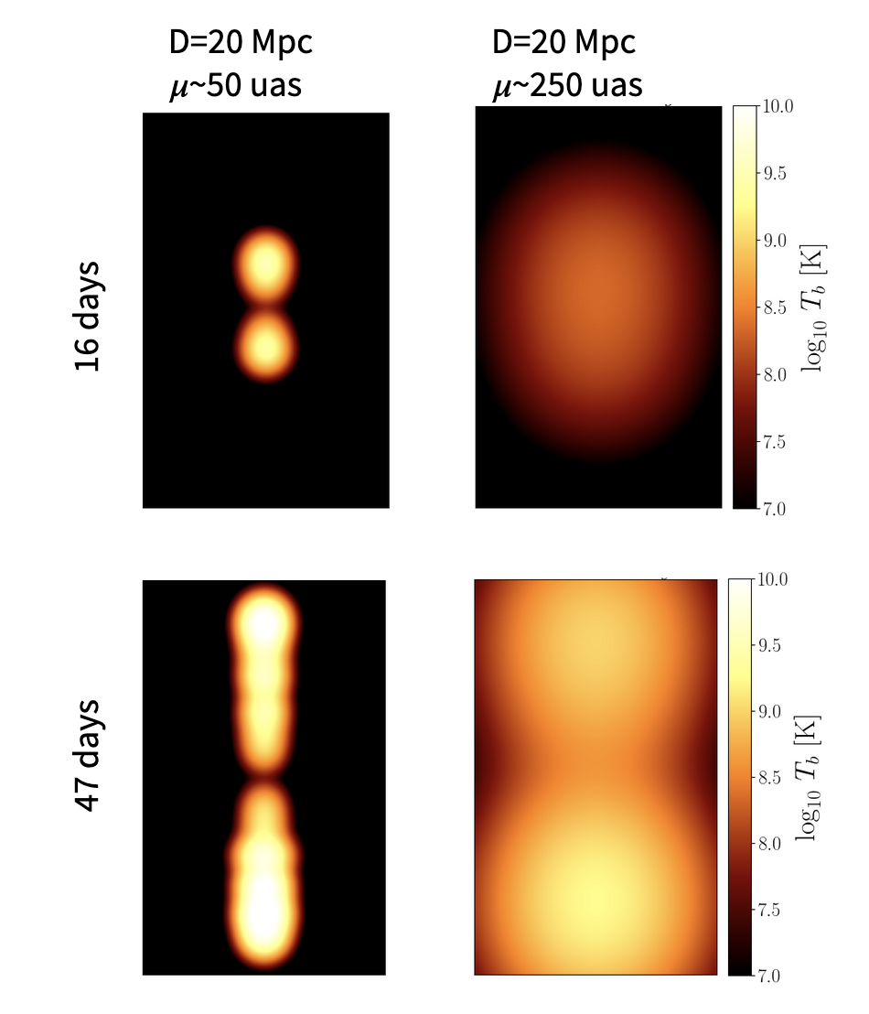
Curd et al. 2022
M_{BH}=10⁷ M_{Sun}
~11-25 times Eddington
Radiation + Poynting accelerated jets
Shock at jet head; Internal shocks from variable ejections of material
Simulation evolved for 48 days
Ray-traced images

