Slide 1
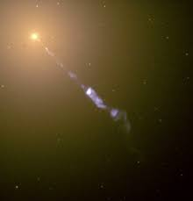
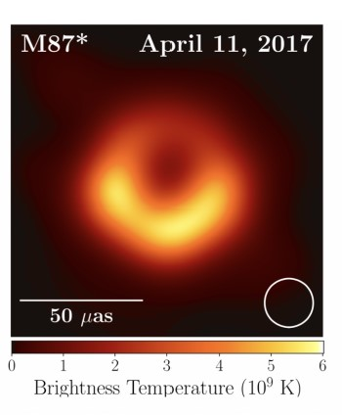
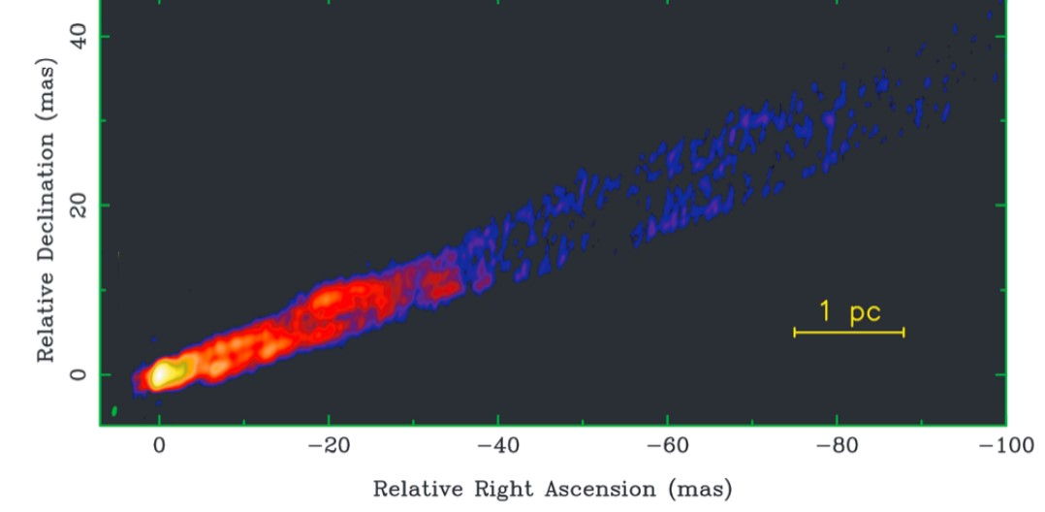
Joaquin Duran
Personal Highlights
First Gen
Movie Junkie
Amateur pianist
Bartender on the weekend
Research Highlights
Part of the EHT team at UTSA
Which will focus on the On the Comparison of AGN with GRMHD Simulations in M87

