Slide 1
Unit I The Theory of Relativity Part I: Classical Physics & Math Methods PHYS 7903/AST 4953 – General Relativistic MHD
Richard anantua
Notes:
1/18/23

Slide 2
Course logistics – SPRING 2023 AST 4953/PHY 7903 General RelativiSTIC MHD
Instructor: Richard Anantua (richard.anantua@utsa.edu)
Days and time: MW 1p-2:15p at Peter T. Flawn Building 2.01.02
Office Hours: By appointment
Materials: Interstellar, Modern Classical Physics by Kip Thorne and Roger Blandford; Optional: The Science of Interstellar by Kip Thorne
Syllabus: Search this course in AST subject on https://bluebook.utsa.edu/ or here:
https://drive.google.com/file/d/1Ji2KDP4fz-g3PHPGcfoba1gSTMYSz20s/view?usp=sharing
Quizzes (30%): Quiz 1 2/20, Quiz 2 3/27
HWs (45%): HW1 1/30, HW2 2/6, HW3 2/13, HW4 2/27, HW5 3/6, HW6 3/20, HW7 4/3, HW8 4/10, HW 9 4/17
Final Presentation (15%): 4/24-5/1
Participation (10%): All day, every day (hopefully)
Notes:
1/23/23

Slide 3
Confessions of an Einstein denier (Group activity)
With a partner, edit the Preamble from http://www.relativityoflight.com/

Slide 4
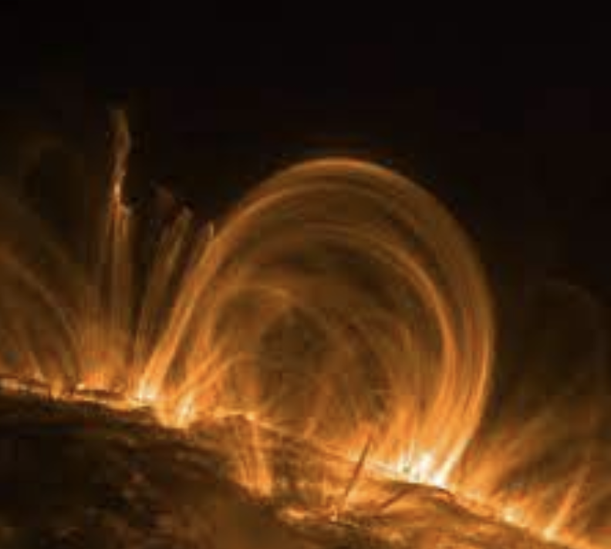
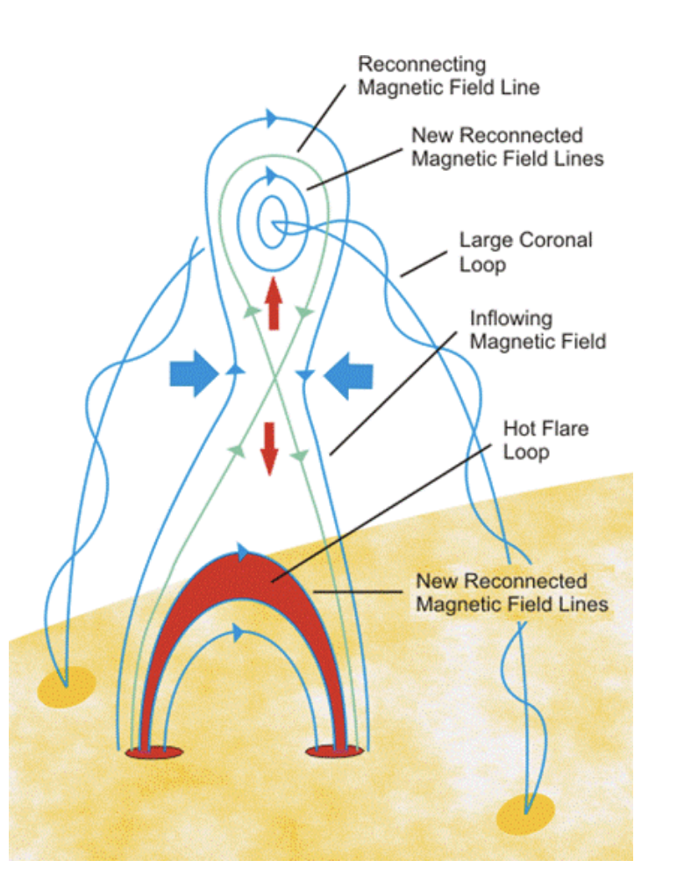
Examples of GRMHD
Solar corona
Notes:
https://suli.pppl.gov/2017/course/Loureiro.pdf
https://progearthplanetsci.springeropen.com/articles/10.1186/s40645-016-0084-7
The solar corona satisfies the low- β plasma condition (β= 0.01–0.1) (Gary 2001) in which the magnetic energy dominates that of the coronal plasma, solar flares are widely considered to be a manifestation of the conversion of the magnetic energy of the solar corona into kinetic and thermal energy, culminating in the release of high-energy particles and electromagnetic radiation

Slide 5
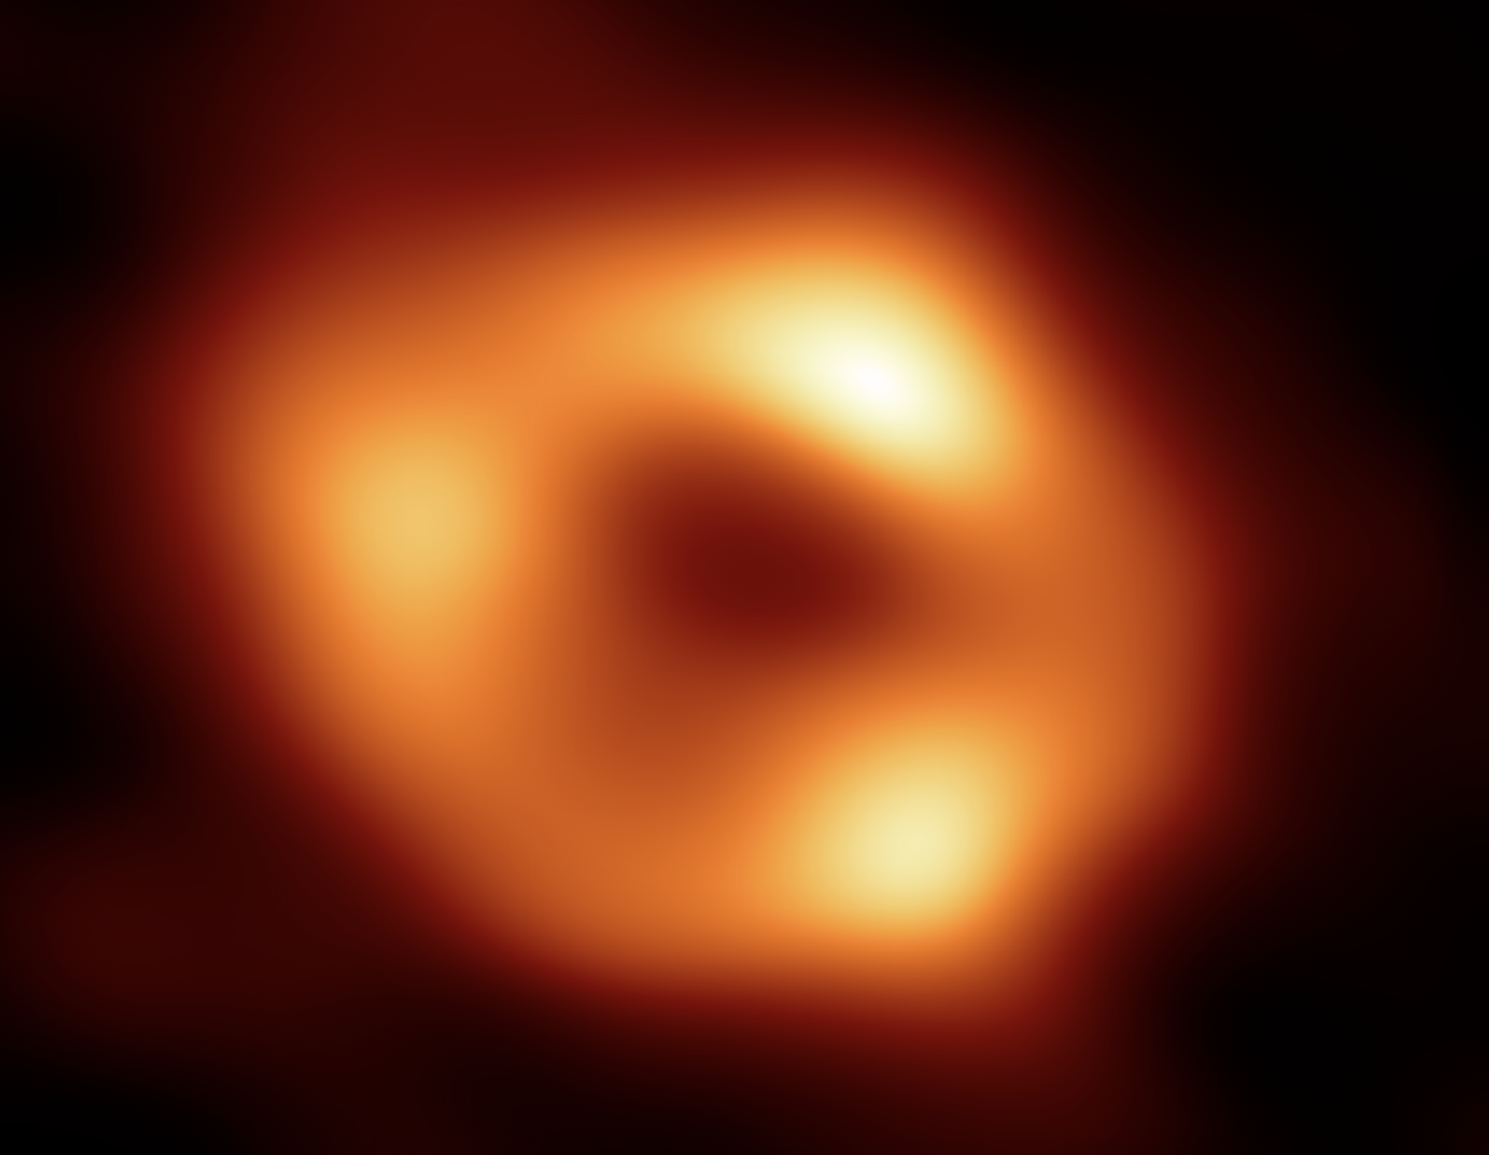
Examples of GRMHD
Solar corona
Supermassive black hole near horizon

Slide 6
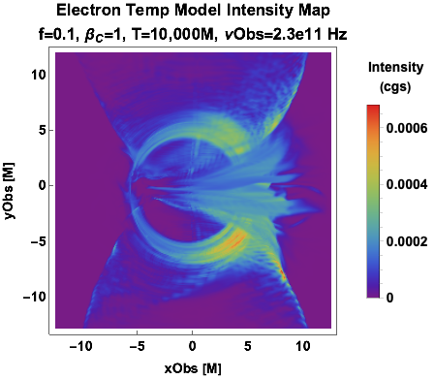
Examples of GRMHD
Solar corona
Supermassive black hole near horizon
GRMHD simulation

Slide 7
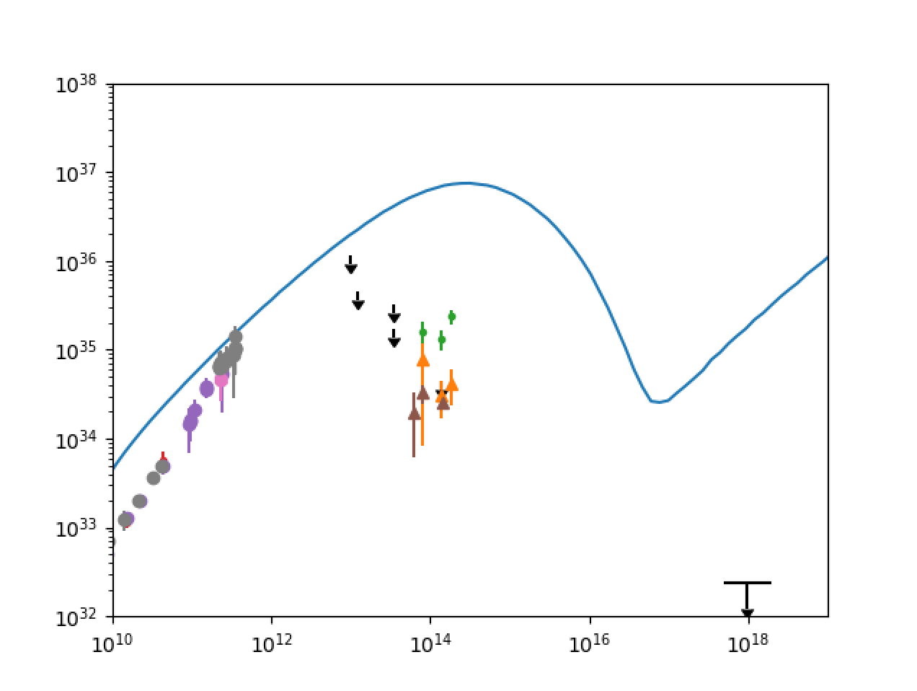
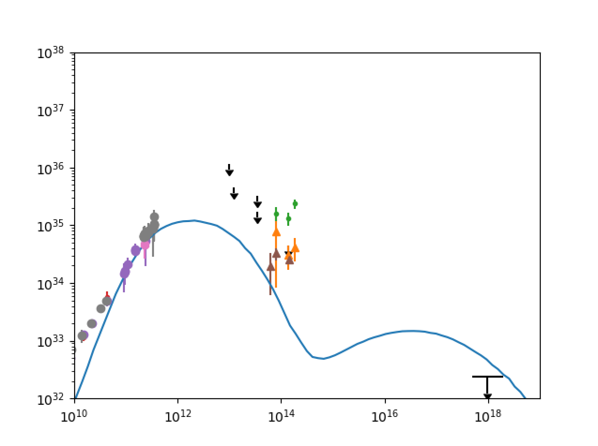
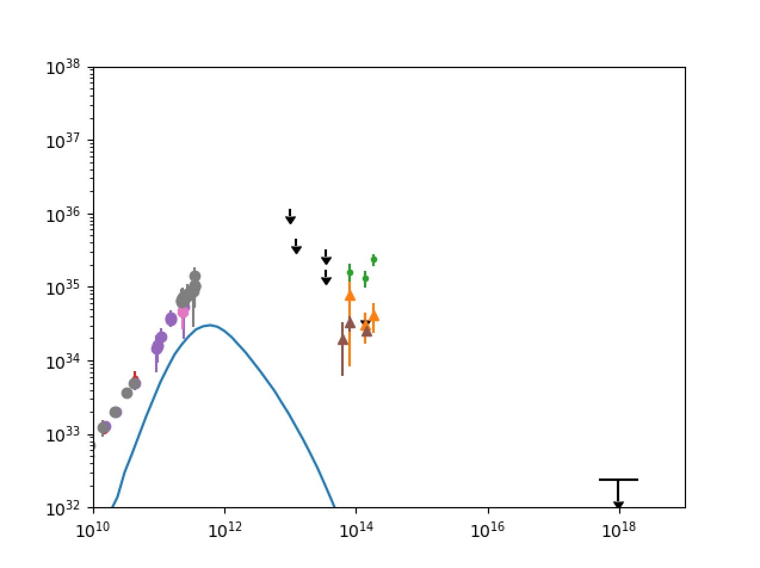
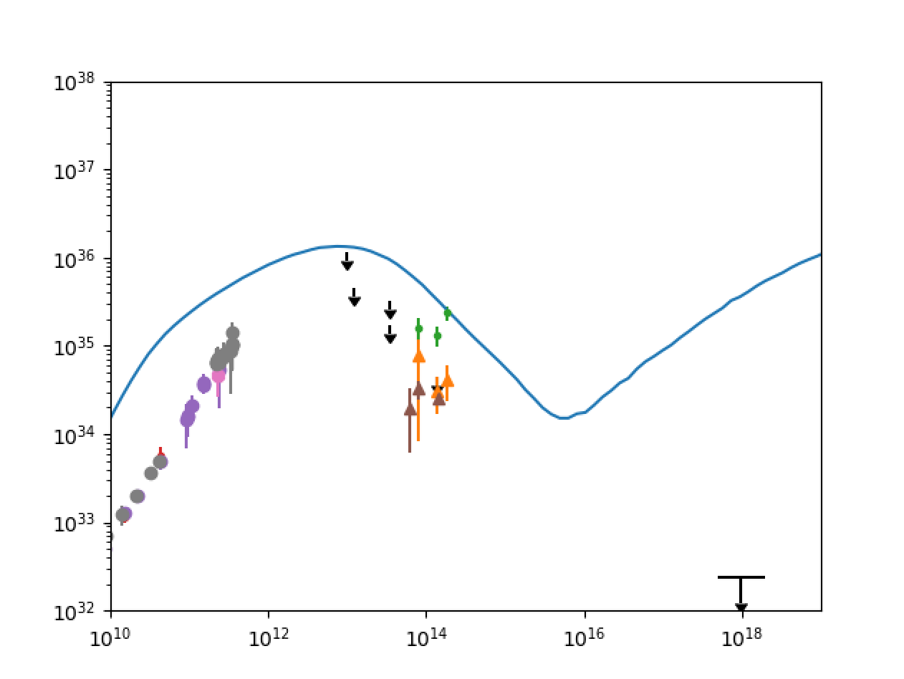
Examples of GRMHD: Sgr A* Model Classification
ARQ20 Model Movies
Tobs=10,000M,10,100M,…,11,000M
Type III- Thick Photon Torus;
spectral excesses at
low and high frequency
Type I - Thin, Compact, Asymmetric Photon Ring/Crescent; best fit spectrum
Type IV - Extended Outflow; spectral excesses at
low and high frequency and flat low frequency knee
Type II - Inflow-Outflow Boundary + Thin Photon Ring; steep spectrum
Notes:
Sgr A*’s dynamical timescales of minutes as opposed to days have thus far prevented its direct sub-mm image reconstruction
The analysis of the Electron Temperature and Beta and Bias Model parameter space presented here reveals that models aggregate into roughly four distinct types:
I. Thin, compact asymmetric photon ring/crescent
II. Inflow-outflow boundary + thin photon ring
III. Thick photon torus
IV. Extended outflow
The image classification above is also correlated with a spectral classification
The images variation on hourly timescales does not greatly deviate from these time-averaged images
Our favored model for Sgr A* is Type I

Slide 8
Math methods – Single-Variable calculus
Function | Derivative | Integral
$$sin(x)$$ | $$cos\left(x\right)$$ | $$?$$
$$x^{n}, n≠−1$$ | $$?$$ | $$\frac{x^{n+1}}{n+1}+C$$
$$1/x$$ | $$−1/x^{2}$$ | $$?$$
$$?$$ | $${ae}^{ax}$$ | $$(1/a)e^{ax}+C$$
Useful derivatives and integrals:
Hint: Chain Rule for differentiating f(u(x)) with respect to x
.
.
$$\frac{df}{dx}=\frac{df}{du}\frac{du}{dx}=f^{′}\left(u\right)u′(x)$$
Notes:
1/25/23

Slide 9
Math methods – Single-Variable calculus
Function | Derivative | Integral
$$sin(x)$$ | $$cos\left(x\right)$$ | $$−cos\left(x\right)+C$$
$$x^{n}, n≠−1$$ | $$nx^{n−1}$$ | $$\frac{x^{n+1}}{n+1}+C$$
$$1/x$$ | $$−1/x^{2}$$ | $$ln\left(x\right)+C$$
$$e^{ax}$$ | $${ae}^{ax}$$ | $$(1/a)e^{ax}+C$$
Useful derivatives and integrals:
Taylor’s Theorem: A function $f(x)$ k-times differentiable at $x=a$ can be expanded as a series (with vanishing remainder as $x→a$)
TERMINOLOGY: A MacLaurin series is the Taylor expansion of a function $f(x)$ about $x=0$
Exercise: Write the MacLaurin series for $f\left(x\right)=e^{x}$
$$f\left(x\right)≈f\left(a\right)+f^{′}\left(a\right)\left(x−a\right)+\frac{1}{2}f′′(a)({x−a)}^{2}+…+\frac{f^{\left(k\right)}\left(a\right)}{k!}({x−a)}^{k}$$

Slide 10
Math methods – Single-Variable calculus
Function | Derivative | Integral
$$sin(x)$$ | $$cos\left(x\right)$$ | $$−cos\left(x\right)+C$$
$$x^{n}, n≠−1$$ | $$nx^{n−1}$$ | $$\frac{x^{n+1}}{n+1}+C$$
$$1/x$$ | $$−1/x^{2}$$ | $$ln\left(x\right)+C$$
$$e^{ax}$$ | $${ae}^{ax}$$ | $$(1/a)e^{ax}+C$$
Useful derivatives and integrals:
Taylor’s Theorem: A function $f(x)$ k-times differentiable at $x=a$ can be expanded as a series (with vanishing remainder as $x→a$)
TERMINOLOGY: A MacLaurin series is the Taylor expansion of a function $f(x)$ about $x=0$
Exercise: Write the MacLaurin series for $f\left(x\right)=e^{x}$
$$f\left(x\right)≈f\left(a\right)+f^{′}\left(a\right)\left(x−a\right)+\frac{1}{2}f′′(a)({x−a)}^{2}+…+\frac{f^{\left(k\right)}\left(a\right)}{k!}({x−a)}^{k}$$
$$e^{x}=\frac{x^{n}}{n!}=1+x+\frac{x^{2}}{2}+\frac{x^{3}}{3!}…$$

Slide 11
Icebreaker – Physics 2 truths and a lie
Make 2 true statements and 1 false statement
1 statement must be about yourself
1 statement must be about your home institution
1 statement must be about physics

Slide 12
Math methods – ordinary differential equations
Differential equations relate functions and their derivatives
We can directly solve some differential equations by methods such as
Integration
Separation of variables
.
$$f^{′}\left(x\right)=\frac{df}{dx}=\frac{1}{x}$$
$$⇒f\left(x\right)=\ln{x}+C$$
$$⇒\int{\frac{dy}{y}=\int{x^{2}}dx⇒\ln{y}}=\frac{x^{3}}{3}+C⇒y=e^{\frac{x^{3}}{3}+C}$$
$$\frac{dy}{dx}=x^{2}y$$

Slide 13
Math methods – ordinary differential equations
Differential equations relate functions and their derivatives
We can directly solve some differential equations by methods such as
integration
Separation of variables
For many differential equations, the simplest method of solution is making a guess, or ansatz
$$f^{′}\left(x\right)=\frac{df}{dx}=\frac{1}{x}$$
$$⇒f\left(x\right)=\ln{x}+C$$
$$⇒\int{\frac{dy}{y}=\int{x^{2}}dx⇒\ln{y}}=\frac{x^{3}}{3}+C⇒y=e^{\frac{x^{3}}{3}+C}$$
$$\frac{dy}{dx}=x^{2}y$$

Slide 14
Math methods – partial differential equations; boundary conditions
Wave PDE:
Ansatz??
$$\frac{∂^{2}f}{∂x^{2}}=\frac{1}{v^{2}}\frac{∂^{2}f}{∂t^{2}}$$

Slide 15
Math methods – partial differential equations; boundary conditions
Wave PDE:
Ansatz: Works when f₋ and f₊ are any differentiable functions!
$$\frac{∂^{2}f}{∂x^{2}}=\frac{1}{v^{2}}\frac{∂^{2}f}{∂t^{2}}$$
$$f=f_{+}(x+vt)+f_{−}\left(x−vt\right)$$

Slide 16
Math methods – partial differential equations; boundary conditions
Wave PDE:
Ansatz: Works when f₋ and f₊ are any differentiable functions!
But WAIT
With Periodic Boundary Conditions:
Solution given by
$$\frac{∂^{2}f}{∂x^{2}}=\frac{1}{v^{2}}\frac{∂^{2}f}{∂t^{2}}$$
$$f=f_{+}(x+vt)+f_{−}\left(x−vt\right)$$
$$f\left(mλ,0\right)=A=f\left(0,nT\right), m,n∈ℤ$$
$$f\left(x,t\right)=A\cos\left(k(x±vt)\right)=A\cos\left(\frac{2π}{λ}x±\frac{2π}{T}t\right)$$

Slide 17
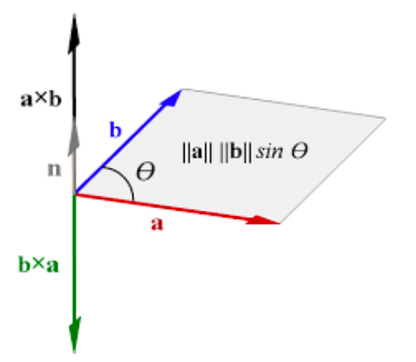
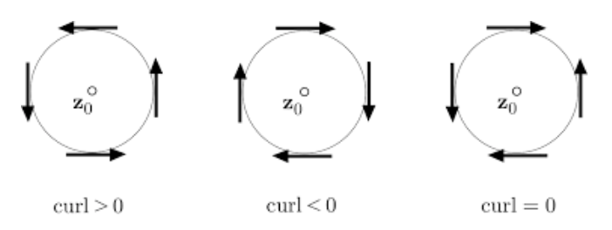
Math methods – multivariate calculus
Vectors in 3D may be multiplied using
Dot product:
Cross product:
A vector field F(x,y,z) is specified by assigning a vector to each point in space. At each point we may calculate
Divergence (whether the vector field looks like a source or a sink)
Curl (whether a paddlewheel would rotate in the vector field)
$$\vec{a}∙\vec{b}=a_{x}b_{x}+a_{y}b_{y}+a_{z}b_{z}=ab\cos{θ}$$
$$\vec{a}×\vec{b}=(a_{y}b_{z}−{b_{y}a}_{z})\hat{x}+(a_{z}b_{x}−{b_{z}a}_{x})\hat{y}+(a_{x}b_{y}−{b_{x}a}_{y})\hat{z}$$
$$\vec{∇}∙\vec{F}=\frac{∂F_{x}}{∂x}+\frac{∂F_{y}}{∂y}+\frac{∂F_{z}}{∂z}$$
$$\vec{∇}×\vec{F}=\left[\begin{matrix}\frac{∂F_{z}}{∂y}−\frac{∂F_{y}}{∂z} \\ \frac{∂F_{x}}{∂z}−\frac{∂F_{z}}{∂x} \\ \frac{∂F_{y}}{∂x}−\frac{∂F_{y}}{∂x}\end{matrix}\right]$$
For these xy-plane vector fields, the sign of the z-component of the curl is given
z
z
z
Notes:
https://commons.wikimedia.org/wiki/File:Cross-product-with-area.svg
https://ltcconline.net/greenl/courses/202/vectorIntegration/divergenceTheorem.htm
https://www.google.com/url?sa=i&rct=j&q=&esrc=s&source=images&cd=&ved=0ahUKEwiq0vT70_PUAhVM3GMKHXvOBpYQjhwIBQ&url=https%3A%2F%2Fmath.stackexchange.com%2Fquestions%2F1054132%2Fcurl-vector-what-exactly-is-rotating&psig=AFQjCNHobNRyMP6BpLT1T3StbEeDcRMwTw&ust=1499395359996385&cad=rjt

Slide 18
Math methods – multivariate calculus
Gauss’ Theorem
Green’s Theorem
Stokes’ Theorem
The integral of the divergence
of a vector field in a volume
equals the flux going through
its surface
The integral of the curl of a vector field
on a surface D on the xy-plane equals
the line integral of the vector field
on the boundary of D
Generalization of Green’s theorem to
arbitrary surfaces

Slide 19
Review of electromagnetism – Maxwell’s equations
Maxwell’s equations:
$$\vec{∇}∙\vec{E}=\frac{ρ}{ε_{0}}$$
Gauss’s Law
Gauss’s Law
for Magnetism
$$\vec{∇}∙\vec{B}=0$$
$$\vec{∇}×\vec{E}=−\frac{∂\vec{B}}{∂t}$$
Faraday’s Law
$\vec{∇}×\vec{B}=μ_{0}\vec{j}+μ_{0}ε_{0}\frac{∂\vec{E}}{∂t}$
Ampère Law
Notes:
1/30/23

Slide 20
Review of electromagnetism – Maxwell’s equations
Exercise: Rewrite Maxwell’s equations in integral form
$$\vec{∇}∙\vec{E}=\frac{ρ}{ε_{0}}$$
Gauss’s Law
Gauss’s Law
for Magnetism
$$\vec{∇}∙\vec{B}=0$$
$$\vec{∇}×\vec{E}=−\frac{∂\vec{B}}{∂t}$$
Faraday’s Law
$\vec{∇}×\vec{B}=μ_{0}\vec{j}+μ_{0}ε_{0}\frac{∂\vec{E}}{∂t}$
Ampère Law

Slide 21
Review of electromagnetism – Maxwell’s equations
Exercise: Rewrite Maxwell’s equations in integral form
Differential Form Integral Form
$$\vec{∇}∙\vec{E}=\frac{ρ}{ε_{0}}$$
$$∯{\vec{E}∙d\vec{A}}=\frac{Q_{enc}}{ε_{0}}$$
Gauss’s Law
Gauss’s Law
for Magnetism
$$\vec{∇}∙\vec{B}=0$$
$∯{\vec{B}∙d\vec{A}}=0$
$$\vec{∇}×\vec{E}=−\frac{∂\vec{B}}{∂t}$$
$$\oint{\vec{E}∙d\vec{l}}=−\frac{∂Φ_{B}}{∂t}$$
Faraday’s Law
$\vec{∇}×\vec{B}=μ_{0}\vec{j}+μ_{0}ε_{0}\frac{∂\vec{E}}{∂t}$
$$\oint{\vec{B}∙d\vec{l}}={μ_{0}I}_{enc}+μ_{0}ε_{0}\frac{∂Φ_{E}}{∂t}$$
Ampère Law

Slide 22
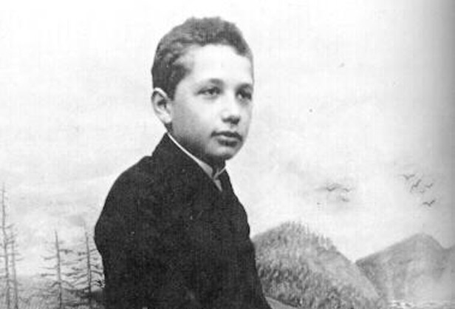
Before Relativity
Classical mechanics – fields and point particles in absolute space and time with “action at a distance”
Newton’s law of universal gravitation where G=6.67x10⁻¹¹Nm²kg⁻²
Dynamics: Newton’s laws of motion (inertia, $\sum_{i}{{\vec{F}}_{i}}=m\vec{a}$, action-reaction)
Electromagnetism – fields and charged point particles
Electrostatics: Coulomb’s law with Coulomb constant k=8.99x10⁹Nm²C⁻²
Magnetostatics: Magnetic force on moving charges in B field
Dynamics: Maxwell’s equations
M₁
M₂
r₁-r₂
$\vec{Fg}1 on{2}=G\frac{M1M2}{r2}$ $\frac{\vec{r}1−\vec{r}2}{|\vec{r}1−\vec{r}2|}$
r₂-r₁
$\vec{Fe}1 on{2}=k\frac{Q1Q2}{r2}$ $\frac{\vec{r}2−\vec{r}1}{|\vec{r}1−\vec{r}2|}, k=\frac{1}{4πε_{0}}$
Q₁
Q₂
$$\vec{F}B=q\vec{v}×\vec{B}$$
$$\vec{F}B$$
$$\vec{v}$$
$$\vec{B}$$
$$×$$
q
Notes:
Einstein-1894
http://nerdywithchildren.com/what-was-albert-einstein-like-as-a-kid/

Slide 23
Review of Classical mechanics – newtonian gravity
Newton’s Law of Universal Gravitation
Gravitational Potential Energy
Kinetic Energy
Taking M₂ = m to be a unit mass, the gravitational potential (P.E. per unit mass) and field (force per unit mass) due to M₁ = M are:
$\vec{F}1 on{2}=\frac{GM1M2}{r2}$ $\frac{\vec{r}1−\vec{r}2}{|\vec{r}1−\vec{r}2|}$
M₁
r₁-r₂
M₂
$$Ug=−\frac{GM1M2}{|\vec{r}1−\vec{r}2|}$$
$KE=\frac{mv^{2}}{2}=\frac{p^{2}}{2m}$, $p$=$mv$
$$Φ_{g}=−\frac{GM}{r}$$
$$\vec{g}=−\frac{GM}{r2}\hat{r}$$
Gravitational Potential
Gravitational Field

Slide 24
Review of Classical mechanics – newtonian gravity
Potentially useful constants: M_{E}=5.98x10²⁴kg, M_{S}=1.99x10³⁰kg, r_{ES}=1.50x10¹¹m, R_{E}=6.37x10⁶m, R_{S}=6.96x10⁸m, G=6.67x10⁻¹¹Nm²/kg²
EXERCISE: What is the gravitational potential energy binding the Earth to the Sun?
EXERCISE: What is the kinetic energy of Earth orbiting the Sun?

Slide 25
Review of Classical mechanics – newtonian gravity
Potentially useful constants: M_{E}=5.98x10²⁴kg, M_{S}=1.99x10³⁰kg, r_{ES}=1.50x10¹¹m, R_{E}=6.37x10⁶m, R_{S}=6.96x10⁸m, G=6.67x10⁻¹¹Nm²/kg²
EXERCISE: What is the gravitational potential energy binding the Earth to the Sun?
EXERCISE: What is the kinetic energy of Earth orbiting the Sun?
$$U_{g}=−\frac{6.67×10^{−11}\frac{N m^{2}}{{kg}^{2}}∙5.98×10^{24}kg∙1.99×10^{30}kg}{1.50×10^{11}m}=−5.29×10^{33}J$$
$$KE=\frac{1}{2}∙5.98×10^{24}kg{\left(\frac{2π∙1.50×10^{11}m}{365.25∙24∙60∙60 s}\right)}^{2}=2.67×10^{33}J$$

Slide 26
Review of math Methods and Classical Physics
Linear differential equations
Wave equations
Classical mechanics and electromagnetism

Slide 27
energy of fields and particles in Classical physics (Group Activity)
What is the kinetic energy of Earth orbiting the Galactic Center if v_{E,GC}=2.0x10⁵m/s?
What is the time-averaged energy density u of an electromagnetic wave with $\vec{E}={\vec{E}}_{0}\cos{(kx−ωt)}$, ${\vec{B}}_{0}=\frac{1}{c}{\vec{E}}_{0}$, $\vec{E}⊥\vec{B}$ and Poynting flux (power per unit area) $\vec{S}=\frac{1}{μ_{0}}\vec{E}×\vec{B}$? Hint: Relate units of u and S. Average over a period T.
By analogy, what is the potential energy density stored in a gravitational field?
What is the potential energy stored in the gravitational field of Earth ($ρ$ =5500kg/m³ )? Hint: Consider volume contributions from concentric shells.
Notes:
Gravitational energy density is negative since it binds particles (which require energy to escape) in contrast to EM radiation energy density, which imparts outward radiation pressure

Slide 28
energy of fields and particles in Classical physics (Group Activity)
What is the kinetic energy of Earth orbiting the Galactic Center if v_{E,GC}=2.0x10⁵m/s?
What is the time-averaged energy density u of an electromagnetic wave with $\vec{E}={\vec{E}}_{0}\cos{(kx−ωt)}$, ${\vec{B}}_{0}=\frac{1}{c}{\vec{E}}_{0}$, $\vec{E}⊥\vec{B}$ and Poynting flux (power per unit area) $\vec{S}=\frac{1}{μ_{0}}\vec{E}×\vec{B}$? Hint: Relate units of u and S. Average over a period T.
By analogy, what is the potential energy density stored in a gravitational field?
Interchanging $\vec{E}↔\vec{g}$ and $\frac{1}{4πε_{0}}↔−G,$
What is the potential energy stored in the gravitational field of Earth ($ρ$ =5500kg/m³ )? Hint: Consider volume contributions from concentric shells.
$${KE}_{GC}=\frac{1}{2}M_{E}{v_{E,GC}}^{2}=\frac{1}{2}∙5.98×10^{24}kg∙({2.0×10^{5}m/s)}^{2}=1.2×10^{35}J$$
$$u=\frac{〈S〉t}{c}=\frac{1}{cT}\int_{0}^{T}{\frac{E_{0}^{2}}{μ_{0}c}\cos^{2}{(kx−ωt)dt}}=\frac{E_{0}^{2}}{μ_{0}c2T}\int_{0}^{T}{\frac{1+cos{(2\left(kx−ωt\right))}}{2}dt}={\frac{E_{0}^{2}}{{2μ}_{0}c2T}\left[t−\frac{1}{2ω}\sin{(2\left(kx−ωt\right))}\right]}_{t=0}^{T}=\frac{E_{0}^{2}}{{2μ}_{0}c2}$$
$u=\frac{E_{0}^{2}}{{2μ}_{0}c^{2}}=\frac{B_{0}^{2}}{{2μ}_{0}}=\frac{{ε_{0}E}_{0}^{2}}{2}$ $⟹u_{grav}=−\frac{g^{2}}{8πG}$
$$U_{grav}=\int{u_{grav}dV}=−\frac{1}{8πG}\int_{0}^{R_{E}}{{\left(\frac{G\frac{4π}{3}r^{3}ρ}{r^{2}}\right)}^{2}4πr^{2}dr}−\frac{1}{8πG}\int_{R_{E}}^{∞}{{\left(\frac{G\frac{4π}{3}{R_{E}}^{3}ρ}{r^{2}}\right)}^{2}4πr^{2}dr=−\frac{8π^{2}}{45}Gρ^{2}{R_{E}}^{5}−\frac{8π^{2}}{9}Gρ^{2}{R_{E}}^{5}}=−\frac{16π^{2}}{15}Gρ^{2}{R_{E}}^{5}$$
$=−\frac{16π^{2}}{15}6.67×10^{−11}\frac{N m^{2}}{{kg}^{2}}{\left(5500\frac{kg }{m^{3}}\right)}^{2}{\left(6.38×10^{6}m\right)}^{5}=−2.2×10^{32}J$
Notes:
Gravitational energy density is negative since it binds particles (which require energy to escape) in contrast to EM radiation energy density, which imparts outward radiation pressure

