Slide 1
Unit I The Theory of Relativity Part iII: General Relativity And Applications PHYS 7903/AST 4953 – General Relativistic MHD
Richard anantua
Notes:
Unit I is the buildup to GR

Slide 2
General theory of relativity
Einstein sought to extend his 1905 special theory of relativity to include non-inertial (accelerating) frames
In strong gravitational fields, such as near black holes or neutron stars, classical+special relativistic predictions for lengths, times, frequencies, energy, etc. fail
In a 1915 lecture at the Prussian Academy of Sciences in Berlin, Einstein unified gravity with special relativity in the general theory of relativity
Notes:
https://www.youtube.com/watch?v=VxYslttKJ1k

Slide 3
Black holes - history
In 1783 John Mitchell theorized that if a star’s radius is >500R_{Sun}, light could not escape it
In 1916, Karl Schwarszchild solved the Einstein field equations for the geometry outside a spherically symmetric, non-rotating mass
In 1963, Roy Kerr solved the Einstein field equations for the geometry outside a spherically symmetric, rotating mass
In the 1970’s, black hole temperature was theorized by Hawking, among others

Slide 4
Tests of relativity
Flying atomic clocks
Muon decay
Light bending around stars
LIGO’s gravitational wave detection

Slide 5
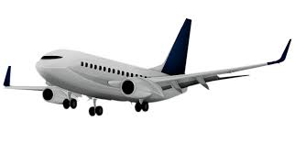
Flying atomic clocks (group activity)
$ω$
In 1971, Joseph Hafele and Richard Keating flew Cs atomic clocks around the world Eastward and Westward
Suppose there a master clock at the center C of the Earth that advances $Δτ$
Taylor expand the kinematic time dilation formula to 2nd order in velocity to find the time elapsed on
a.) The surface of the Earth ($ΔT$) _{SC}
b.) The Eastbound flight ($ΔT$) _{EC}
c.) The Westbound flight ($ΔT$) _{WC}
What is the time difference relative to the Earth’s surface for Eastbound and Westbound flights?
The kinematic time dilation contribution to time elapsed on flying clocks may take either sign. What signs may the gravitational contribution take?
Notes:
http://hyperphysics.phy-astr.gsu.edu/hbase/Relativ/airtim.html#c5

Slide 6
Flying atomic clocks (group activity)
$ω$
In 1971, Joseph Hafele and Richard Keating flew Cs atomic clocks around the world Eastward and Westward
Suppose there a master clock at the center C of the Earth that advances $Δτ$
Taylor expand the kinematic time dilation formula to 2nd order in velocity to find the time elapsed on
a.) The surface of the Earth ($ΔT$) _{SC}
b.) The Eastbound flight ($ΔT$) _{EC}
c.) The Westbound flight ($ΔT$) _{WC}
What is the time difference relative to the Earth’s surface for Eastbound and Westbound flights?
The kinematic time dilation contribution to time elapsed on flying clocks may take either sign. What signs may the gravitational contribution take?
$$({ΔT)}_{SC}≈\left(1+\frac{R^{2}ω^{2}}{{2c}^{2}}\right)Δτ$$
$$ΔT={\left(1−\frac{v^{2}}{c^{2}}\right)}^{−1/2}Δτ≈\left(1+\frac{1}{2c^{2}}v^{2}\right)Δτ⇒$$
$$({ΔT)}_{EC}≈\left(1+\frac{\left(v+Rω\right)2}{{2c}^{2}}\right)Δτ$$
$$({ΔT)}_{WC}≈\left(1+\frac{\left(v−Rω\right)2}{{2c}^{2}}\right)Δτ$$
$$({ΔT)}_{EC}−({ΔT)}_{SC}≈\left(\frac{2Rωv+v^{2}}{{2c}^{2}}\right)Δτ, ({ΔT)}_{WC}−({ΔT)}_{SC}≈\left(\frac{−2Rωv+v^{2}}{{2c}^{2}}\right)Δτ$$
Positive, since clocks flying at high altitude run faster in the weaker gravitational field relative to the surface
Notes:
http://hyperphysics.phy-astr.gsu.edu/hbase/Relativ/airtim.html#c5

Slide 7
Flying atomic clocks
$ω$
In 1971, Joseph Hafele and Richard Keating flew Cs atomic clocks around the world Eastward and Westward
The results of the experiment (Hafele and Keating, 1972) were:
Notes:
https://en.wikipedia.org/wiki/Hafele%E2%80%93Keating_experiment
Clocks tick faster in the weaker gravitational field while airborne, thus gaining ns
Clocks move faster relative to the Center of Earth moving Eastward, thus losing ns
Clocks move slower relative to the Center of Earth moving Westward, thus gaining ns

Slide 8
Muon decay
Exercise: In 1977 at CERN, muons (specifically $μ$⁺ particles) were accelerated to v/c=0.9994 in a 14m circumference storage ring. If a muon’s lifetime (before decaying into positrons and neutrinos) at rest is $τ$=2.2x10⁻⁶s, what does special relativity predict is the expected lifetime T of the boosted muon?
Notes:
Hartle p. 64

Slide 9
Muon decay
Exercise: In 1977 at CERN, muons (specifically $μ$⁺ particles) were accelerated to v/c=0.9994 in a 14m circumference storage ring. If a muon’s lifetime (before decaying into positrons and neutrinos) at rest is $τ$=2.2x10⁻⁶s, what does special relativity predict is the expected lifetime T of the boosted muon?
$$T=γτ=\frac{τ}{\sqrt{1−v^{2}/c^{2}}}=\frac{2.2∙{10}^{−6}}{\sqrt{1−{(0.9994)}^{2}}}s=6.4∙{10}^{−5}s$$
Notes:
Hartle p. 64

Slide 10
Muon decay
Exercise: In 1977 at CERN, muons (specifically $μ$⁺ particles) were accelerated to v/c=0.9994 in a 14m circumference storage ring. If a muon’s lifetime (before decaying into positrons and neutrinos) at rest is $τ$=2.2x10⁻⁶s, what does special relativity predict is the expected lifetime T of the boosted muon?
The experimentally (Bailey et al. 1977) measured lifetimes were related as
$$T=γτ=\frac{τ}{\sqrt{1−v^{2}/c^{2}}}=\frac{2.2∙{10}^{−6}}{\sqrt{1−{(0.9994)}^{2}}}s=6.4∙{10}^{−5}s$$
$$\frac{TExp }{γτExp }=1+({9±2)∙10}^{−4}$$
Notes:
Hartle p. 64

Slide 11
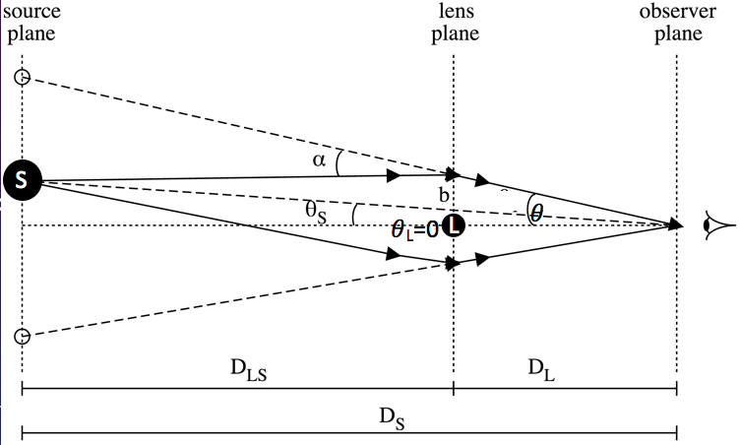
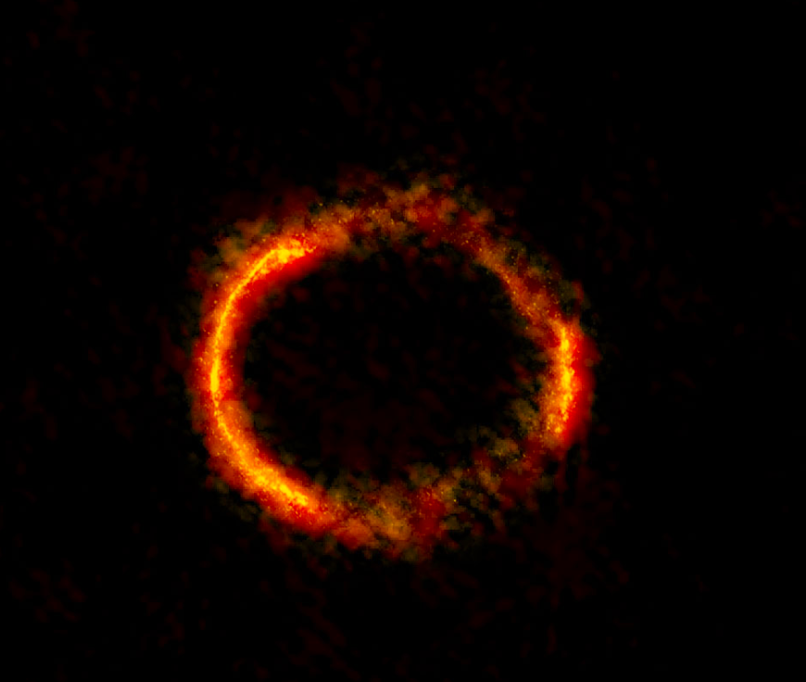
Light bending around stars – astromeric microlensing
In astrometric microlensing, light from a source at D_{s} is deflected by a gravitationally lensing star of mass M at D_{L} into at least 2 images
and possibly Einstein ring of angular width
L
$$θ_{E}=\sqrt{\frac{4GM}{c^{2}D_{r}}},{ D}_{r}≈{\left(\frac{1}{D_{S}}−\frac{1}{D_{L}}\right)}^{−1}=\frac{{D_{S}D}_{L}}{D_{S}−D_{L}}$$
Einstein ring of gravitationally lensed galaxy SDP 81. Courtesy of ALMA (NRAO/ESO/NAOJ); B. Saxton NRAO/AUI/NSF
Notes:
https://owlcation.com/stem/Exoplanet-Detection-Methods
PPN Parameters
https://en.wikipedia.org/wiki/Einstein_ring
Gravitational mirror

Slide 12
Light bending around stars – astromeric microlensing
In astrometric microlensing, light from a source at D_{s} is deflected by a gravitationally lensing star of mass M at D_{L} into at least 2 images
The deflection $α$ of light from the source rays in the absence of the lens is given by
L
$$α=δθ={ θ}_{E}\frac{\sqrt{{\left(\frac{ΔSLθ}{{ θ}_{E}}\right)}^{2}+4}−\frac{ΔSLθ}{{ θ}_{E}}}{2}, ΔSLθ=θ_{S}−θ_{L}$$
Notes:
https://owlcation.com/stem/Exoplanet-Detection-Methods
PPN Parameters
https://en.wikipedia.org/wiki/Einstein_ring
Gravitational mirror

Slide 13
Light bending around stars
Exercise: Read http://science.sciencemag.org/content/early/2017/06/06/science.aal2879.ful and determine which are the source and the lensing stars. Assume the lens is directly in front of the observer
to determine the angular deflection $α$ (in arc seconds (“)) of a source separated 0.5” from a lens resulting in Einstein radius 31 mas (where 1 mas = 1x10⁻³”). If $ΔSLθ→$ 0, how do source and image relate and what does the observer see?
$$α=δθ={ θ}_{E}\frac{\sqrt{{\left(\frac{ΔSLθ}{{ θ}_{E}}\right)}^{2}+4}−\frac{ΔSLθ}{{ θ}_{E}}}{2}, ΔSLθ=θ_{S}−θ_{L}$$
$$α=δθ={ θ}_{E}\frac{\sqrt{{\left(\frac{Δθ}{{ θ}_{E}}\right)}^{2}+4}−\frac{Δθ}{{ θ}_{E}}}{2},ΔSLθ=θ_{S}−θ_{L}$$
L
Notes:
https://owlcation.com/stem/Exoplanet-Detection-Methods
PPN Parameters
Gravitational mirror

Slide 14
Light bending around stars
Exercise: Read http://science.sciencemag.org/content/early/2017/06/06/science.aal2879.ful and determine which are the source and the lensing stars. Assume the lens is directly in front of the observer
to determine the angular deflection $α$ (in arc seconds (“)) of a source separated 0.5” from a lens resulting in Einstein radius 31 mas (where 1 mas = 1x10⁻³”). If $ΔSLθ→$ 0, how do source and image relate and what does the observer see?
See Problem Set
$$α=δθ={ θ}_{E}\frac{\sqrt{{\left(\frac{ΔSLθ}{{ θ}_{E}}\right)}^{2}+4}−\frac{ΔSLθ}{{ θ}_{E}}}{2}, ΔSLθ=θ_{S}−θ_{L}$$
$$α=δθ={ θ}_{E}\frac{\sqrt{{\left(\frac{Δθ}{{ θ}_{E}}\right)}^{2}+4}−\frac{Δθ}{{ θ}_{E}}}{2},ΔSLθ=θ_{S}−θ_{L}$$
L
Notes:
https://owlcation.com/stem/Exoplanet-Detection-Methods
PPN Parameters
Gravitational mirror

Slide 15
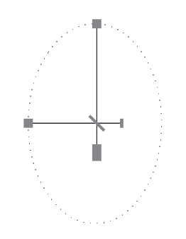
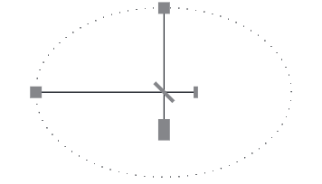
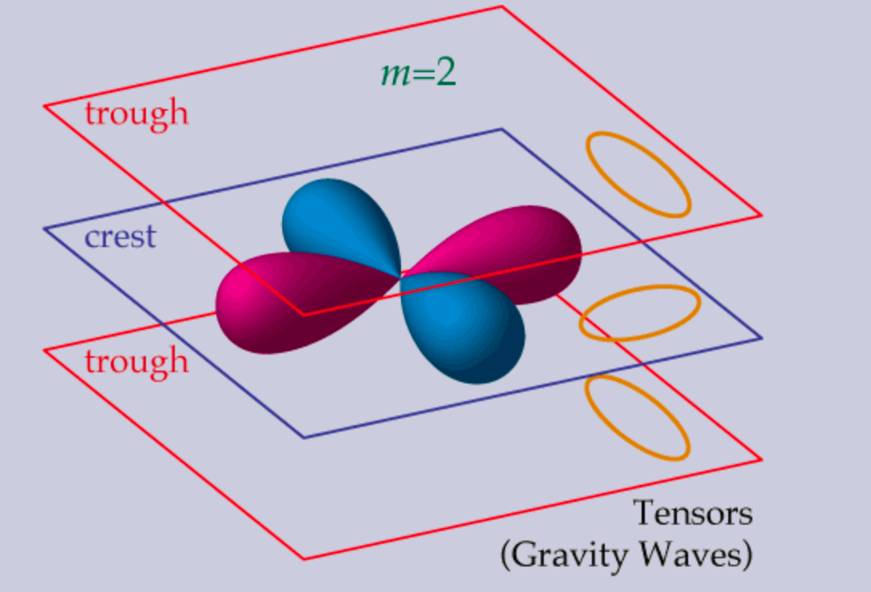
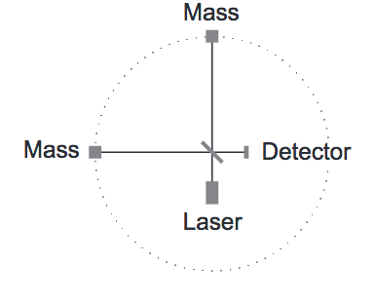
Gravitational waves
Gravitational waves are tensor perturbations ${\sim Y}_{l}^{m}$ in space distorting mass distributions in |m|=2 perpendicular directions
Notes:
http://background.uchicago.edu/~whu/polar/webversion/node6.html
http://eagle.phys.utk.edu/guidry/astro616/lectures/lecture_ch21.pdf

Slide 16
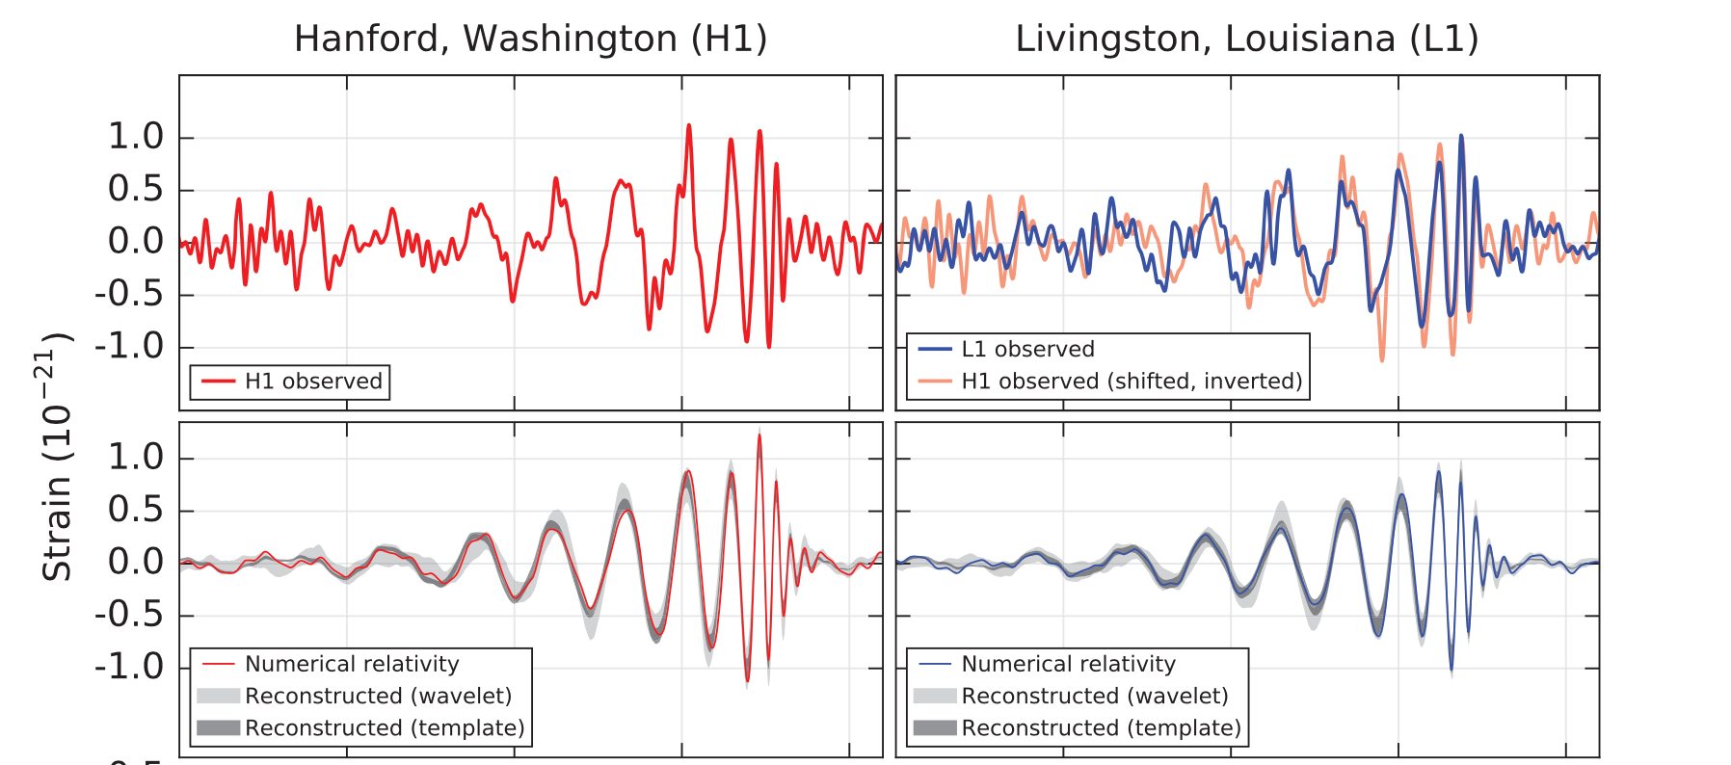
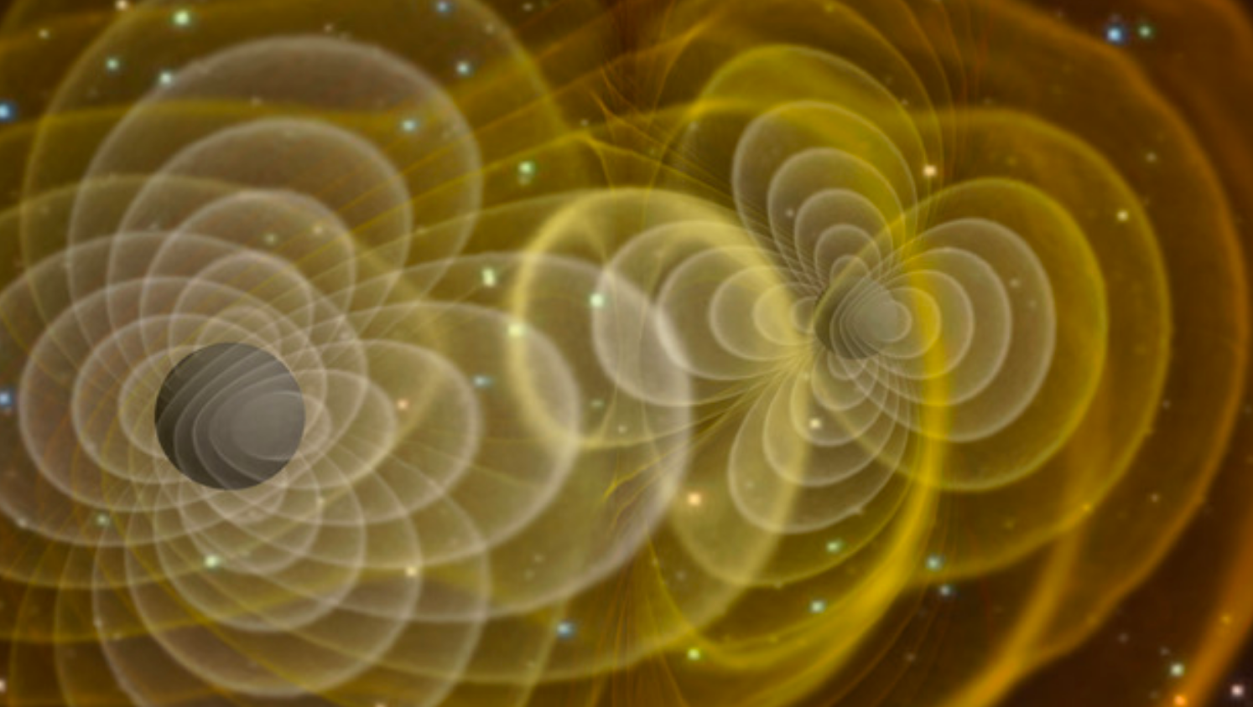
Gravitational waves
In 2015, the Laser Interferometer Gravitational-Wave Observer (LIGO) detected gravitational waves matching the general relativistic predicted signal due to a black hole merger:
https://journals.aps.org/prl/pdf/10.1103/PhysRevLett.116.061102
Detector
H1
Detector
L1
Notes:
https://www.ligo.caltech.edu/page/what-are-gw
https://www.quora.com/How-much-did-the-gravity-waves-detected-at-LIGO-stretch-space-A-micrometer
The strain measured by the LIGO interferometer in recent gravitational wave events was about 10−21, or one part in a sextillion. The LIGO tunnel is 4 kilometers in length, so the measured change in length is about 4×10−18 meters, or roughly 1/200th the size of a proton.

Slide 17
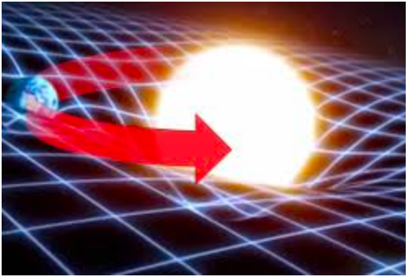
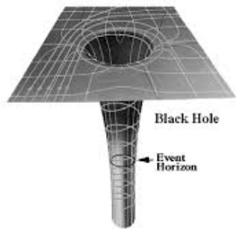
Strong gravity and black holes
We have seen that Einstein’s special relativity postulates can warp space and time
Can gravity warp spacetime as well?
Yes! Dense objects change the spacetime distance formula from flat space
STRONG gravity as one approaches singularity of infinite spacetime curvature
Singularity
Notes:
http://www.cosmotography.com/images/supermassive_blackholes_drive_galaxy_evolution.html
https://www.quora.com/Are-Black-Holes-actual-holes-or-spheres

Slide 18
Interstellar – 31:25-31:55
What theorized phenomenon could be what Romiley is describing?
Notes:
33:00 -> iTunes 31:30

Slide 19
Interstellar – gravitational anomaly
Interstellar Min 31:30 “gravitational anomaly”- mysterious disturbance of spacetime
Some of these “anomalies”– like the ones seen by Coop-- send ripples through space much like the gravitational waves discovered by LIGO
Some of these ”anomalies” parallel wormholes
Notes:
33:00 -> iTunes 31:30
With LIGP

Slide 20
Black holes - Theory
Objects launched from massive bodies will fall back unless their kinetic energy is at least the magnitude of the potential energy binding them to the object:
Note: The object’s mass m does not enter the escape speed
Exercise: Apply the escape speed condition to a massless photon traveling at the speed of light c to find the Schwarzschild radius $r_{S}$ , i.e., the radius in which M would have to be contained so that light cannot escape.
$$\vec{v}$$
$\frac{mv_{esc}^{ 2}}{2}$ = $\frac{GMm}{R}$
$$⇒v_{esc}^{ }=\sqrt{\frac{2GM}{R}}$$
m
M
R

Slide 21
Black holes - Theory
Objects launched from massive bodies will fall back unless their kinetic energy is at least the magnitude of the potential energy binding them to the object:
Note: The object’s mass m does not enter the escape speed
Exercise: Apply the escape speed condition to a massless photon traveling at the speed of light c to find the Schwarzschild radius $r_{S}$ , i.e., the radius in which M would have to be contained so that light cannot escape.
$\frac{mv_{esc}^{ 2}}{2}$ = $\frac{GMm}{R}$
$$⇒v_{esc}^{ }=\sqrt{\frac{2GM}{R}}$$
M
$$\text{c}$$
r_{S}
$$c=\sqrt{\frac{2GM}{R}}$$
${⇒r}_{S}$ $≡$ $R$= $\frac{2GM}{c^{2}}$

Slide 22
Review
Length contraction
Exercise: A circle of radius r=1 in its rest frame is boosted with $γ$=2. What is its area now?
Relativity of simultaneity
Whether two events are simultaneous depends on the state of motion of the observer
General relativity
Gravity can be viewed as spacetime curvature
Black holes form when sufficient mass is within Schwarzschild radius

Slide 23
Review
Length contraction
Exercise: A circle of radius r=1 in its rest frame is boosted with $γ$=2. What is its area now?
Relativity of simultaneity
Whether two events are simultaneous depends on the state of motion of the observer
General relativity
Gravity can be viewed as spacetime curvature
Black holes form when sufficient mass is within Schwarzschild radius
A=$π$ab
1
1
0.5
A=$π$
A=$π$/2

Slide 24
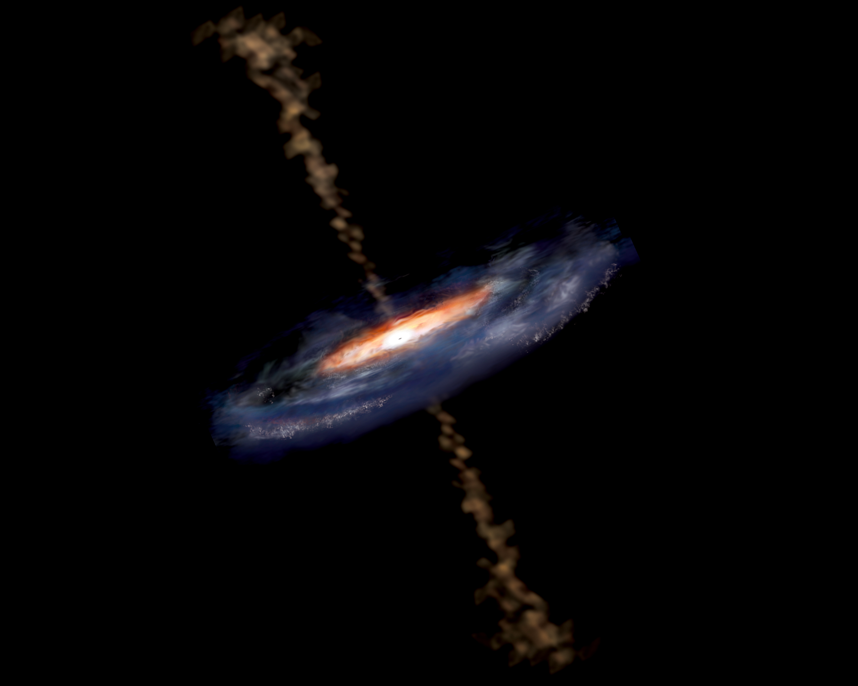
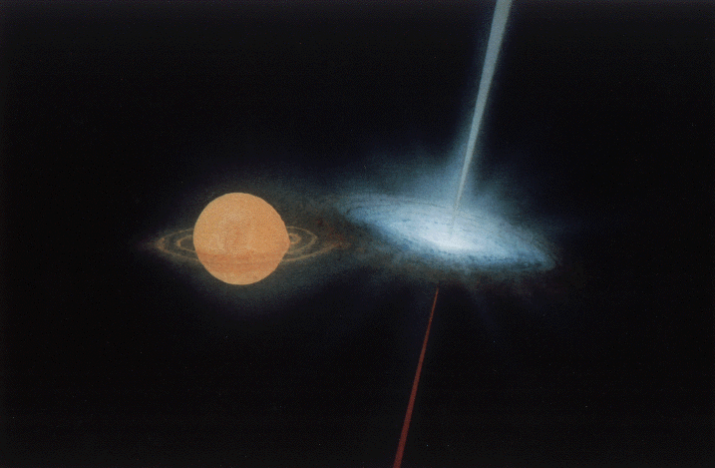
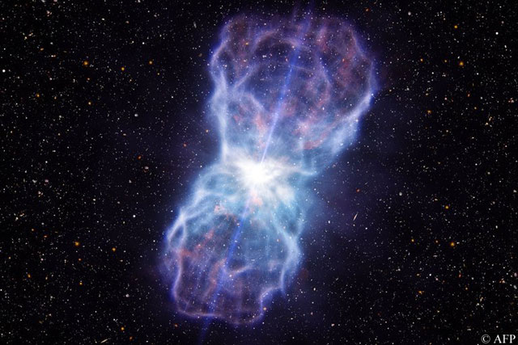
Black holes in astronomy
Remnants of stars >4M_{Sun} produce black holes when the star runs out of nuclear fuel providing outward pressure against gravitational collapse
If a black holes is formed from a star that was in a binary system, it accretes the companion star, producing x-ray radiation
Supermassive (10⁶-10¹⁰M_{Sun}) black holes reside in Active Galactic Nuclei
Relativistic jets of radiating cosmic rays can be ejected from the poles of black holes in:
AGN
BH/X-Ray binaries
Gamma ray bursts
Notes:
We start with some background on black holes
We commonly associate relativistic jets with AGN, and around 10% of AGN host jets
Black hole/x-ray binary stars are also known to host relativistic jets with bulk Lorentz factors of a few
Finally, gamma ray bursts host the most powerful jets known, with Lorentz factors approaching 1000

Slide 25
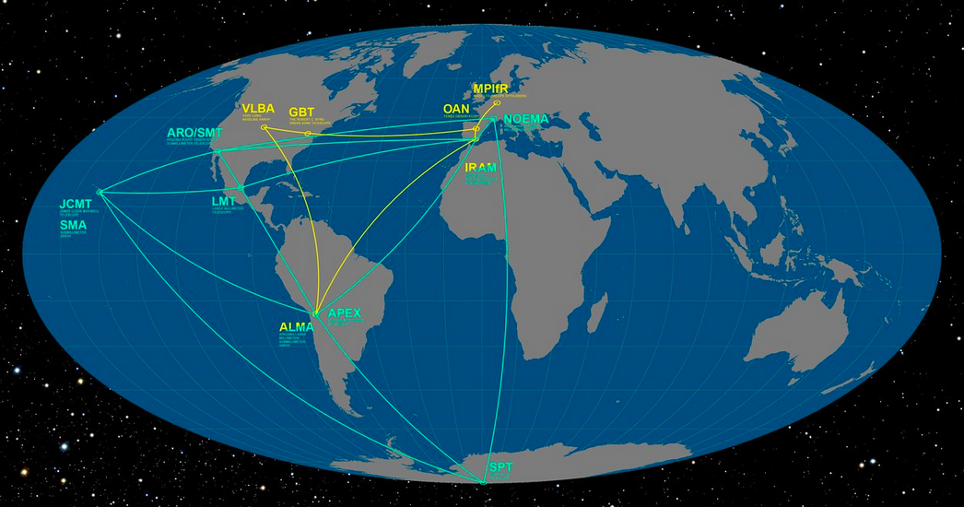
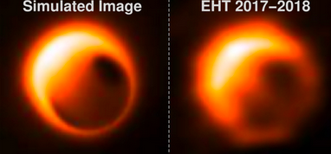
Black holes - observations
The Event Horizon Telescope is a collection of radio antennae forming a network of intercontinental baselines to form mm-images
Read: http://news.nationalgeographic.com/2017/04/black-hole-event-horizon-telescope-pictures-genius-science/
Exercise: Can you explain why baselines of radio telescopes are so long in view of the angular resolution limit below?
$${∆θ}_{min}=1.22\frac{ λ}{D _{aperture }}$$
Notes:
Pass out EHT article
https://en.wikipedia.org/wiki/Event_Horizon_Telescope
http://www.scintillatingastronomy.com/eht/

Slide 26
Black holes - observations
The Event Horizon Telescope is a collection of radio antennae forming a network of intercontinental baselines to form mm-images
Read: http://news.nationalgeographic.com/2017/04/black-hole-event-horizon-telescope-pictures-genius-science/
Exercise: Can you explain why baselines of radio telescopes are so long in view of the angular resolution limit below?
The ability to distinguish two sources at smaller angular separation increases with aperture diameter
$${∆θ}_{min}=1.22\frac{ λ}{D _{aperture }}$$
Notes:
Pass out EHT article
https://en.wikipedia.org/wiki/Event_Horizon_Telescope
http://www.scintillatingastronomy.com/eht/

Slide 27
Interstellar-Einstein rings
Interstellar 2:12:25 – Shuttle approaches Gargantua with visible Einstein rings
Notes:
2:14:10 -> iTunes 2:12:25

Slide 28
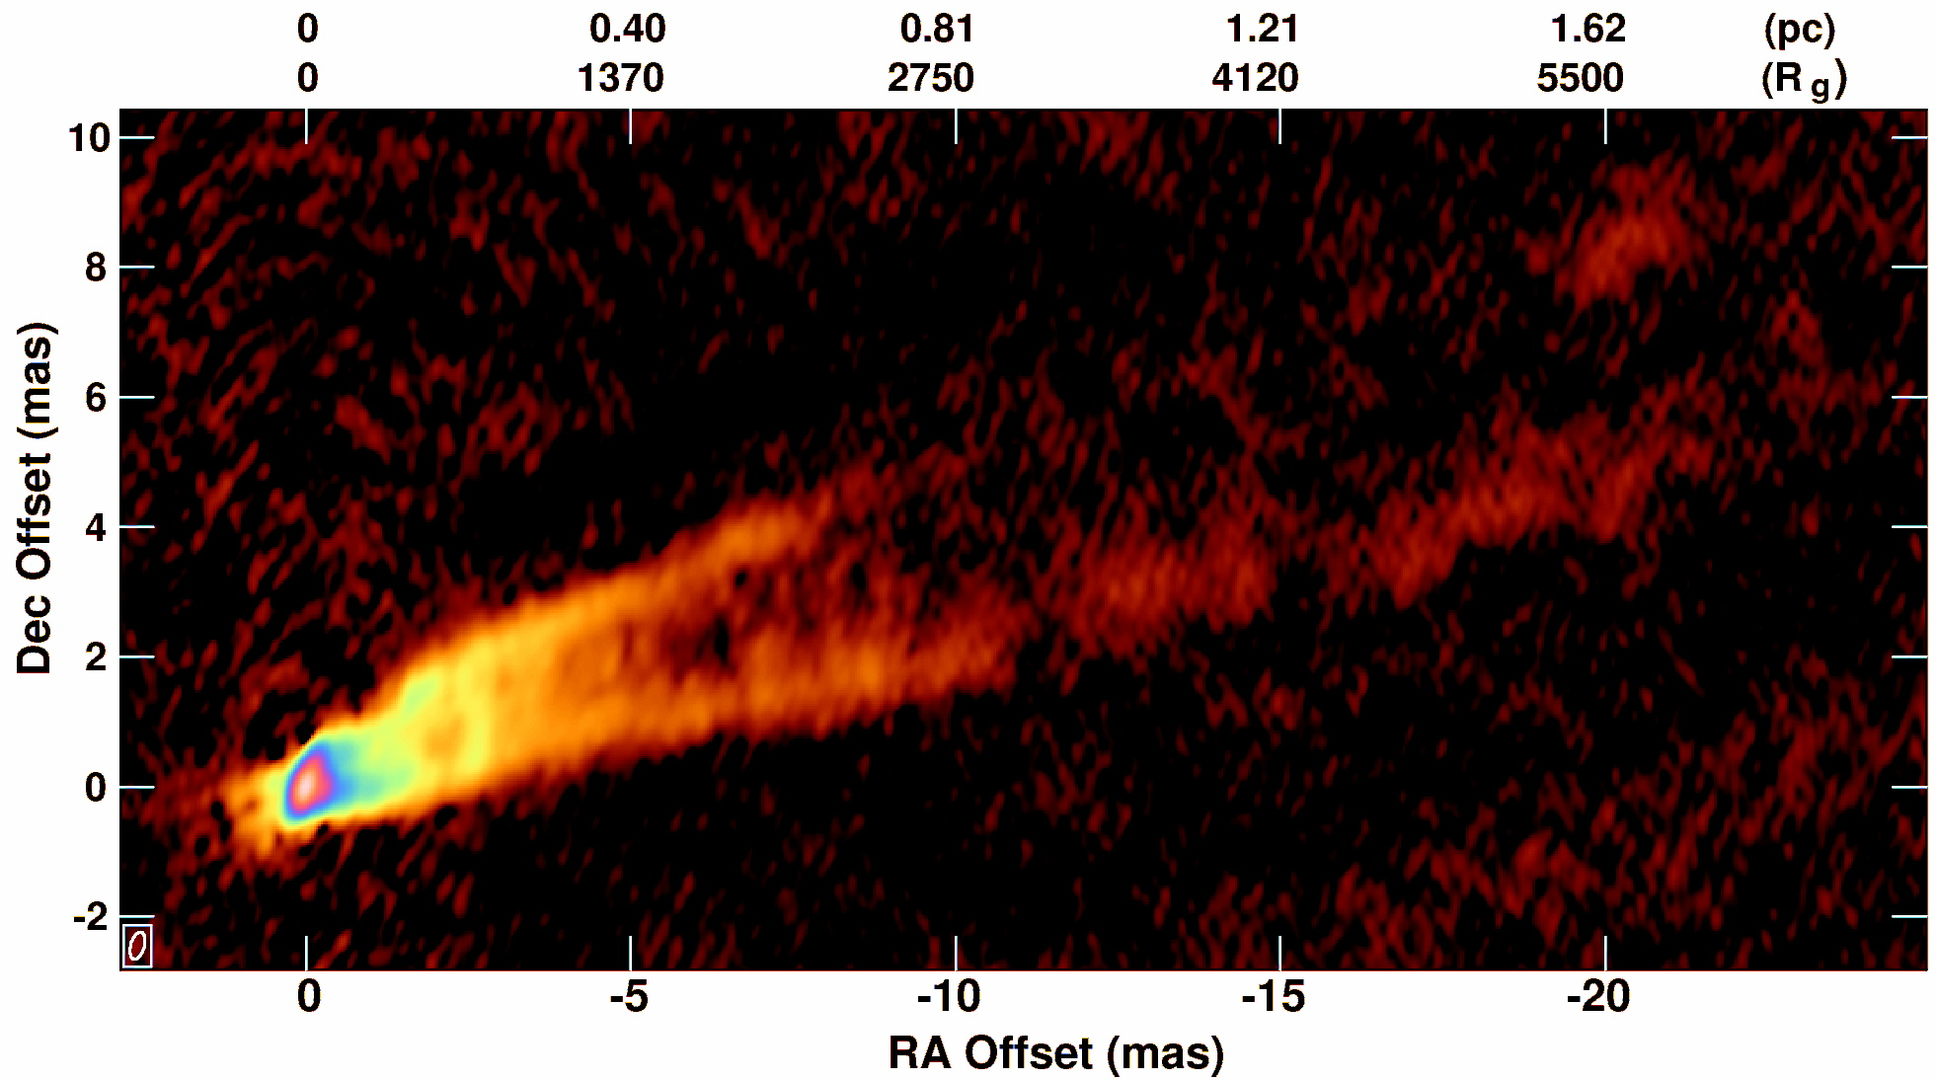
Black holes – relativistic jets
The galaxy M87 is a contains a good example of a relativistic jet
M87 is a giant elliptical galaxy located in the Virgo Cluster 5.4x10⁷ly from us.
M87’s jets source from radio to gamma rays.
M87’s 6x10⁹ solar mass central black hole has angular width (3.9μas)— comparable to that of Sgr A* (5.3μas).
43GHz (7mm) VLBA M87 Observation (Courtesy of Craig Walker (NRAO))
Notes:
First, we embed the observing jet simulations approach within its astrophysical context
M87 is the prototypical case for a jet/accretion disk/black hole system
As one of the most massive giant elliptical galaxies near (5.4x10^7ly) Earth and one of the brightest radio sources in the sky, Messier 87 is a popular target for both amateur astronomy observations and professional astronomy study. (Wikipedia)
Image: 3C274_98A_43_MATHS_76.png http://www.aoc.nrao.edu/~cwalker/M87/
The advent of higher resolution sub-mm from the Event Horizon Telescope will provide us images we can compare with our highest resolution simulations
EHT is centered on ALMA, uses Hawaii, Mexico, Chile,etc.
ALMA: anchor of EHT

Slide 29
relativistic jets (Group activity)
Read https://kipac-web.stanford.edu/seeing-believing-observing-simulations-relativistic-jets
Exercise: What is a gravitational radius m as a mass, length and time in mks units for the 4x10⁶M_{Sun} Galactic Center black hole?

Slide 30
Black Hole Scales
Read https://kipac-web.stanford.edu/seeing-believing-observing-simulations-relativistic-jets
Exercise: What is a gravitational radius m as a mass, length and time in mks units for the 4x10⁶M_{Sun} Galactic Center black hole?

Slide 31
Black Hole Scales
Read https://kipac-web.stanford.edu/seeing-believing-observing-simulations-relativistic-jets
Exercise: What is a gravitational radius m as a mass, length and time in mks units for the 4x10⁶M_{Sun} Galactic Center black hole?
$$m_{M}=4×{10}^{6}×2×{10}^{30}kg=8×{10}^{36}kg$$
$$m_{L}=\frac{{Gm}_{M}}{c2}=\frac{\left(6.8×{10}^{−11}N\frac{m2}{kg2}\right)8×{10}^{36}kg }{\left(3.00×{10}^{8}m /s\right)2}=6×{10}^{9}m$$
$$m_{T}=\frac{m_{L}}{c}=20s$$

Slide 32
Equivalence principle
Mass appears in these two apparently distinct force laws in nature:

Slide 33
Equivalence principle
Mass appears in these two apparently distinct force laws in nature:
Why should we expect these masses to be the same?
Newton’s 2nd Law
Newton’s Law of Universal Gravitation
$$\sum_{i}{{\vec{F}}_{i}}=m\vec{a}$$
$$\vec{Fg}=G\frac{M1M2}{r2} \frac{\vec{r}1−\vec{r}2}{|\vec{r}1−\vec{r}2|}$$
Notes:
F_a=m_a a => m_a^2 = F_a/a
F_g = G m_g m_g/r^2 => m_g^2 =F_g r^2/g

Slide 34
Equivalence principle
Consider two labs: GraviLab and AccLab
Is there any experiment in either lab that can distinguish the black hole from the piston?
GraviLab
AccLab
Notes:
Jay Z
Free fall can be replicated in GraviLab taking M->0
Buoyancy can be replicated in AccLab by the floor knocking air molecules up to balloon

Slide 35
Equivalence principle - Tidal forces
Consider two labs: GraviLab and AccLab
Tidal forces would affect only the person in GraviLab:
$$T≈\frac{MH}{r^{3}}$$
GraviLab
AccLab
Notes:
The presence of the black hole gravity warps the spacetime on large scales near GraviLab, and does not do this near AccLab

Slide 36
Equivalence principle
Consider two labs: GraviLab and AccLab
For sufficiently small labs, there is no experiment to distinguish them
GraviLab
AccLab
Notes:
The effects of tidal forces accompanying gravitational curvature vanish for sufficiently small labs

Slide 37
Equivalence principle
Equivalence principle:
Mathematically, near any point $P$ of globally curved spacetime there exists a local coordinate transformation of the metric tensor $g_{μν}→g_{αβ}$ transforming it to the flat space metric tensor
$$\text{Local} \text{properties} \text{of} \text{curved} \text{spacetime} \text{are} \text{indistinguishable} \text{from} \text{flat} \text{spacetime}$$
$$g_{αβ}\left(P\right)=η_{αβ}$$
Notes:
Explicit examples require more background in differential geometry

Slide 38
Gravitational time dilation
Energy of a photon:
Energy is lost by a photon escaping a gravitational field, reducing its frequency, or rate of ticking, just as motional time dilation
$$E_{γ}=hf$$

Slide 39
Gravitational time dilation
Energy of a photon:
Energy is lost by a photon escaping a gravitational field, reducing its frequency, or rate of ticking, just as motional time dilation
Putting the escape speed into the time dilation formula
$$E_{γ}=hf=\frac{h}{T}=\frac{hc}{λ}$$

Slide 40
Gravitational time dilation
Energy of a photon:
Energy is lost by a photon escaping a gravitational field, reducing its frequency, or rate of ticking, just as motional time dilation
Putting the escape speed into the time dilation formula
$$E_{γ}=hf=\frac{h}{T}=\frac{hc}{λ}$$
$$v_{esc}^{ }=\sqrt{\frac{2GM}{r}}$$
$$t_{0}^{ }=t_{d}^{ }\sqrt{1−\frac{v_{esc}^{ 2}}{c2}}$$
$$⇒t_{0}^{ }=t_{d}^{ }\sqrt{1−\frac{2GM}{rc2}}$$

Slide 41
Gravitational time dilation
Energy of a photon:
Energy is lost by a photon escaping a gravitational field, reducing its frequency, or rate of ticking, just as motional time dilation
Putting the photon escape speed into the time dilation formula
$$E_{γ}=hf=\frac{h}{T}=\frac{hc}{λ}$$
$$v_{esc}^{ }=\sqrt{\frac{2GM}{r}}$$
$$t_{0}^{ }=t_{d}^{ }\sqrt{1−\frac{v_{esc}^{ 2}}{c2}}$$
$$⇒t_{0}^{ }=t_{d}^{ }\sqrt{1−\frac{2GM}{rc2}}=t_{d}^{ }\sqrt{1−\frac{rS}{r}}$$

Slide 42
Interstellar-gravitational time dilation
Interstellar Min 1:04:30 - Dr. Brand and Romiley explain gravitational time dilation
Exercise: Every hour spent on Miller planet appears as 7 years to outside observers. If Gargantua is a Schwarszchild black hole with r_{S}= 3x10¹¹m, how far from the horizon is Miller’s planet?
Notes:
1:04:30 -> iTunes 1:02:30

Slide 43
Interstellar-gravitational time dilation
Interstellar Min 1:04:30 - Dr. Brand and Romiley explain gravitational time dilation
Exercise: Every hour spent on Miller’s planet appears as 7 years to outside observers. If Gargantua is a Schwarszchild black hole with r_{S}= 3x10¹¹m, how far from the horizon is Miller’s planet
$$7×365×24=\frac{t_{0}^{ }}{t_{d}^{ }}=\sqrt{1−\frac{rS}{r}}⇒$$
$$r−rS=\left(\frac{{61320}^{2}}{{61320}^{2}−1}−1\right)rS=79m$$
Notes:
1:04:30 -> iTunes 1:02:30

Slide 44
Confessions of an Einstein denier (Group activity)
With a partner, edit two chapters from http://www.relativityoflight.com/ Part II. The Unnecessary Special Theory Of Relativity

Slide 45
Interstellar-Wormholes
Interstellar Min 33:50 artificial wormhole “They” created to allow travel to remote regions in space
Explain wormholes as Einstein-Rosen bridge solution of Einstein field equations
Compare wormholes with other methods of travel to remote regions in space in popular science, e.g., Star Trak warp drive
Interstellar Min 33:00

Slide 46
Interstellar-time dilation
Interstellar Min 41:10 - Cooper explains Murph will think his watch slow when he is traveling at speed of light or is near a black hole in his mission

Slide 47
Interstellar-Einstein rings
Interstellar Min 1:07:40 - Romiley explains to Coop nothing can escape Gargantua– not even light
Interstellar 2:14:10 – Shuttle approaches Gargantua with visible Einstein rings

Slide 48
Interstellar-tidal forces
Interstellar Min 1:11:00 - Miller (Water) Planet 130% Earth gravity
Interstellar Min 1:11:45 - Miller (Water) Planet mountainous waves
Interstellar 1:48:30 Romiley explains Gargantua is a ”gentle” enough singularity that a probe crossing the horizon could survive

Slide 49
Interstellar-cosmic censorship
Interstellar Min 1:44:18 - The laws of nature prohibit a naked singularity.

Slide 50
transformations – review of tensors
Terminology: Lorentz tensors are multidimensional arrays whose components mix in a prescribed manner under Lorentz transformations. Contravariant tensor indices occur in superscript, e.g., a^{μ}; covariant tensor indices in subscript, e.g., a_{μ}
Einstein summation notation: sum over repeated indices in subscript-superscript pairs
Lowering and raising of indices:
where metric tensor g_{μν} is determined by spacetime geometry by reading of coefficients from the Lorentz invariant spacetime interval:
Minkowski (flat space) metric tensor η_{μν} defined by line element
Note: Unlike positive definite Euclidean 3-space, Minkowski 4-space has indefinite scalar product
${a_{ν}b}^{ν}={a_{μ}b}^{μ}=a^{μ}b_{μ}=a^{ν}b_{ν}$=$a^{0}b_{0}$+$a^{1}b_{1}$+$a^{2}b_{2}$+$a^{3}b_{3}$
$$a_{}={{g_{μν}a}^{ν}; a}^{}=g^{μν}a_{ν}$$
$ds$²=${{g^{μ}{ν{dx}_{μ}dx}^{ν}=g}_{μ}}^{ν}{dx}^{μ}{dx}_{ν}$=$g^{μν}{{dx}_{μ}dx}_{ν}$=${g_{μν}{dx}^{μ}dx}^{ν}$
= ${g_{00}{dx}^{0}dx}^{0}$+${g_{01}{dx}^{0}dx}^{1}$+${g_{02}{dx}^{0}dx}^{2}$+${g_{03}{dx}^{0}dx}^{3}$
+ ${g_{10}{dx}^{1}dx}^{0}$+${g_{11}{dx}^{1}dx}^{1}$+${g_{12}{dx}^{1}dx}^{2}$+${g_{13}{dx}^{1}dx}^{3}$
+ ${g_{20}{dx}^{2}dx}^{0}$+${g_{21}{dx}^{2}dx}^{1}$+${g_{22}{dx}^{2}dx}^{2}$+${g_{23}{dx}^{2}dx}^{3}$
+ ${g_{30}{dx}^{3}dx}^{0}$+${g_{31}{dx}^{3}dx}^{1}$+${g_{32}{dx}^{3}dx}^{2}$+${g_{33}{dx}^{3}dx}^{3}$
$ds$² = ${−(dx}^{0})$² ${+(dx}^{1})$² ${+(dx}^{2})$² ${+(dx}^{3})$²

Slide 51
Minkowski metric in spherical coordinates
Minkowski flat space is empty, so it can be equally well represented in coordinates emphasizing spherical symmetry instead of planar symmetry
Exercise: What are the lengths of Arc 1 and Arc 2 if the sphere has radius r+dr and$θ,φ, dθ$ and d$φ$ are defined as in the diagram?
Cartesian Coordinates
Spherical Coordinates
$${ds}^{2}={η_{μν}dx}^{μν}=−c^{2}dt^{2}+dx^{2}+dy^{2}+dz^{2}$$
$${ds}^{2}=−c^{2}dt^{2}+dr^{2}+r^{2}dθ^{2}+r^{2}s{in}^{2}{θ}dφ^{2}$$
$$\hat{r}$$
$$Arc 1$$
$$dr$$
$$r$$
$$Arc 2$$

Slide 52
Minkowski metric in spherical coordinates
Minkowski flat space is empty, so it can be equally well represented in coordinates emphasizing spherical symmetry instead of planar symmetry
Exercise: What are the lengths of Arc 1 and Arc 2 if the sphere has radius r+dr and$θ,φ, dθ$ and d$φ$ are defined as in the diagram?
Cartesian Coordinates
Spherical Coordinates
$${ds}^{2}={η_{μν}dx}^{μν}=−c^{2}dt^{2}+dx^{2}+dy^{2}+dz^{2}$$
$${ds}^{2}=−c^{2}dt^{2}+dr^{2}+r^{2}dθ^{2}+r^{2}s{in}^{2}{θ}dφ^{2}$$
$$\hat{r}$$
$$Arc 1$$
$$dr$$
$$r$$
Arc 1: $rdθ$
Arc 2: $r\sin{θ}$ $dφ$
$$Arc 2$$

Slide 53
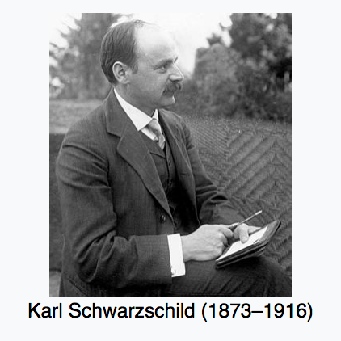
Schwarzschild geometry
Schwarzschild coordinates for geometry around spherically symmetric mass M
$ds$²= $−\left(1−\frac{2M}{r}\right)dt^{2}+{\left(1−\frac{2M}{r}\right)}^{−1}dr^{2}+r^{2}{(dθ^{2}+sin}^{2}θdφ^{2})$

Slide 54
Group activity: Wormholes in Warpdrive spacetime

Slide 55
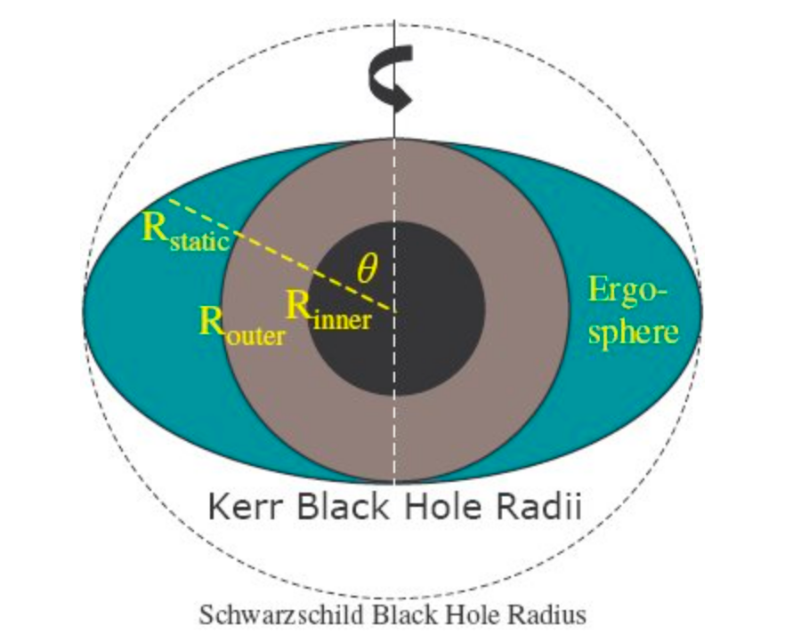
Kerr geometry
Since Gargantua is a Kerr (rotating) black hole, its (outer) event horizon is slightly within its Schwarzschild radius
http://cr4.globalspec.com/blogentry/1372/Rotating-Black-Holes-the-Naked-Truth
Kerr metric
$ds$²= $− \left(1−\frac{2Mr}{ρ^{2}}\right)dt^{2}−\frac{4Mar\sin^{2}θ}{ρ^{2}}dtdφ+\frac{ρ^{2}}{Δ}dr^{2}+ρ^{2}dθ^{2}+(r^{2}+a^{2}+\frac{{2Mra^{2} sin}^{2}θ}{ρ^{2}}) \sin^{2}θdφ^{2}$
Notes:
http://cr4.globalspec.com/blogentry/1372/Rotating-Black-Holes-the-Naked-Truth

Slide 56
Interstellar-Wormholes
Interstellar Min 33:50 artificial wormhole “They” created to allow travel to remote regions in space
Explain wormholes as Einstein-Rosen bridge solution of Einstein field equations
Compare wormholes with other methods of travel to remote regions in space in popular science, e.g., Star Trak warp drive
Interstellar Min 33:00

Slide 57
Interstellar-gravitational time dilation
Interstellar Min 1:04:30 - Dr. Brand and Romiley explain gravitational time dilation

Slide 58
Interstellar-Einstein rings
Interstellar Min 1:07:40 - Romiley explains to Coop nothing can escape Gargantua– not even light
Interstellar 2:14:10 – Shuttle approaches Gargantua with visible Einstein rings

Slide 59
Interstellar-tidal forces
Interstellar Min 1:11:00 - Miller (Water) Planet 130% Earth gravity
Interstellar Min 1:11:45 - Miller (Water) Planet mountainous waves
Interstellar 1:48:30 Romiley explains Gargantua is a ”gentle” enough singularity that a probe crossing the horizon could survive

Slide 60
Interstellar-cosmic censorship
Interstellar Min 1:44:18 - The laws of nature prohibit a naked singularity.

Slide 62
Interstellar – 31:25-31:55
What theorized phenomenon could be what Romiley is describing?
Notes:
33:00 -> iTunes 31:30

Slide 63
Interstellar – gravitational anomaly
Interstellar Min 31:30 “gravitational anomaly”- mysterious disturbance of spacetime
Some of these “anomalies”– like the ones seen by Coop-- send ripples through space much like the gravitational waves discovered by LIGO
Some of these ”anomalies” parallel wormholes
Notes:
33:00 -> iTunes 31:30
With LIGP

