Slide 1
Unit II: MHD Part I: Theory of Magnetohydrodynamics
Richard Anantua (UTSA)
PHYS 7903-AST 4953 - General Relativistic MHD
3/6/2023 – 3/22/2023
1
Notes:
MCP Problem 16.1 Gravity Waves: https://www.physics.umd.edu/grt/taj/374a/waterwaves.pdf

Slide 2
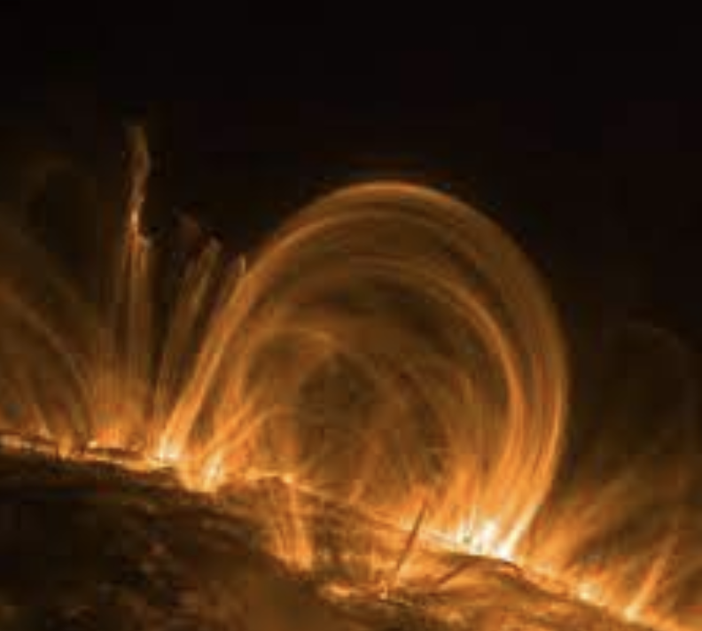
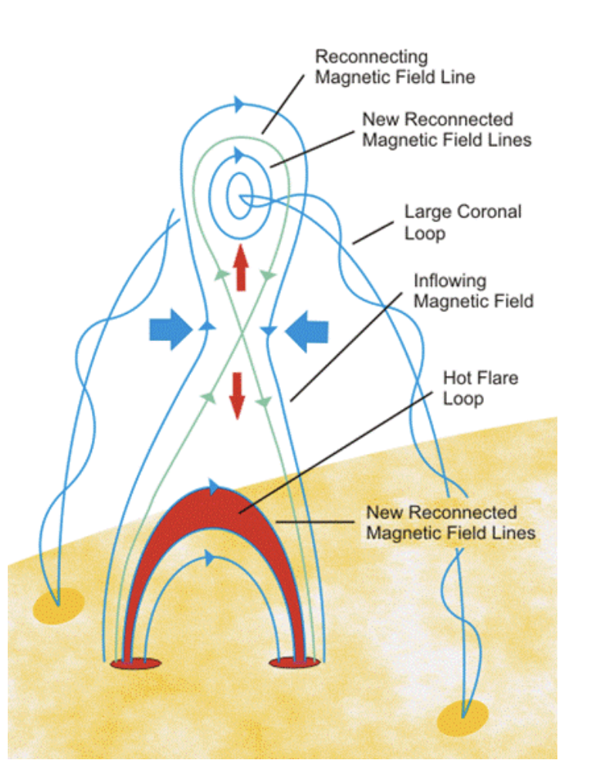
Example of MHD
Solar corona
2
Notes:
https://suli.pppl.gov/2017/course/Loureiro.pdf
https://progearthplanetsci.springeropen.com/articles/10.1186/s40645-016-0084-7
The solar corona satisfies the low- β plasma condition (β= 0.01–0.1) (Gary 2001) in which the magnetic energy dominates that of the coronal plasma, solar flares are widely considered to be a manifestation of the conversion of the magnetic energy of the solar corona into kinetic and thermal energy, culminating in the release of high-energy particles and electromagnetic radiation

Slide 3
Math methods – linear algebra
TERMINOLOGY: A linear operator A satisfies
for all scalars c,d and vectors v,w
$$\text{A}\text{(}\text{c}\text{v}\text{+}\text{d}\text{w}\text{) =} \text{?}$$
3

Slide 4
Math methods – linear algebra
TERMINOLOGY: A linear operator A satisfies
for all scalars c,d and vectors v,w
Note: Linear superposition of waves satisfy the wave equation
$$\text{A}\text{(}\text{c}\text{v}\text{+}\text{d}\text{w}\text{) =} \text{cA}\text{v}\text{+}\text{dA}\text{w}$$
$$\frac{∂^{2}f}{∂x^{2}}=\frac{1}{v^{2}}\frac{∂^{2}f}{∂t^{2}}$$
4

Slide 5
Math methods – linear algebra
Eigenvalues λ and eigenvectors v satisfy
where v = v_{i}, i = 1,2,…,n; A = A_{ij}, i,j = 1,2,…,n and v $≠$ 0
Eigenvalues exists if and only if (A- λI)v=0, which amounts to the matrix A- λI being singular, i.e.,
TERMINOLOGY: A positive (negative) definite operator has all positive (negative) eigenvalues; a positive (negative) semidefinite operator has all non-negative (non-positive) eigenvalues; an indefinite operator has positive and negative eigenvalues
$$\text{A}\text{v}\text{=}\text{λ}\text{v}$$
$$\text{det}\text{(}\text{A}\text{ −λ}\text{I}\text{)}\text{=}\text{0}$$
5

Slide 6
Review of Linear Algebra: Determinants, Eigenvalues and Eigenvectors
Finding determinants http://mathworld.wolfram.com/Determinant.html
Finding eigenvalues https://www.khanacademy.org/math/linear-algebra/alternate-bases/eigen-everything/v/linear-algebra-example-solving-for-the-eigenvalues-of-a-2x2-matrix
Finding (families or spaces of) eigenvectors https://www.khanacademy.org/math/linear-algebra/alternate-bases/eigen-everything/v/linear-algebra-finding-eigenvectors-and-eigenspaces-example
6

Slide 7
Math methods – linear algebra
EXERCISE: Find the eigenvalues and eigenvectors of
$$\text{A}\text{1}\text{ = }\left[\begin{matrix}1 & 1 \\ 1 & 1\end{matrix}\right]\text{ ,}$$
$$\text{A}\text{2}\text{ = }\left[\begin{aligned}\begin{matrix}a_{11} & \\ & a_{22}\end{matrix} \\ \begin{matrix} & \\ & \end{matrix} \begin{matrix}… & \\ & a_{nn}\end{matrix}\end{aligned}\right] \text{= }\text{diag}\text{(}a_{11}\text{, }a_{22}\text{,}\text{…}\text{, }a_{nn}\text{)}$$
0=Det(A₁- $λ$I)=(1- $λ$)1-1(1- $λ$)=0 (Trivial)
Since A₁ singular, it has a 0 eigenvalue
0=Det(A₂- $λ$I)=(a₁₁- $λ$)(a₂₂- $λ$)…(a_{nn}- $λ$)= 0
7
Notes:
Eigensystem[{{1, 1}, {1, 1}}] {{2, 0}, {{1, 1}, {-1, 1}}}
Eigensystem[{{a1, 0, 0}, {0, a2, 0}, {0, 0, a3}}] {{a1, a2, a3}, {{1, 0, 0}, {0, 1, 0}, {0, 0, 1}}}
𝐴 singular ⟺det(𝐴)=0⟺det(𝐴−0⋅𝐼)=0⟺0 is eigenvalue of 𝐴.

Slide 8
Math methods – linear algebra
Exponential function of one variable as Taylor series
where e=2.718281828459045… is the exponential constant
Matrix exponential
Note Identity matrix satisfies Iv=v for any vector v
$$e^{x}=\frac{x^{n}}{n!}=1+x+\frac{x^{2}}{2}+\frac{x^{3}}{3!}…$$
$$e^{M}=\sum_{n=1}^{∞}{\frac{1}{n!}M^{n}=I+M+\frac{1}{2!}M^{2}+…}$$
8

Slide 9
Math methods – ordinary differential equations
Linear first-order system
Ansatz?
$$\frac{d\vec{x}}{dt}=A\vec{x}(t)$$
Want to write x(t)=e^{At}, but the matrix exponential e^{At} is a matrix while x(t) must be a vector
What if we assume A has eigenvectors E_{j} satisfying
AE_{j}= $λ$_{i}E_{j}, and write our guess solution as a linear combination of these eigenvectors weighted by $e^{λ_{i}It}$?
9

Slide 10
Math methods – ordinary differential equations
Linear first-order system
Ansatz: Assuming A has eigenvalues, i.e., Av = $λI\text{v}$
$$\frac{d\vec{x}}{dt}=A\vec{x}(t)$$
$$\vec{x}\left(t\right)=\sum_{i=1}^{N}{e^{λ_{i}It }c_{i}{\vec{E}}_{i}}=\sum_{i=1}^{N}{\sum_{n=0}^{∞}{\frac{{\left(λ_{i}It\right)}^{n}}{n!}}c_{i}{\vec{E}}_{i}}=\sum_{i=1}^{N}{\left(\sum_{n=0}^{∞}{\frac{{\left(λ_{i}t\right)}^{n}}{n!}I^{n}}\right)c_{i}{\vec{E}}_{i}=}\sum_{i=1}^{N}{\left(I\sum_{n=0}^{∞}{\frac{{\left(λ_{i}t\right)}^{n}}{n!}}\right)c_{i}{\vec{E}}_{i}}=\sum_{i=1}^{N}{e^{λ_{i}t}c_{i}{\vec{E}}_{i}}$$
10

Slide 11
Math methods – ordinary differential equations
Linear first-order system
Ansatz: Assuming A has eigenvalues, i.e., Av = $λI\text{v}$
Solution:
$$\frac{d\vec{x}}{dt}=A\vec{x}(t)$$
$$\vec{x}\left(t\right)=\sum_{i=1}^{N}{e^{λ_{i}t}c_{i}{\vec{E}}_{i}}$$
$$\frac{d\vec{x}}{dt}=\frac{d}{dt}\sum_{i=1}^{n}{c_{i}{\vec{E}}_{i}}e^{λ_{i}t}\text{=}\sum_{i=1}^{n}{c_{i}{\vec{E}}_{i}}\frac{d}{dt}e^{λ_{i}t}=\sum_{i=1}^{n}{c_{i}({\vec{E}}_{i}}λ_{i})e^{λ_{i}t}=\sum_{i=1}^{n}{c_{i}({A\vec{E}}_{i}})e^{λ_{i}t}=A\sum_{i=1}^{n}{c_{i}{\vec{E}}_{i}}e^{λ_{i}t}=A\vec{x}$$
11

Slide 12
Review of electromagnetism – Particles and Fields
Electromagnetism – fields (obeying superposition) and charged point particles
Electrostatics: Coulomb’s law with Coulomb constant k=8.99x10⁹Nm²C⁻²
Magnetostatics: Magnetic force on moving charges in B field
Ohm’s Law
where
Fields satisfy wave equation
Dynamics: Maxwell’s equations
$$\vec{Fe}1 on{2}=k\frac{Q1Q2}{r2} \frac{\vec{r}2−\vec{r}1}{|\vec{r}1−\vec{r}2|}, k=\frac{1}{4πε_{0}}$$
Q₁
r₂-r₁
Q₂
$$\vec{F}B=q\vec{v}×\vec{B}$$
$$\vec{v}$$
$$\vec{B}$$
q
$$×$$
$$\vec{F}B$$
$$\vec{j}=σ\vec{E}$$
$$σ=1/ρ$$
$$\frac{∂^{2}f}{∂x^{2}}=\frac{1}{v^{2}}\frac{∂^{2}f}{∂t^{2}}$$
12
Notes:
Einstein-1894
http://nerdywithchildren.com/what-was-albert-einstein-like-as-a-kid/

Slide 13
Review of electromagnetism – Maxwell’s equations
Maxwell’s equations govern EM waves (fields obeying superposition) interacting with sources
Differential Form Integral Form
$$\vec{∇}∙\vec{E}=\frac{ρ}{ε_{0}}$$
$$∯{\vec{E}∙d\vec{A}}=\frac{Q_{enc}}{ε_{0}}$$
Gauss’s Law
Gauss’s Law
for Magnetism
$$\vec{∇}∙\vec{B}=0$$
$∯{\vec{B}∙d\vec{A}}=0$
$$\vec{∇}×\vec{E}=−\frac{∂\vec{B}}{∂t}$$
$$\oint{\vec{E}∙d\vec{l}}=−\frac{∂Φ_{B}}{∂t}$$
Faraday’s Law
$\vec{∇}×\vec{B}=μ_{0}\vec{j}+μ_{0}ε_{0}\frac{∂\vec{E}}{∂t}$
$$\oint{\vec{B}∙d\vec{l}}={μ_{0}I}_{enc}+μ_{0}ε_{0}\frac{∂Φ_{E}}{∂t}$$
Ampère Law
13

Slide 14
From Particles to Fluids
Water is made of particles, yet oceanographers don’t care much for the interactions of molecules
A fluid is a phenomenon emerging from a large collection of particles acting coherently with locally well-defined fluid variables such as temperature, density and pressure
We will build up equations governing fluids from collections of particles to macroscopic systems in this section
14

Slide 15
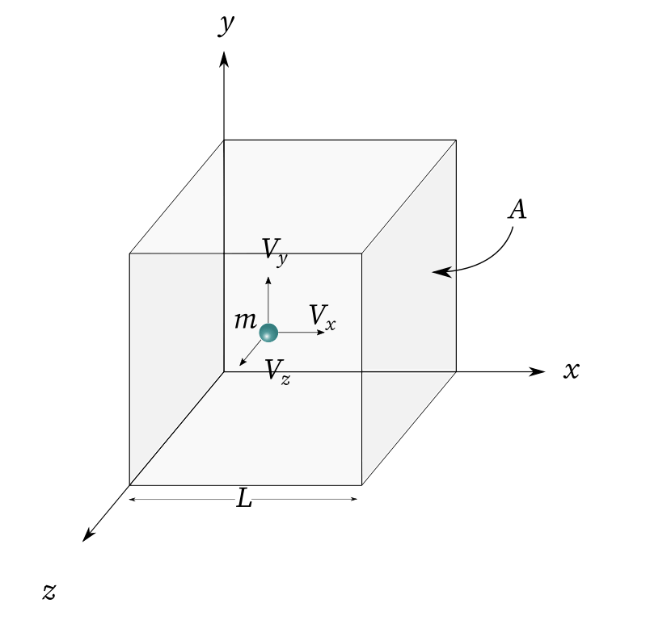
From Particles to Fluids: Ideal Gas LaW
Assume (cf. https://chemistrygod.com/ideal-gas-equation-derivation ):
All the molecules of the gas have the same mass.
The molecules are pointlike and in constant random motion.
The intermolecular forces among the molecules are zero. The molecules do not exert any forces among themselves.
All collisions among them and between the molecules and wall of the container are perfectly elastic in nature.
Then a particle collides between walls (e.g., at x=0 and L) a large number k times, taking on average between collisions
The force by the wall on the particle is
For N particles, the force by the wall is
The pressure (on any face) is then
Using we have the Ideal Gas Law
$$t=\frac{2L}{v_{x}}$$
$${(F_{wp})}_{x}=\frac{∆p_{x}}{t}=2mv_{x}\frac{v_{x}}{2L}=m\frac{{v_{x}}^{2}}{L}$$
$$F_{x}=\frac{m}{L}\sum_{i=1}^{N}{{v_{xi}}^{2}}=\frac{Nm{\overline{v_{x}}}^{2}}{L}$$
$$P=\frac{F}{A}=\frac{Nm{\overline{v_{x}}}^{2}}{AL}=\frac{Nm{\overline{v_{x}}}^{2}}{V}=\frac{Nm{\overline{v}}^{2}}{3V}$$
$\frac{m{\overline{v}}^{2}}{2}=\frac{3}{2}k_{B}T$ (Monatomic 3D Gas)
$$P=\frac{{Nk}_{B}T}{V}$$
15
Notes:
https://chemistrygod.com/ideal-gas-equation-derivation
MCP Ex 13.20 Relativistic Bernoulli Eq.

Slide 16
From Particles to Fluids: 1D-Diffusion
Particles can take many microscopic steps between collisions to traverse macroscopic distances within a fluid
This can be modeled as a random walk.
In 1D, assume a particle moves on a line one step at a time in which each the probability to step right is q and left is (1-q) (cf. https://www.princeton.edu/~akosmrlj/MAE545_S2018/lecture17_slides.pdf )
The position after steps $x_{i}∈\left\{−λ,λ\right\}, i=1,…,N$ can be written
The average displacement for the first step is
Then the average position after N steps is
The probability to step into $X$ can be written
For $u=X−λ$Taylor expand at $X,$ $⟹p(X−λ,t)≅p\left(X,t\right)+\left(−λ\right)\frac{∂p}{∂X}+\frac{λ^{2}}{2}\frac{∂^{2}p}{∂X^{2}}$ and $w=X+λ$ $⇒p(X+λ,t)≅p\left(X\right)+\left(λ\right)\frac{∂p}{∂X}+\frac{λ^{2}}{2}\frac{∂^{2}p}{∂X^{2}}$
This, we have
$$X=\sum_{i=1}^{N}{x_{i}}$$
$$\left\langle x_{1}\right\rangle =\sum_{x_{1}∈\{−λ,λ\}}{x_{1}ℙ(x)}=\left(λ\right)\left(q\right)+\left(−λ\right)\left(1−q\right)=\left(2−q\right)λ$$
$\left\langle X\right\rangle =\left\langle \sum_{i=1}^{N}{x_{i}}\right\rangle =\sum_{i=1}^{N}{\left\langle x_{i}\right\rangle }=N$ $\left\langle x_{1}\right\rangle =Nλ\left(2−q\right)$
Recursive Probability Mass Function (pmf) of $X$
$$p\left(X,t+∆t\right)=qp\left(X−λ,t\right)+\left(1−q\right)p\left(X+λ,t\right)$$
$$p+∆t\frac{∂p}{∂t}=q\left(p−λ\frac{∂p}{∂X}+\frac{λ^{2}}{2}\frac{∂^{2}p}{∂X^{2}}\right)+\left(1−q\right)\left(p+λ\frac{∂p}{∂X}+\frac{λ^{2}}{2}\frac{∂^{2}p}{∂X^{2}}\right)$$
16
Particle PMF Differential Equation
Notes:
https://www.princeton.edu/~akosmrlj/MAE545_S2018/lecture17_slides.pdf

Slide 17
From Particles to Fluids: Fokker-Planck Equation
We may rewrite the differential equation
for the probability a particle would be found at (X,t) as
where
and
$$p+∆t\frac{∂p}{∂t}=q\left(p−λ\frac{∂p}{∂X}+\frac{λ^{2}}{2}\frac{∂^{2}p}{∂X^{2}}\right)+\left(1−q\right)\left(p+λ\frac{∂p}{∂X}+\frac{λ^{2}}{2}\frac{∂^{2}p}{∂X^{2}}\right)$$
$$\frac{∂p}{∂t}=−v\frac{∂p}{∂X}+D\frac{∂^{2}p}{∂X^{2}}$$
Fokker-Planck Equation
$$v=(2q−1)\frac{λ}{∆t}$$
(Drift Velocity)
$$D=\frac{λ^{2}}{2∆t}$$
(Diffusion Coefficient)
17
Notes:
https://www.princeton.edu/~akosmrlj/MAE545_S2018/lecture17_slides.pdf

Slide 18
From Particles to Fluids: 2D-Random Walk
Particles can take many microscopic steps between collisions to traverse macroscopic distances within a fluid
This can be modeled as a random walk
Assume a particle starting at (0,0) moves on a square lattice where each direction is equally probable
In 2D, find the root mean square distance $L_{rms}=\sqrt{\left\langle {\vec{R}}^{2}\right\rangle }=\sqrt{\left\langle X^{2}\right\rangle +\left\langle Y^{2}\right\rangle }$ traveled in $N$ steps $\left\{(x_{1},y_{1}),…,\text{(}x_{N},y_{N}\text{)}\right\}$
Note, for 1 step in 2D,
For N steps in 2D
For a 2D lattice random walk
$${\left\langle X^{2}\right\rangle }_{1−step}=\left\langle {x_{1}}^{2}\right\rangle =\sum_{x_{1}∈\{−λ,0,λ\}}{{x_{1}}^{2}ℙ(x)}={\left(−λ\right)}^{2}\left(\frac{1}{4}\right)+{\left(0\right)}^{2}\left(\frac{1}{2}\right)+{\left(λ\right)}^{2}\left(\frac{1}{4}\right)=\frac{λ^{2}}{2}={\left\langle Y^{2}\right\rangle }_{1−step}$$
$$\left\langle X^{2}\right\rangle =\left\langle \sum_{i=1}^{N}{x_{i}}\sum_{j=1}^{N}{x_{j}}\right\rangle =\left\langle \sum_{i=1}^{N}{{x_{i}}^{2}}+\sum_{\begin{aligned}i,j=1 \\ i≠j\end{aligned}}^{N}{x_{i}x_{j}}\right\rangle =\sum_{i=1}^{N}{\left\langle {x_{i}}^{2}\right\rangle }+0=N\left\langle {x_{1}}^{2}\right\rangle =\frac{Nλ^{2}}{2}=\left\langle Y^{2}\right\rangle$$
$$⇒{L_{rms}}^{2}=\frac{Nλ^{2}}{2}+\frac{Nλ^{2}}{2}=Nλ^{2}$$
$$L_{rms}=N^{1/2}λ$$
18
Notes:
https://math.stackexchange.com/questions/4237401/2d-random-walk-expected-time-to-hit-enclosing-square
https://mathworld.wolfram.com/RandomWalk2-Dimensional.html
https://en.wikipedia.org/wiki/Random_walk

Slide 19
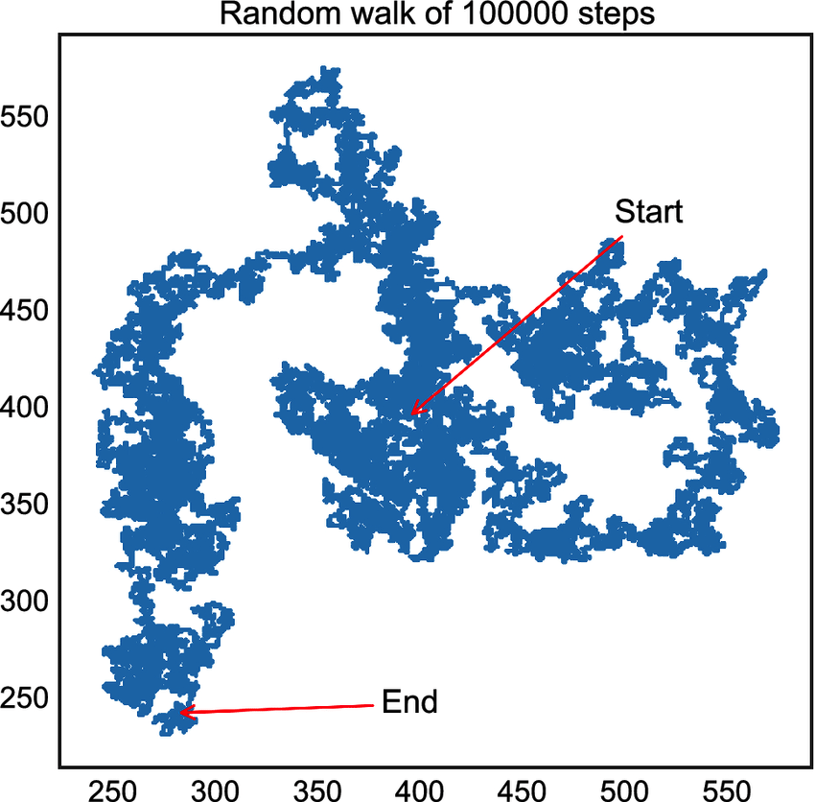
From Particles to Fluids: 2D-Random Walk
Particles can take many microscopic steps between collisions to traverse macroscopic distances within a fluid
This can be modeled as a random walk
Source: https://www.researchgate.net/figure/A-random-walk-of-100-000-steps-on-a-2D-square-lattice-The-random-walker-starts-at-site_fig1_331835380
19
Notes:
https://www.researchgate.net/figure/A-random-walk-of-100-000-steps-on-a-2D-square-lattice-The-random-walker-starts-at-site_fig1_331835380

Slide 20
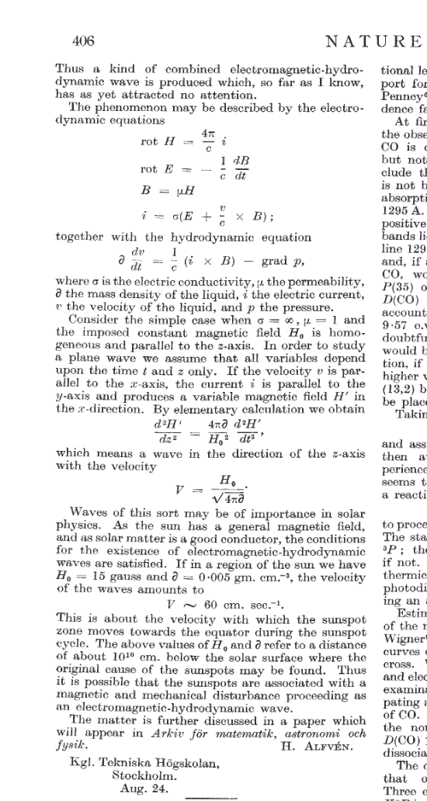
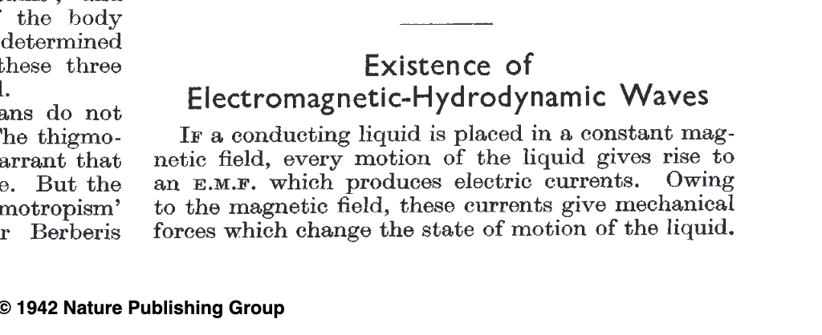
Hannes Alfven: Primary Source
Alfvén 1942: Existence of Electromagnetic-Hydrodynamic Waves
Conducting plasma with const B field interacts with moving charged particles to induce a B-field wave!
Ohm’s law: Particle velocity v ($\hat{x}$ ) sets up current i=j(- $\hat{y}$= $\hat{x}$ x $\hat{z}$ ) over a pillbox/swath of width Delta x (the field B induced wraps around the pillbox CCW mostly in +/- x-direction and falls off with z)
The induced H field satisfies a wave equation and propagates at v_{A}
20
Notes:
https://www.nobelprize.org/prizes/physics/1970/alfven/facts/
Conducting plasma with const B field interacts with moving charged particles to induce a B-field wave!
Ohm’s law: Particle velocity v (xHat) sets up current i=j(-yHat=xHat x zHat) over a pillbox/swath of width Delta x (the field B induced wraps around the pillbox CCW mostly in +/- x-direction and falls off with z)
The induced H field satisfies a wave equation and propagates at vA

Slide 21
NASA Alfven Waves
NASA MMS mission
21
Notes:
https://svs.gsfc.nasa.gov/4560

Slide 22
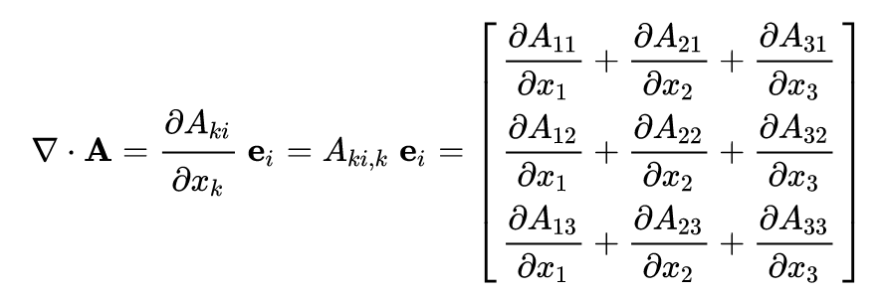
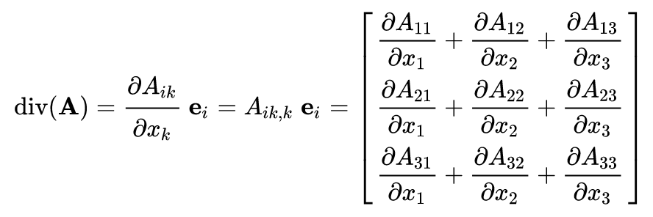
Generalized Ohm’s Law
Generalized Ohm’s Law
Matrix divergence
$$\vec{E}+\vec{u}×\vec{B}=\frac{m_{e}m_{i}}{e^{2}ρ}\left[∂_{t}\vec{j}+\vec{∇}∙\left(\vec{u}\vec{j}+\vec{j}\vec{u}\right)\right]−\frac{m_{i}}{eρ}\vec{∇}p_{e}+\frac{m_{i}}{eρ}\vec{j}×\vec{B}+η\vec{j}$$
Electron Inertia
Electron Pressure
Hall effect
22
Notes:
https://youjunhu.github.io/research_notes/mhd/node3.html
https://en.wikipedia.org/wiki/Divergence#Application_in_Cartesian_coordinates
In magnetic field, in addition to electric current along the electric field there is also current that is perpendicular to ~E (Hall’s current).
https://lweb.cfa.harvard.edu/~namurphy/Lectures/Ay253_04_BeyondIdealMHD.pdf

Slide 23
Generalized Ohm’s Law: Dimensional Analysis
Generalized Ohm’s Law
Exercise: Show that the LHS $\vec{E}+\vec{u}×\vec{B}$ has the same units as the Electron Pressure Term $−\frac{M_{i}}{eρ}\vec{∇}p_{e}$
LHS: [$\vec{E}+\vec{u}×\vec{B}$ ] is (Force per Charge) (Lorentz force law)
RHS’s Electron Pressure Term
$\text{Pressure} \text{gradient} \text{is}\text{ (}\text{Force} \text{per} \text{Volume}\text{)}$
$ρ$ is a Mass Density, $ρ$/M a Number Density; q $ρ$/m is Charge per Volume
(Force per Volume)/(Charge per Volume) = Force per Charge
$$\vec{E}+\vec{u}×\vec{B}=\frac{m_{e}m_{i}}{e^{2}ρ}\left[∂_{t}\vec{j}+\vec{∇}∙\left(\vec{u}\vec{j}+\vec{j}\vec{u}\right)\right]−\frac{m_{i}}{eρ}\vec{∇}p_{e}+\frac{m_{i}}{eρ}\vec{j}×\vec{B}+η\vec{j}$$
Electron Inertia
Electron Pressure
Hall effect
23
Notes:
E+uxB is force per charge (Lorentz force law)
rho is a mass density, rho/M a number density; q rho/M is charge per unit volume; pressure gradient is force per unit volume
(Force per Volume)/(Charge per Volume) = Force per Charge
https://youjunhu.github.io/research_notes/mhd/node3.html
https://en.wikipedia.org/wiki/Divergence#Application_in_Cartesian_coordinates
In magnetic field, in addition to electric current along the electric field there is also current that is perpendicular to ~E (Hall’s current).
https://lweb.cfa.harvard.edu/~namurphy/Lectures/Ay253_04_BeyondIdealMHD.pdf

Slide 24
Generalized Ohm’s Law: Dimensional Analysis
Generalized Ohm’s Law
Using unit vector $\left|\hat{B}\right|=1$, write $\vec{B}=B_{0}\hat{B}$ in Alfvén speed
Travel time
Frequencies $→$ Inertial lengths of each particle species
$$\vec{E}+\vec{u}×\vec{B}=\frac{m_{e}m_{i}}{e^{2}ρ}\left[∂_{t}\vec{j}+\vec{∇}∙\left(\vec{u}\vec{j}+\vec{j}\vec{u}\right)\right]−\frac{m_{i}}{eρ}\vec{∇}p_{e}+\frac{m_{i}}{eρ}\vec{j}×\vec{B}+η\vec{j}$$
$$v_{A} =\frac{B_{0}}{\sqrt{μ_{0}ρ_{0}}}=u_{0}$$
$$T_{0}=\frac{L_{0}}{u_{0}}$$
$$\hat{E}+\hat{u}×\hat{B}=\frac{c^{2}}{ω_{pe}L_{0}^{2}}\frac{1}{\hat{p}}\left[\frac{d}{dt}\hat{j}+\vec{∇}∙\left(\hat{u}\hat{j}+\hat{j}\hat{u}\right)\right]−\frac{c}{ω_{pi}L_{0}}\frac{\vec{∇}{\hat{p}}_{e}}{\hat{p}}+\frac{c}{ω_{pi}L_{0}}\frac{1}{\hat{p}}\hat{j}×\hat{B}+η\hat{j}$$
$$\frac{c}{ω_{pe}}=\sqrt{\frac{ε_{0}m_{e}c^{2}}{ne^{2}}}$$
$$\frac{c}{ω_{pi}}=\sqrt{\frac{m_{i}}{m_{e}}}\frac{c}{ω_{pe}}≫\frac{c}{ω_{pe}}$$
24
Notes:
SI units with B/Sqrt[mu0]
E+uxB is force per charge (Lorentz force law)
rho is a mass density, rho/M a number density; q rho/M is charge per unit volume; pressure gradient is force per unit volume
MeMi/(e^2 rho) =? Sqrt[epsilon0 m_e c^2/(ne^2)] c/(L_0^2 p). L0/T0=L0 omega = u0
The ion inertial length is defined as the speed of light divided by the ion cyclotron frequency λi = c/ωpi.
https://ecommons.cornell.edu/bitstream/handle/1813/17095/Martin,%20Matthew.pdf;sequence=1
Plasma frequency ωpe
https://youjunhu.github.io/research_notes/mhd/node3.html
https://en.wikipedia.org/wiki/Divergence#Application_in_Cartesian_coordinates

Slide 25
Resistive MHD
Resistive MHD
Constraint
.
$$\left\{\begin{aligned}\begin{aligned}\frac{∂ρ}{∂t}+\vec{∇}∙(ρ\vec{u})=0 \\ \frac{∂}{∂t}ρ\vec{u}+\vec{∇}∙\left(p\vec{u}\vec{u}\right)=−\vec{∇}p+\vec{j}×\vec{B} \\ \vec{E}+\vec{u}×\vec{B}=η\vec{j}\end{aligned} \\ \frac{1}{γ−1}\left(∂_{t}ρ+\vec{∇}∙(p\vec{u})\right)=−p\vec{∇}∙\vec{u}+ηj^{2} \\ \vec{∇}×\vec{B}=μ_{0}\vec{j} \\ \vec{∇}×\vec{E}+\frac{∂\vec{B}}{∂t}=\vec{0}\end{aligned}\right.$$
Continuity Eq.
Euler Eq.
Ohm’s Law
Closure Eq. / E.o.S.
Ampere’s Law
Induction Eq.
$$\vec{∇}∙\vec{B}=0$$
where
$$P_{B}=\frac{B^{2}}{2μ_{0}}$$
25
Notes:
https://youjunhu.github.io/research_notes/mhd/node3.html
p. 3 https://warwick.ac.uk/fac/sci/physics/research/cfsa/people/valery/teaching/khu_mhd/KHU_mhd_handout.pdf

Slide 26
Resistive MHD
Resistive MHD
Key equations w. $\vec{j}=\vec{∇}×\vec{B}$ to analyze perturbations in p, B, and $ρ$:
$$\left\{\begin{aligned}\begin{aligned}\frac{∂ρ}{∂t}+\vec{∇}∙(ρ\vec{u})=0 \\ \frac{∂}{∂t}ρ\vec{u}+\vec{∇}∙\left(p\vec{u}\vec{u}\right)=−\vec{∇}p+\vec{j}×\vec{B} \\ \vec{E}+\vec{u}×\vec{B}=η\vec{j}\end{aligned} \\ \frac{1}{γ−1}\left(∂_{t}ρ+\vec{∇}∙(p\vec{u})\right)=−p\vec{∇}∙\vec{u}+ηj^{2} \\ \vec{∇}×\vec{B}=μ_{0}\vec{j} \\ \vec{∇}×\vec{E}+\frac{∂\vec{B}}{∂t}=\vec{0}\end{aligned}\right.$$
$$\left\{\begin{aligned}∂_{t}ρ=−\vec{∇}∙(ρ\vec{u}) \\ ∂_{t}\left(ρ\vec{u}\right)=−\vec{∇}∙\left(p\vec{u}\vec{u}\right)−\vec{∇}p+\frac{1}{μ_{0}}(\vec{∇}×\vec{B})×\vec{B} \\ ∂_{t}\vec{B}=−\vec{∇}×(\vec{u}×\vec{B}) \\ ∂_{t}p=−\vec{u}∙\vec{∇}p−γp\vec{∇}∙\vec{u}\end{aligned}\right.$$
26
Notes:
https://youjunhu.github.io/research_notes/mhd/node3.html
https://en.wikipedia.org/wiki/Divergence#Application_in_Cartesian_coordinates

Slide 27
Resistive MHD – PertuRbation Theory
Resistive MHD
Perturbation analysis (around mean quantities)
.
$$\left\{\begin{aligned}∂_{t}ρ=−\vec{∇}∙(ρ\vec{u}) \\ ∂_{t}\left(ρ\vec{u}\right)=−\vec{∇}∙\left(p\vec{u}\vec{u}\right)−\vec{∇}p+\frac{1}{μ_{0}}(\vec{∇}×\vec{B})×\vec{B} \\ ∂_{t}\vec{B}=−\vec{∇}×(\vec{u}×\vec{B}) \\ ∂_{t}p=−\vec{u}∙\vec{∇}p−γp\vec{∇}∙\vec{u}\end{aligned}\right.$$
$$\left\{\begin{aligned}ρ=ρ_{0}+ρ_{1} \\ B=B_{0}+B_{1} \\ p=p_{0}+p_{1} \\ {\vec{u}=\vec{u}}_{1}\end{aligned}\right.$$
$$⟹\left\{\begin{aligned}∂_{t}ρ_{1}=−ρ_{0}\vec{∇}∙{\vec{u}}_{1} \\ ρ_{0}∂_{t}{\vec{u}}_{1}=−\vec{∇}p_{1}+\frac{1}{μ_{0}}(\vec{∇}×{\vec{B}}_{1})×{\vec{B}}_{0} \\ ∂_{t}{\vec{B}}_{1}=−\vec{∇}×({\vec{u}}_{1}×{\vec{B}}_{0}) \\ ∂_{t}p_{1}=−γp_{0}\vec{∇}∙{\vec{u}}_{1}\end{aligned}\right.$$
Keep as small variable, not perturbation
27
Notes:
https://youjunhu.github.io/research_notes/mhd/node3.html
https://en.wikipedia.org/wiki/Divergence#Application_in_Cartesian_coordinates
No plasma frequency, no gyrofrequency

Slide 28
Resistive MHD – Wave Equation
Resistive MHD perturbations
.
Let
Then (Momentum Equation)
.
$$\left\{\begin{aligned}∂_{t}ρ_{1}=−ρ_{0}\vec{∇}∙{\vec{u}}_{1} (1) \\ ρ_{0}∂_{t}{\vec{u}}_{1}=−\vec{∇}p_{1}+\frac{1}{μ_{0}}\left(\vec{∇}×{\vec{B}}_{1}\right)×{\vec{B}}_{0} (2) \\ ∂_{t}{\vec{B}}_{1}=−\vec{∇}×\left({\vec{u}}_{1}×{\vec{B}}_{0}\right) (3) \\ ∂_{t}p_{1}=−γp_{0}\vec{∇}∙{\vec{u}}_{1} (4)\end{aligned}\right.$$
$$\left\{\begin{aligned}c_{s}=\frac{γp}{ρ} \\ {\vec{B}}_{0}=B_{0}\hat{z} \\ v_{A}^{2}=\frac{B_{0}^{2}}{μ_{0}ρ_{0}}\end{aligned}\right.$$
$$∂_{t}^{2}{\vec{u}}_{1}=c_{s}^{2}\vec{∇}\left(\vec{∇}∙{\vec{u}}_{1}\right)+v_{A}^{2}\vec{∇}×(\vec{∇}×\left({\vec{u}}_{1}×\hat{z}\right))×\hat{z}$$
Exercise: Derive the Momentum Equation from Resistive MHD
28
Notes:
https://youjunhu.github.io/research_notes/mhd/node3.html
https://en.wikipedia.org/wiki/Divergence#Application_in_Cartesian_coordinates

