Slide 1
Unit II: MHD Part II: Applications of Magnetohydrodynamics
Richard Anantua (UTSA)
PHYS 7903-AST 4953 - General Relativistic MHD
4-3-2023
1

Slide 2
Review: Key Equations – Maxwell’s equations
Maxwell’s equations describe the dynamics of electric and magnetic fields
$$\vec{v}$$
Lorentz Force Law:
$$\vec{F}=q(\vec{E}+\vec{v}×\vec{B})$$
$$\vec{∇}∙\vec{E}=\frac{ρ}{ε_{0}}$$
$$\vec{F}B$$
$$\vec{B}$$
$$Φ_{E}=∯{\vec{E}∙d\vec{A}}=\frac{Q_{enc}}{ε_{0}}$$
$$×$$
Gauss’s Law
q
$$\vec{∇}∙\vec{B}=0$$
Gauss’s Law
for Magnetism
$$Φ_{B}=∯{\vec{B}∙d\vec{A}}=0$$
Now that we know these
basic relationships between
$\vec{E}$ and $\vec{B}$… Let there be light!
$$\vec{∇}×\vec{E}=−\frac{∂\vec{B}}{∂t}$$
$$\oint{\vec{E}∙d\vec{l}}=−\frac{∂Φ_{B}}{∂t}$$
Poynting flux (power per unit area):
$$\vec{S}=\frac{1}{μ_{0}}\vec{E}×\vec{B}$$
Faraday’s Law
$\vec{∇}×\vec{B}=μ_{0}\vec{j}+μ_{0}ε_{0}\frac{∂\vec{E}}{∂t}$
$$\oint{\vec{B}∙d\vec{l}}={μ_{0}I}_{enc}+μ_{0}ε_{0}\frac{∂Φ_{E}}{∂t}$$
Let’s also see Maxwell’s Eqs. in integral form
Ampère Law
2

Slide 3
Review: Relativity of e and b - Magnet and conductor
In the frame of the conductor, the moving magnet creates a changing magnetic flux that results in an electric field in the conductor, and subsequently a current
In the frame of the magnet?
I
v
$$\vec{E}$$
$$\oint{\vec{E}∙d\vec{l}}=−\frac{∂Φ_{B}}{∂t}$$
S
N
3

Slide 4
Review: Relativity of e and b - Magnet and conductor
In the frame of the conductor, the moving magnet creates a changing magnetic flux that results in an electric field in the conductor, and subsequently a current
In the frame of the magnet, the moving conductor’s free charges are deflected by the magnetic field
I
v
$$\vec{E}$$
$$\oint{\vec{E}∙d\vec{l}}=−\frac{∂Φ_{B}}{∂t}$$
S
N
I
$$\vec{F}B=q\vec{v}×\vec{B}$$
S
N
$$\vec{F}B$$
.
v
$${\vec{B}}_{⊥}$$
4

Slide 5
Review: Key Magnetohydrodynamic Equations
$$\frac{∂ρ}{∂t}+\vec{∇}∙\left(ρ\vec{u}\right)=0$$
Continuity Equation
Momentum Equation (Equation of Motion of a Fluid Element)
Ohm’s Law
Energy Equation
Maxwell’s Equations (except $\vec{∇}∙\vec{E}=\frac{ρ}{ε_{0}}$)
$$\frac{∂}{∂t}\left(ρ\vec{u}\right)+\vec{∇}∙\left(ρ\vec{u}⨂\vec{u}\right)=−\vec{∇}p+ \vec{j}×\vec{B}$$
$$\vec{E}+\vec{u}×\vec{B}=η\vec{j}+…$$
$$\vec{E}+\vec{u}×\vec{B}=η\vec{j}+\frac{m_{i}m_{e}}{e^{2}ρ}\int{{\left[\frac{d\vec{j}}{dt}+\vec{∇}∙\left(\vec{u}\vec{j}−\vec{j}\vec{u}\right)\right]d}^{3}x}−\frac{m}{eρ}\vec{∇}∙{\overset{⃡}{p}}_{e}+\frac{m_{i}}{eρ}\vec{j}×\vec{B}$$
$$\frac{1}{γ_{E.o.S}−1}\left(\frac{∂p}{∂t}+\vec{∇}∙(p\vec{u})\right)=−p\vec{∇}∙\vec{u}+η{\vec{j}}^{2}$$
$$\vec{∇}∙\vec{B}=0$$
$$\vec{∇}×\vec{E}=−\frac{∂\vec{B}}{∂t}$$
$$\vec{∇}×\vec{B}=μ_{0}\vec{j}$$
5

Slide 6
OhM’s Law and relativity
Take a simple case of Ohm’s law with conductivity $σ$in the frame comoving with a fluid element
In the frame in which the fluid has velocity $\vec{u}$
For Ideal MHD, i.e., no resistivity ($η=1/σ=0$)
yielding the Induction Equation for an MHD dynamo
$$\vec{j}=σ\vec{E}′$$
$$\vec{j}=σ\left(\vec{E}+\vec{u}×\vec{B}\right)$$
$$\vec{E}=−\vec{u}×\vec{B}$$
$$\frac{∂\vec{B}}{∂t}=\vec{∇}×\left(\vec{u}×\vec{B}\right)$$
Confer MCP Eq. 19.6
6

Slide 7
MHD Applications:
Stellar Physics
7

Slide 8
Stellar Physics – Flux Freezing
The magnetic flux through a surface $S$ is
Exercise: If the Sun were to suddenly become a neutron star when it had an initial surface threading dipole field of strength ${\vec{B}}_{i}=1$T, what would be the new field ${\vec{B}}_{f}$ if the radius goes from $R_{i}=7×{10}^{8}m→R_{f}=2.1×{10}^{4}m$ during the collapse?
Equating initial and final fluxes through the Equatorial Plane
Flux freezing is a consequence of Faraday’s law of induction
$$Φ_{B}=\int_{S}^{.}{\vec{B}∙d\vec{A}}$$
$$πB_{i}{R_{i}}^{2}=Φ_{B}=πB_{f}{R_{f}}^{2}$$
$$⟹B_{f}={\left(\frac{R_{i}}{R_{f}}\right)}^{2}B_{i}={\left(\frac{7}{21}∙\frac{{10}^{8}}{10^{3}}\right)}^{2}B_{i}={10}^{9}T$$
8
Notes:
The Solar magnetic field: (Solanki et al. 2006) https://arxiv.org/pdf/1008.0771.pdf

Slide 9
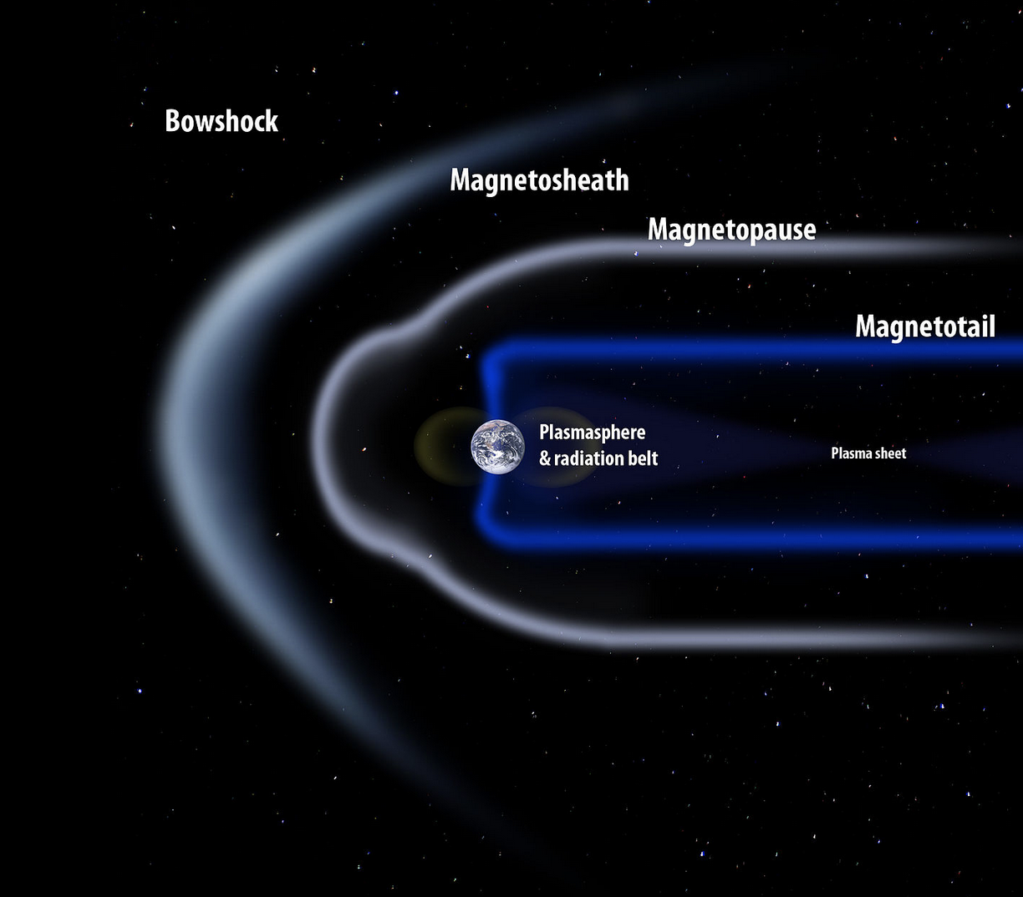
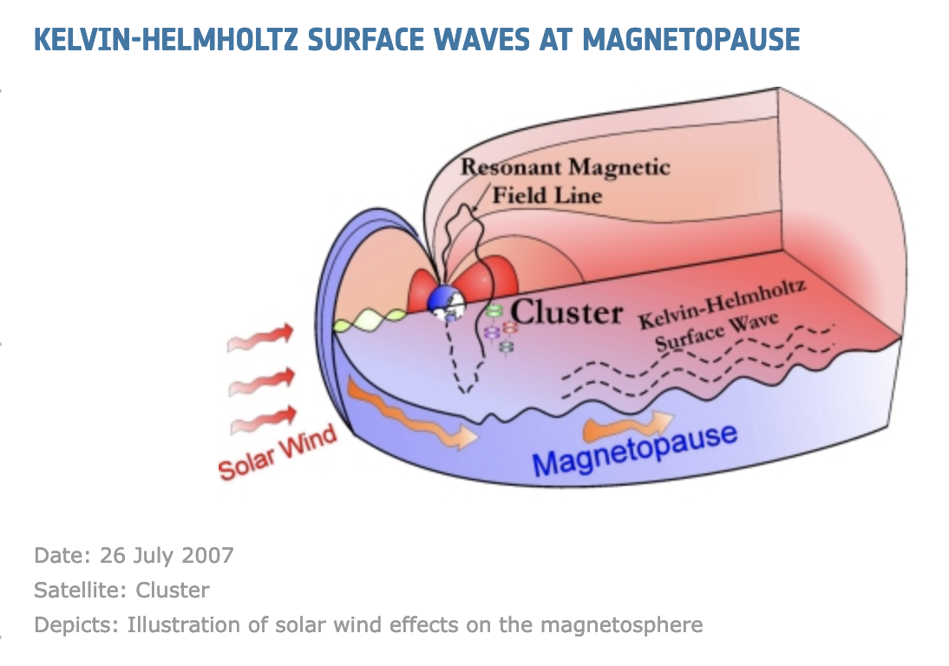
Stellar/Planetary Physics – Magnetopause
The magnetospheres of stars interact with those of planets
The Earth’s magnetic field shields it from cosmic rays from the Sun
The magnetic fields of Sun and Earth are in approximate equilibrium at the magnetopause layer
The magnetopause is unstable to Kelvin-Helmholtz instability
CC BY-SA 3.0
9
Notes:
https://en.wikipedia.org/wiki/Magnetopause
https://sci.esa.int/web/cluster/-/41214-kelvin-helmholtz-surface-waves-at-magnetopause

Slide 10
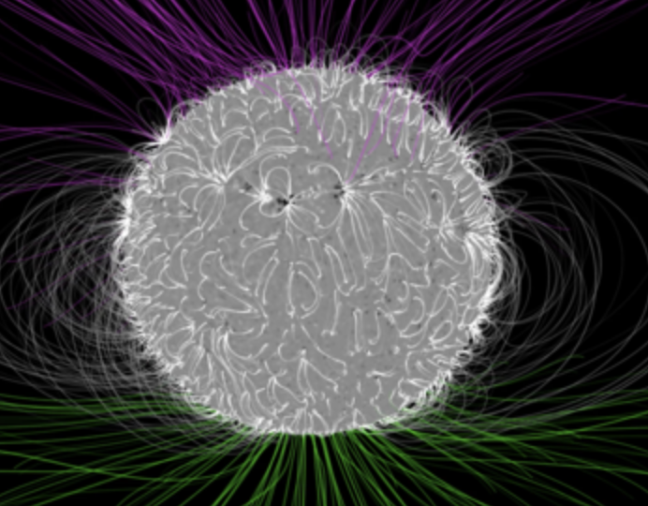
Ferraro’s Law of Isorotation
$$φ$$
z
What anchors B fields to rotating conductors (magnetospheres)?
Take a rotating star like the sun and assume axisymmetry
In equilibrium ($∂_{t}=0$), Faraday’s Law reads
Then so
For a force-free magnetosphere ($\vec{E}+\vec{v}×\vec{B}=0$)
So $−\vec{E}=\left(\left[\begin{aligned}0 \\ 0 \\ Ω\end{aligned}\right]×\left[\begin{aligned}s \\ 0 \\ z\end{aligned}\right]\right)×\vec{B}=\left[\begin{aligned}0 \\ sΩ \\ 0\end{aligned}\right]×\vec{B}=\left[\begin{aligned}sΩB_{z} \\ 0 \\ −sΩB_{s}\end{aligned}\right]$ and Faraday’s law w./ $∂_{t}=0$ gives
Using we have
Let ${\vec{Ω}}^{∗}$ be the star’s ang. vel. and apply b.c. E_{tang} continuous at $θ=0$ plane:
s
$$0=\frac{∂\vec{B}}{∂t}=−\vec{∇}×\vec{E}$$
$$0=\frac{∂\vec{B}}{∂t}=\oint_{∂S}^{.}{\vec{E}∙d\vec{s}}=2πsE_{φ}⟹E_{φ}=0$$
$$\vec{E} ∝\hat{φ}×\vec{B}=−A\left(\hat{Ω}×\vec{r}\right)×\vec{B}, \vec{r} ε Span(\hat{s},\hat{z})$$
Credits: NASA's Goddard Space Flight Center/Bridgman
$$\vec{E}=−\vec{v}×\vec{B}=−\left(\hat{Ω}×\vec{r}\right)×\vec{B}$$
$$\vec{0}=\vec{∇}×\left(\left(\hat{Ω}×\vec{r}\right)×\vec{B}\right)=(∂_{z}\left(sΩB_{z}\right)+∂_{s}\left(sΩB_{s}\right))\hat{φ}$$
$$0=\vec{∇}∙\vec{B}=\frac{1}{s}∂_{s}\left(sΩB_{s}\right)+∂_{z}B_{z}$$
$$\left(\vec{B}∙\vec{∇}\right)\vec{Ω}=\vec{0}$$
$$E_{\text{tang}}^{\text{ext}}=E_{z}^{\text{ex}\text{t}}=$$
$$s{Ω^{∗}B}_{\text{n}\text{orm}}^{\text{ex}\text{t}}=s{Ω^{∗}B}_{s}^{\text{ex}\text{t}}$$
$$=E_{\text{tang}}^{\text{int}}=s{ΩB}_{\text{norm}}^{\text{in}\text{t}}$$
10
$$\vec{Ω}={\vec{Ω}}^{∗}$$
Notes:
MCP Ex. 19.11

Slide 11
MHD Applications:
Plasma Physics
11

Slide 12
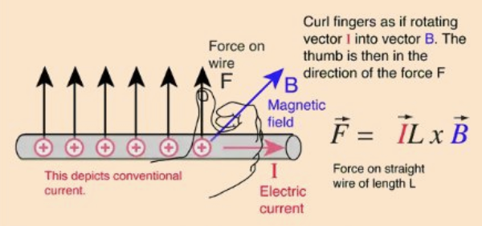
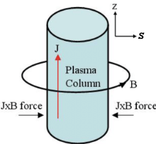
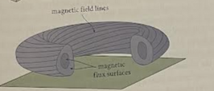
Magnetic Plasma Confinement
Magnetic force on a current-carrying wire:
Units of pressure gradient are related to those of force by:
[Grad P]=[P]/[L]=[F]/[L]³
Units of current density $\vec{j}=\frac{dI}{dA_{⊥}}\hat{A}$ are related to those of current by:
[j]=[I]/[L]²
In cylindrical coords $\{s,φ,z\}$, plasma carrying current $\hat{z}$has pressure gradient balanced by where
Other geometries can be magnetically confined:
$${\vec{F}}_{wire}=I\vec{L}×\vec{B}$$
From http://hyperphysics.phy-astr.gsu.edu/hbase/magnetic/forwir2.html
$$\vec{∇}P=\vec{j}×\vec{B}$$
$$\vec{j}=\frac{1}{μ_{0}}\vec{∇}×\vec{B}$$
Credit: Wilkin Tang
$φ$- Pinch Tokamak
From: Modern Classical Physics (Thorne & Blandford)
Notes:
https://www.researchgate.net/publication/30864443_Theoretical_Analysis_of_Some_Contemporary_Issues_on_Wire-Array_Z-Pinch

Slide 13
MHD Applications:
Jets, Accretion Flows and Black Holes
13

Slide 14
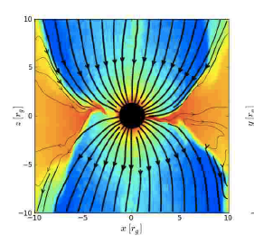
Accretion disk dynamos in jet/accretion disk/black hole (jab) Systems
Accretion disks around supermassive black holes can generate dynamos that build up helical magnetic fields in jets S. A. Colgate, T. K. Fowler, H. Li, J. Pino, ApJ 789,144 (2014) [Paper I.]
Poloidal disk magnetic field boundary conditions can support stable Poynting flux jet steady states S. A. Colgate, T. K. Fowler, H. Li, E. B.Hooper, J. McClenaghan, Z.Lin, ApJ 813, 136 (2015) [Paper II.]
Poynting flux jets can accelerate particles to ultra-high-energies analogously to spheromaks T. K. Fowler & H. Li, J. Plas. Phys. 82, 595820503 (2016) [Paper III.]
Analytical models of cosmic ray acceleration by accretion disk dynamos are supported by simulations and yield observational predictions Fowler, Li & Anantua (2019) ArXiv1903.06839v1 (ApJ 885, 4 (2019)) [Paper IV.]
Hawley et al. 2015. Paper II. Paper III. McKinney & Blandford 2009
14

Slide 15
GRMHD Simulation Assumptions and Fluid Equations
Start with a HARM GRMHD simulation assuming:
Geometrically thick disk
Magnetically arrested disk
Jet power derived from flux threading black hole of mass M
and spin a/M=0.92
Mass conservation
Energy-momentum conservation
$$∇_{μ}\left({ρu}^{μ}\right)=0$$
McKinney, Tchekhovskoy and Blandford
MNRAS 423 3083 (2012)
$$∇_{μ}T^{μν}=0$$
$r_{g}=M=\frac{GM_{BH}}{c^{2}}=5.0×{10}^{12}$m
$$T_{ν}^{μ}=\left(ρ+u_{g}+P_{g}+b^{2}\right)u^{μ}u_{ν}+{(P}_{g}+b^{2}/2)δ_{ν}^{μ}−b^{μ}b_{ν}$$
Notes:
------
Compare Induction Eq.
partial B/partial t – curl(u x B) = 0, curl(u x B) = curl(<uy Bz- uz By, uz Bx – ux Bz, ux By – uy Bx> ) =
<Dz(uz Bx – ux Bz)-Dy(ux By – uy Bx),
Dx(ux By – uy Bx)-Dz(uy Bz- uz By),
Dx(uz Bx – ux Bz)-Dy(ux By – uy Bx)>1
X_mu = eta_mu nu X^nu
X_0 = eta_00 X^0 + eta_01 X^1 + eta_02 X^2 + eta_03 X^3 = -X^0
Dx Bi vx – Dx Bx vi + Dy Bi vy – Dy By vi + Dz Bi vz – Dz Bz vi

Slide 16
GRMHD Simulations in action
McKinney & Blandford (2009)

Slide 17
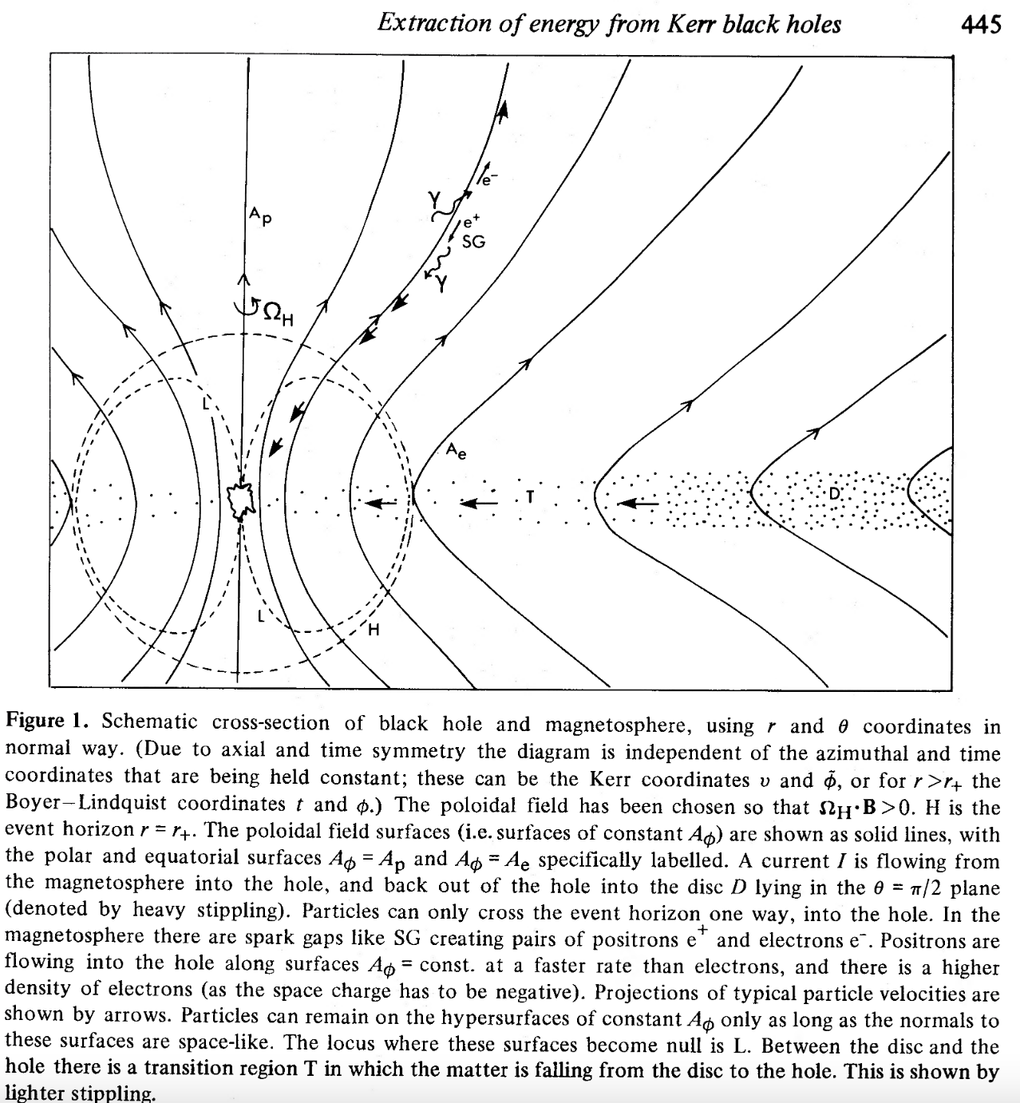
Blandford-Znajek Mechanism
Rotating black holes accreting flux due to vertical magnetic field B source bipolar relativistic outflows via the Blandford-Znajek (BZ) mechanism (Blandford & Znajek 1977)
The BZ jet power depends on the initial field configuration, and liberates electromagnetic power (luminosity) with scaling dependencies on black hole spin a and horizon-threading flux $Φ_{H}$:
For an accretion disk-fed black hole
Paraboloidal initial field solution
BZ jets in active galactic nuclei (AGN) typically have $V\sim 100EV$, $Φ_{H}\sim {10}^{25−28}Wb$, $I\sim$10PA-1EA (Blandford & Anantua 2017)
$$L_{BZ}\sim {\left(aΦ_{H}\right)}^{2}$$
$$Φ_{H}\sim \sqrt{\dot{M}r_{g}c}$$
$$L_{BZ}=$$
Notes:
https://articles.adsabs.harvard.edu/pdf/1977MNRAS.179..433B
https://academic.oup.com/mnras/article/447/2/1498/2593773
I could title this slide with some explicit astrophysical term, but Roger Blandford’s name is synonymous with relativistic jets

Slide 18
Disk-Dynamo-Driven Jets
Seed$\vec{B}$ field gets amplified by dynamo current $I_{\text{dyn}}$
$\vec{E}$ field , Voltage
When current $I_{\text{dyn}}$ reaches $V/Z_{0}$, a jet is launched at speed $≈$ $c$
Ohm’s Law with turbulent hyperresistivity $\vec{D}$and in terms of potentials $\vec{A}$ and $Φ$:
Jet momentum equation:
, where
$$E_{r}=\left|rΩB_{z}/c\right|$$
$$V=\int{dr}E_{r}$$
$$\vec{E}+\frac{1}{c}{\vec{v}}_{⊥}×\vec{B}=−c\frac{∂\vec{A}}{∂t}−\vec{∇}Φ+\frac{1}{c}{\vec{v}}_{⊥}×\vec{B}=\vec{D}$$
$$\frac{d\vec{P}}{dt}=\frac{1}{c}\vec{j}×\vec{B}+σ\vec{E}−\vec{∇}p_{amb}$$
$$σ=\frac{1}{4π}\vec{∇}∙\vec{E}$$
Notes:
-----------------------------------------
I(r =~ 20M) = V/Z0
E=vxB=(Omega x R)xB

Slide 19
Conical jet Steady State
Force-free degenerate electrodynamics (FDE) approximation and $\vec{D}$= $\vec{0}$
for $p_{amb}=0, j_{φ}=0$ gives jet expansion steady state (dP_{r}/dt=0) when
Ohm’s law in the conical jet gives:
These jets have $\vec{j}×\vec{B}≠\vec{0}$and are launched by force due to $\vec{E}$
Near black hole ($r≲100M$): $I= V/Z_{0}$, power extracted ${\sim V}^{2}/Z_{0}$ (Blandford & Anantua 2017)
$${\left(\frac{1}{c}\vec{j}×\vec{B}+σ\vec{E}\right)}_{r}=\frac{1}{c}{B_{z}j}_{φ}−\frac{1}{8πr^{2}}{\frac{∂}{∂r}r}^{2}\left(B_{φ}^{2}−E_{r}^{2}\right)=0$$
$$E_{r}=B_{φ}$$
$$E_{r}=\frac{1}{c}\left(rΩ{|B}_{z}|+{v_{z}B}_{φ}\right)$$
$$⟹v_{⊥z}≈cE_{r}/B_{φ}≈c$$
Conical Jet
$$\frac{dL}{dt}≈v_{⊥z}≈c\left(\frac{E_{r}}{B_{φ}}\right)$$
$${\frac{dL}{dt}≈c⇔E}_{r}≈B_{φ}$$
Notes:
We begin by treating the jet plasma in this model as:
-Force-free (i.e., Lorentz force is negligible and momentum carried by E& M fields)
-Degenerate (i.e., enough mobile charges to form currents and screen E fields)
The momentum equation can be solved in the force-free degenerate electrodynamics approximation with 0 ambient pressure to yield a steady state with $E_{r}=B_{φ}$
This gives a conical jet with no net collimating pinch force
This jet propagates away from the black hole at almost the speed of light
As the disk dynamo current grows, the conical jet current remains at I = V/$Z_{0}$, which we will see is due to short circuiting
-----------------------------------
Er = Bphi does not self collimate
No net collimating pinch force
Force free <-> magnetization more important than plasma inertia
Degenerate <-> Electric field screened by electric currents

Slide 20
Tower jet Steady State
A magnetic tower Grad-Shafronov steady state solution (Paper II) of FDE approximation
occurs for whenever the jet slows down so that
These jets have $\vec{j}×\vec{B}=\vec{0}$
As $B_{φ}$ exceeds $E_{r}$ in the disk, jet cumulative current $I_{jet}\left(r\right)$ can grow past$I_{jet}\left(a\right)=I_{A}$
For typical AGN lifetime $τ$ $≈$100 Myr, our tower model predicts and
$${\left(\frac{1}{c}\vec{j}×\vec{B}+σ\vec{E}\right)}_{r}=\frac{1}{c}{B_{z}j}_{φ}−\frac{1}{8πr^{2}}{\frac{∂}{∂r}r}^{2}\left(B_{φ}^{2}−E_{r}^{2}\right)=0$$
$$E_{r}<<B_{φ}$$
$$\frac{dL}{dt}≈c\left(\frac{E_{r}}{B_{φ}}\right)≪c$$
Tower Jet
$$λ\left(ψ\right)=\left|\frac{j_{z}}{B_{z}}\right|$$
$$ψ\left(r,z\right) Poloidal Flux$$
$$L=\left[{\left(\frac{dL}{dt}\right)}_{tower}τ\right]≈0.01cτ ≈{10}^{24}\text{cm}$$
$$R=0.1L{=10}^{23}\text{cm}$$
Notes:
------------------------------------
D_phi =~ -D_r by Paper I Appendix A
Inside the disk, v_z<v_r
Er = Bphi does not self collimate
Keplerian disk constrains angular momentum
There is a min radius a at which solution fails

Slide 21
Why Don’t Towers Emerge in some grmhd Simulations?
Energy dissipation is related to jet speed in Paper II: .
The persistence of turbulent short circuits (seen in poloidal current (j_{x},j_{z}) below) may suppress tower formation in simulations, e.g., (McKinney et al., 2012)
$f_{eff}$ = efficiency of
converting accretion power to
EM power instead of
shocks, ion acceleration,…
$f_{eff}\left(IV\right)=\frac{d}{dt}\int{d\vec{x}}\left(\frac{B^{2}+E^{2}}{8π}\right)≈\frac{d}{dt}\left\{{L\left(\frac{I}{c}\right)}^{2}\left[1+\frac{I_{⊥}^{2}}{I^{2}}\ln{\frac{R_{2}(z)}{R_{1}(z)}}+\frac{I_{||}^{2}}{I^{2}}\ln{\frac{R}{a}}\right]\right\}$
then
$\frac{dL}{dt}≈\frac{f_{eff}c}{1+\frac{1}{4}\frac{v_{⊥z}^{4}}{v_{A}^{∗4}}\ln{\frac{R_{2}(z)}{R_{1}(z)}}+{\left(1−\frac{v_{⊥z}^{2}}{v_{A}^{∗2}}\right)}^{2}\ln{\frac{R}{a}}}$ $→ \left\{\begin{aligned}\frac{c}{1+\frac{1}{4}\ln{\frac{R_{2}}{R_{1}}}}>0.8c, f_{eff}=1,v_{⊥z}≈v_{A}^{∗} (conical jet) \\ \frac{c/4}{1+0.9\ln{\frac{R}{a}}}≈0.01c,{ f}_{eff}=\frac{1}{4},I_{∥}≈\frac{15}{16}I, R\left(t\right)=0.1L\left(t\right) at L=0.01{ L}_{max},\ln{\frac{R}{a}}≈20 (tower jet)\end{aligned}\right.$
Current loops in xz-slices for
-20M<x,z<20M,
the region of greatest gravity-
driven MRI activity
Notes:
--------------------
feff=fdis = ½(1−fconv) , fconv = frac EM power to ion accel
½ IV generates shocks; and ion acceleration uses between 0 (fconv=0, feff=fdis=½ ) and ½ IV (fconv=1, feff=fdis=0)
feff $∝$ remaining CC power not dissipated to ions
fconv=1=> feff=fdis=0 (all EM power dissipated to ions)
fconv=0=> feff=fdis=½ (no EM power dissipated to ions, half EM power to shocks)
-----
https://www.nature.com/articles/s42005-018-0103-7

Slide 22
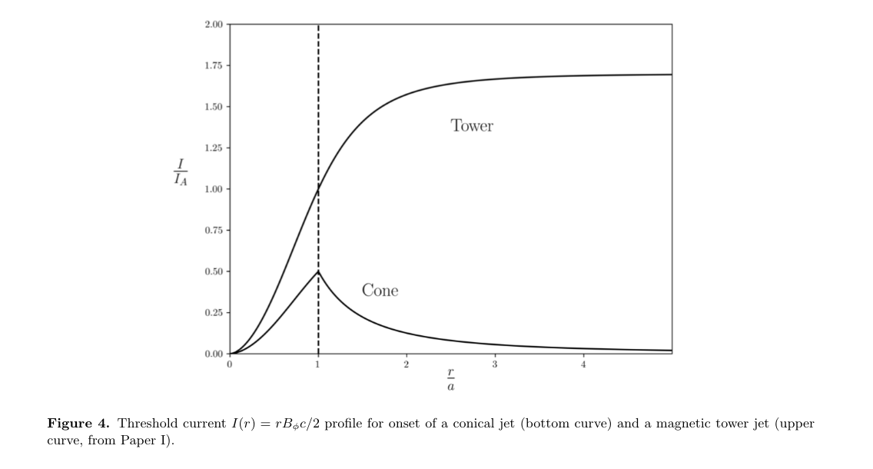
Eliminating the short circuit
Short circuit current density component ${\vec{j}}_{⊥}^{∗}$is maintained by acceleration as
where the poloidal force component
vanishes with sufficient ambient pressure gradient
The short circuit component $j_{φ}$ can eliminated for $\frac{dL}{dt}→0$
$${\vec{j}}_{⊥}^{∗}={\vec{j}}_{⊥}−σc\frac{\vec{E}×\vec{B}}{B^{2}}=−\frac{c}{B^{2}}\left(\frac{d\vec{P}}{dt}×\vec{B}\right)$$
Cumulative Current vs. Cylindrical Radius
$$\frac{d{\vec{P}}_{Pol}}{dt}≈ρ\frac{∂}{∂t}\left(c{\vec{E}}_{ϕ}×\frac{\vec{B}}{B^{2}}\right)=\frac{1}{c}{\left({\vec{j}}_{⊥}^{∗}×\vec{B}\right)}_{Pol}−\vec{∇}p_{amb}, for \frac{d\vec{P}}{dt}≈ρ\frac{∂\vec{v}}{∂t}$$
$$\frac{1}{c}\frac{∂{\vec{E}}_{ϕ}}{∂t}≈{\left(\frac{dL}{dt}\right)}^{2}\frac{1}{c^{2}r}\frac{∂^{2}ψ}{∂z^{2}}$$
$$≈\frac{4{πj}_{φ}^{∗}}{c}−4πr\frac{dp_{amb}}{dψ}$$
$$ψ={rA}_{φ}, \hat{φ}×\vec{B}=\frac{1}{r}\vec{∇}ψ$$
Slowing down the jet eliminates the short circuit current ${\vec{j}}^{∗}$ (for suitable ambient pressures)

Slide 23
Ion acceleration in jets
$$\frac{d\vec{p}}{dt}=e\left(\frac{1}{c}\frac{\vec{p}}{mγ}×\vec{B}+\vec{E}−{\vec{E}}_{rad}\right)$$
In the relativistic limit, jet particle momentum is given by
where $\vec{E}$ is given by Ohm’s law with relativistic correction and Hall terms:
Hyperresistivity $\vec{D}$ also has units of electric field, and components
Plasma turbulence (hyper-resistivity $\vec{D}$ in Ohm’s law) accelerates jet ions
In the Central Column by kink modes with $r_{Lar}≪a$
In the Nose by resonance with electron drift waves for $r_{Lar}\sim Δ$, where $Δ$ is magnetic flux width
$$\vec{E}+\frac{1}{c}\vec{v}×\vec{B}−\sum_{particles}{\left[\int{d\vec{p}\left(\frac{f}{n}\right)\left(\frac{m_{e}γ_{e}}{mγ}\right)\frac{\vec{u}\left(\vec{u}∙\vec{E}\right)}{c^{2}}}\right]}−\left(\frac{\vec{j}}{nec}\right)×\vec{B}−\vec{D}=\vec{0}$$
Relativistic correction
Hall term
Hyperresistivity
$${{\vec{D}}_{⊥}=E}_{⊥}+\frac{1}{c}\vec{v}×\vec{B} , {\vec{D}}_{||}={\vec{E}}_{||}−\sum_{particles}{\left[\int{d\vec{p}\left(\frac{f}{n}\right)\left(\frac{m_{e}γ_{e}}{mγ}\right)\frac{{\vec{u}}_{||}\left(\vec{u}∙\vec{E}\right)}{c^{2}}}\right]}\frac{d\vec{B}}{B^{2}}≡C_{rel}{\vec{E}}_{||}, C_{rel}≈1$$
Notes:
--------------------------
Relativistic correction arises from $\frac{∂γ_{L}}{∂p}$ in an integration by parts

Slide 24
Ion acceleration: central column Vs. Nose
$$\frac{dp_{||}}{dt}=e\left(E_{||}−E_{rad}\right), E_{||}=D_{||}=−\frac{1}{c}{\left\langle {\vec{v}}_{1}×{\vec{B}}_{1}\right\rangle }_{||}=−{\left\langle \frac{\left(E_{1}×\vec{B}\right)×{\vec{B}}_{1}}{B^{2}}\right\rangle }_{||}$$
In the Central Column (CC),
where subscript “1” indicates 3D fluctuations around the mean fields due to kink modes contributing to ${\vec{E}}_{||}$, $η_{H}=D_{||}/j_{||}$, $j_{||}=\frac{cB_{a}}{4πa}, D_{r}^{H}=c^{2}\frac{c^{2}η_{H}}{4π}$
Ideal MHD fluctuations can correlate to produce finite $E_{||}$ (cf. SPHEX experiment (al Karkhy et al. 1993))
Energy is dissipated into ions by curvature radiation and electrons by synchrotron:
To find maximum Lorentz factor, set E|| equal to the maximum $\vec{E}$ field under curvature radiation for which independent of particle mass
In the Nose, curvature radiation parameter $α_{C}∝1/r$, so particle acceleration is no longer limited by curvature radiation
Drift Cyclotron Loss Cone (DCLC) instability (Post & Rosenbluth 1966) accelerates ions in the nose to $γ\sim {10}^{11}$ ($E\sim {10}^{20}$eV)
$$⟹{\vec{E}}_{||}=−\left\langle {\vec{E}}_{1⊥}∙{\vec{B}}_{1⊥}\right\rangle \frac{\vec{B}}{B^{2}}, E_{||}=−\frac{1}{c}{\left\langle {\vec{v}}_{1}×{\vec{B}}_{1}\right\rangle }_{||}=η_{H}j_{||}≈\left(\frac{D_{r}^{H}}{ac}\right)B_{a}≈\left(\frac{a}{ct}\right)B_{a}=\frac{V}{ct}$$
Hyperresistive-Diffusion-Mediated Ion Transport
$$∆V=LE_{||}=0.01V$$
$$E_{||}=E_{rad}=\frac{2}{3}eα_{C}^{2}{\left(\frac{vγ}{c^{2}}\right)}^{4}, α_{C}=\frac{c^{2}}{R_{C}},R_{C}=a$$
$$γ_{CC}≤{\left(\frac{3E_{||}R_{C}^{2}}{2e}\right)}^{1/4}=3.4×{10}^{7}M_{8}^{\frac{5}{8}}$$
Jet ions (red)
Cosmic rays (black)
Notes:
Kink instability https://www-users.york.ac.uk/~bd512/teaching/media/mcf_lecture_10.pdf
-----------------------
How noise gets power out of mean:
Outward E => Outward j in order that j.E extracts power from the beam

Slide 25
Drift cyclotron loss cone (DCLC) instability
$$ε≡\frac{dn/dz}{n}=\frac{1}{Δ}$$
As ions enter the nose, they excite electron density gradients causing electron “drift waves” giving DCLC instability resonant at the ion cyclotron frequency.
Ions following bending field lines into the nose experience a centrifugal force that causes them to acquire a minimum , giving then a hole in ${f(p}_{⊥})$ around $p_{⊥}=0$
DCLC (with $k_{||}=0$) requires that the distribution function $f$ averaged over $p_{||}$be non-Maxwellian (Paper III.), and the electrostatic potential confining the ions to create a hole in momentum space around $p_{⊥}=0$ , yielding the free energy producing DCLC turbulence
Thus the onset of DCLC changes the dynamics in the following sequence:
DCLC acceleration sets in at ${r>R}_{ac}$
Ion Larmor radius $r_{Li}$ increases to ∆ = a/2, the initial flux width in the nose
Any further increase in energy may cause ions to escape; but, in trying to escape, ions attached to field lines begin to spread out the flux, causing the flux width ∆ to expand so as to contain the most energetic ions.
As the flux expands, β⊥ → 1
$$p_{⊥}=(r_{L0}/a)p_{||}$$
Notes:
-------------------------
R_{ac}/a=1.7x10^5 $M_{8}^{−1/5}$ (p. 24)

Slide 26
Hyper-resistive diffusion of ions in the nose
$$E_{r}=−\frac{1}{c}\frac{∂A_{r}}{∂t}−\frac{∂Φ}{∂t}=\frac{1}{c}v_{z}B_{φ}+D_{r}$$
The radial component of Ohm’s law in the nose
The accelerator field can be expressed
where disk-averaged ion velocity $\left\langle v_{z}\right\rangle ≈dL/dt$ and radial hyper-resistivity is related to vertical hyper-resistivity $\left\langle D_{z}^{H}\right\rangle$ (averaged over ion energies), which ejects ions in the z-direction and $Δ$ is the nose flux width
The escape of cosmic rays vertically drives cosmic ray acceleration radially
Hyperresistivity mediates ion distribution
The solution may be approximated as
Builds up $B_{φ}$
Accelerates CRs
$${\left(E_{r}\right)}_{accl}=−\frac{∂Φ}{∂t}=\frac{1}{c}\left(\left\langle v_{z}\right\rangle −\frac{dL}{dt}\right)B_{φ}+\frac{\left\langle D_{z}^{H}\right\rangle }{cΔ}B_{φ}$$
$${\left(E_{r}\right)}_{accl}≈\frac{\left\langle D_{z}^{H}\right\rangle }{cΔ}B_{φ}$$
$$\frac{∂f}{∂t}=−eE_{r}\frac{∂f}{∂P_{r}}+\frac{∂}{∂P_{r}}D_{pr}^{H}\frac{∂f}{∂P_{r}}+\frac{∂}{∂P_{μ}}D_{pr}^{H}\frac{∂f}{∂P_{μ}}+S=\frac{∂}{∂P_{r}}\left[−e{\left(E_{r}\right)}_{accl}f+D_{pr}^{H}\frac{∂f}{∂P_{r}}\right]+\frac{∂}{∂z}D_{z}^{H}\frac{∂f}{∂z}+\frac{∂}{∂r}D_{r}^{H}\frac{∂f}{∂r}+S$$
$$D_{pr}^{H}=\left\langle {eE}_{1r}Ω_{ci}\int_{−∞}^{t}{dt^{′}eE_{1r}(r^{′}{(t}^{′}))}\right\rangle ,D_{z}^{H}=\frac{D_{pr}^{H}}{{\left(\frac{∂P_{r}}{∂t}\right)}^{2}},D_{r}=D_{μ}D_{pr}^{H}/\left(\frac{∂P_{r}}{∂z}\right)≤r_{Li}^{2}Ω_{ci}≈c∆$$
where
$$f\left(r,E\right)=n\left(r\right)\left[C^{∗∗}\exp{\int_{p_{a}}^{E/c}{dp_{r}}}\left[e{\left(E_{r}\right)}_{accl}\right]/D_{pr}^{H}\right]≈n\left(r\right)\left[C^{∗∗}\exp{\int_{0}^{E}{dE′}}\left[(1/E_{max}(r)\right]\right]≈n\left(r\right)\left(\frac{1}{1.73E_{max}(r)}\right)\exp\left[E/E_{max}(r)\right]$$

Slide 27
Observed flux from distant uhecr sources
The spectrum of CRs becomes $I_{CR}(E)∝E^{−3}$
Where
where
$$I\left(E\right)=\int_{R(E)}^{R}{2πrdr\int_{0}^{Δ}{dz\frac{∂}{∂z}D_{z}^{H}\frac{∂f}{∂z}}}≈\int_{R(E)}^{R}{2πrdr\int_{0}^{Δ}{dzD_{z}^{H}(I/e\left\langle v\right\rangle 2πr∆)f_{0}(E)\left(\frac{κ^{∗}}{Δ^{2}}\right)}}$$
$$≈κ^{∗}(I/e)\int_{R(E)}^{R}{rdr\left(\frac{D_{z}^{H}}{r\left\langle v_{r}\right\rangle }\right)f_{0}(E){\left(eV/rE_{max}\right)}^{2}}≈κ(I/e)\int_{R(E)}^{R}{\frac{1}{r}drf_{0}(E){\left(eV/rE_{max}\right)}^{2}}$$
$$f≈nf_{0}\left(E\right)≈\left(\frac{I}{e\left\langle v_{r}\right\rangle 2πr∆}\right)f_{0}\left(E\right), E=\int_{R\left(E\right)}^{R}{dreE_{r}}, κ=κ^{∗}(D_{z}^{H}/D_{r}^{H})$$
$$I\left(E\right)=κ\left(\frac{I}{e}\right)\int_{E/eV}^{1}{dY\left(\frac{r}{Y}\right)\frac{1}{r}{\left(\frac{eV}{E_{max}}\right)}^{2}\left(\frac{1}{1.73E_{max}}\right)\exp{Y}=κ\left(\frac{I}{e}\right)\left(\frac{1}{eV}\right){\left(\frac{eV}{E}\right)}^{3}K(E)}$$
$$K\left(E\right)=\left(\frac{1}{1.73}\right)\int_{E/eV}^{1}{dYY^{2}\exp{Y}}=(2.73/1.73)\left\{1−\left[2\left(1−\frac{E}{eV}\right)+{\left(\frac{E}{eV}\right)}^{2}\right]\exp{[−(1−E/eV)]}\right\}$$
Notes:
Using the distribution function from DCLC transport theory gives cosmic ray spectrum $I(E)∝E^{−3}$

Slide 28
Comparison with Observation
Following Cronin (1999), denote the photon count rate above energy $E_{1}$ from an AGN, $I_{1}\left(E_{1}\right)$our model gives
For $p=3$ ($I(E)∝E^{−3}$), for $N=470$local AGN (within 80 Mpc) for E₁=6x10¹⁹eV
This is concordant with Pierre Auger Collaboration (2007) observation with Pierre Auger Observatory
$$I_{1}\left(E_{1}\right)=\int_{E_{1}}^{eV}{dE I\left(E\right)=}\int_{E_{1}}^{eV}{dE \left[κ\left(\frac{I}{e^{2}V}\right){\left(\frac{eV}{E}\right)}^{p}\right]}=\left(\frac{I}{e}\right)(κ/(p−1))\left[{\left(\frac{eV}{E_{1}}\right)}^{p−1}−1\right]$$
$$\sum_{n=1}^{N}{{\left(I_{1}\left(E_{1}\right)/4πR_{S}^{2}\right)}_{n}}=1/(km2century)$$
Notes:
For AGN within 80 Mpc,
the predicted ${10}^{20}$eV cosmic ray flux on Earth from our models is concordant with
the Pierre Auger Observatory rate of 1 per sq. km per century

Slide 29
Conclusions
Our hyper-resistive diffusion model has two jet quasi-steady states
For typical AGN lifetime $τ$ $≈$100 Myr, our model predicts tower dimensions
Maximum length
Maximum width .
Energetics:
Synchrotron from . in CC: , <1% of total jet luminosity
DCLC transport in nose powers UHECR ion acceleration to up to ${E≈10}^{20}\text{eV}$
Conical State | Tower State
Short-circuited current | Increasing current
Speed dL/dt $≈$ c | Speed dL/dt << c
I<I_{dyn} | I$→$I_{dyn}
Kink unstable | DCLC unstable
$${L=\left(\frac{dL}{dt}\right)}_{tower}τ≈0.01cτ ≈{10}^{24} \text{cm}\text{ =} 320 \text{kpc}$$
$$R=0.1L{=10}^{23}\text{cm}\text{ = }32 \text{kpc}$$
$$∆V=LE_{||}=0.01V$$
$$P=1.4∙{10}^{43}M_{8} \text{erg}\text{/}\text{s}$$

Slide 30
Conclusions: Dynamo-Driven Jets
Disk dynamo produces the following quasi-steady state jets
Conical jet
Expands at speed c
Has constant current I_{jet} = V(a)/Z₀ $≤$ I_{dyn} , a=10R_{s}
Requires short circuit through disk
If jet is slowed, disk short circuit is eliminated so that
I_{jet} increases to I_{dyn}
Collimated magnetic tower emerges
Poloidal field loop instability needed to create dynamo
Notes:
Dynamo power j.E

