Slide 1
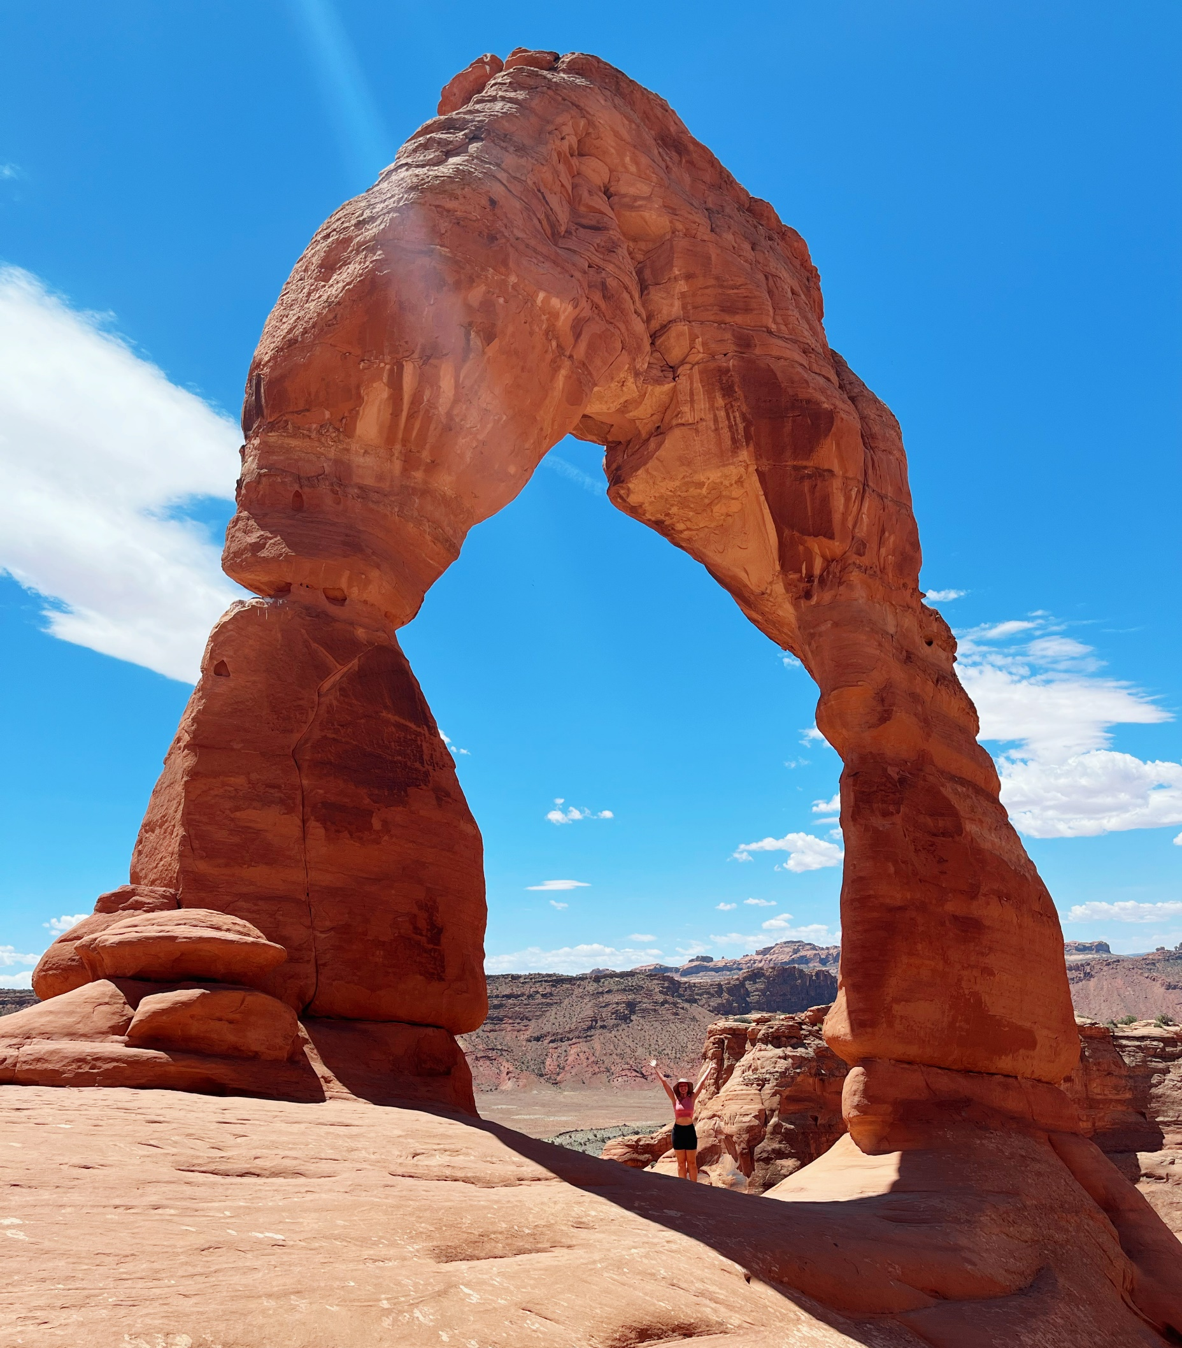
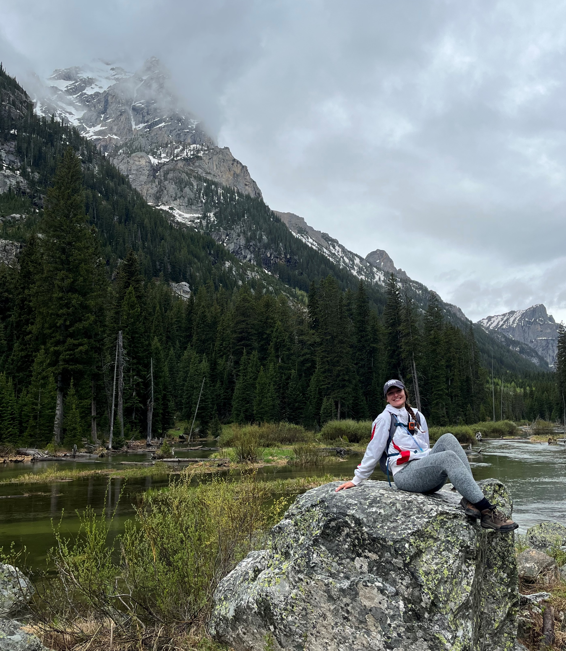
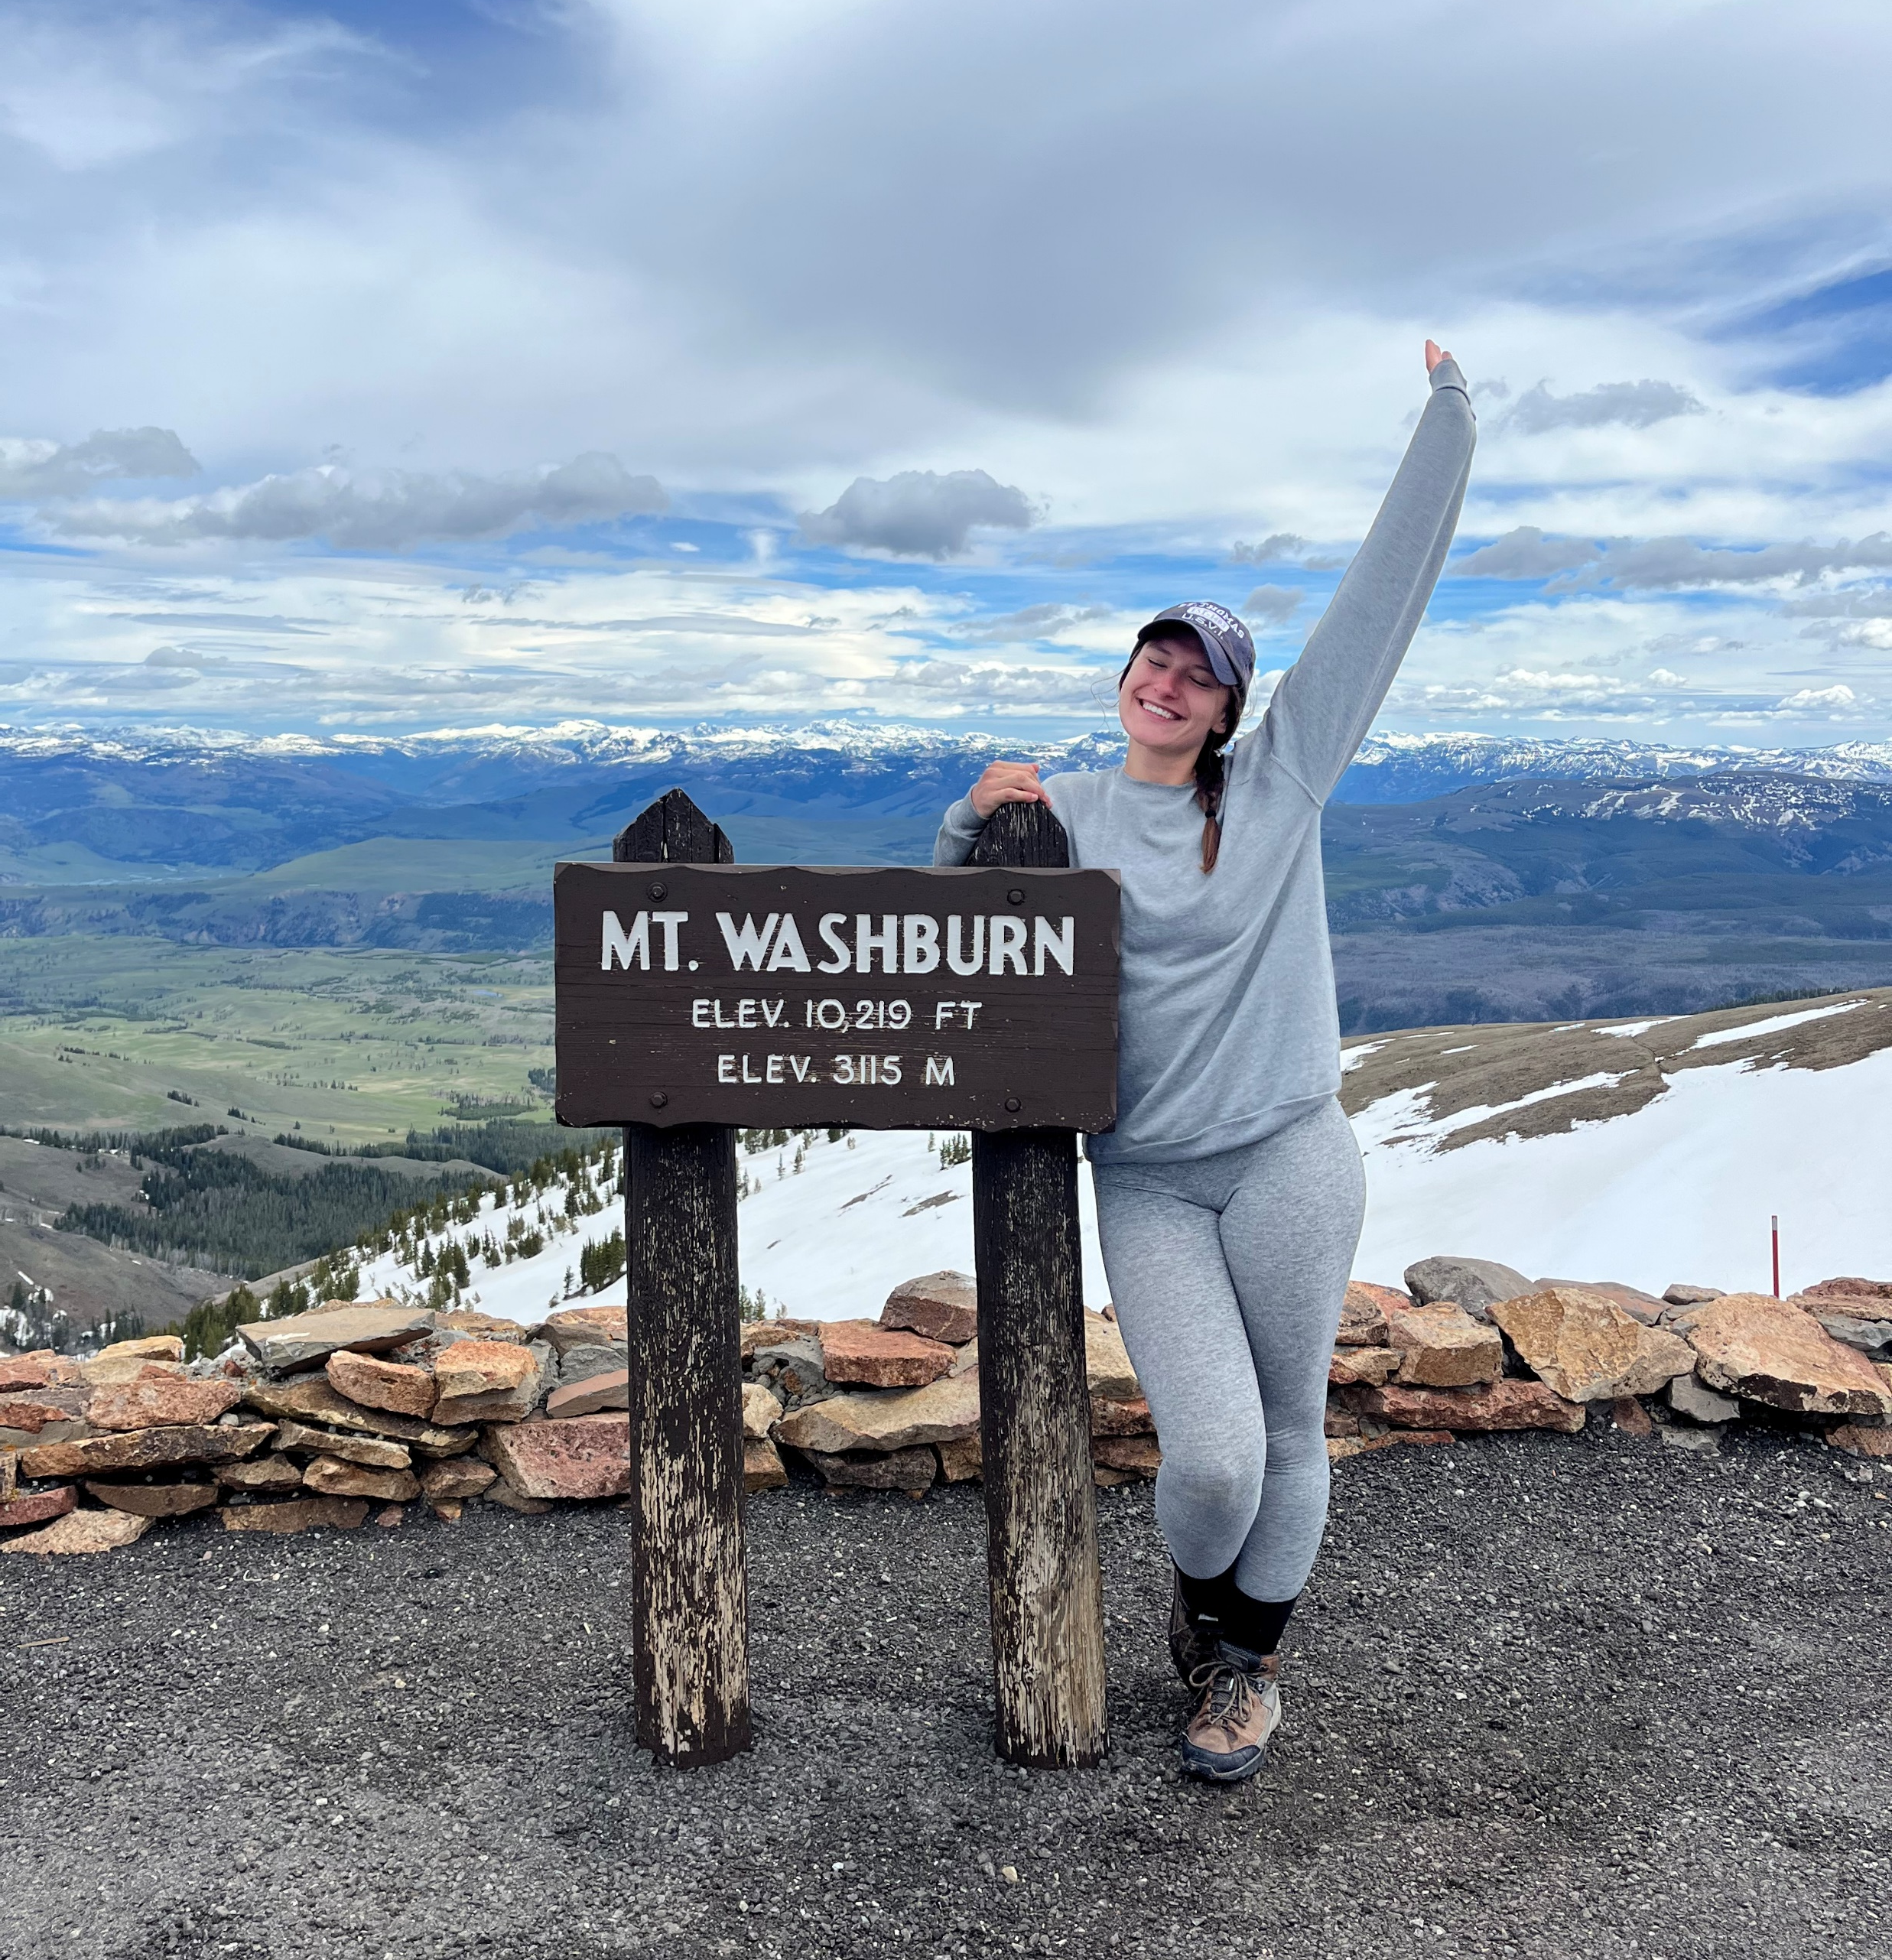
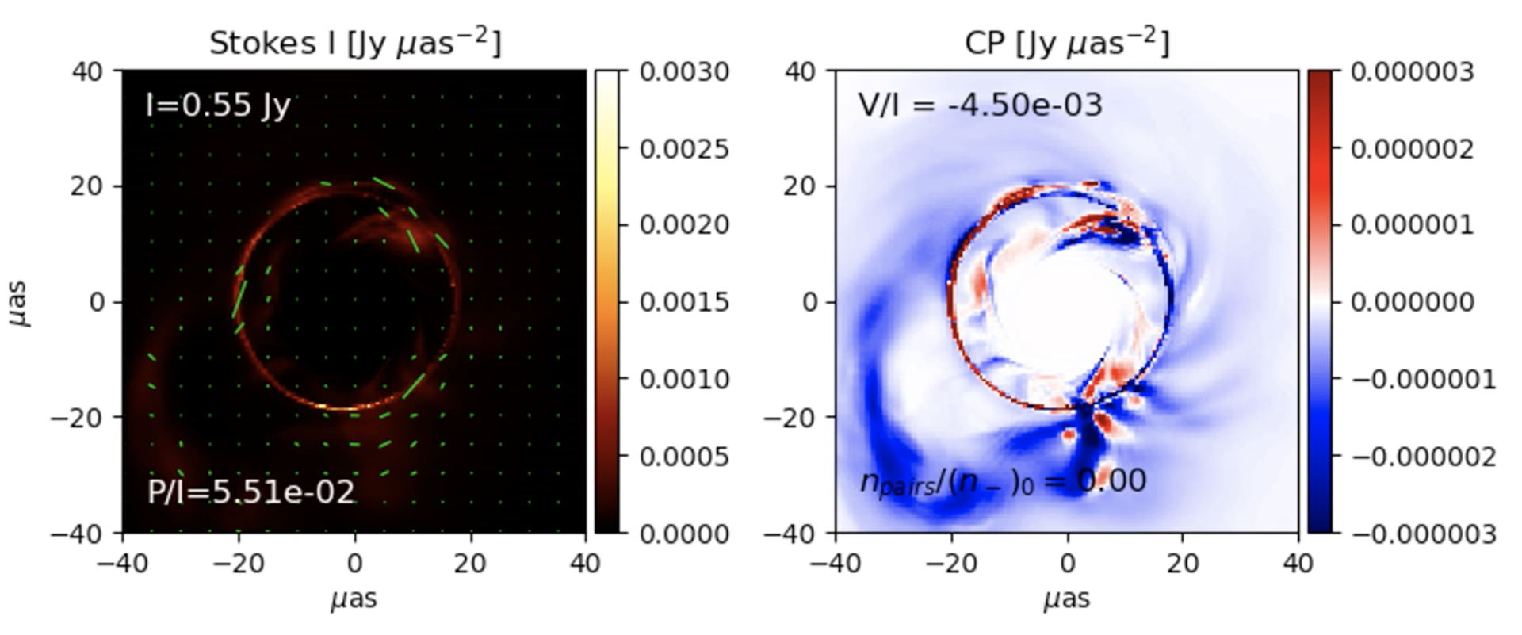
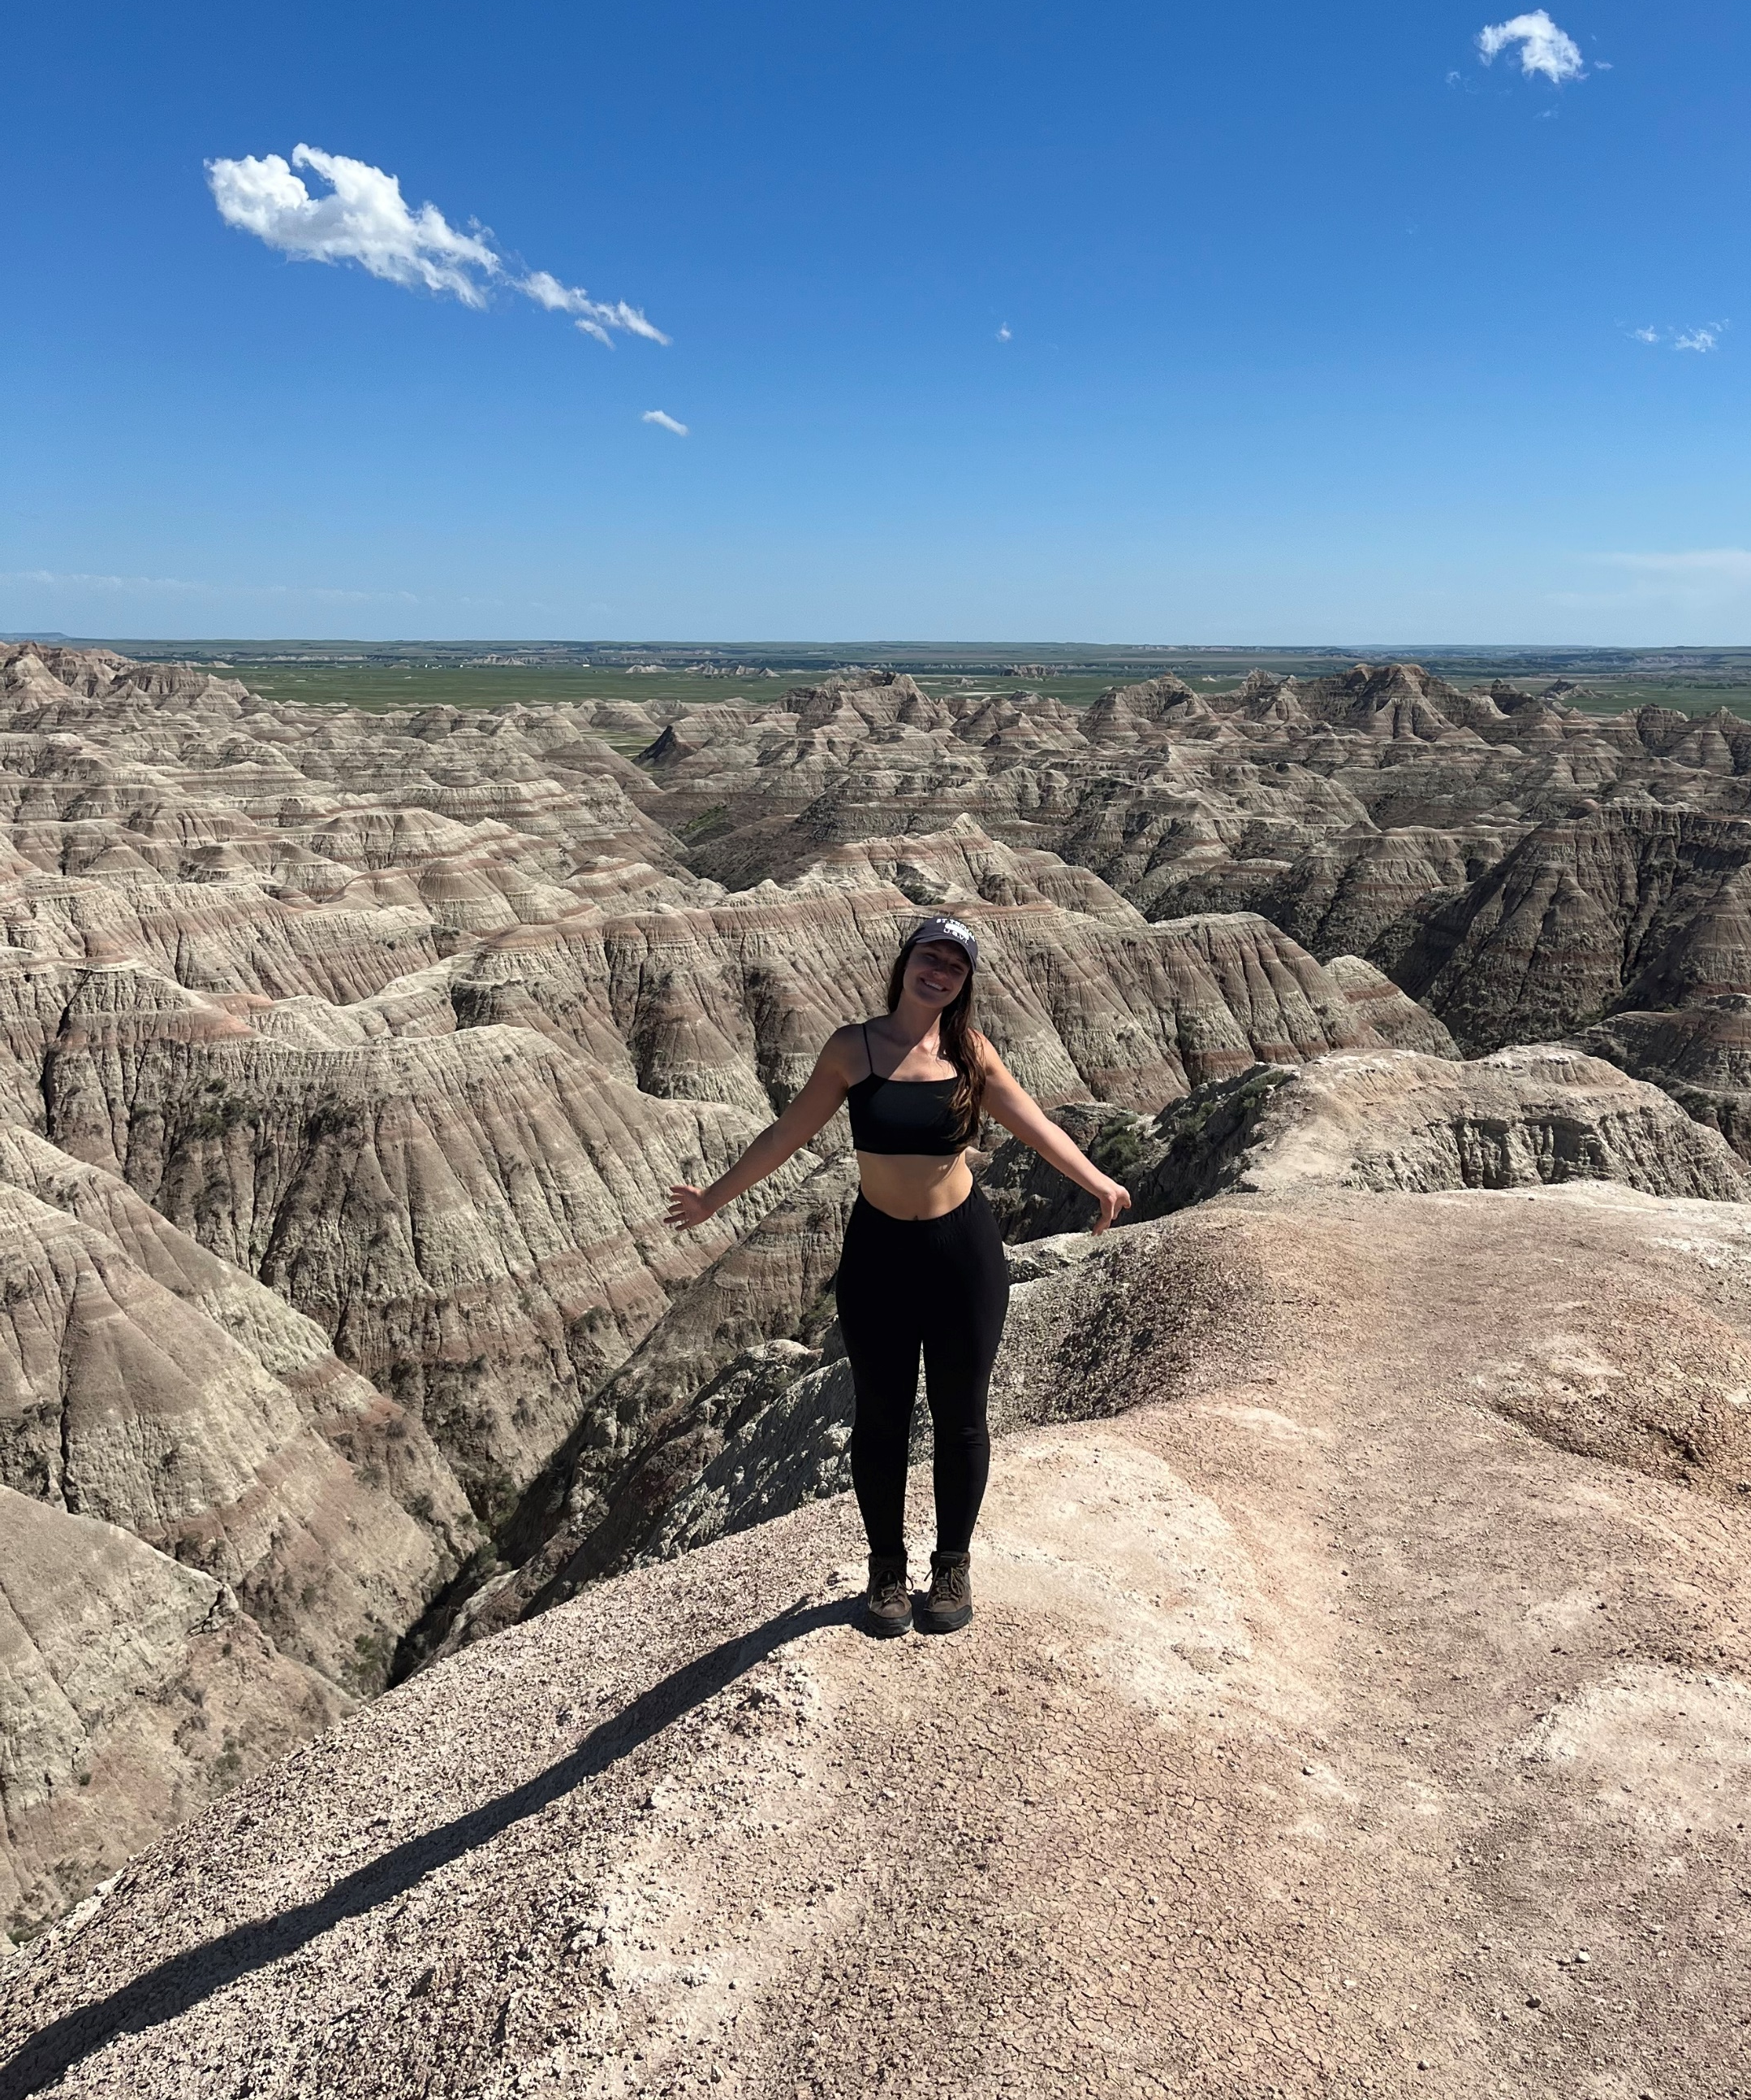
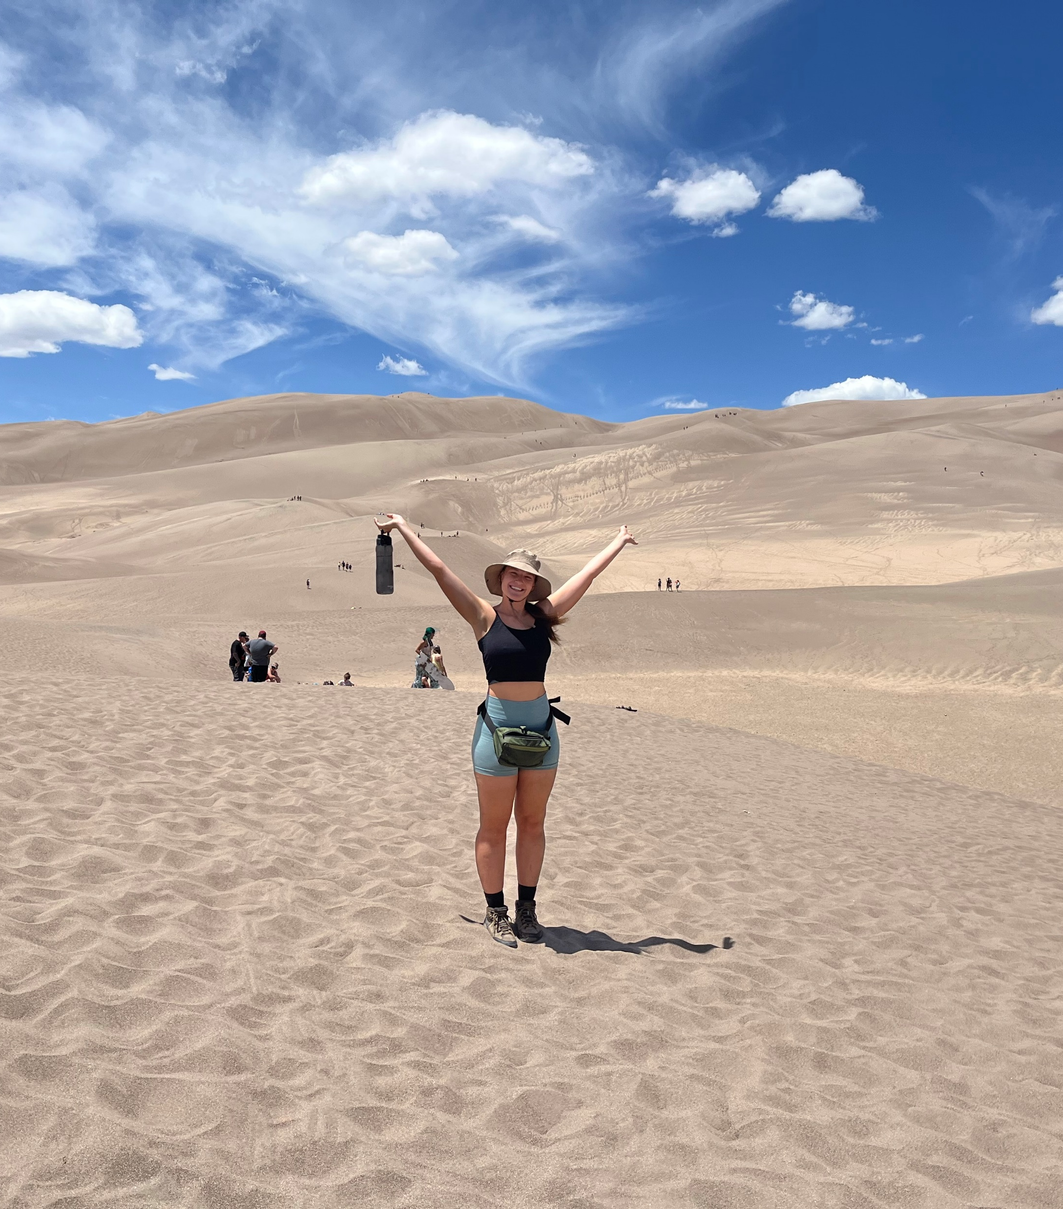
Research Highlights:
Currently using two different radiative transport codes (GRMONTY, IPOLE)
Fine-tuning a thesis in the coming ~timeline~ over modeling emissions from AGN sources using these codes and GRMHD simulations
Personal Highlight
Trying to visit every national park (I thank my undergrad for that ambition)
Most recent publication:
Large flux eruption loop around photon ring at T = 25000 aligning with mass accretion rate trough ($\dot{M}$) and horizon-threading flux peak ($φ$) for spin $a/M=−0.5$
arXiv preprint at https://arxiv.org/abs/2309.05602

