Slide 1
Galactic Dynamics
UTSA PHY 7903 Spring 2024
UNIT 3 – Mechanics of Galaxy Formation
Profs. Richard Anantua and Karl Gebhardt

Slide 2
Review: Classical Mechanics – Virial Theorem
The Virial Theorem states
For 1D and 3D
.
$${\vec{F}}_{k}$$
$$2<T> =−\sum_{k=1}^{N}{<{\vec{F}}_{k}∙{\vec{r}}_{k}>}$$
$${\vec{r}}_{k}$$
~Virial
$$<T> =\frac{1}{2}<x\frac{dV}{dx}>$$
$$<T> =\frac{1}{2}<\vec{r}∙\vec{∇}V>$$
When is a potential energy function V proportional to the virial?
For V $∝$ r^{n}

Slide 3
Classical Mechanics
Classical mechanics – fields and point particles in absolute space and time with “action at a distance”
Newton’s law of universal gravitation where G=6.67x10⁻¹¹Nm²kg⁻²
Dynamics: Newton’s laws of motion (inertia, $\sum_{i}{{\vec{F}}_{i}}=m\vec{a}$, action-reaction)
M₁
M₂
$\vec{Fg}1 on{2}=G\frac{M1M2}{r2}$ $\frac{\vec{r}1−\vec{r}2}{|\vec{r}1−\vec{r}2|}$
r₁-r₂

Slide 4
Classical Mechanics – Newtownian Gravity
Newton’s Law of Universal Gravitation
Gravitational Potential Energy
Kinetic Energy
Taking M₂ = m to be a unit mass, the gravitational potential (P.E. per unit mass) and field (force per unit mass) due to M₁ = M are:
$\vec{F}1 on{2}=\frac{GM1M2}{r2}$ $\frac{\vec{r}1−\vec{r}2}{|\vec{r}1−\vec{r}2|}$
$$Ug=−\frac{GM1M2}{|\vec{r}1−\vec{r}2|}$$
M₁
M₂
r₁-r₂
$KE=\frac{mv^{2}}{2}=\frac{p^{2}}{2m}$,
$p$=$mv$
$$Φ_{g}=−\frac{GM}{r}$$
$$\vec{g}=−\frac{GM}{r2}\hat{r}$$
Gravitational Potential
Gravitational Field

Slide 5
Classical Mechanics – Newtonian Gravity
Potentially useful constants: M_{E}=5.98x10²⁴kg, M_{S}=1.99x10³⁰kg, r_{ES}=1.50x10¹¹m, R_{E}=6.37x10⁶m, R_{S}=6.96x10⁸m, G=6.67x10⁻¹¹Nm²/kg²
EXERCISE: What is the gravitational potential energy binding the Earth to the Sun?
EXERCISE: What is the kinetic energy of Earth orbiting the Sun?
$$U_{g}=−\frac{6.67×10^{−11}\frac{N m^{2}}{{kg}^{2}}∙5.98×10^{24}kg∙1.99×10^{30}kg}{1.50×10^{11}m}=−5.29×10^{33}J$$
$$KE=\frac{1}{2}∙5.98×10^{24}kg{\left(\frac{2π∙1.50×10^{11}m}{365.25∙24∙60∙60 s}\right)}^{2}=2.67×10^{33}J$$

Slide 6
Gauss’ Law for Gravitation
Use $\vec{∇}∙\frac{\vec{r}}{{\left|\vec{r}\right|}^{3}}=4πδ(\vec{r}′)$(HW1) to show Gauss’ Law for Gravitation: $\vec{∇}∙\vec{g}=−4πGρ$
Apply Gauss’ theorem to write Gauss’ law in integral form
$$Φ_{g}=−G\int{\frac{dM(\vec{r}′)}{|r−r^{′}|}}$$
$$\vec{g}=−\vec{∇}Φ_{g}=−G\int{\frac{dM(\vec{r}′)}{{\left|\vec{r}−\vec{r}′\right|}^{2}}\hat{\vec{r}−\vec{r}′}}=−G\int{ρ}\frac{\vec{r}−\vec{r}′}{{\left|r−r^{′}\right|}^{3}}dV$$
$$⇒\vec{∇}∙\vec{g}=−G\iiint{V^{′}}\vec{∇}∙\frac{\vec{r}−\vec{r}′}{{\left|\vec{r}−\vec{r}′\right|}^{3}}ρdV^{′}=−4πG\iiint{V^{′}}ρδ(\vec{r}−\vec{r}′)dV^{′}=−4πGρ$$
$$\iiint{V}\vec{∇}∙\vec{g}dV$$
$$∯{∂V \vec{g}}∙d\vec{S}= .$$
$$=−4πG\iiint{V}ρdV=−4πGρ$$
$$⇒∯{∂V \vec{g}}∙d\vec{S}=−4πGρ$$
Gauss’ Law (Integral Form)

Slide 7
Putting It All Together
$\text{EXERCISE}\text{: }\text{How} \text{are} \text{and} \text{related}\text{? }$
HINT: $\text{The} \text{gradient} \text{in} \text{spherical} \text{coordinates} \text{is}$
$\text{EXERCISE}\text{: }$Using Gauss’ Law for Gravitation find the Laplacian $∆≡∇^{2}=\vec{∇}∙\vec{∇}$ of $Φ_{g}$.
$$Φ_{g}=−\frac{GM}{r}$$
$$\vec{g}=−\frac{GM}{r2}\hat{r}$$
$$\vec{∇}=\frac{∂}{∂r}\hat{r}+\frac{1}{r}\frac{∂}{∂θ}\hat{θ}++\frac{1}{r\sin{θ}}\frac{∂}{∂φ}\hat{φ}$$
$$\vec{g}=−\vec{∇}Φ_{g}$$
$$\vec{∇}∙\vec{g}=−4πGM$$
$$∇^{2}Φ_{g}=\vec{∇}∙\vec{∇}Φ_{g}=\vec{∇}∙\left(−\vec{g}\right)=4πGM$$
Poisson Equation

Slide 8
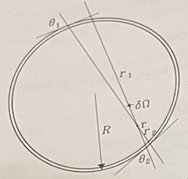
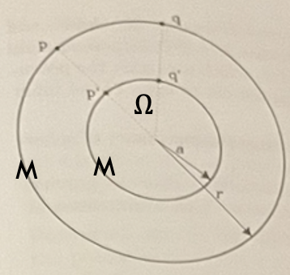
Binney & Tremaine Ch 2.2 Potentials of Spherical Systems: Newton’s Shell Theorems
Newton’s 1st Shell Theorem
At any point in a sphere, surface density $σ$, we choose direction $\hat{r_{1}}≈−\hat{r_{2}}$
The force from the segment at${\vec{r}}_{1}$ of width $r_{1}θ_{1}$ is $F_{1}≈\frac{G\left(π{\left(\frac{r_{1}θ_{1}}{2}\right)}^{2}σ\right)m}{r_{1}^{2}}$
Likewise, from ${\vec{r}}_{2}$, $F_{2}≈\frac{G\left(π{\left(\frac{r_{2}θ_{2}}{2}\right)}^{2}σ\right)m}{r_{2}^{2}}⟹\frac{F_{1}}{F_{2}}≈{\left(\frac{θ_{1}}{θ_{2}}\right)}^{2}≈1^{2}≈1$
Newton’s 2nd Shell Theorem
A shell (radius r, mass M) induces potential $−\frac{GM}{r}$ at 0 (const. everywhere in shell)
Compare potentials across 2 shells between pairs of points on “X” pattern:
Thus, the shells induce the same potentials on each other:
${\vec{F}}_{1}$= ${−\vec{F}}_{2}⟹$
no net force in the sphere
$$δΦ=−\frac{GM}{|\vec{p}−\vec{q}′|}\frac{δΩ}{4π}$$
$$δΦ′=−\frac{GM}{|\vec{p}′−\vec{q}|}\frac{δΩ}{4π}$$
$$\left|\vec{p}−{\vec{q}}^{′}\right|=\left|{\vec{p}}^{′}−\vec{q}\right|$$
$$⇒δΦ^{′}=δΦ$$
$$Φ=Φ′=−\frac{GM}{r}$$
A spherical shell (mass M) gravitates as any smaller concentric shell (or point) w./mass M
Notes:
Potential at p due to q’
Potential at p’ due to q

Slide 9
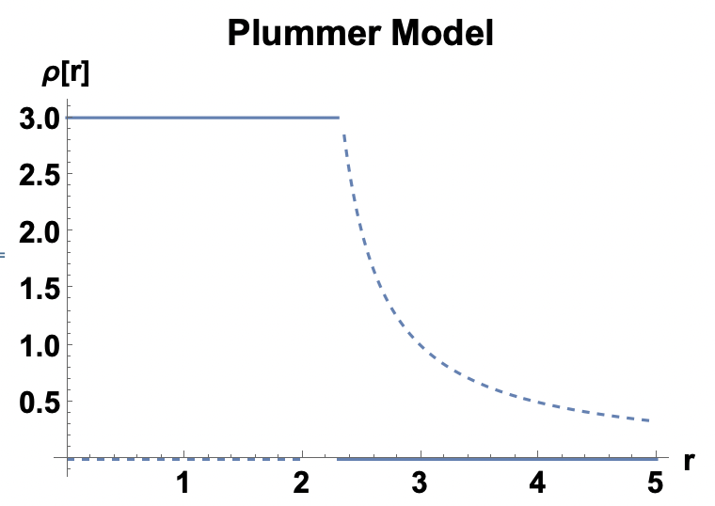
Ch 2 Binney & Tremaine – Spherical Potentials
For point mass at origin $Φ=−\frac{GM}{r}$;
Uniform ball: Let $ρ=ρ_{0}$ for $r≤r_{0}$ and $ρ=0$ otherwise. Derive $Φ(r)$:
Plummer Model: $Φ_{Plummer}\left(r\right)=−\frac{GM}{\sqrt{r^{2}+r_{0}^{2}}}$.
The Laplacian is $∇^{2}Φ_{Plummer}=\frac{1}{r^{2}}\frac{d}{dr}\left(r^{2}\frac{dΦ_{Plummer}}{dr}\right)=−\frac{3GMr_{0}^{2}}{{\left(r^{2}+r_{0}^{2}\right)}^{5/2}}$
The density in the Plummer model is then $ρ(r)=\frac{∇^{2}Φ_{Plummer}}{−4πG}=\frac{3M}{4πr_{0}^{3}}{\left(1+\frac{r^{2}}{r_{0}^{2}}\right)}^{−5/2}$
for point mass at r₀ $Φ=−\frac{GM}{|\vec{r}−{\vec{r}}_{0}|}$
$$r≤r_{0}⟹Φ\left(r\right)=−G\int_{0}^{M\left(r\right)}{\frac{dM\left(r^{′}\right)}{r^{′}}dr^{′}}=−G\int_{0}^{r}{\frac{4π{r^{′}}^{2}ρ_{0}}{r^{′}}dr^{′}}=2πGr^{2}ρ_{0}$$
$$r>r_{0}⟹Φ\left(r\right)=−G\frac{4πr_{0}^{3}ρ_{0}}{3r}$$
$r≪r_{0}$
$$−\frac{GM}{r_{0}\sqrt{{(r/r_{0})}^{2}+1}}$$
$$≈−\frac{GM}{r_{0}}\left(1−\frac{1}{2}\frac{r^{2}}{r_{0}^{2}}\right)+𝒪\left(\frac{r^{3}}{r_{0}^{3}}\right)$$
$r≫r_{0}$
$$−\frac{GM}{r\sqrt{{(r_{0}/r)}^{2}+1}}$$
$$≈−\frac{GM}{r}\left(1−\frac{1}{2}\frac{r_{0}^{2}}{r^{2}}\right)≈−\frac{GM}{r}+𝒪\left(\frac{r_{0}^{3}}{r^{3}}\right)$$

Slide 10
Classical Mechanics – Euler-Lagrange Equations
We have encountered functions mapping vector spaces to vector spaces
A functional is a function over function space (function of functions) –
Much like functions f(x) being optimized when the slope df/dx is 0, functionals are optimized when the variation $\frac{δF}{δx}$ w.r.t. the path x(t) is 0
We wish to find a condition s.t. the first variation $F\left[x+δx\right]−F\left[x\right]$ is 0 to first order terms in $δx$.
Let us parameterize the path: $x\left(α,t\right)=x(0,t)+αη(t)$, where $η\left(t_{1}\right)=0=η\left(t_{2}\right)$
Then we seek a condition so that
Integrating the last term by parts
Euler Lagrange Eq.
Consider the integral functional
$$F\left[x\right]=\int_{t_{1}}^{t_{2}}{f\left\{x,\dot{x};t\right\}dt}$$
$$\frac{δF}{δx}={\left.\frac{∂F}{∂α}\right|}_{α=0}=0$$
$$0=\frac{∂F}{∂α}=\frac{∂}{∂α}\int_{t_{1}}^{t_{2}}{f\left\{x\left(α,t\right),\frac{∂x(α,t)}{∂t};t\right\}dt}=\int_{t_{1}}^{t_{2}}{\frac{∂f}{∂x}\frac{∂x}{∂α}+\frac{∂f}{∂\left(\frac{∂x}{∂t}\right)}\frac{∂^{2}x}{∂α∂t}dt}=\int_{t_{1}}^{t_{2}}{\frac{∂f}{∂x}η(t)+\frac{∂f}{∂\left(\frac{∂x}{∂t}\right)}\frac{dη}{dt}dt}$$
$$0=\int_{t_{1}}^{t_{2}}{\frac{∂f}{∂x}η\left(t\right)−\frac{d}{dt}\frac{∂f}{∂\left(\frac{∂x}{∂t}\right)}η\left(t\right)dt+{\left.η\left(t\right)\frac{∂f}{∂\left(\frac{∂x}{∂t}\right)}\right]}_{{t=t}_{1}}^{{t=t}_{2}}}=\int_{t_{1}}^{t_{2}}{\left(\frac{∂f}{∂x}−\frac{d}{dt}\frac{∂f}{∂\left(\frac{∂x}{∂t}\right)}\right)η\left(t\right)dt}$$
$$\frac{∂f}{∂x}−\frac{d}{dt}\frac{∂f}{∂\left(\frac{∂x}{∂t}\right)}=0$$
Satisfied by Lagrangian $ℒ=T−V$

Slide 11
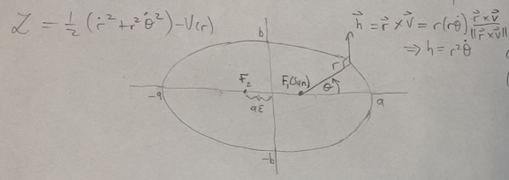
Central Force Motion
The motion of a body under a central force with V=V(r) can be characterized by Lagrangian
$ℒ$ is cyclic in $θ$, i.e., has no explicit $θ$dependence, thus angular momentum is conserved:
We derive the radial Equation of Motion via
To solve the r-E.o.M., note . so $r{\left(\frac{dθ}{dt}\right)}^{2}=r{\left(\frac{h}{r^{2}}\right)}^{2}=\frac{h^{2}}{r^{3}}$
In r-E.o.M. $\ddot{r}−\frac{h^{2}}{r^{3}}+\frac{dV}{dr}=0$, make key substitution: u=1/r:
The radial E.o.M. in u is: $−h^{2}u^{2}\frac{d^{2}u}{{dθ}^{2}}−h^{2}u^{3}+\frac{d\text{Φ}\left(\frac{1}{u(r)}\right)}{dr}=0$
The E.o.M. for gravitational potential $Φ$=GM/r=Gmu is:
$$ℒ=\frac{1}{2}m\left({\dot{r}}^{2}+r^{2}{\dot{θ}}^{2}\right)−V(r)$$
$h=$const.
$$\frac{∂ℒ}{∂r}=\frac{d}{dt}\frac{∂ℒ}{∂\dot{r}}$$
$⟹\ddot{r}−{r\dot{θ}}^{2}+\frac{dΦ}{dr}=0, Φ$= $V/m$
$$h=r^{2}\frac{dθ}{dt}⇒\frac{d}{dt}=\frac{h}{r^{2}}\frac{d}{dθ}$$
$$\frac{dr}{dt}=−\frac{1}{u^{2}}\frac{du}{dt}=−\frac{1}{u^{2}}\frac{dθ}{dt}\frac{du}{dθ}=−r^{2}\dot{θ}\frac{du}{dθ}=−h\frac{du}{dθ}$$
$$\frac{d^{2}r}{{dt}^{2}}=−h\frac{d}{dt}\frac{du}{dθ}=−\frac{h^{2}}{r^{2}}\frac{d^{2}u}{dθ^{2}}=−h^{2}u^{2}\frac{d^{2}u}{dθ^{2}}$$
$$\frac{d^{2}u}{dθ^{2}}+u=\frac{GM}{h^{2}}$$

Slide 12
Gravitational Central Force Motion– Solving the Radial Equation
Equation of motion: $\frac{d^{2}u}{dθ^{2}}+u=\frac{GM}{h^{2}}$
The solution is manifestly: $u=A\cos{(θ−θ_{0})}+\frac{GM}{h^{2}}$ ,
Setting $θ_{0}=0$, the r Equation of motion reads
Defining $ε≡\frac{{Ah}^{2}}{GM}$, $r_{0}≡\frac{h^{2}}{GM(1+ε)}$
$$r=\frac{1}{A\cos{θ}+\frac{GM}{h^{2}}}$$
Conic section w. Origin at one focus
$$⟹r=\frac{1}{\frac{GM}{h^{2}}+A\cos{θ}}=\frac{\frac{h^{2}}{GM}}{1+ε\cos{θ}}⟹$$
$$r=r_{0}\frac{1+ε}{1+ε\cos{θ}}$$

Slide 13
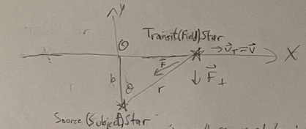
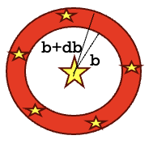
Binney & Tremaine Ch 1.2: Continuum Approximation and Coulomb Logarithm
When can $N$ stars in a region be represented by a continuous density $σ=\frac{N}{πR^{2}}$ (R = galaxy radius ) and gravitational field?
Consider a star transiting a galaxy at speed v perturbing a star at rest
Case 1: Transit (Field) Star encounters single discrete Source (Subject) Star
At closest approach, $g_{0}=\frac{Gm}{b^{2}}$ , with interaction time ${\left(∆t\right)}_{0}≈\frac{2b}{v}$ $⟹δv≈g_{0}{\left(∆t\right)}_{0}=\frac{2Gm}{bv}$
Case 2: Transit Stars w./surface density $σ$ interact with Source Star from distances b to b+db
In 1 revolution, $δn=\frac{N}{πR^{2}}2πbdb=\frac{2Nb}{R^{2}}db$ stars contribute deflections $δ\vec{v}$w./$\left\langle δ\vec{v}\right\rangle =\vec{0}$ but $\left\langle {δ\vec{v}}^{2}\right\rangle ≠0$:
The total (square) deflection for 1 revolution is
$$\text{Breaks} \text{down} \text{for} δv≳v\text{, }\text{i}\text{.}\text{e}\text{., }\text{transit} \text{star} \text{gets} \text{within} b≲b_{90}≡\frac{2Gm}{v^{2}} \text{so} \text{is} \text{deflected} ≈90° \text{from} \vec{v}$$
$$\sum_{[b,b+db]}{δv^{2}≈δv^{2}}δn={\left(\frac{2Gm}{bv}\right)}^{2}\frac{2N}{R^{2}}bdb=\frac{8G^{2}m^{2}N}{bv^{2}R^{2}}db$$
$$Δv^{2}≡\int_{b_{min}}^{b_{max}}{8N{\left(\frac{Gm}{Rv}\right)}^{2}}\frac{db}{b}=8N{\left(\frac{Gm}{Rv}\right)}^{2}\ln{Λ},$$
$\ln{Λ}≡\ln{\frac{b_{max}}{b_{min}}},$ is the Coulomb logarithm
$$\text{Breaks} \text{down} \text{for} b_{max}>\text{R}$$

Slide 14
Binney & Tremaine Ch 1.2. Collisional Systems – Relaxation and Crossing Times
Using the expression for the mean square velocity change per crossing
and the speed of stars on the edge of a flat disk with $M=Nm$:
The number of crossing interactions so the cumulative effect of $Δv^{2}$becomes comparable to $v^{2}$ satisfies $n_{relax}\frac{Δv^{2}}{v^{2}}≈1⇒n_{relax}=\frac{N}{8ln{Λ}}$, so the relaxation time $t_{relax}{=n}_{relax}t_{cross}$ is (using $Λ=\frac{R}{b_{90}}=\frac{Rv^{2}}{2Gm}≈\frac{N}{2}$)
$$Δv^{2}≡\int_{b_{min}}^{b_{max}}{8N{\left(\frac{Gm}{Rv}\right)}^{2}\frac{db}{b}}=8N{\left(\frac{Gm}{Rv}\right)}^{2}\ln{Λ}, \ln{Λ}≡\ln{\frac{b_{max}}{b_{min}}},$$
$$v^{2}≈\frac{GNm}{R}⇒R≈\frac{GNm}{v^{2}},$$
$$\frac{Δv^{2}}{v^{2}}=\frac{8ln{Λ}}{N},$$
$$t_{relax}=\frac{N}{8ln{N/2}}t_{cross}≈\frac{N}{8ln{N}}t_{cross}$$

Slide 15
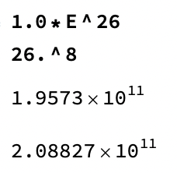
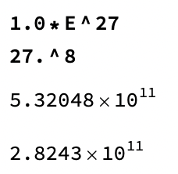
Kinetic Theory: Relaxation Processes (Binney & Tremaine Ch. 7.1)
. Recall for collisional N-body systems
For what size system is $t_{relax}>t_{cross}$?
Repeat for (B&T Formula 7.1; Cf. HW3)
For large N systems, $t_{relax}$can be far greater than $t_{cross}$.
.
$$t_{relax}≈\frac{N}{8ln{N}}t_{cross}$$
$$\frac{N}{8ln{N}}≳1$$
$$N≳8ln{N}=\ln{N^{8}}$$
$$e^{N}≳e^{\ln{N^{8}}}=N^{8}$$
$$26 ≲N≲27$$
$$t_{relax}≈0.1\frac{N}{\ln{N}}t_{cross}$$

Slide 16
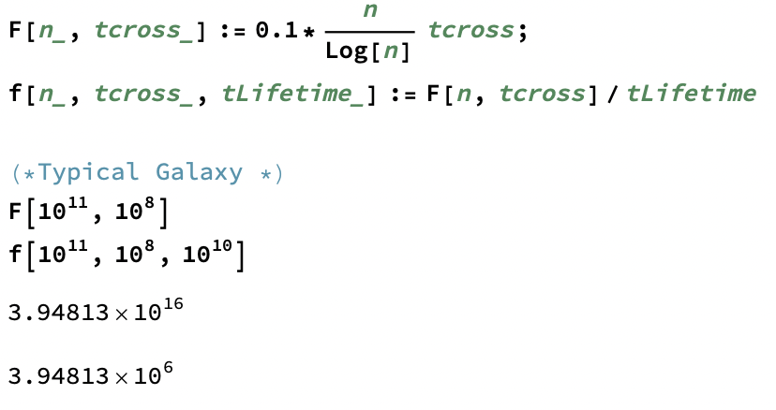
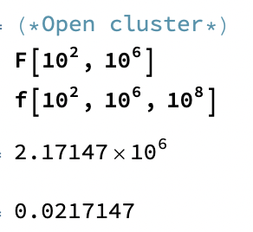
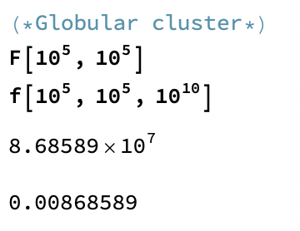
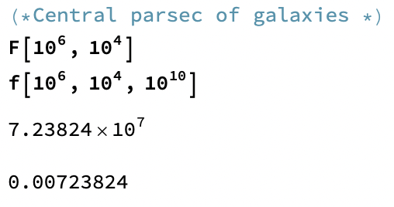
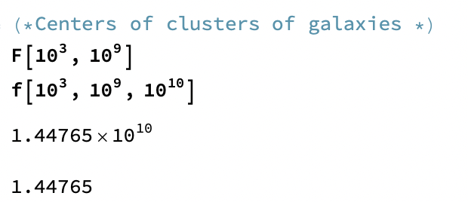
Kinetic Theory: Relaxation Processes (Binney & Tremaine Ch. 7.1)
How long is the collisional relaxation time $t_{relax}$ relative to lifetime for:
Typical galaxy (N $≈{10}^{11}$, $t_{cross}$ $≈$1Myr, Lifetime $≈$10Gyr)
Globular cluster (N $≈{10}^{5}$, $t_{cross}$ $≈{10}^{5}$yr, Lifetime $≈$10Gyr)
Open cluster (N $≈{10}^{2}$, $t_{cross}$ $≈{10}^{6}$yr, Lifetime $≈$100Myr)
Central parsec (N $≈{10}^{6}$, $t_{cross}$ $≈{10}^{4}$yr, Lifetime $≈$10Gyr)
HW 3 Repeat for Center of cluster of galaxies (N $≈{10}^{3}$, $t_{cross}$ $≈{10}^{9}$yr, Lifetime $≈$10Gyr)
.

Slide 17
Classical Mechanics: Hamilton’s Equations of Motion
William Hamilton’s 1833 insight was to recast Lagrange’s formalism in terms of momentum $p_{i}=\frac{∂ℒ}{∂{\dot{q}}_{i}}$
Then the Euler-Lagrange Eq. $\frac{∂ℒ}{∂q_{i}}=\frac{d}{dt}\frac{∂ℒ}{∂{\dot{q}}_{i}}$ becomes $\frac{∂ℒ}{∂q_{i}}=\dot{p_{i}}$
We can also write the total derivative of the Lagrangian in terms of $p_{i}$
The Hamiltonian function/functional describing the energy of a system is
From the total derivative of the Hamiltonian
we find Hamilton’s Equations of Motion
$$dℒ=\sum_{i}{\left(\frac{∂ℒ}{∂q_{i},}dq_{i}+\frac{∂ℒ}{∂\dot{q_{i}}}d\dot{q_{i}}\right)}=\sum_{i}{(\dot{p_{i}}{dq}_{i}+p_{i}d\dot{q_{i}})}$$
$$H=\sum_{i}{\frac{∂ℒ}{∂\dot{q_{i}}}\dot{q_{i}}}−ℒ\left({q_{i},\dot{q}}_{i};t\right)=\sum_{i}{p_{i}\dot{q_{i}}}−ℒ({q_{i},\dot{q}}_{i};t)$$
$$dH=\sum_{i}{(\dot{q_{i}}{dp}_{i}+p_{i}d\dot{q_{i}})}−\sum_{i}{\left(\dot{p_{i}}{dq}_{i}+p_{i}d\dot{q_{i}}\right)}$$
$$=\sum_{i}{(\dot{q_{i}}{dp}_{i}−\dot{p_{i}}{dq}_{i})}$$
$${\frac{∂H}{∂p_{i}}=\dot{q}}_{i}$$
$${\frac{∂H}{∂q_{i}}=−\dot{p}}_{i}$$
Notes:
https://math.stackexchange.com/questions/3799031/understanding-the-meaning-of-hamiltons-general-equation-of-motion
https://www.lehman.edu/faculty/dgaranin/Mechanics/Hamiltonian_mechanics.pdf

Slide 18
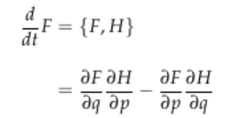
Classical Mechanics: Hamilton’s Equations of Motion
Exercise: Write Hamilton’s Equations of Motion in terms of the
With the Poisson bracket,
Hamilton’s Equations become
$${\dot{q}}_{i}=\frac{∂H}{∂p_{i}}, {\dot{p}}_{i}=−\frac{∂H}{∂q_{i}}$$
Poisson Bracket
$${\dot{q}}_{i}=\frac{dq_{i}}{dt}=\left\{q_{i},H\right\}=\frac{∂q_{i}}{∂q_{i}}\frac{∂H}{∂p_{i}}−\frac{∂q_{i}}{∂p_{i}}\frac{∂H}{∂q_{i}}=\frac{∂H}{∂p_{i}}$$
$${\dot{p}}_{i}=\frac{dp_{i}}{dt}=\left\{p_{i},H\right\}=\frac{∂p}{∂q_{i}}\frac{∂H}{∂p_{i}}−\frac{∂p_{i}}{∂p_{i}}\frac{∂H}{∂q_{i}}=−\frac{∂H}{∂q}$$
$${\dot{q}}_{i}=\{q_{i},H\}=\frac{∂H}{∂p_{i}}$$
$${\dot{p}}_{i}=\left\{p_{i},H\right\}=−\frac{∂H}{∂q_{i}}$$
Notes:
https://math.stackexchange.com/questions/3799031/understanding-the-meaning-of-hamiltons-general-equation-of-motion

Slide 19
Phase Space Distribution Function (cf. Binney & Tremaine Ch. 4.1)
Particles dynamics in classical mechanics can be described by particle positions and velocities
This information can be encoded in a (normalized) particle distribution function $f(\vec{x},\vec{v};t)$ giving probabilities particles occupy portions of phase space $ℝ^{3}×ℝ^{3}$
For $𝒱⊂ℝ^{3}×ℝ^{3}$small enough so f varies slowly and $\vec{w},\vec{W}∈𝒱$
Continuity Eq. for mass conservation
Continuity Eq. for phase space probability conservation
.
$$\int{d^{3}\vec{x}d^{3}\vec{v}f(\vec{x},\vec{v},t)}=1$$
The distribution function has the same value for a point represented in any coordinate system
$$P=f\left(\vec{w}\right)\int_{𝒱}^{.}{d^{6}\vec{w}}=F(\vec{W})\int_{𝒱}^{.}{d^{6}\vec{W}}$$
$$\frac{∂ρ}{∂t}+\frac{∂}{∂\vec{x}}∙(ρ\dot{\vec{x}})=0$$
where $\vec{v}=\dot{\vec{x}}$
$$\frac{∂f}{∂t}+\frac{∂}{∂\vec{w}}∙(f\dot{\vec{w}})=0, \vec{w}=(\vec{q},\vec{p})$$

Slide 20
The Collisionless Boltzmann Equation (Binney & Tremaine Ch. 4.1)
$$\frac{∂f}{∂t}+\frac{∂}{∂\vec{w}}∙(f\dot{\vec{w}})=0, \vec{w}=(\vec{q},\vec{p})$$
Starting from the phase space continuity equation
We may use the canonical Hamiltonian formalism to derive the Collisionless Boltzmann Eq.
where and
So we have the Collisionless Boltzmann Eq. w./Hamiltonian
Eliminating the Hamiltonian, the Collisionless Boltzmann Eq. is
.
$$0=\frac{∂f}{∂t}+\frac{∂}{∂\vec{w}}∙\left(f\dot{\vec{w}}\right)=\frac{∂f}{∂t}+\frac{∂}{∂\vec{q}}∙\left(f\dot{\vec{q}}\right)+\frac{∂}{∂\vec{p}}∙\left(f\dot{\vec{p}}\right)=\frac{∂f}{∂t}+\frac{∂f}{∂\vec{q}}∙\left(f\dot{\vec{q}}\right)+\frac{∂}{∂\vec{p}}∙\left(f\dot{\vec{p}}\right),$$
$$\frac{∂}{∂\vec{q}}∙\left(f\dot{\vec{q}}\right)=\frac{∂f}{∂\vec{q}}∙\dot{\vec{q}}+f\frac{∂}{∂\vec{q}}∙\dot{\vec{q}}=\frac{∂f}{∂\vec{q}}∙\frac{∂H}{∂\vec{p}}+f\frac{∂^{2}H}{∂\vec{q}∂\vec{p}}$$
$$\frac{∂}{∂\vec{p}}∙\left(f\dot{\vec{p}}\right)=\frac{∂f}{∂\vec{p}}∙\dot{\vec{p}}+f\frac{∂}{∂\vec{p}}∙\dot{\vec{p}}=−\frac{∂f}{∂\vec{p}}∙\frac{∂H}{∂\vec{q}}−f\frac{∂^{2}H}{∂\vec{p}∂\vec{q}}$$
$$0=\frac{∂f}{∂t}+\frac{∂f}{∂\vec{q}}∙\frac{∂H}{∂\vec{p}}−\frac{∂f}{∂\vec{p}}∙\frac{∂H}{∂\vec{q}}=\frac{∂f}{∂t}+\left\{f,H\right\}$$
$$0=\frac{∂f}{∂t}+\frac{∂f}{∂\vec{q}}∙\dot{\vec{q}}+\frac{∂f}{∂\vec{p}}∙\dot{\vec{p}}$$

