Slide 1
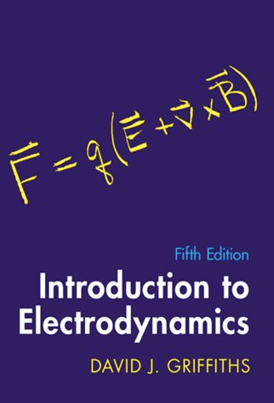
ElectroDynamics
UTSA PHY 3513 - Fall 2024
ElectroDynamics
UNIT 1 – Math Methods
Prof. Richard Anantua (UTSA)
Notes:
Crossing time, collision time, hubble time
Star cluster, globular cluster

Slide 2
Course Logistics
PHY 3513. Electrodynamics. 3 Credit Hours.
Schedule: TTh 1:00 pm - 2:15 pm; Peter T. Flawn Building 3.02.01
Materials: Griffith’s Introduction to Electrodynamics 5th Ed. ISBN 978-1009397759 (Amazon https://www.amazon.com/Introduction-Electrodynamics-David-J-Griffiths-dp-1009397753/dp/1009397753/ref=dp_ob_image_bk )
Syllabus: https://utsa.simplesyllabus.com/doc/7z1udnw3k/Fall-2024-PHY-3513-001-Electrodynamics?mode=view
Prerequisites: PHY 2823 and PHY 3423 (with a C- or better), or consent of instructor. Continuation of the material started in PHY 3423. Topics include Maxwell’s equations, electromagnetic waves, wave guides, and radiation from accelerated charges.
Unit 1 Math Methods (Ch. 1); Unit 2 Electrostatics and Potential Theory (Chs. 2-3); Unit 3 Electric and Magnetic Fields in Matter (Chs. 4-6); Unit 4 Electrodynamics and Conservation Laws (Chs. 7,8); Unit 5 Electromagnetic Waves and Waveguides (Ch. 9); Unit 6 Potentials, Fields and Radiation – Relativistic Formalism (Chs. 10,11,12)
Quizzes (30%): Quiz 1 Tu 9/24, Quiz 2 Tu 11/12
HWs (30%): HW1 Th 9/5, HW2 Tu 9/17, HW3 Tu 10/8, HW4 Tu 10/22, HW 5 Tu 11/19; HW 6 Tu 12/3
Final Presentation (30%): Tu 12/3 and Th 12/5
Participation (10%): All day, every day (hopefully)
Notes:
Syllabus: https://utsa.simplesyllabus.com/api2/doc-pdf/7z1udnw3k/Fall-2024-PHY-3513-001-Electrodynamics.pdf?locale=en-US
Academic Calendar: https://asap.utsa.edu/pls/prod/bwckschd.p_disp_detail_sched?term_in=202510&crn_in=17088
https://www.utsa.edu/registrar/reg_materials/reg_calendar_fall.pdf
1:00 pm - 2:15 pm
TR
Peter T. Flawn Building 3.02.01
Aug 26, 2024 - Dec 13, 2024
Prerequisites: PHY 2823 and PHY 3423 (with a C- or better), or consent of instructor. Continuation of the material started in PHY 3423. Topics include Maxwell’s equations, electromagnetic waves, wave guides, and radiation from accelerated charges. Generally offered: Spring. Differential Tuition: $150. Course fee: DL01 $75

Slide 3
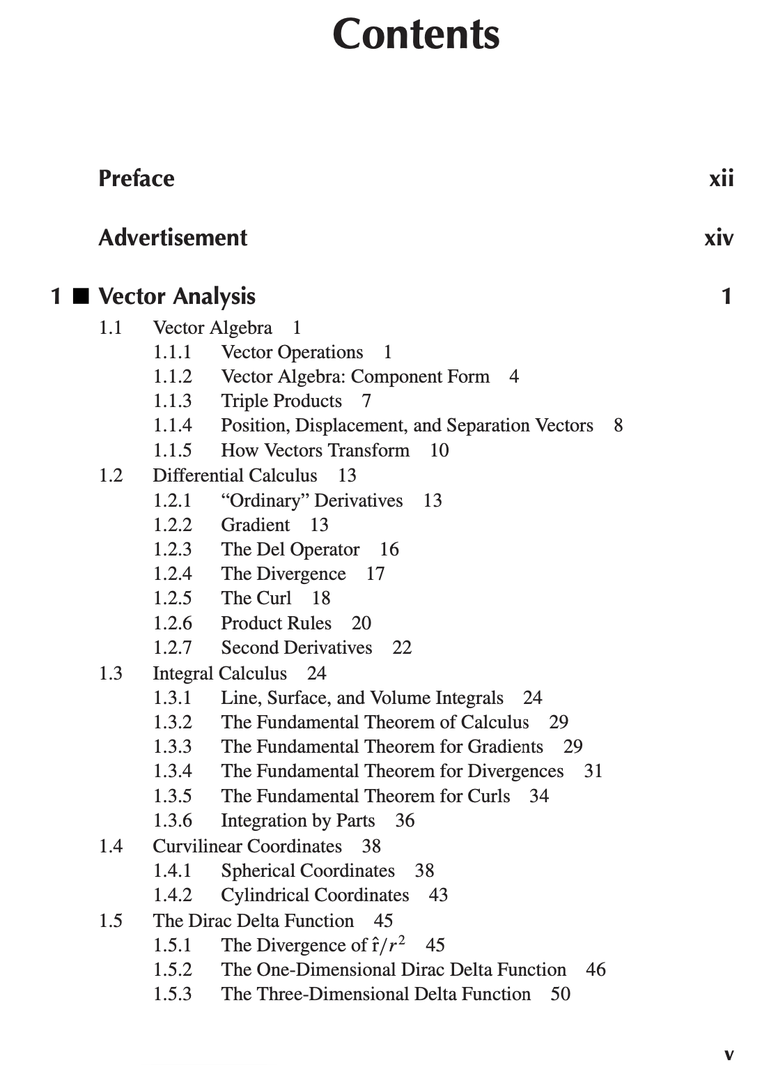
Course Roadmap
Course Syllabus: https://utsa.simplesyllabus.com/doc/7z1udnw3k/Fall-2024-PHY-3513-001-Electrodynamics?mode=view
Academic Calendar: https://www.utsa.edu/registrar/reg_materials/reg_calendar_fall.pdf
Unit 1 Math Methods (Ch. 1); Unit 2 Electrostatics and Potential Theory (Chs. 2-3); Unit 3 Electric and Magnetic Fields in Matter (Chs. 4-6); Unit 4 Electrodynamics and Conservation Laws (Chs. 7,8); Unit 5 Electromagnetic Waves and Waveguides (Ch. 9); Unit 6 Potentials, Fields and Radiation – Relativistic Formalism (Chs. 10,11,12)
Griffith’s E&M

Slide 4
Icebreaker – Physics 2 truths and a lie
Make 2 true statements and 1 false statement
1 statement must be about yourself
1 statement must be about your home (state, country, institution,…)
1 statement must be about physics

Slide 5
units
A unit in physics represents a specific amount of a physical quantity such as mass, length or time.

Slide 6
Unit systems – base units
Physical quantities may be expressed using several choices of units
Unit systems express physical quantities in terms of base units or combinations thereof
Quantity | SI (mks) | Gaussian cgs | Imperial
Length | Meter (m) | Centimeter (cm) | Foot (ft)
Mass | Kilogram (kg) | Gram (g) | Pound (lb)
Time | Second (s) | Second (s) | Second (s)
Temperature | Kelvin (K) | Kelvin (K)* | Farenheit (ºF)
Luminous intensity | Candela (cd) | Candela (cd)*
Amount | Mole (mol) | Mole (mol)*
Current | Ampere (A)
* Sometimes not considered a base cgs unit
Notes:
All dimensionful quantities in a unit system have at least one base unit
pound (lb) 1 0.45359237 kg is a unit of MASS; weight is a force m*g

Slide 7
Unit systems – derived units
Units may be derived from others
Quantity | SI | cgs
Momentum | kg m s⁻¹ | g cm s⁻¹
Force | Newton N=kg m s⁻² | Dyne g cm s⁻²
Energy | Joule J=kg m² s⁻² | Erg g cm² s⁻²
Power | Watt J=kg m² s⁻³ | g cm² s⁻³
Pressure | Pascal Pa=kg m⁻¹ s⁻² | Barye g cm⁻¹ s⁻²

Slide 8
Dimensional analysis
Intuitive question: 10 pigs + 5 pigs = ?

Slide 9
Dimensional analysis
Intuitive question: 10 pigs + 5 pigs = 15 pigs
How about: 10 pigs + 5 cats = ?

Slide 10
Dimensional analysis
Intuitive question: 10 pigs + 5 pigs = 15 pigs
How about: 10 pigs + 5 cats = ?
We can’t directly combine the number of pigs and cats because they are fundamentally different quantities.

Slide 11
Dimensional analysis
Intuitive question: 10 pigs + 5 pigs = 15 pigs
How about: 10 pigs + 5 cats = ?
We can’t directly combine the number of pigs and cats because they are fundamentally different quantities.
Any equation in physics must reduce to the same units on both sides
Can we relate the variables F, m and a in a dimensionally consistent way?
Variables | Variables in Base Units
m | [M]
a | [L][T]⁻²
F | [M][L][T]⁻²
Variables | Variables in Base Units
m
a
F
$F=ma⟹$ (only if)
[M][L][T]⁻²=([M])([L][T]⁻²)

Slide 12
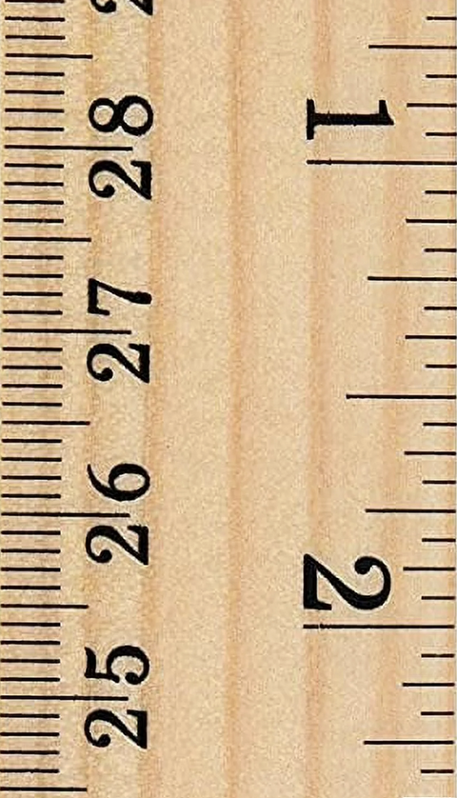
Scientific Notation and Significant Figures
Physical measurements are limited by the precision of the measuring device
Is a measurement of 2.36mm from the ruler on the right meaningful? How about 2mm?
The significant figures of a number are those digits that carry meaning contributing to its precision at the resolution limit of the measurement device¹.
Rules for significant figures:
All non-zero numbers ARE significant.
Zeros between two non-zero digits ARE significant.
Leading zeros are NOT significant.
Trailing zeros to the right of the decimal ARE significant.
Trailing zeros in a whole number with the decimal shown ARE significant.
Trailing zeros in a whole number with no decimal shown are NOT significant.
Exact numbers have an INFINITE number of significant figures.
For a number in scientific notation: N x 10^{x}, all digits comprising N ARE significant by the first 6 rules; "10" and "x" are NOT significant.
Cf. https://brilliant.org/wiki/significant-figures-and-precision/
Alternate definition includes 1 digit of uncertainty just below measurement resolution limit
https://en.wikipedia.org/wiki/Significant_figures#cite_note-:0-1
Notes:
https://www.walmart.com/ip/25-Pack-Wooden-Ruler-12-Inch-Rulers-Bulk-Wood-Measuring-Ruler-Office-Ruler-2-Scale/8145820895?wmlspartner=wlpa&selectedSellerId=101680689&adid=222222222278145820895_101680689_14069003552_202077872&wl0=&wl1=g&wl2=c&wl3=42423897272&wl4=pla-295289030566&wl5=9028088&wl6=&wl7=&wl8=&wl9=pla&wl10=5365745483&wl11=online&wl12=8145820895_101680689&veh=sem&gad_source=1&gclid=CjwKCAjw_Na1BhAlEiwAM-dm7Ixe1Sur-bhnkdcnWLawqfi9dqc9C7kW_BCzX435H44v62-RChp1GhoCikIQAvD_BwE

Slide 13
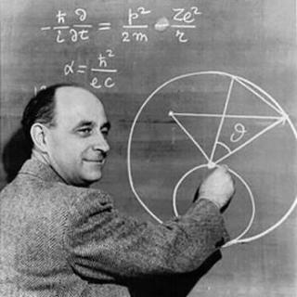
Fermi problems
Enrico Fermi (1901-1954) designed the first nuclear reactor and laid the theoretical foundation for the atomic bomb
Fermi problems are back-of-the-envelope calculations providing fast— but often surprisingly accurate— solutions through prudent assumptions
Notes:
http://www.ilnotiziario.net/2017/12/04/la-pila-atomica-enrico-fermi-paragonato-cristoforo-colombo/

Slide 14
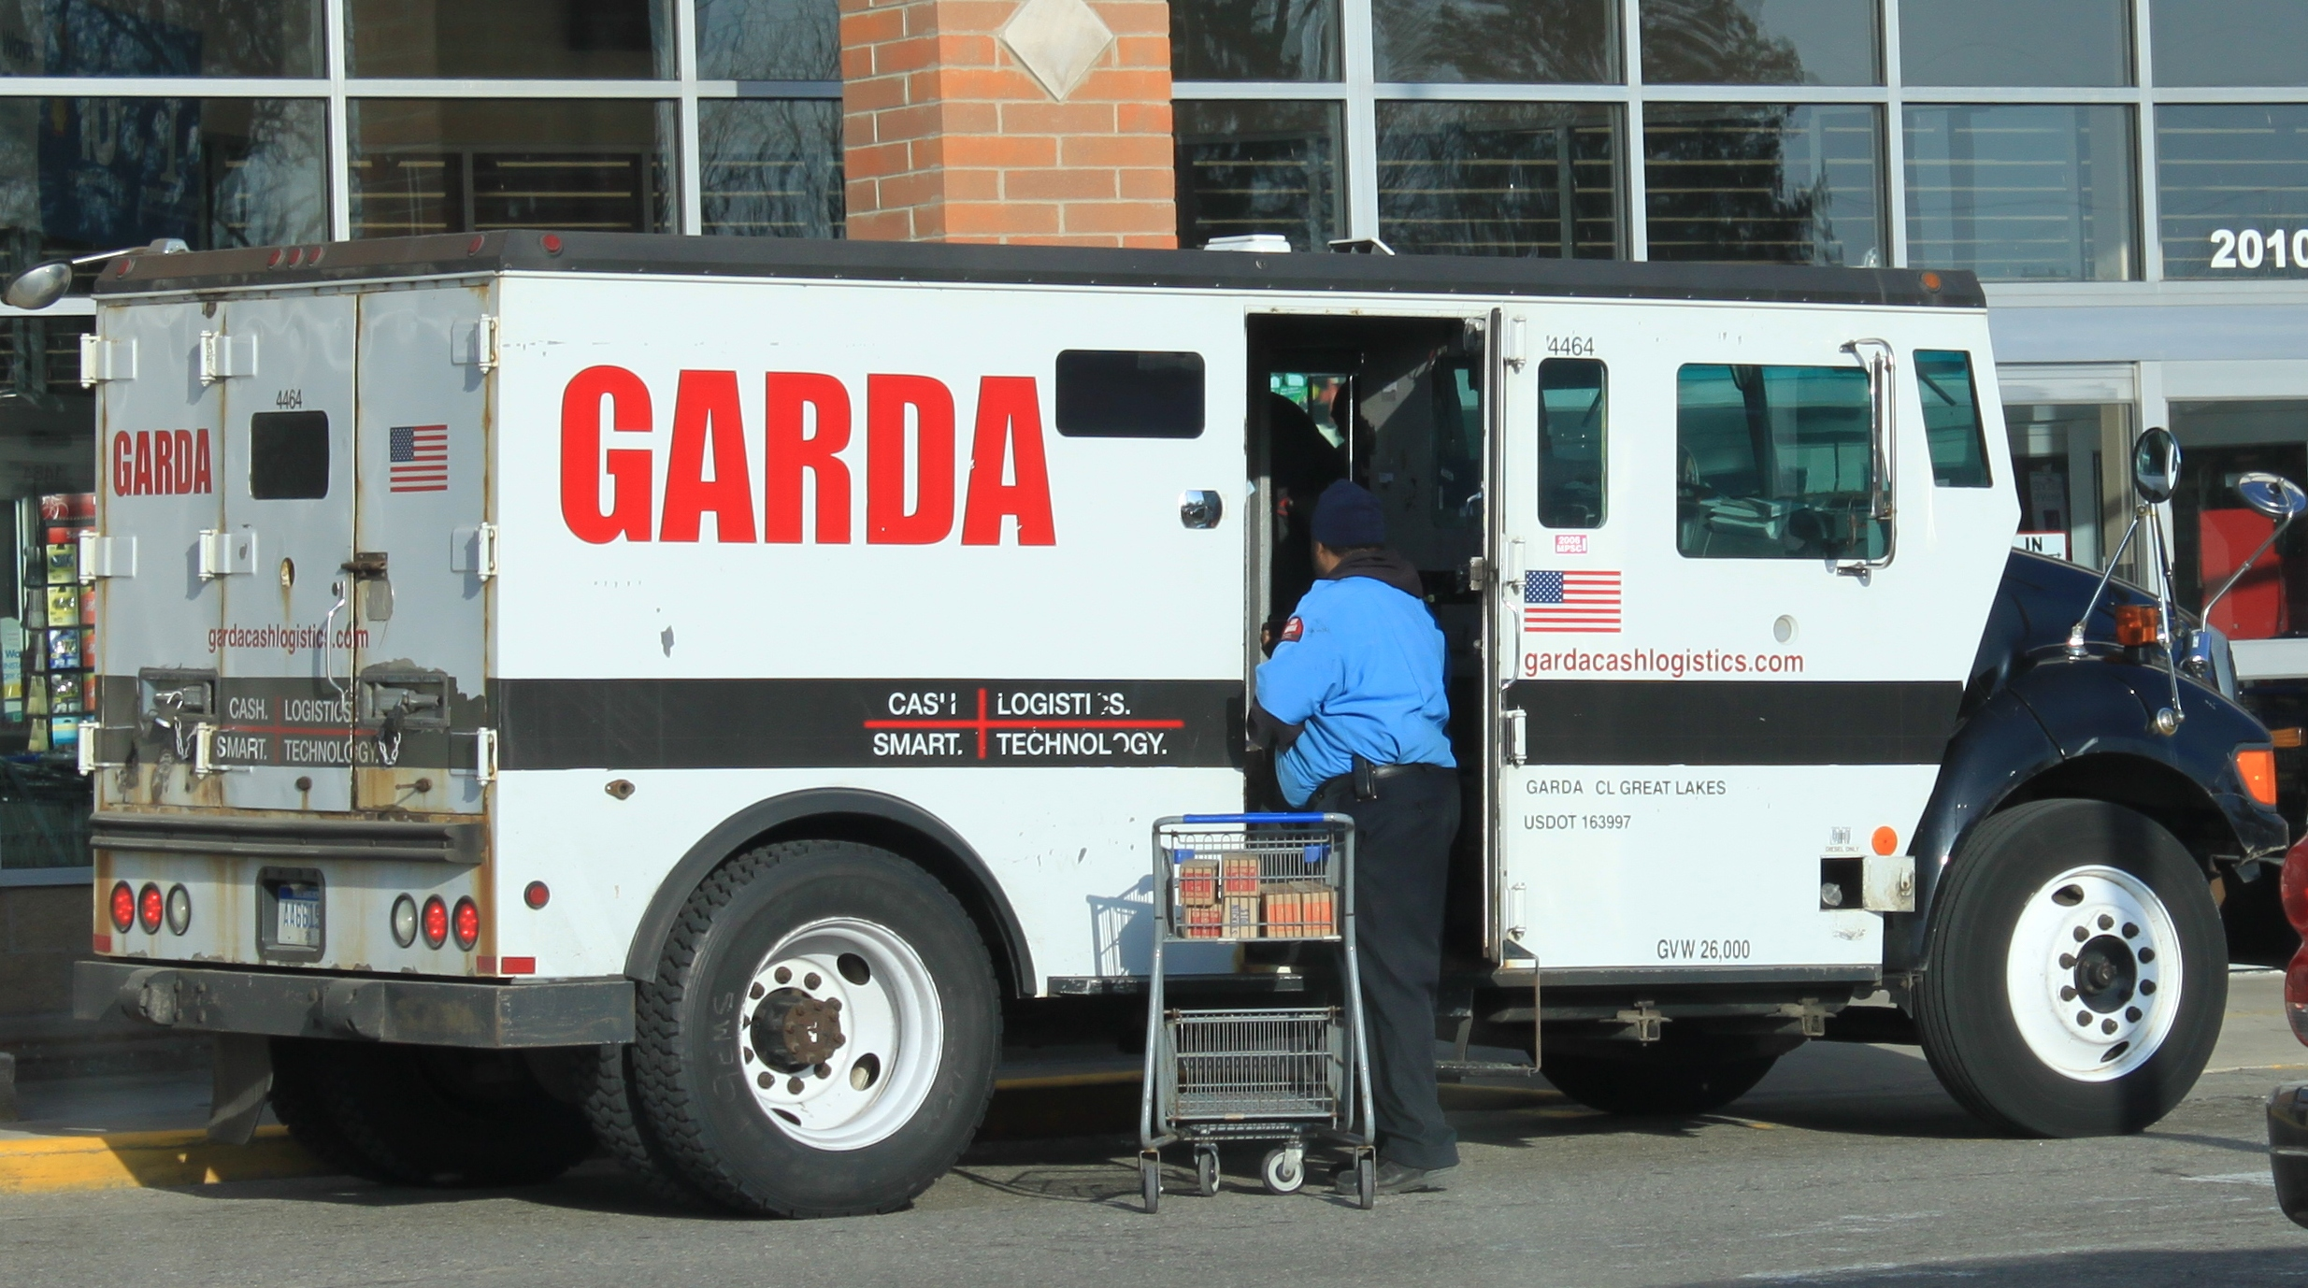
Fermi problems
How much money is typically transported by an armored car in the US?

Slide 15
Fermi problems
How much money is typically transported by an armored car in the US?
Approach 1
Assumptions: A US bill is the thickness of a sheet in a ream (500 sheets) ~5cm , Average bill = $20
. . .
.
Approach 2
Assumptions: A US bill is the thickness of a sheet in a ream (500 sheets) ~5cm, $ρ_{bill}$ = $ρ_{water}$ =1000kg/m³, Average bill = $20
. . .
.

Slide 16
Fermi problems
How much money is typically transported by an armored car in the US?
Approach 1
Assumptions: A US bill is the thickness of a sheet in a ream (500 sheets) ~5cm, Average bill = $20
Solution: N bills x Avg. bill = (V_{cargo}/V_{bill}) x $20 = ((2m)(2m)(1m)/((7x10⁻²m)(15x10⁻²m)(0.05/500 m))) x $20 = $7.6x10⁷
Approach 2
Assumptions: A US bill is the thickness of a sheet in a ream (500 sheets) ~5cm, $ρ_{bill}$ = $ρ_{water}$ =1000kg/m³, Average bill = $20
Solution: (Payload/m_{bill}) x $20 = 1000kg/($ρ_{bill}$V_{bill}) = 1000kg/(1000kg m⁻³ ((.07m)(.15m)(0.0001m)) ) x $20 = $1.9x10⁷

Slide 17
Loomis fargo $17 million heist
Notes:
https://www.youtube.com/watch?v=vsDuMRt5ULk
https://www.worldatlas.com/articles/biggest-heists-and-bank-robberies-in-american-history.html

Slide 18
Drake Equation
Estimate the number $N≥1$of advanced Milky Way civilizations we can communicate with
Hard to extrapolate from local samples, since we only know a sample of 1
Astrobiologist Frank Drake’s (1961) approach: Start with the broadest set of candidates and narrow down by estimating viable fractions at each step
R*= Average star formation rate (estimated from our galaxy)
$f_{p}$ = fraction of stars formed with planets
n_{e} = average number of Earthlike/habitable planets per star
$f_{l}$ = fraction of habitable planets with life
$f_{i}$ = fraction of habitable planets with life that is intelligent life
$f_{c}$ = fraction of intelligent life with communicating civilizations
t = average time for which civilizations are communicating their existence
$$N=R_{∗}f_{p}n_{e}f_{l}f_{i}f_{c}t$$
Notes:
We have no pictures of the historical Drake, so we’ll use a modern one
https://www.rottentomatoes.com/celebrity/aubrey_graham
https://en.wikipedia.org/wiki/Drake_equation

Slide 19
Math methods – Single-Variable calculus
Function | Derivative | Integral
$$sin(x)$$ | $$cos\left(x\right)$$ | $$?$$
$$x^{n}, n≠−1$$ | $$?$$ | $$\frac{x^{n+1}}{n+1}+C$$
$$1/x$$ | $$−1/x^{2}$$ | $$?$$
$$?$$ | $${ae}^{ax}$$ | $$(1/a)e^{ax}+C$$
$$H\left(x\right)=\left\{\begin{aligned}0, x<0 \\ 1, x≥0\end{aligned}\right.$$ | $$?$$ | $$?$$
Useful derivatives and integrals:
Hint: Chain Rule for differentiating f(u(x)) with respect to x
.
$$\frac{df}{dx}=\frac{df}{du}\frac{du}{dx}=f^{′}\left(u\right)u′(x)$$
Notes:
1/25/23

Slide 20
Math methods – Single-Variable calculus
Function | Derivative | Integral
$$sin(x)$$ | $$cos\left(x\right)$$ | $$−cos\left(x\right)$$
$$x^{n}, n≠−1$$ | $${nx}^{n−1}$$ | $$\frac{x^{n+1}}{n+1}+C$$
$$1/x$$ | $$−1/x^{2}$$ | $$\ln{x}+C$$
$$e^{ax}$$ | $${ae}^{ax}$$ | $$(1/a)e^{ax}+C$$
$$H\left(x\right)=\left\{\begin{aligned}0, x<0 \\ 1, x≥0\end{aligned}\right.$$ | $$δ\left(x\right)=\left\{\begin{aligned}0, x≠0 \\ ∞, x=0\end{aligned}\right.$$ $$\int_{−∞}^{∞}{δ\left(x\right)f\left(x\right)dx}=f(0)$$ | $$\int_{−∞}^{x_{max}}{H\left(x\right)dx}=\left\{\begin{aligned}0,x_{max}<0 \\ x_{max},x_{max}≥0\end{aligned}\right.$$
Useful derivatives and integrals:
Hint: Chain Rule for differentiating f(u(x)) with respect to x
.
$$\frac{df}{dx}=\frac{df}{du}\frac{du}{dx}=f^{′}\left(u\right)u′(x)$$
Notes:
1/25/23 Just as a sequence of points can converge to a (point) value, a sequence of functions can have a limit, e.g., normalized top hats to delta function

Slide 21
Math methods – Single-Variable calculus
Function | Derivative | Integral
$$sin(x)$$ | $$cos\left(x\right)$$ | $$−cos\left(x\right)$$
$$x^{n}, n≠−1$$ | $${nx}^{n−1}$$ | $$\frac{x^{n+1}}{n+1}+C$$
$$1/x$$ | $$−1/x^{2}$$ | $$\ln{x}+C$$
$$e^{ax}$$ | $${ae}^{ax}$$ | $$(1/a)e^{ax}+C$$
$$H\left(x\right)=\left\{\begin{aligned}0, x<0 \\ 1, x≥0\end{aligned}\right.$$ | $$δ\left(x\right)=\left\{\begin{aligned}0, x≠0 \\ ∞, x=0\end{aligned}\right.$$ $$\int_{−∞}^{∞}{δ\left(x\right)f\left(x\right)dx}=f(0)$$ | $$\int_{−∞}^{x_{max}}{H\left(x\right)dx}=\left\{\begin{aligned}0,x_{max}<0 \\ x_{max},x_{max}≥0\end{aligned}\right.$$
Useful derivatives and integrals:
Taylor’s Theorem: A function $f(x)$ k-times differentiable at $x=a$ can be expanded as a series (with vanishing remainder as $x→a$)
.
$$f\left(x\right)≈f\left(a\right)+f^{′}\left(a\right)\left(x−a\right)+\frac{1}{2}f′′(a)({x−a)}^{2}+…+\frac{f^{\left(k\right)}\left(a\right)}{k!}({x−a)}^{k}$$
Notes:
1/25/23

Slide 22
Math methods – Single-Variable calculus
Function | Derivative | Integral
$$sin(x)$$ | $$cos\left(x\right)$$ | $$−cos\left(x\right)$$
$$x^{n}, n≠−1$$ | $${nx}^{n−1}$$ | $$\frac{x^{n+1}}{n+1}+C$$
$$1/x$$ | $$−1/x^{2}$$ | $$\ln{x}+C$$
$$e^{ax}$$ | $${ae}^{ax}$$ | $$(1/a)e^{ax}+C$$
$$H\left(x\right)=\left\{\begin{aligned}0, x<0 \\ 1, x≥0\end{aligned}\right.$$ | $$δ\left(x\right)=\left\{\begin{aligned}0, x≠0 \\ ∞, x=0\end{aligned}\right.$$ $$\int_{−∞}^{∞}{δ\left(x\right)f\left(x\right)dx}=f(0)$$ | $$\int_{−∞}^{x_{max}}{H\left(x\right)dx}=\left\{\begin{aligned}0,x_{max}<0 \\ x_{max},x_{max}≥0\end{aligned}\right.$$
Useful derivatives and integrals:
Taylor’s Theorem: A function $f(x)$ k-times differentiable at $x=a$ can be expanded as a series (with vanishing remainder as $x→a$)
. TERMINOLOGY: A MacLaurin series is the Taylor expansion of a function $f(x)$ about $x=0$
Exercise: Write the MacLaurin series for $f\left(x\right)=e^{x}$
$$f\left(x\right)≈f\left(a\right)+f^{′}\left(a\right)\left(x−a\right)+\frac{1}{2}f′′(a)({x−a)}^{2}+…+\frac{f^{\left(k\right)}\left(a\right)}{k!}({x−a)}^{k}$$
$$e^{x}=\frac{x^{n}}{n!}=1+x+\frac{x^{2}}{2}+\frac{x^{3}}{3!}…$$
Notes:
1/25/23

Slide 23
Dirac Delta Function
The Dirac delta function is a generalized function, or distribution, with the following properties:
and
and
Consequently, $∀$continuous function f, and
Moreover,
.
$δ:ℝ↦ℝ$ is such that:
$$δ\left(x\right)=\left\{\begin{aligned}∞, x=0 \\ 0, x≠0\end{aligned}\right.$$
$$\int_{−∞}^{∞}{δ\left(x\right)dx}=1$$
$δ:ℝ^{3}↦ℝ$ is such that:
$$δ\left(\vec{x}\right)=δ\left(x\right)δ\left(y\right)δ\left(z\right)$$
$$\int_{ℝ^{3}}^{.}{δ\left(\vec{x}\right)dτ}=\int_{−∞}^{∞}{\int_{−∞}^{∞}{\int_{−∞}^{∞}{δ\left(x\right)δ\left(y\right)δ(z)dx}dy}dz=1}$$
$$f(x)δ\left(x\right)=f(0)δ\left(x\right)$$
$$\int_{−∞}^{∞}{f\left(x\right)δ\left(x\right)dx}=f\left(0\right)\int_{−∞}^{∞}{δ\left(x\right)dx}=f(0)$$
$$δ\left(x−a\right)=\left\{\begin{aligned}∞, x=a \\ 0, x≠a\end{aligned}\right.$$
$$\int_{−∞}^{∞}{δ\left(x−a\right)dx}=1$$
$$⟹f\left(x\right)δ\left(x−a\right)=f\left(a\right)δ\left(x−a\right)$$
$$\int_{−∞}^{∞}{f(x)δ\left(x−a\right)dx}=f\left(a\right)\int_{−∞}^{∞}{δ\left(x−a\right)dx}=f(a)$$

Slide 24
Math methods – ordinary differential equations
Differential equations relate functions and their derivatives
We can directly solve some differential equations by methods such as
Integration
Separation of variables
Integration by parts
For many differential equations, the simplest method of solution is making a guess, or ansatz
$$f^{′}\left(x\right)=\frac{df}{dx}=\frac{1}{x}$$
$$⇒f\left(x\right)=\ln{x}+C$$
$$⇒\int{\frac{dy}{y}=\int{x^{2}}dx⇒\ln{y}}=\frac{x^{3}}{3}+C⇒y=e^{\frac{x^{3}}{3}+C}$$
$$\frac{dy}{dx}=x^{2}y$$
$$\int{xe^{kx}dx}$$
$$=−\int{\frac{1}{k}e^{kx}dx}+\frac{x}{k}e^{kx}$$
$$=−\frac{1}{k^{2}}e^{kx}+\frac{x}{k}e^{kx}+C$$
u
dv
v
du

Slide 25
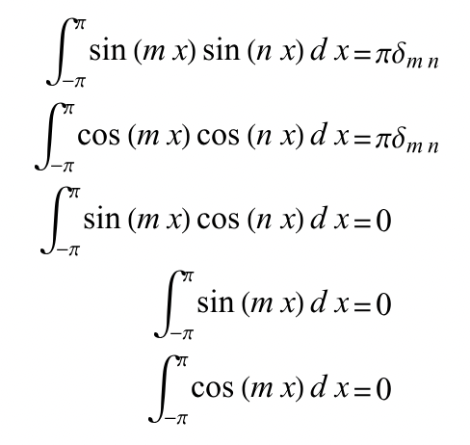
Math Methods – Fourier’s Trick
Suppose a periodic function F(x) can be expressed in a Fourier series¹
Now, how do we find the coefficients?
Use orthogonality of the basis functions $\sin{\frac{nπx}{a}}$
.
$$F(x)=\sum_{n=0}^{∞}{C_{n}}\sin{\frac{nπx}{a}}$$
$$\int_{0}^{a}{F(x)\sin{\frac{mπx}{a}}}dx=\int_{0}^{a}{\sum_{n=0}^{∞}{C_{n}}\sin{\frac{nπx}{a}}\sin{\frac{mπx}{a}}dx}$$
$$=\int_{0}^{a}{C_{m}\sin^{2}{\frac{mπx}{a}}dx}=C_{m}\int_{0}^{a}{\left(\frac{1}{2}−\cos{\frac{2mπx}{a}}\right)dx}=\frac{a}{2}C_{m}$$
A Fourier series is a decomposition into an infinite sum of sines and cosines, where
https://mathworld.wolfram.com/FourierSeries.html
Notes:
Cos 2x = cos^2 x – sin^2 x
Sin 2x = 2 cos x sin x
Sin^2x = (1-cos 2x)/2
Griffiths 3.3.1 Separation of Variables – Cartesian Coordinates
Fourier’s Trick may have been due to Euler

Slide 26
Math methods – partial differential equations; boundary conditions
Wave PDE:
Ansatz??
$$\frac{∂^{2}f}{∂x^{2}}=\frac{1}{v^{2}}\frac{∂^{2}f}{∂t^{2}}$$

Slide 27
Math methods – partial differential equations; boundary conditions
Wave PDE:
Ansatz: Works when f₋ and f₊ are any differentiable functions!
$$\frac{∂^{2}f}{∂x^{2}}=\frac{1}{v^{2}}\frac{∂^{2}f}{∂t^{2}}$$
$$f=f_{+}(x+vt)+f_{−}\left(x−vt\right)$$

Slide 28
Math methods – partial differential equations; boundary conditions
Wave PDE:
Ansatz: Works when f₋ and f₊ are any differentiable functions!
But WAIT:
$$\frac{∂^{2}f}{∂x^{2}}=\frac{1}{v^{2}}\frac{∂^{2}f}{∂t^{2}}$$
$$f=f_{+}(x+vt)+f_{−}\left(x−vt\right)$$
$$f\left(mλ,0\right)=A=f\left(0,nT\right), m,n∈ℤ$$
Solution given by
$$f\left(x,t\right)=A\cos\left(k(x±vt)\right)=A\cos\left(\frac{2π}{λ}x±\frac{2π}{T}t\right)$$

Slide 29
Gradients and Line Elements
The scalar valued function T(x,y,z) with domain in 3D space has total derivative
This can be expressed in terms of the gradient $\vec{∇}T$ (rate of change in the direction of fastest change), as
where the line element in Cartesian coordinates is
$$dT=\frac{∂T}{∂x}dx+\frac{∂T}{∂y}dy+\frac{∂T}{∂z}dz$$
$$d\left(T\left(x,y,z\right)\right)=dT=\frac{∂T}{∂x}dx+\frac{∂T}{∂y}dy+\frac{∂T}{∂z}dz=\left(\frac{∂T}{∂x}\hat{x}+\frac{∂T}{∂y}\hat{y}+\frac{∂T}{∂z}\hat{z}\right)∙\left(dx\hat{x}+dy\hat{y}+dz\hat{z}\right)=\vec{∇}T∙d\vec{ℓ}$$
$$d\vec{ℓ}=dx\hat{x}+dy\hat{y}+dz\hat{z}$$

Slide 30
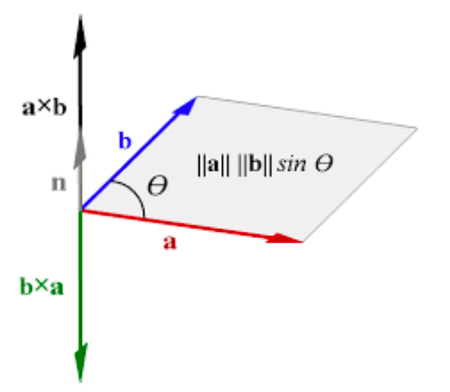
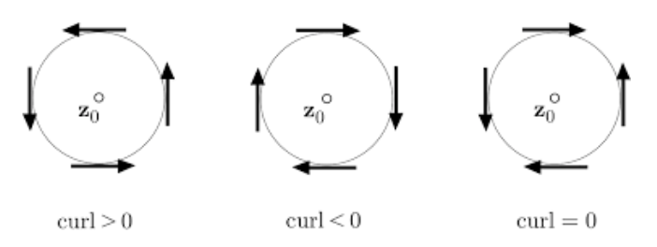
Math methods – Vector calculus
Vectors in 3D may be multiplied using
Dot product:
Cross product:
A vector field F(x,y,z) is specified by assigning a vector to each point in space. At each point we may calculate
Divergence (whether the vector field looks like a source or a sink)
Curl (whether a paddlewheel would rotate in the vector field)
$$\vec{a}∙\vec{b}=a_{x}b_{x}+a_{y}b_{y}+a_{z}b_{z}=ab\cos{θ}$$
$$\vec{a}×\vec{b}=(a_{y}b_{z}−{b_{y}a}_{z})\hat{x}+(a_{z}b_{x}−{b_{z}a}_{x})\hat{y}+(a_{x}b_{y}−{b_{x}a}_{y})\hat{z}$$
$$\vec{∇}∙\vec{F}=\frac{∂F_{x}}{∂x}+\frac{∂F_{y}}{∂y}+\frac{∂F_{z}}{∂z}$$
$$\vec{∇}×\vec{F}=\left[\begin{matrix}\frac{∂F_{z}}{∂y}−\frac{∂F_{y}}{∂z} \\ \frac{∂F_{x}}{∂z}−\frac{∂F_{z}}{∂x} \\ \frac{∂F_{y}}{∂x}−\frac{∂F_{y}}{∂x}\end{matrix}\right]$$
For these xy-plane vector fields, the sign of the z-component of the curl is given
z
z
z
Notes:
https://commons.wikimedia.org/wiki/File:Cross-product-with-area.svg
https://ltcconline.net/greenl/courses/202/vectorIntegration/divergenceTheorem.htm
https://www.google.com/url?sa=i&rct=j&q=&esrc=s&source=images&cd=&ved=0ahUKEwiq0vT70_PUAhVM3GMKHXvOBpYQjhwIBQ&url=https%3A%2F%2Fmath.stackexchange.com%2Fquestions%2F1054132%2Fcurl-vector-what-exactly-is-rotating&psig=AFQjCNHobNRyMP6BpLT1T3StbEeDcRMwTw&ust=1499395359996385&cad=rjt

Slide 31
Divergence oF Electric field of A Point Charge
For simplicity assume q at origin
$$\vec{∇}∙\vec{E}=k_{e}q\left(\frac{∂}{∂x}\frac{x}{{(x^{2}+y^{2}+z^{2})}^{3/2}}+\frac{∂}{∂x}\frac{y}{{(x^{2}+y^{2}+z^{2})}^{3/2}}+\frac{∂}{∂z}\frac{z}{{(x^{2}+y^{2}+z^{2})}^{3/2}}\right)$$
$$\vec{E}=\frac{1}{4πε_{0}}q\frac{\hat{r}}{{\left|\vec{r}\right|}^{2}}=k_{e}q\frac{\vec{r}}{{\left|\vec{r}\right|}^{3}}=k_{e}\frac{q}{{(x^{2}+y^{2}+z^{2})}^{3/2}}\left[\begin{aligned}x \\ y \\ z\end{aligned}\right]$$
z
$$=k_{e}q\left(\frac{1}{{(x^{2}+y^{2}+z^{2})}^{3/2}}−\frac{\frac{3}{2}2x∙x}{{\left(x^{2}+y^{2}+z^{2}\right)}^{\frac{5}{2}}}+\frac{1}{{\left(x^{2}+y^{2}+z^{2}\right)}^{\frac{3}{2}}}−\frac{3y^{2}}{{\left(x^{2}+y^{2}+z^{2}\right)}^{\frac{5}{2}}}+\frac{1}{{\left(x^{2}+y^{2}+z^{2}\right)}^{\frac{3}{2}}}−\frac{3z^{2}}{{(x^{2}+y^{2}+z^{2})}^{3/2}}\right)$$
y
$$\vec{r}$$
$$k_{e}=\frac{1}{4πε_{0}}=8.99×{10}^{9}\frac{N m^{2}}{C^{2}}$$
= $k_{e}q\left(\frac{3}{{(x^{2}+y^{2}+z^{2})}^{3/2}}−\frac{3\left(x^{2}+y^{2}+z^{2}\right)}{{\left(x^{2}+y^{2}+z^{2}\right)}^{\frac{5}{2}}}\right)=k_{e}q\left(\frac{3}{{(x^{2}+y^{2}+z^{2})}^{3/2}}−\frac{3}{{(x^{2}+y^{2}+z^{2})}^{3/2}}\right)$
$$→\left\{\begin{aligned}0, \left(x,y,z\right)≠\vec{0} \\ indeterminate, \left(x,y,z\right)=\vec{0}\end{aligned}\right.$$
$$q$$
x

Slide 32
Divergence oF Electric field of A Point Charge
For simplicity assume q at origin
$$\vec{∇}∙\vec{E}=k_{e}q\left(\frac{∂}{∂x}\frac{x}{{(x^{2}+y^{2}+z^{2})}^{3/2}}+\frac{∂}{∂y}\frac{y}{{(x^{2}+y^{2}+z^{2})}^{3/2}}+\frac{∂}{∂z}\frac{z}{{(x^{2}+y^{2}+z^{2})}^{3/2}}\right)$$
$$\vec{E}=\frac{1}{4πε_{0}}q\frac{\hat{r}}{{\left|\vec{r}\right|}^{2}}=k_{e}q\frac{\vec{r}}{{\left|\vec{r}\right|}^{3}}=k_{e}\frac{q}{{(x^{2}+y^{2}+z^{2})}^{3/2}}\left[\begin{aligned}x \\ y \\ z\end{aligned}\right]$$
z
$$=k_{e}q\left(\frac{1}{{(x^{2}+y^{2}+z^{2})}^{3/2}}−\frac{\frac{3}{2}2x∙x}{{\left(x^{2}+y^{2}+z^{2}\right)}^{\frac{5}{2}}}+\frac{1}{{\left(x^{2}+y^{2}+z^{2}\right)}^{\frac{3}{2}}}−\frac{3y^{2}}{{\left(x^{2}+y^{2}+z^{2}\right)}^{\frac{5}{2}}}+\frac{1}{{\left(x^{2}+y^{2}+z^{2}\right)}^{\frac{3}{2}}}−\frac{3z^{2}}{{(x^{2}+y^{2}+z^{2})}^{3/2}}\right)$$
y
$$\vec{r}$$
$$k_{e}=\frac{1}{4πε_{0}}=8.99×{10}^{9}\frac{N m^{2}}{C^{2}}$$
= $k_{e}q\left(\frac{3}{{(x^{2}+y^{2}+z^{2})}^{3/2}}−\frac{3\left(x^{2}+y^{2}+z^{2}\right)}{{\left(x^{2}+y^{2}+z^{2}\right)}^{\frac{5}{2}}}\right)=k_{e}q\left(\frac{3}{{(x^{2}+y^{2}+z^{2})}^{3/2}}−\frac{3}{{(x^{2}+y^{2}+z^{2})}^{3/2}}\right)$
$$→\left\{\begin{aligned}0, \left(x,y,z\right)≠\vec{0} \\ indeterminate, \left(x,y,z\right)=\vec{0}\end{aligned}\right.$$
$$θ$$
$$φ$$
$$q$$
$$\cos{φ}=\frac{x}{\sqrt{x^{2}+y^{2}}}, \sin{φ}=\frac{y}{\sqrt{x^{2}+y^{2}}}$$
x
$$\cos{θ}=\frac{z}{\sqrt{x^{2}+y^{2}+z^{2}}}, \sin{θ}=\frac{\sqrt{x^{2}+y^{2}}}{\sqrt{x^{2}+y^{2}+z^{2}}}$$

Slide 33
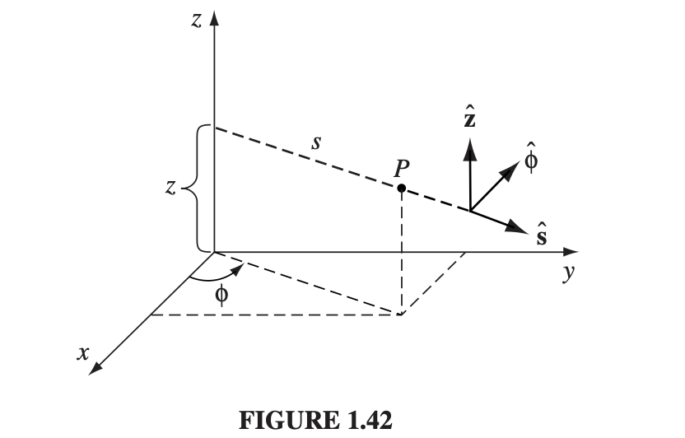
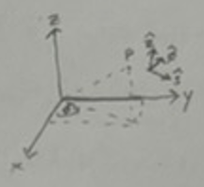
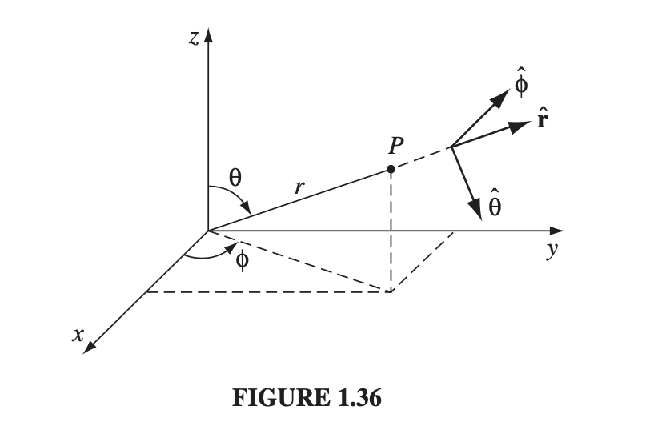
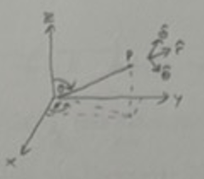
Alternate Coordinate SYstems
Cylindrical Polar
Spherical Polar
$$\hat{s}=\cos{φ}\hat{x}+\sin{φ}\hat{y}$$
$$\hat{φ}=−sin{φ}\hat{x}+\cos{φ}\hat{y}$$
$$\hat{z}=\hat{z}$$
$$\hat{r}=\sin{θ}\cos{φ}\hat{x}+\sin{θ}\sin{φ}\hat{y}+\cos{θ}\hat{z}$$
$$\hat{θ}=\cos{θ}\cos{φ}\hat{x}+\cos{θ}\sin{φ}\hat{y}−\sin{θ}\hat{z}$$
$$\hat{φ}=−\sin{φ}\hat{x}+\cos{φ}\hat{y}$$

Slide 34
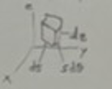
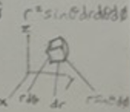
Vector Derivatives
$$\vec{∇}=\hat{x}\frac{∂}{∂x}+\hat{y}\frac{∂}{∂y}+\hat{z}\frac{∂}{∂z}$$
$$=\frac{∂^{2}}{∂x^{2}}+\frac{∂^{2}}{∂y^{2}}+\frac{∂^{2}}{∂z^{2}}$$
$$∇^{2}=\vec{∇}∙\vec{∇}$$
.
Gradient
$$\vec{∇}f=$$
Divergence
$$\vec{∇}∙\vec{f}=$$
Curl
$$\vec{∇}×\vec{f}=$$
Laplacian
$$∇^{2}f=$$
Line, Area and Volume Element
$$\hat{x}\left(\frac{∂f_{z}}{∂y}−\frac{∂f_{y}}{∂z}\right)$$
$$+\hat{y}\left(\frac{∂f_{x}}{∂z}−\frac{∂f_{z}}{∂x}\right)+\hat{z}\left(\frac{∂f_{y}}{∂x}−\frac{∂f_{x}}{∂y}\right)$$
$$\frac{∂^{2}f}{∂x^{2}}+\frac{∂^{2}f}{∂y^{2}}+\frac{∂^{2}f}{∂z^{2}}$$
$$d\vec{ℓ}=\hat{x}dx+\hat{y}dy+\hat{z}dz$$
Cartesian
$$\hat{x}\frac{∂f}{∂x}+\hat{y}\frac{∂f}{∂y}+\hat{z}\frac{∂f}{∂z}$$
$$\frac{∂f}{∂x}+\frac{∂f}{∂y}+\frac{∂f}{∂z}$$
$$dτ=dxdydz$$
$$±d\vec{a}=\hat{x}dydz+\hat{y}dxdz+\hat{z}dxdy$$
$$\vec{∇}f=\hat{s}\frac{∂f}{∂s}+\hat{φ}\frac{1}{s}\frac{∂f}{∂φ}+\hat{z}\frac{∂f}{∂z}$$
$$\vec{∇}∙\vec{f}=\frac{1}{s}\frac{∂}{∂s}\left({sf}_{s}\right)+\frac{1}{s}\frac{∂f_{φ}}{∂φ}+\frac{∂f}{∂z}$$
$$\vec{∇}×\vec{f}= \\ \hat{s}\left(\frac{1}{s}\frac{∂f_{z}}{∂φ}−\frac{∂f_{φ}}{∂z}\right)$$
$$+\hat{φ}\left(\frac{∂f_{s}}{∂z}−\frac{∂f_{φ}}{∂s}\right)+\hat{z}\frac{1}{s}\left(\frac{∂}{∂s}\left(sf_{φ}\right)−\frac{∂f_{z}}{∂φ}\right)$$
$$∇^{2}f= \\ \frac{1}{s} \frac{∂}{∂s}\left(s\frac{∂f}{∂s}\right)−\frac{1}{s^{2}}\frac{∂^{2}f}{∂φ^{2}}$$
$$+\frac{∂^{2}f}{∂z^{2}}$$
$$d\vec{ℓ}=\hat{s}ds+\hat{φ}sdφ+\hat{z}dz$$
$$dτ=sdsdφdz$$
Cylindrical
$$±d\vec{a}=\hat{s}sdφdz+\hat{φ}dsdz+\hat{z}sdsdφ$$
$$\vec{∇}f=$$
$$\hat{r}\frac{∂f}{∂r}+\hat{θ}\frac{1}{r}\frac{∂f}{∂θ}+\hat{φ}\frac{1}{r\sin{θ}}\frac{∂f}{∂φ}$$
$$\vec{∇}∙\vec{f}=\frac{1}{r^{2}}\frac{∂}{∂r}\left(r^{2}f_{r}\right)+\frac{1}{r\sin{θ}}\frac{∂}{∂θ}\left({\sin{θ}f}_{θ}\right)+\frac{1}{r\sin{θ}}\frac{∂f_{φ}}{∂φ}$$
Spherical
$$\vec{∇}×\vec{f}= \\ \hat{r}\frac{1}{r\sin{θ}}\left(\frac{∂}{∂θ}\left({\sin{θ}f}_{φ}\right)−\frac{∂f_{z}}{∂φ}\right)$$
$$+\hat{θ}\frac{1}{r}\left(\frac{1}{\sin{θ}}\frac{∂f_{r}}{∂φ}−\frac{∂}{∂r}\left(rf_{φ}\right)\right)+\hat{φ}\frac{1}{r}\left(\frac{∂}{∂r}\left(rf_{θ}\right)−\frac{∂f_{r}}{∂θ}\right)$$
$$∇^{2}f= \\ \frac{1}{r^{2}}\frac{∂}{∂r}\left(r^{2}\frac{∂^{2}f}{∂r^{2}}\right)+\frac{1}{r^{2}\sin{θ}}\left(\frac{∂}{∂θ}\left(\sin{θ}\frac{∂f}{∂θ}\right)\right)$$
$$+\frac{1}{r^{2}\sin^{2}{θ}}\frac{∂^{2}f}{∂φ^{2}}$$
$$d\vec{ℓ}=\hat{r}dr+\hat{θ}rdθ+\hat{φ}r\sin{θ}dφ$$
$$dτ=r^{2}\sin{θ}drdθdφ$$
$$±d\vec{a}=\hat{r}r^{2}\sin{θ}dθdφ+\hat{θ}r\sin{θ}drdφ+\hat{φ}rdrdθ$$
$$f_{r}=\vec{f}∙\hat{r},f_{θ}=\vec{f}∙\hat{θ},f_{φ}=\vec{f}∙\hat{φ}$$

Slide 35
Divergence oF Electric field of A Point Charge
Now use spherical polar coordinates. See HW 1.
$$\vec{E}(\vec{r})=\frac{1}{4πε_{0}}q\frac{\vec{r}−{\vec{r}}^{′}}{{|\vec{r}−{\vec{r}}^{′}|}^{3}}=k_{e}\frac{q}{{|\vec{𝓇}|}^{2}}\hat{𝓇}$$
$$\vec{r}$$
$$\vec{𝓇}=\vec{r}−\vec{r} ′$$
$$\vec{r} ′$$

Slide 36
Math methods – multivariate calculus
Gauss’ (Divergence)
Theorem
Green’s Theorem
Stokes’ Theorem
The integral of the divergence
of a vector field in a volume
equals the flux going through
its surface
The integral of the curl of a vector field
on a surface D on the xy-plane equals
the line integral of the vector field
on the boundary of D
Generalization of Green’s theorem to
arbitrary surfaces

Slide 37
Electrodynamics – Maxwell’s equations
Maxwell’s equations:
$$\vec{∇}∙\vec{E}=\frac{ρ}{ε_{0}}$$
Gauss’s Law
Gauss’s Law
for Magnetism
$$\vec{∇}∙\vec{B}=0$$
$$\vec{∇}×\vec{E}=−\frac{∂\vec{B}}{∂t}$$
Faraday’s Law
$\vec{∇}×\vec{B}=μ_{0}\vec{j}+μ_{0}ε_{0}\frac{∂\vec{E}}{∂t}$
Ampère Law
Notes:
1/30/23

Slide 38
Gauss’ Law
Use $\vec{∇}∙\frac{\vec{r}}{{\left|\vec{r}\right|}^{3}}=4πδ(\vec{r}′)$(HW1) to show Gauss’ Law: $\vec{∇}∙\vec{E}=\frac{ρ }{ε_{0}}$
Apply Gauss’ divergence theorem to write Gauss’ law in integral form
$$Φ_{E}=\frac{\text{1} }{4πε_{0}}\int{\frac{dq(\vec{r}′)}{|r−r^{′}|}}$$
$$\vec{E}=−\vec{∇}Φ_{E}=\frac{\text{1} }{4πε_{0}}\int{\frac{dq(\vec{r}′)}{{\left|\vec{r}−\vec{r}′\right|}^{2}}\hat{\vec{r}−\vec{r}′}}=\frac{\text{1} }{4πε_{0}}\int{ρ}\frac{\vec{r}−\vec{r}′}{{\left|r−r^{′}\right|}^{3}}dV$$
$$⇒\vec{∇}∙\vec{E}=\frac{\text{1} }{4πε_{0}}\iiint{V^{′}}\vec{∇}∙\frac{\vec{r}−\vec{r}′}{{\left|\vec{r}−\vec{r}′\right|}^{3}}ρdV^{′}=\frac{\text{1} }{4πε_{0}}\iiint{V^{′}}ρδ(\vec{r}−\vec{r}′)dV^{′}=\frac{ρ}{ε_{0}}$$
Delta function nonzero only at $\vec{r}′∈V′$
$$\iiint{V}\vec{∇}∙\vec{E}dV$$
$$∯{∂V \vec{E}}∙d\vec{S}= .$$
$$=\frac{\text{1} }{4πε_{0}}\iiint{V}ρdV=\frac{Q_{enc}}{ε_{0}}$$
$$⇒∯{∂V \vec{E}}∙d\vec{S}=\frac{Q_{enc}}{ε_{0}}$$
Gauss’ Law (Integral Form)

Slide 39
Vector Identities
$$\vec{A}∙\left(\vec{B}×\vec{C}\right)=\vec{C}∙\left(\vec{A}×\vec{B}\right)=\vec{B}∙\left(\vec{C}×\vec{A}\right)$$
We may permute in cyclic order the factors of a triple scalar product without altering its value
.
$$\vec{A}×\left(\vec{B}×\vec{C}\right)=\vec{B}\left(\vec{A}∙\vec{C}\right)−\vec{C}\left(\vec{A}∙\vec{B}\right)$$
BAC-CAB Rule
$$\vec{∇}\left(fg\right)=f\left(\vec{∇}g\right)+g\left(\vec{∇}f\right)$$
$$\text{Product} \text{Rule} \text{for} \text{Gradients}$$
$$\vec{∇}\left(\vec{A}∙\vec{B}\right)=\vec{A}×\left(\vec{∇}×\vec{B}\right)+\vec{B}×\left(\vec{∇}×\vec{A}\right)+\left(\vec{A}∙\vec{∇}\right)\vec{B}+\left(\vec{B}∙\vec{∇}\right)\vec{A}$$
$$\vec{A}∙\vec{∇}=A_{1}\frac{∂}{∂x_{1}}+A_{2}\frac{∂}{∂x_{2}}+A_{3}\frac{∂}{∂x_{3}}$$
$$\vec{∇}∙\left(f\vec{A}\right)=f\left(\vec{∇}∙\vec{A}\right)+\vec{A}∙\vec{∇}f$$
$$\vec{∇}∙\left(\vec{A}×\vec{B}\right)=\vec{B}∙\left(\vec{∇}×\vec{A}\right)−\vec{A}∙\left(\vec{∇}×\vec{B}\right)$$
$$\vec{∇}×\left(f\vec{A}\right)=f\left(\vec{∇}×\vec{A}\right)−\vec{A}×\left(\vec{∇}f\right)$$
$$\vec{∇}×\left(\vec{A}×\vec{B}\right)=\left(\vec{B}∙\vec{∇}\right)\vec{A}−\left(\vec{A}∙\vec{∇}\right)\vec{B}+\vec{A}\left(\vec{∇}∙\vec{B}\right)−\vec{B}\left(\vec{∇}∙\vec{A}\right)$$
$$\vec{∇}∙\left(\vec{∇}×\vec{A}\right)=0$$
$$\text{Divergence} \text{of} \text{a} \text{Curl} \text{is}\text{ 0}$$
$$\vec{∇}× \left(\vec{∇}f\right)=\vec{0}$$
$$\text{Curl} \text{of} \text{a} \text{Gradient} \text{is}\text{ 0}$$
$$\vec{∇}× \left(\vec{∇}×\vec{A}\right)=\vec{∇}\left(\vec{∇}∙\vec{A}\right)−∇^{2}\vec{A}$$

Slide 40
Integration By Parts
We may transfer a derivative from one function to another incurring a negative sign and a boundary term
$$\vec{∇}∙\left(f\vec{A}\right)=f\left(\vec{∇}⋅\vec{A}\right)+\vec{A}∙\left(\vec{∇}f\right)$$
$$⇒\int_{V}^{.}{\vec{∇}∙\left(f\vec{A}\right)dτ}=\int_{V}^{.}{f\left(\vec{∇}∙\vec{A}\right)dτ}+\int_{V}^{.}{\vec{A}∙\left(\vec{∇}f\right)dτ}=\oint_{A}^{.}{f\vec{A}∙d\vec{a}}$$
$$⇒\int_{V}^{.}{f\left(\vec{∇}∙\vec{A}\right)dτ}=−\int_{V}^{.}{\vec{A}∙\left(\vec{∇}f\right)dτ}+\oint_{A}^{.}{f\vec{A}∙d\vec{a}}$$
$$\vec{∇}×\left(f\vec{A}\right)=f\left(\vec{∇}×\vec{A}\right)−\vec{A}×\left(\vec{∇}f\right)$$
$$⇒\int_{S}^{.}{\left(\vec{∇}×\left(f\vec{A}\right)\right)∙d\vec{a}}=\int_{S}^{.}{f\left(\vec{∇}×\vec{A}\right)∙d\vec{a}}−\int_{S}^{.}{\left(\vec{A}×\left(\vec{∇}f\right)\right)∙d\vec{a}}=\oint_{γ}^{.}{f\vec{A}∙d\vec{ℓ}}$$
$$⇒\int_{S}^{.}{f\left(\vec{∇}×\vec{A}\right)∙d\vec{a}}=\int_{S}^{.}{\left(\vec{A}×\left(\vec{∇}f\right)\right)∙d\vec{a}}+\oint_{γ}^{.}{f\vec{A}∙d\vec{ℓ}}=−\int_{S}^{.}{\left(\left(\vec{∇}f\right)×\vec{A}\right)∙d\vec{a}}+\oint_{γ}^{.}{f\vec{A}∙d\vec{ℓ}}$$
$$\vec{∇}∙\left(\vec{A}×\vec{B}\right)=\vec{B}∙\left(\vec{∇}×\vec{A}\right)−\vec{A}∙\left(\vec{∇}×\vec{B}\right)$$
$$⇒\int_{V}^{.}{\vec{∇}∙\left(\vec{A}×\vec{B}\right)dτ}=\int_{V}^{.}{\vec{B}∙\left(\vec{∇}×\vec{A}\right)dτ}−\int_{V}^{.}{\vec{A}∙\left(\vec{∇}×\vec{B}\right)dτ}=\int_{S}^{.}{\left(\vec{A}×\vec{B}\right)∙d\vec{a}}$$
$$⇒\int_{V}^{.}{\vec{B}∙\left(\vec{∇}×\vec{A}\right)dτ}=\int_{V}^{.}{\vec{A}∙\left(\vec{∇}×\vec{B}\right)dτ}+\int_{S}^{.}{\left(\vec{A}×\vec{B}\right)∙d\vec{a}}$$

