Slide 1
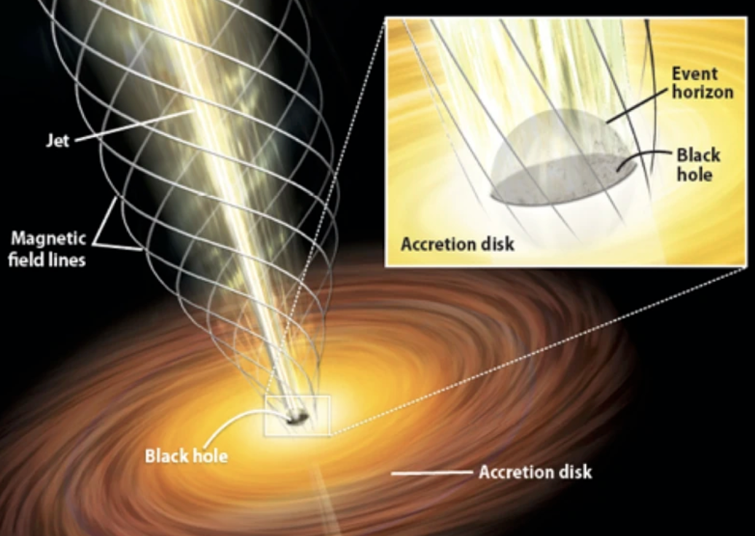
ElectroDynamics
UTSA PHY 3513 - Fall 2024
ElectroDynamics
UNIT 4 – Electrodynamics and Conservation Laws
Prof. Richard Anantua
Notes:
Crossing time, collision time, hubble time
Star cluster, globular cluster

Slide 2
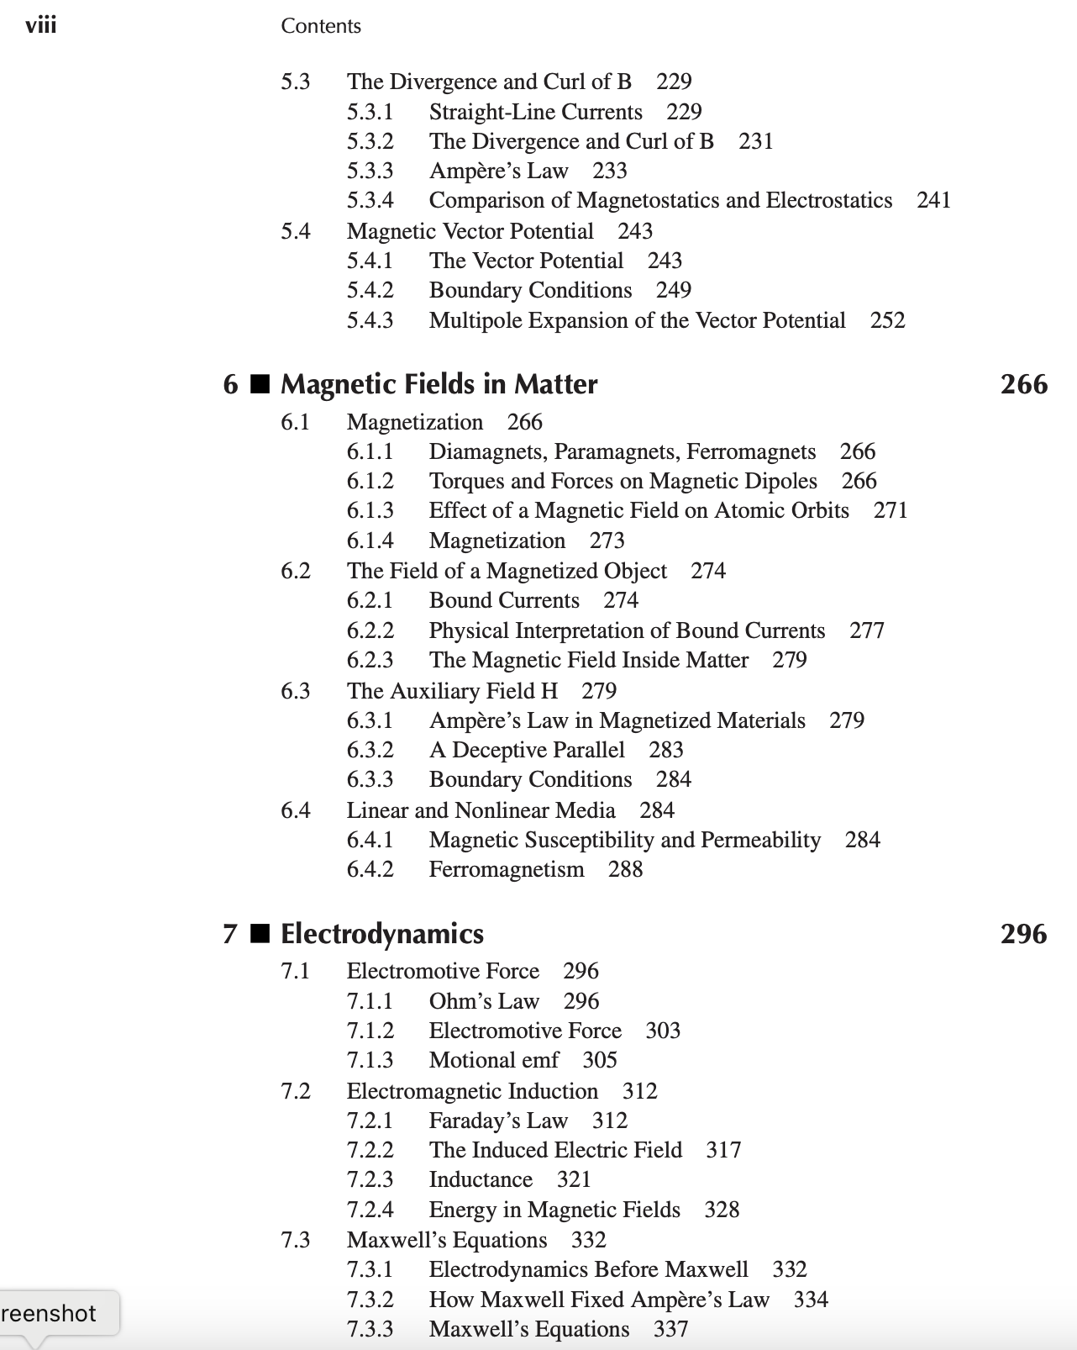
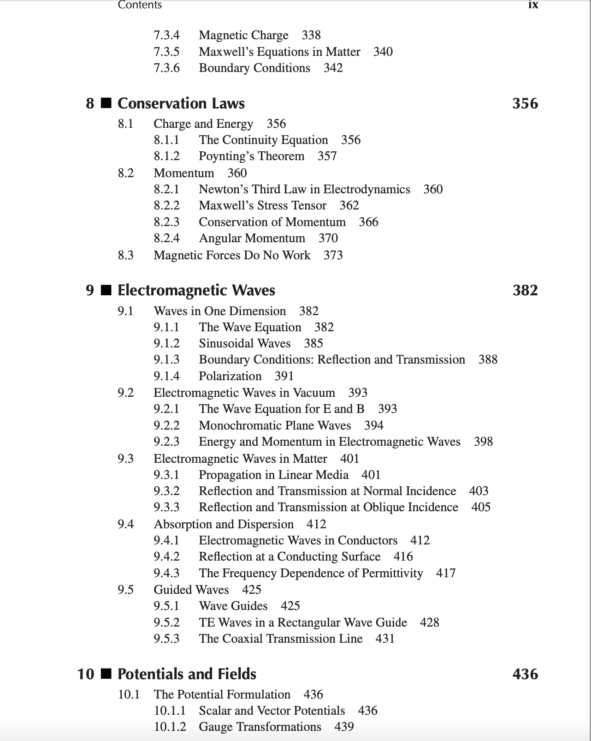
Course Roadmap
Course Syllabus: https://utsa.simplesyllabus.com/doc/7z1udnw3k/Fall-2024-PHY-3513-001-Electrodynamics?mode=view
Academic Calendar: https://www.utsa.edu/registrar/reg_materials/reg_calendar_fall.pdf
Unit 1 Math Methods (Ch. 1); Unit 2 Electrostatics and Potential Theory (Chs. 2-3); Unit 3 Electric and Magnetic Fields in Matter (Chs. 4-6); Unit 4 Electrodynamics and Conservation Laws (Chs. 7,8); Unit 5 Electromagnetic Waves and Waveguides (Ch. 9); Unit 6 Potentials, Fields and Radiation – Relativistic Formalism (Chs. 10,11,12)
Griffith’s E&M

Slide 3
Review of electroDynamics – Maxwell’s equations
Exercise: Rewrite Maxwell’s equations in integral form
Differential Form Integral Form
$$\vec{∇}∙\vec{E}=\frac{ρ}{ε_{0}}$$
$$∯{\vec{E}∙d\vec{A}}=\frac{Q_{enc}}{ε_{0}}$$
Gauss’s Law
Gauss’s Law
for Magnetism
$$\vec{∇}∙\vec{B}=0$$
$∯{\vec{B}∙d\vec{A}}=0$
$$\vec{∇}×\vec{E}=−\frac{∂\vec{B}}{∂t}$$
$$\oint{\vec{E}∙d\vec{l}}=−\frac{∂Φ_{B}}{∂t}$$
Faraday’s Law
$\vec{∇}×\vec{B}=μ_{0}\vec{j}+μ_{0}ε_{0}\frac{∂\vec{E}}{∂t}$
$$\oint{\vec{B}∙d\vec{l}}={μ_{0}I}_{enc}+μ_{0}ε_{0}\frac{∂Φ_{E}}{∂t}$$
Ampère Law

Slide 4
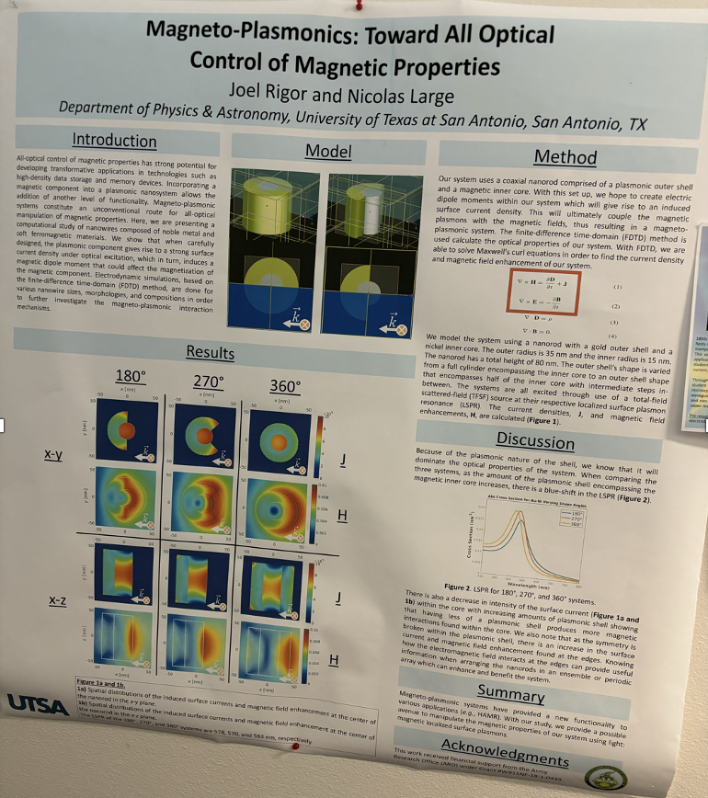
Application - Maxwell’s equations in matter
For electrodynamics in matter, Maxwell’s Eqs. become
Application: Magnetoplasmonics
All-optical control over a mechanical device
$\vec{∇}∙\vec{D}=ρ_{f}$
$$\vec{∇}∙\vec{B}=0$$
$$\vec{∇}×\vec{E}=\frac{∂\vec{B}}{∂t}$$
$$\vec{∇}×\vec{H}={\vec{J}}_{f}+\frac{∂\vec{D}}{∂t}$$
$$𝒪$$

Slide 5
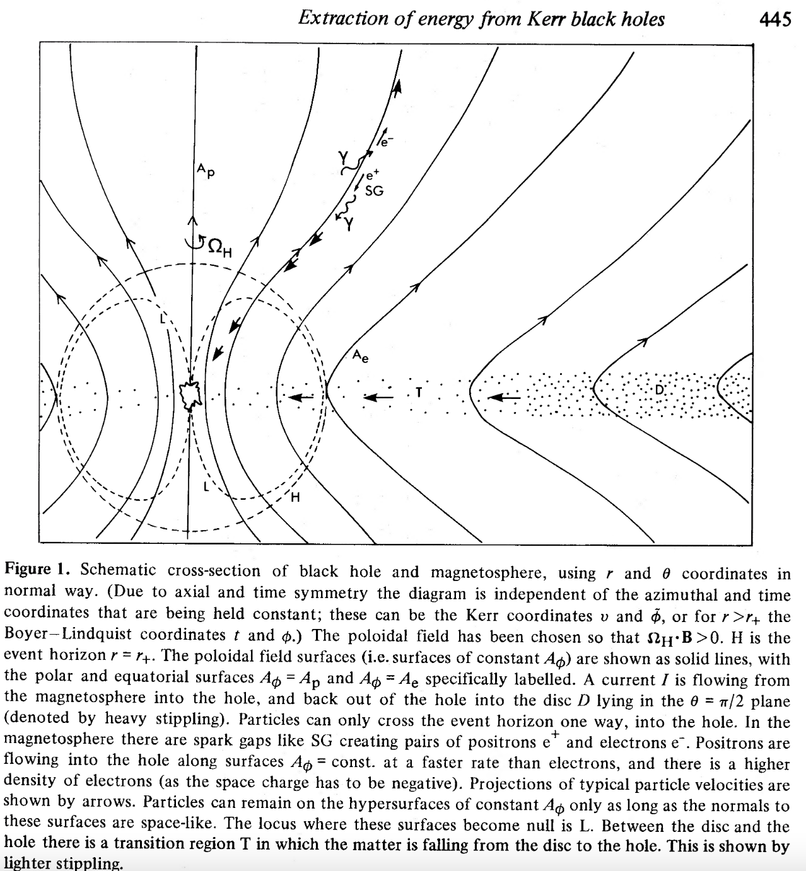
Electrodynamics in Action - Blandford-Znajek Mechanism
Rotating black holes accreting flux due to vertical magnetic field B source bipolar relativistic outflows via the Blandford-Znajek (BZ) mechanism (Blandford & Znajek 1977)
The BZ jet power depends on the initial field configuration, and liberates electromagnetic power (luminosity) with scaling dependencies on black hole spin a and horizon-threading flux $Φ_{H}$:
For an accretion disk-fed black hole
Paraboloidal initial field solution
BZ jets in active galactic nuclei (AGN) typically have $V\sim 100EV$, $Φ_{H}\sim {10}^{25−28}Wb$, $I\sim$10PA-1EA (Blandford & Anantua 2017)
$$L_{BZ}\sim {\left(aΦ_{H}\right)}^{2}$$
$$Φ_{H}\sim \sqrt{\dot{M}r_{g}c}$$
$$L_{H}=0.3{(a/M)}^{2}L_{D}\sim {10}^{38}{(a/M)}^{2}\dot{M} W$$
Notes:
I could title this slide with some explicit astrophysical term, but Roger Blandford’s name is synonymous with relativistic jets
In one of his theories of the formation of relativistic jets,
rotating black holes accreting flux due to vertical magnetic field B source bipolar relativistic outflows via the Blandford-Znajek (BZ) mechanism
The BZ jet power depends on the initial field configuration, and liberates electromagnetic power (luminosity) with scaling dependencies on black hole spin a and horizon-threading flux $Φ_{H}$
The accreted flux can be tied to an accretion rate
The BZ luminosity can be given in terms of the black hole spin and accretion rate
https://articles.adsabs.harvard.edu/pdf/1977MNRAS.179..433B
https://academic.oup.com/mnras/article/447/2/1498/2593773
I could title this slide with some explicit astrophysical term, but Roger Blandford’s name is synonymous with relativistic jets

Slide 6
Ohm’s Law
Ohm’s Law
Generalized Ohm’s Law
$$\vec{E}+\vec{v}×\vec{B}=η\vec{j}+…$$
$$\vec{E}+\vec{v}×\vec{B}=η\vec{j}+\frac{m_{i}m_{e}}{e^{2}ρ}\int{{\left[\frac{d\vec{j}}{dt}+\vec{∇}∙\left(\vec{v}\vec{j}−\vec{j}\vec{v}\right)\right]d}^{3}x}−\frac{m}{eρ}\vec{∇}∙{\overset{⃡}{p}}_{e}+\frac{m_{i}}{eρ}\vec{j}×\vec{B}$$
Electron inertia
term
Electron pressure
term
Hall
term
5
Notes:
https://youjunhu.github.io/research_notes/mhd/node3.html
MHD neglects particle identity:
in much the same way as oceanography ignores water molecules.
In this continuum limit fields and plasma interact according to the following
-Continuity equation describing mass conservation
-Momentum Equation (Equation of Motion of a Fluid Element)
Ohm’s law relates E and B to current density, an electron inertial term, an electron pressure term and Hall term– but who wants to solve all that
We close the system with an energy equation
And
Maxwell’s equations
Without div E or a displacement current mu0epsilon0 d E /dt
This simplification where E does not source B is at the heart of the special role of M in MHD, rather than the a more complicated system E&MHD
https://www.sciencedirect.com/topics/earth-and-planetary-sciences/magnetohydrodynamics
Two quite different theoretical approaches have been followed to model these waves. On the one hand, the electrodynamics can be described in the continuum limit, supplementing Maxwell’s equations with either the force-free, FF, condition, ρE + j × B = 0, or a relativistic MHD, RMHD, prescription, that treats the plasma as a relativistic fluid. This assumes that the microphysics accommodates the macrophysics in much the same way as oceanography ignores water molecules.
For low frequency, Ampere’s law neglects the displacement current
We start with a few fundamentals:
Disk magnetic fields can be amplified by a dynamo current
If the dynamo current reaches disk voltage over the impedence of free space— typically at around 10 Schwarszchild radii from an AGN black hole— a jet is launched at nearly the speed of light
The jet is governed by: Ohm’s law with a turbulent hyperresistivity term (where hyper-resistivity is any source of kinetic or MHD turbulence) and a momentum equation
-----------------------------------------
I(r =~ 20M) = V/Z0
In MHD, the force on the bulk fluid depends only on the magnetic in- duction B, which is evolved by a simplified form of Faraday’s Law that depends only on the fluid velocity V and the magnetic
9

Slide 7
Electrodynamics – Current Wires
Questions
What moves a charge?
What sets up currents?
Ohm’s law can be written $\vec{j}=σ\left(\vec{E}+\vec{v}×\vec{B}\right)=σ\frac{\vec{F}}{q}=σ\vec{f}$, where $σ=1/η$ is the conductivity
Then Lorentz force per unit charge $\vec{f}$ moves charge
Circuit wires: $I=\left|\vec{J}\right|A=σ\left|\vec{E}\right|A\sim σ\frac{V}{L}A$.
Dimensional Analysis: If electric potential $V$ is work per unit charge, what is electric power $P$?
$$R=V/I$$
($R$ const. is Ohm’s law)
(Grade school version)
Then for Ohmic conductors, resistance $R\sim \frac{L}{σA}$
$$\frac{\left[\text{Work}\right]}{[\text{Charge}]}\frac{[\text{Charge}]}{[\text{Time}]}$$
$$=\frac{\left[\text{Energy}\right]}{[\text{Time}]}\text{=[}\text{P}\text{]}$$
$$I$$
$$\left[V\right][ ]=$$
$\text{leads} \text{to} P=IV$
For Ohmic resistors, $P=I^{2}R$ (Joule heating law)

Slide 8
Currents in Circuits: EMF in electrostatics
Define electromotive force (EMF)
Note, the force per unit charge $\vec{f}={\vec{f}}_{s}+\vec{E}$, where ${\vec{f}}_{s}$ pertains to localized circuit elements moving charges such as batteries or generators
Since $\vec{E}$is conservative in electrostatics, i.e., $\oint{\vec{E}∙d\vec{l}}=0$ , then $ε=\oint{\vec{f}∙d\vec{l}}=\oint{{\vec{f}}_{s}∙d\vec{l}}$
$$ε=\oint{\vec{f}∙d\vec{l}}$$
(Electrostatics)
$$V=−\int_{\vec{a}}^{\vec{b}}{\vec{E}∙d\vec{l}}=\int_{\vec{a}}^{\vec{b}}{{\vec{f}}_{s}∙d\vec{l}}$$
a
b

Slide 9
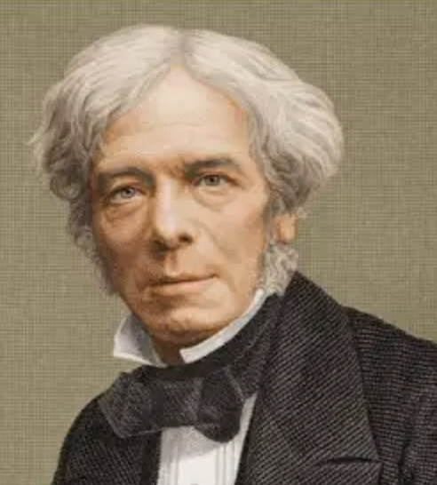
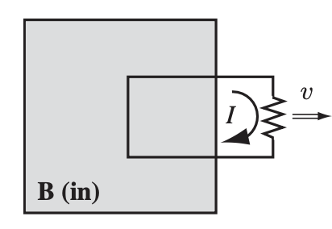
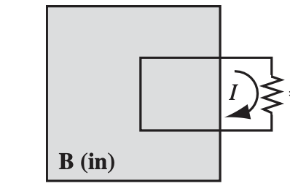
Motional EMF
In 1831, Michael Faraday discovered an EMF would appear across circuits when
There is relative motion between a current loop and a region containing a B field
There is a B-field whose strength changes with time
These results can be expressed as where
Then
Michael Faraday
1791-1867
$$\frac{∂\vec{B}}{∂t}≠\vec{0}$$
$$ε=\oint{\vec{E}∙d\vec{l}}=−\frac{∂Φ_{B}}{∂t}$$
$$Φ_{B}=\int{\vec{B}∙d\vec{a}}$$
$$ε=\oint{\left(\vec{∇}×\vec{E}\right)∙d\vec{l}}=−\int{\frac{∂\vec{B}}{∂t}∙d\vec{a}}$$
$$⇒\vec{∇}×\vec{E}=−\frac{∂\vec{B}}{∂t}$$
Faraday’s Law
Notes:
https://images.app.goo.gl/6dJLHncjg88MxVe39

Slide 10
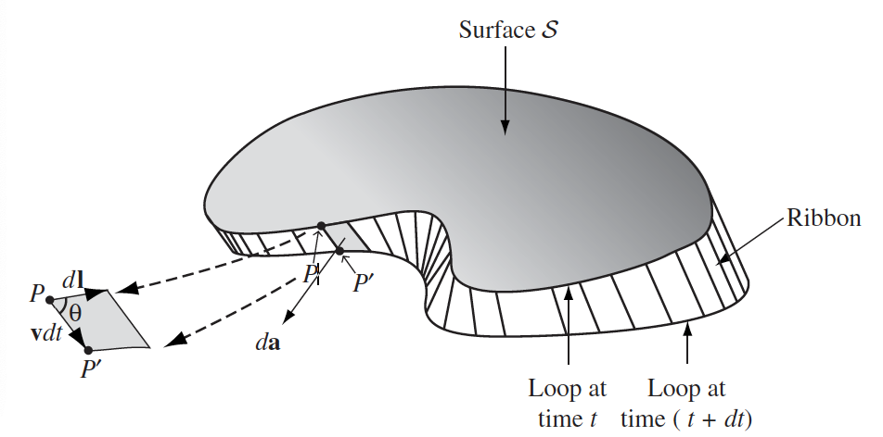
Flux through a moving current Loop
A closer (infinitesimal) look at the moving current loop
The area element can be written
Using the triple scalar product identity
Then
Note ${\vec{f}}_{\text{mag}}=\frac{{\vec{F}}_{B}}{q}=\vec{w}×\vec{B}$
$$\vec{u}||d\vec{l}$$
$$d\vec{a}=\left(\vec{v}×d\vec{l}\right)dt$$
$$\frac{dΦ_{B}}{dt}=\oint{\vec{B}∙}\left(\vec{v}×d\vec{l}\right)$$
$$\frac{dΦ_{B}}{dt}=\oint{\vec{B}∙}\left(\vec{w}×d\vec{l}\right)$$
Net velocity $\vec{w}=\vec{u}+\vec{v}, \vec{u}||d\vec{l}$
$$\vec{B}∙\left(\vec{w}×d\vec{l}\right)=−\left(\vec{w}×\vec{B}\right)∙d\vec{l}$$
$$\frac{dΦ_{B}}{dt}=−\oint{\left(\vec{w}×\vec{B}\right)∙d\vec{l}}$$
$$⟹\frac{dΦ_{B}}{dt}=−\oint{{\vec{f}}_{\text{mag}}∙d\vec{l}}=ε$$
Notes:
https://images.app.goo.gl/6dJLHncjg88MxVe39

Slide 11
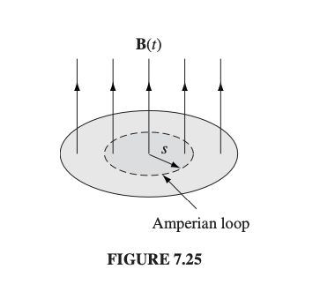
Electrodynamics: Induction
Induction: Change $\vec{B}$, get current, get $\vec{E}$
Assume $\frac{∂\vec{B}}{∂t}≠\vec{0}$ .
Example: Find the induced electric field if $\vec{B}$ changes in the current loop
$$\oint{\vec{B}∙d\vec{l}}=μ_{0}I_{enc}$$
$$\oint{\vec{E}∙d\vec{l}}=−\frac{∂Φ_{B}}{∂t}$$
For $ρ=0$
$$\oint{\vec{E}∙d\vec{l}}=\left|\vec{E}\right|2πs=E_{φ}2πs=−\frac{∂Φ_{B}}{∂t}$$
$$=−\frac{d}{dt}\left(πs^{2}|\vec{B}\left(t\right)|\right)$$
$$E_{φ}=−\frac{s}{2}\frac{dB_{z}}{dt}$$
$$\vec{E}=−\frac{s}{2}\frac{dB_{z}}{dt}\hat{φ}$$

Slide 12
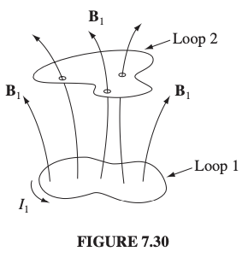
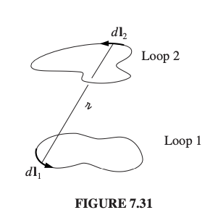
Inductance
Two current loops can induce flux through each other
Mutual Inductance $M$- The proportionality factor between Flux2 and Current1
Example: Nested solenoids
$${\vec{B}}_{1}=\frac{μ_{0}}{4π}I_{1}\oint{\frac{d{\vec{ℓ}}_{1}\hat{𝓇}}{𝓇^{2}}}∝I_{1}$$
$$Φ_{2}=\int{{\vec{B}}_{1}∙d}\vec{a}=M_{21}I_{1}$$
$$Φ_{2}=\int_{S}^{.}{\left(\vec{∇}×{\vec{A}}_{1}\right)∙}{d\vec{a}}_{2}=\oint_{L}^{.}{{\vec{A}}_{1}∙{d\vec{l}}_{2}}$$
$$\vec{A}\left(\vec{r}\right)=\frac{μ_{0}I}{4π}\oint{\frac{d\vec{l}′}{𝓇}}$$
$$⟹Φ_{2}=\frac{μ_{0}I}{4π}\oint{\left(\oint{\frac{{d\vec{l}′}_{1}}{𝓇}}\right)∙{d\vec{l}′}_{2}=M_{21}I}$$
$$⟹M_{21}≡\frac{μ_{0}}{4π}\oint{\left(\oint{\frac{{d\vec{l}′}_{1}}{𝓇}}\right)∙{d\vec{l}′}_{2}}$$
$$=M_{12}$$
$$B_{z}=μ_{0}n_{2}I$$
$$Φ_{1}=|B_{z}|(πa^{2})(n_{1}ℓ)$$
$$=μ_{0}n_{1}n_{2}ℓπa^{2}I$$
$$=μ_{0}n_{1}n_{2}𝒱I$$
$$⟹M_{12}=μ_{0}n_{1}n_{2}𝒱$$
Solenoid 1
Solenoid 2

Slide 13
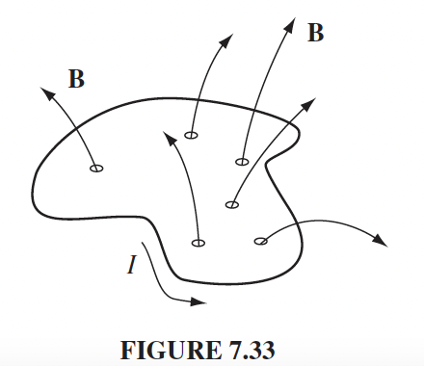
Self-Inductance
Can a single current loop drive a flux through itself?
Self Inductance -
YES!
$$ε=−L\frac{dI}{dt}$$
$$Φ=LI$$
Notes:
Toroidal Coil

Slide 14
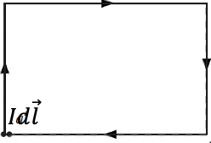
Energy In B Field
Consider a segment of current wire
To move charge $q$ a distance $d\vec{l}$ in the segment
For the whole wire,
$${\left(∆W\right)}_{segment}=−q\vec{f}∙d\vec{l}$$
$$=−I∆t\vec{f}∙d\vec{l}$$
$$\frac{{\left(∆W\right)}_{loop}}{∆t}=−\oint{I(t)\vec{f}∙d\vec{l}}$$
$$=−I(t)\oint{\vec{f}∙d\vec{l}}$$
$$⟹\frac{dW}{dt}=−εI=LI\frac{dI}{dt}$$
$$⟹W=\frac{1}{2}LI^{2}$$

Slide 15
Electromagnetic Force on Charges
The force on all the charges in a region is a (coordinate independent) integral
Now, we use Maxwell’s Eq. to substitute sources with fields
Using vector calculus,
Then
$$\vec{F}=\int_{𝒱}^{.}{\left(\vec{E}(\vec{x})+\vec{v}(\vec{x})×\vec{B}(\vec{x})\right)ρ(\vec{x})dτ}$$
$$\vec{J}=ρ\vec{v}⇒\vec{F}=\int_{𝒱}^{.}{\left(ρ\vec{E}+\vec{J}×\vec{B}\right)dτ}=\int_{𝒱}^{.}{\vec{f}dτ}$$
where $\vec{f}=ρ\vec{E}+\vec{J}×\vec{B}$ is the force per unit volume
$$+\left(\frac{1}{μ_{0}}\vec{∇}×\vec{B}−ε_{0}\frac{∂\vec{E}}{∂t}\right)×\vec{B}$$
$$\vec{f}=ρ\vec{E}+\vec{J}×\vec{B}$$
$$=ε_{0}\left(\vec{∇}∙\vec{E}\right)\vec{E}$$
$$\frac{∂\vec{E}}{∂t}×\vec{B}=\frac{∂}{∂t}\left(\vec{E}×\vec{B}\right)−\vec{E}×\frac{∂\vec{B}}{∂t}$$
$=\frac{∂}{∂t}\left(\vec{E}×\vec{B}\right)+\vec{E}×\left(\vec{∇}×\vec{E}\right)$ (by Faraday’s law)
$$\vec{f}=ε_{0}\left[\left(\vec{∇}∙\vec{E}\right)\vec{E}−\vec{E}×\left(\vec{∇}×\vec{E}\right)\right]−\frac{1}{μ_{0}}\left[\vec{B}×\left(\vec{∇}×\vec{B}\right)\right]−ε_{0}\frac{∂}{∂t}\left(\vec{E}×\vec{B}\right)$$
$$⟹\vec{f}=ε_{0}\left[\left(\vec{∇}∙\vec{E}\right)\vec{E}−\left\{\frac{1}{2}∇\left(E^{2}\right)−\left(\vec{E}∙\vec{∇}\right)\vec{E}\right\}\right]+\frac{1}{μ_{0}}\left[\left(\vec{∇}∙\vec{B}\right)\vec{B}−\left\{\frac{1}{2}∇\left(B^{2}\right)−\left(\vec{B}∙\vec{∇}\right)\vec{B}\right\}\right]−ε_{0}\frac{∂}{∂t}\left(\vec{E}×\vec{B}\right)$$
$$⟹\vec{f}=ε_{0}\left[\left(\vec{∇}∙\vec{E}\right)\vec{E}+\left(\vec{E}∙\vec{∇}\right)\vec{E}\right]+\frac{1}{μ_{0}}\left[\left(\vec{∇}∙\vec{B}\right)\vec{B}+\left(\vec{B}∙\vec{∇}\right)\vec{B}\right]−\frac{1}{2}∇\left(ε_{0}E^{2}+\frac{1}{μ_{0}}B^{2}\right)−ε_{0}\frac{∂}{∂t}\left(\vec{E}×\vec{B}\right)$$

Slide 16
Maxwell Stress Tensor
We have seen the force per unit charge $\vec{f}$ in a volume
can be written in terms of fields
This can be simplified introducing the Maxwell stress tensor
In matrix form
Example: Write T_{xx} in terms of $\vec{E}$ and $\vec{B}$ components
$$\vec{F}=\int_{𝒱}^{.}{\left(ρ\vec{E}+\vec{J}×\vec{B}\right)dτ}=\int_{𝒱}^{.}{\vec{f}dτ}$$
$$\vec{f}=ε_{0}\left[\left(\vec{∇}∙\vec{E}\right)\vec{E}+\left(\vec{E}∙\vec{∇}\right)\vec{E}\right]+\frac{1}{μ_{0}}\left[\left(\vec{∇}∙\vec{B}\right)\vec{B}+\left(\vec{B}∙\vec{∇}\right)\vec{B}\right]−\frac{1}{2}∇\left(ε_{0}E^{2}+\frac{1}{μ_{0}}B^{2}\right)−ε_{0}\frac{∂}{∂t}\left(\vec{E}×\vec{B}\right)$$
$$T_{ij}=ε_{0}\left(E_{i}E_{j}−\frac{1}{2}δ_{ij}E^{2}\right)+\frac{1}{μ_{0}}\left(B_{i}B_{j}−\frac{1}{2}δ_{ij}B^{2}\right)$$
$$\overset{⃡}{T}=ε_{0}\left(\left[\begin{matrix}E_{11} & E_{12} & E_{13} \\ E_{21} & E_{22} & E_{23} \\ E_{31} & E_{32} & E_{33}\end{matrix}\right]−\frac{E^{2}}{2}\left[\begin{matrix}1 & 0 & 0 \\ 0 & 1 & 0 \\ 0 & 0 & 1\end{matrix}\right]\right)+\frac{1}{μ_{0}}\left(\left[\begin{matrix}B_{11} & B_{12} & B_{13} \\ B_{21} & B_{22} & B_{23} \\ B_{31} & B_{32} & B_{33}\end{matrix}\right]−\frac{B^{2}}{2}\left[\begin{matrix}1 & 0 & 0 \\ 0 & 1 & 0 \\ 0 & 0 & 1\end{matrix}\right]\right)$$
$$T_{xx}={E_{x}}^{2}−\frac{ε_{0}}{2}\left({E_{x}}^{2}+{E_{y}}^{2}+{E_{z}}^{2}\right)+\frac{1}{{2μ}_{0}}\left({B_{x}}^{2}+{B_{y}}^{2}+{B_{z}}^{2}\right)$$
$$=\frac{ε_{0}}{2}\left({E_{x}}^{2}−{E_{y}}^{2}−{E_{z}}^{2}\right)+\frac{1}{{2μ}_{0}}\left({B_{x}}^{2}−{B_{y}}^{2}−{B_{z}}^{2}\right)$$

Slide 17
Maxwell Stress Tensor and Poynting Vector
We have seen the force per unit charge $\vec{f}$ in a volume
can be written in terms of fields
We can relate $\vec{f}$ to the Maxwell stress tensor
and Poynting vector $\vec{S}=\frac{1}{μ_{0}}\vec{E}×\vec{B}$ as
$$\vec{F}=\int_{𝒱}^{.}{\left(ρ\vec{E}+\vec{J}×\vec{B}\right)dτ}=\int_{𝒱}^{.}{\vec{f}dτ}$$
$$\vec{f}=ε_{0}\left[\left(\vec{∇}∙\vec{E}\right)\vec{E}+\left(\vec{E}∙\vec{∇}\right)\vec{E}\right]+\frac{1}{μ_{0}}\left[\left(\vec{∇}∙\vec{B}\right)\vec{B}+\left(\vec{B}∙\vec{∇}\right)\vec{B}\right]−\frac{1}{2}∇\left(ε_{0}E^{2}+\frac{1}{μ_{0}}B^{2}\right)−ε_{0}\frac{∂}{∂t}\left(\vec{E}×\vec{B}\right)$$
$$\overset{⃡}{T}=ε_{0}\left(\left[\begin{matrix}E_{11} & E_{12} & E_{13} \\ E_{21} & E_{22} & E_{23} \\ E_{31} & E_{32} & E_{33}\end{matrix}\right]−\frac{E^{2}}{2}\left[\begin{matrix}1 & 0 & 0 \\ 0 & 1 & 0 \\ 0 & 0 & 1\end{matrix}\right]\right)+\frac{1}{μ_{0}}\left(\left[\begin{matrix}B_{11} & B_{12} & B_{13} \\ B_{21} & B_{22} & B_{23} \\ B_{31} & B_{32} & B_{33}\end{matrix}\right]−\frac{B^{2}}{2}\left[\begin{matrix}1 & 0 & 0 \\ 0 & 1 & 0 \\ 0 & 0 & 1\end{matrix}\right]\right)$$
$$\vec{f}=\vec{∇}∙\overset{⃡}{T}−{μ_{0}ε}_{0}\frac{∂\vec{S}}{∂t}$$

Slide 18
energy of fields and particles in Classical physics (Group Activity)
What is the kinetic energy of Earth orbiting the Galactic Center if v_{E,GC}=2.0x10⁵m/s?
What is the time-averaged energy density u of an electromagnetic wave with $\vec{E}={\vec{E}}_{0}\cos{(kx−ωt)}$, ${\vec{B}}_{0}=\frac{1}{c}{\vec{E}}_{0}$, $\vec{E}⊥\vec{B}$ and Poynting flux (power per unit area) $\vec{S}=\frac{1}{μ_{0}}\vec{E}×\vec{B}$? Hint: Relate units of u and S. Average over a period T.
By analogy, what is the potential energy density stored in a gravitational field?
What is the potential energy stored in the gravitational field of Earth ($ρ$ =5500kg/m³ )? Hint: Consider volume contributions from concentric shells.
Notes:
Gravitational energy density is negative since it binds particles (which require energy to escape) in contrast to EM radiation energy density, which imparts outward radiation pressure

Slide 19
energy of fields and particles in Classical physics (Group Activity)
What is the kinetic energy of Earth orbiting the Galactic Center if v_{E,GC}=2.0x10⁵m/s?
What is the time-averaged energy density u of an electromagnetic wave with $\vec{E}={\vec{E}}_{0}\cos{(kx−ωt)}$, ${\vec{B}}_{0}=\frac{1}{c}{\vec{E}}_{0}$, $\vec{E}⊥\vec{B}$ and Poynting flux (power per unit area) $\vec{S}=\frac{1}{μ_{0}}\vec{E}×\vec{B}$? Hint: Relate units of u and S. Average over a period T.
By analogy, what is the potential energy density stored in a gravitational field?
Interchanging $\vec{E}↔\vec{g}$ and $\frac{1}{4πε_{0}}↔−G,$
What is the potential energy stored in the gravitational field of Earth ($ρ$ =5500kg/m³ )? Hint: Consider volume contributions from concentric shells.
$${KE}_{GC}=\frac{1}{2}M_{E}{v_{E,GC}}^{2}=\frac{1}{2}∙5.98×10^{24}kg∙({2.0×10^{5}m/s)}^{2}=1.2×10^{35}J$$
$$u=\frac{〈S〉t}{c}=\frac{1}{cT}\int_{0}^{T}{\frac{E_{0}^{2}}{μ_{0}c}\cos^{2}{(kx−ωt)dt}}=\frac{E_{0}^{2}}{μ_{0}c2T}\int_{0}^{T}{\frac{1+cos{(2\left(kx−ωt\right))}}{2}dt}={\frac{E_{0}^{2}}{{2μ}_{0}c2T}\left[t−\frac{1}{2ω}\sin{(2\left(kx−ωt\right))}\right]}_{t=0}^{T}=\frac{E_{0}^{2}}{{2μ}_{0}c2}$$
$u=\frac{E_{0}^{2}}{{2μ}_{0}c^{2}}=\frac{B_{0}^{2}}{{2μ}_{0}}=\frac{{ε_{0}E}_{0}^{2}}{2}$ $⟹u_{grav}=−\frac{g^{2}}{8πG}$
$$U_{grav}=\int{u_{grav}dV}=−\frac{1}{8πG}\int_{0}^{R_{E}}{{\left(\frac{G\frac{4π}{3}r^{3}ρ}{r^{2}}\right)}^{2}4πr^{2}dr}−\frac{1}{8πG}\int_{R_{E}}^{∞}{{\left(\frac{G\frac{4π}{3}{R_{E}}^{3}ρ}{r^{2}}\right)}^{2}4πr^{2}dr=−\frac{8π^{2}}{45}Gρ^{2}{R_{E}}^{5}−\frac{8π^{2}}{9}Gρ^{2}{R_{E}}^{5}}=−\frac{16π^{2}}{15}Gρ^{2}{R_{E}}^{5}$$
$=−\frac{16π^{2}}{15}6.67×10^{−11}\frac{N m^{2}}{{kg}^{2}}{\left(5500\frac{kg }{m^{3}}\right)}^{2}{\left(6.38×10^{6}m\right)}^{5}=−2.2×10^{32}J$
Notes:
Gravitational energy density is negative since it binds particles (which require energy to escape) in contrast to EM radiation energy density, which imparts outward radiation pressure

Slide 20
Energy of self Assembly & Energy in Fields
Recall, the energy of self-assembly for a continuous distribution is:
Now,
Then $W=\frac{ε_{0}}{2}\left(\int_{𝒱}^{.}{E^{2}dτ}+\oint_{S}^{.}{V\vec{E}∙d\vec{a}}\right)$ and setting $𝒱$ to all space, $V→V\left(∞\right)=0$, so $W=\frac{ε_{0}}{2}\int_{\text{All} \text{space}}^{.}{E^{2}dτ}$
$$W=\frac{1}{2}\int_{𝒱}^{.}{ρVdτ}$$
$$=\frac{ε_{0}}{2}\int_{𝒱}^{.}{\left(\vec{∇}∙\vec{E}\right)Vdτ}$$
$\vec{∇}∙\left(V\vec{E}\right)=V$ $\left(\vec{∇}∙\vec{E}\right)+\vec{E}∙\vec{∇}V$
$$⟹\int_{𝒱}^{.}{\vec{∇}∙\left(V\vec{E}\right)dτ}=\int_{𝒱}^{.}{V\left(\vec{∇}∙\vec{E}\right)dτ}+\int_{𝒱}^{.}{\vec{E}∙\left(\vec{∇}V\right)dτ}=\oint_{S}^{.}{V\vec{E}∙d\vec{a}}$$
$$⟹\frac{2}{ε_{0}}W−\int_{𝒱}^{.}{\left(\vec{E}∙\vec{E}\right)dτ}=\oint_{S}^{.}{V\vec{E}∙d\vec{a}}$$

Slide 21
Conservation Laws
Continuity Equation
Momentum Equation (Equation of Motion of a Fluid Element)
Energy Conservation
$$\frac{∂ρ}{∂t}+\vec{∇}∙\left(ρ\vec{v}\right)=0$$
Charge Conservation (Analogous to Mass Conservation)
$$\frac{∂}{∂t}\left(ρ\vec{v}\right)+\vec{∇}∙\left(ρ\vec{v}⨂\vec{v}\right)=−\vec{∇}p+ \vec{j}×\vec{B}$$
Momentum Conservation (See HW 5)
$$\frac{∂u}{∂t}+\vec{∇}∙\vec{S}=0$$
5
Notes:
MHD neglects particle identity:
in much the same way as oceanography ignores water molecules.
In this continuum limit fields and plasma interact according to the following
-Continuity equation describing mass conservation
-Momentum Equation (Equation of Motion of a Fluid Element)
Ohm’s law relates E and B to current density, an electron inertial term, an electron pressure term and Hall term– but who wants to solve all that
We close the system with an energy equation
And
Maxwell’s equations
Without div E or a displacement current mu0epsilon0 d E /dt
This simplification where E does not source B is at the heart of the special role of M in MHD, rather than the a more complicated system E&MHD
https://www.sciencedirect.com/topics/earth-and-planetary-sciences/magnetohydrodynamics
Two quite different theoretical approaches have been followed to model these waves. On the one hand, the electrodynamics can be described in the continuum limit, supplementing Maxwell’s equations with either the force-free, FF, condition, ρE + j × B = 0, or a relativistic MHD, RMHD, prescription, that treats the plasma as a relativistic fluid. This assumes that the microphysics accommodates the macrophysics in much the same way as oceanography ignores water molecules.
For low frequency, Ampere’s law neglects the displacement current
We start with a few fundamentals:
Disk magnetic fields can be amplified by a dynamo current
If the dynamo current reaches disk voltage over the impedence of free space— typically at around 10 Schwarszchild radii from an AGN black hole— a jet is launched at nearly the speed of light
The jet is governed by: Ohm’s law with a turbulent hyperresistivity term (where hyper-resistivity is any source of kinetic or MHD turbulence) and a momentum equation
-----------------------------------------
I(r =~ 20M) = V/Z0
In MHD, the force on the bulk fluid depends only on the magnetic in- duction B, which is evolved by a simplified form of Faraday’s Law that depends only on the fluid velocity V and the magnetic
9

Slide 22
Flux Conservation – Stellar Flux Freezing
The magnetic flux through a surface $S$ is
Exercise: If the Sun were to suddenly become a neutron star when it had an initial surface threading dipole field of strength ${\vec{B}}_{i}=1$T, what would be the new field ${\vec{B}}_{f}$ if the radius goes from $R_{i}=7×{10}^{8}m→R_{f}=2.1×{10}^{4}m$ during the collapse?
Equating initial and final fluxes through the Equatorial Plane
Flux freezing is a consequence of Faraday’s law of induction
$$Φ_{B}=\int_{S}^{.}{\vec{B}∙d\vec{A}}$$
$$πB_{i}{R_{i}}^{2}=Φ_{B}=πB_{f}{R_{f}}^{2}$$
$$⟹B_{f}={\left(\frac{R_{i}}{R_{f}}\right)}^{2}B_{i}={\left(\frac{7}{21}∙\frac{{10}^{8}}{10^{3}}\right)}^{2}B_{i}={10}^{9}T$$
8
Notes:
The Solar magnetic field: (Solanki et al. 2006) https://arxiv.org/pdf/1008.0771.pdf

Slide 23
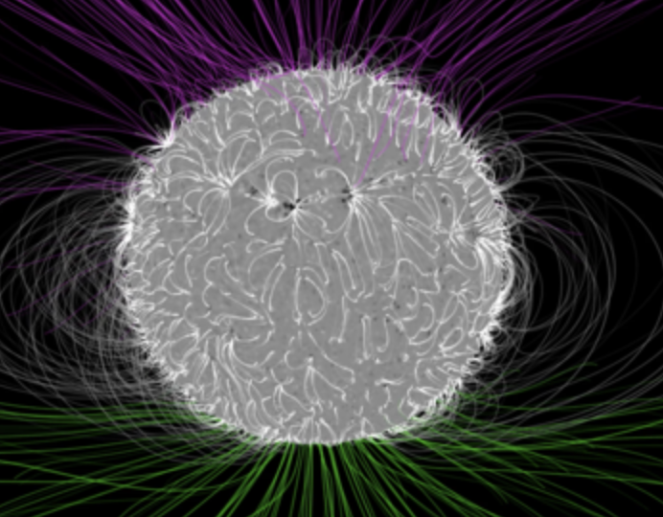
Ferraro’s Law of Isorotation
$$φ$$
z
What anchors B fields to rotating conductors (magnetospheres)?
Take a rotating star like the sun and assume axisymmetry
In equilibrium ($∂_{t}=0$), Faraday’s Law reads
Then so
For a force-free magnetosphere ($\vec{E}+\vec{v}×\vec{B}=\vec{0}$)
So $−\vec{E}=\left(\left[\begin{aligned}0 \\ 0 \\ Ω\end{aligned}\right]×\left[\begin{aligned}s \\ 0 \\ z\end{aligned}\right]\right)×\vec{B}=\left[\begin{aligned}0 \\ sΩ \\ 0\end{aligned}\right]×\vec{B}=\left[\begin{aligned}sΩB_{z} \\ 0 \\ −sΩB_{s}\end{aligned}\right]$ and Faraday’s law w./ $∂_{t}=0$ gives
Using we have
Let ${\vec{Ω}}^{∗}$ be the star’s ang. vel. and apply b.c. E_{tang} continuous at $θ=0$ plane:
$$\vec{0}=\frac{∂\vec{B}}{∂t}=−\vec{∇}×\vec{E}$$
s
$$0=\frac{∂\vec{B}}{∂t}=\oint_{∂S}^{.}{\vec{E}∙d\vec{s}}=2πsE_{φ}⟹E_{φ}=0$$
$$\vec{E} ∝\hat{φ}×\vec{B}=−A\left(\hat{Ω}×\vec{r}\right)×\vec{B}, \vec{r} ε Span(\hat{s},\hat{z})$$
Credits: NASA's Goddard Space Flight Center/Bridgman
$$\vec{E}=−\vec{v}×\vec{B}=−\left(\hat{Ω}×\vec{r}\right)×\vec{B}$$
$$\vec{0}=\vec{∇}×\left(\left(\hat{Ω}×\vec{r}\right)×\vec{B}\right)=(∂_{z}\left(sΩB_{z}\right)+∂_{s}\left(sΩB_{s}\right))\hat{φ}$$
$$0=\vec{∇}∙\vec{B}=\frac{1}{s}∂_{s}\left(sΩB_{s}\right)+∂_{z}B_{z}$$
$$\left(\vec{B}∙\vec{∇}\right)\vec{Ω}=\vec{0}$$
$$E_{\text{tang}}^{\text{ext}}=E_{z}^{\text{ex}\text{t}}=$$
$$s{Ω^{∗}B}_{\text{n}\text{orm}}^{\text{ex}\text{t}}=s{Ω^{∗}B}_{s}^{\text{ex}\text{t}}$$
$$=E_{\text{tang}}^{\text{int}}=s{ΩB}_{\text{norm}}^{\text{in}\text{t}}$$
$$\vec{Ω}={\vec{Ω}}^{∗}$$
Notes:
MCP Ex. 19.11

